Slide 1
Independent Living Research Utilization

Slide 2
SILC STANDARDS AND INDICATORS
SILC Congress
January 17, 2016
Vicki Gottlich, Esq.
Jennifer Klocinski, MA
Administration for Community Living
Department of Health and Human Services

Slide 3
Title 2 Goes Here
Overview of Session
What does ACL mean by Standards and Indicators
Review of ACL draft
Questions for you and questions from you
Process going forward

Slide 4
Meaning of Standards and Indicators
Language in the law does not reflect common definitions of a standard or an indicator.
Statutory language only says “indicators of minimum compliance”
Language in the law does not reflect performance management concepts.
ACL’s approach used concepts that mirror language associated with standards for CILs which reflect roles and responsibilities.
ACL’s approach to indicators was to operationalize the standards in such a way that through a reporting process or site visit compliance could be objectively determined.

Slide 5
ACL Recommended Standards
SILC membership and IL philosophy
The Council fulfills all the duties in Section 705(c)(1) regarding the State Plan for Independent Living
Documenting coordination activities, in the SPIL and otherwise
The SILC conducts hearings and forums necessary to carry out its duties
The Council shall have a resource plan sufficient to carry out the functions of the SILC

Slide 6
Discussion of Standards and Indicators and Questions for You
How do you see the standards and indicators being used?
Indicator 1.1 – How have you worked in the past with the appointing authority regarding recommendations for SILC membership?
Indicator 2.1 – Do you want more specification about the number of days in advance notice must be provided about meetings?
Indicators 4.2 and 4.3 – These were proposed as guidance. Do you agree that they be indicators?
Indicator 5.3 – What references do you use for accounting principles? HR practices? Would it be helpful to be specific?

Slide 7
Your Turn to Raise Questions and Suggestions

Slide 8
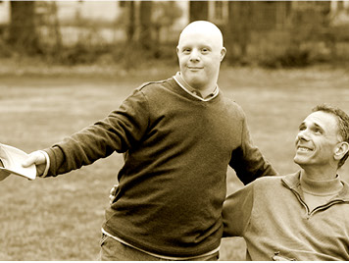
Vicki Gottlich vicki.gottlich@acl.hhs.gov Jennifer Klocinski jennifer.klocinski@acl.hhs.gov

Slide 9
SILC-NET Attribution
Support for development of this training was provided by the Department of Health and Human Services, Administration for Community Living under grant numbers 90TT0001-01-00 and 90IT0001-01-00. No official endorsement of the Department of Health and Human Services should be inferred. Permission is granted for duplication of any portion of this PowerPoint presentation, providing that the following credit is given to the project: Developed as part of the SILC-NET, a project of the IL-NET, an ILRU/NCIL/APRIL National Training and Technical Assistance Program.
SILC-NET, a project of ILRU – Independent Living Research Utilization

