Slide 1
Independent Living Research Utilization

Slide 2
Community Integration: A Holistic Approach to the New Core Services for Transition & Diversion Necessary Elements of Transition and Diversion August 22, 2017 Atlanta, GA Presenters: Darrel Christenson Paula McElwee

Slide 3
What the Law and Final Regulations Say Paula McElwee

Slide 4
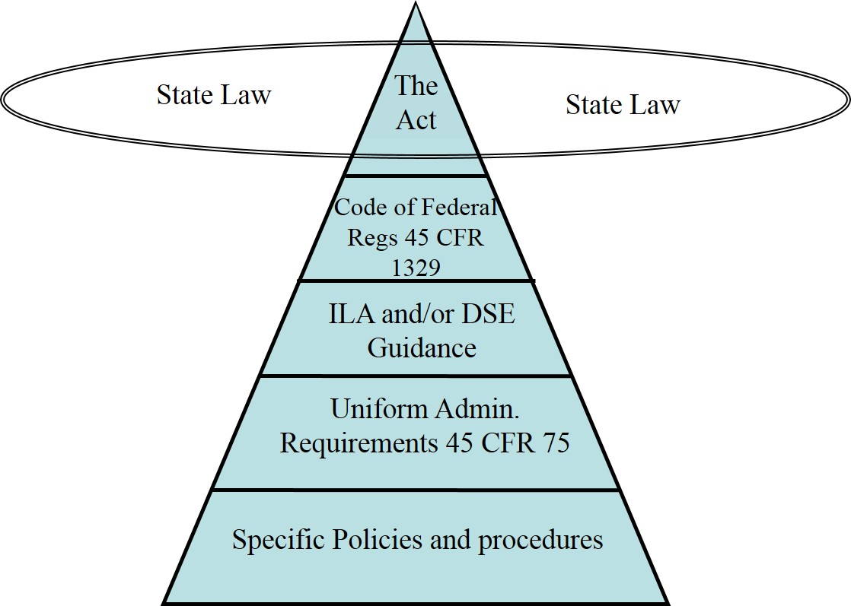
What is the order of authority?

Slide 5
What does the Rehabilitation Act say?
The language in the actual federal statute, as passed by Congress and signed into law in 2014, contains language that the regulations cannot change; only Congress can make those changes.
Where the regulations speak, typically they clarify the Rehab Act; they can be changed through a process of draft/public comment/finalization as long as the changes are consistent with the Act.
When neither addresses an area of interest or concern, we can request clarification (FAQ) or guidance from ACL/ILA.

Slide 6
Definition: Core Services*
Independent living core services mean, for purposes of services that are supported under the Independent Living Services (ILS) or Center for Independent Living (CIL) programs—
(A) Information and referral services;
(B) Independent Living skills training;
(C) Peer counseling, including cross-disability peer counseling;
(D) Individual and systems advocacy;
*§1329.4

Slide 7
Definition of Core Services, cont’d.
(E) Services that:
(i) Facilitate the transition of individuals with significant disabilities from nursing homes and other institutions to home and community-based residences, with the requisite supports and services. This process may include providing services and supports that a consumer identifies are needed to move that person from an institutional setting to community based setting, including systems advocacy required for the individual to move to a home of his or her choosing;

Slide 8
Definition of Core Services, cont’d. 2
(ii) Provide assistance to individuals with significant disabilities who are at risk of entering institutions so that the individuals may remain in the community. A determination of who is at risk of entering an institution should include self-identification by the individual as part of the intake or goal-setting process; and
(iii) Facilitate the transition of youth who are individuals with significant disabilities, who were eligible for individualized education programs under section 614(d) of the Individuals with Disabilities Education Act (20 U.S.C. 1414(d)), and who have completed their secondary education or otherwise left school ...

Slide 9
1329.5 Indicators of Minimum Compliance
To be eligible to receive funds under this part, a Center must comply with the standards in section 725(b) and assurances in section 725(c) of the Act, with the indicators of minimum compliance, and the requirements contained in the terms and conditions of the grant award.

Slide 10
Your grant(s) and Program Performance Report (formerly 704 Report) address Annual Program and Planning Objectives
Achievements – goals, objectives and progress
Challenges – problems and attempted resolutions
Comparison with Prior Report
Work plan for the next year
How the work plan goals, objectives and action plans are consistent with the current SPIL.
How will the report reflect transition services? Are you keeping track of the three components of transition – moving from an institution, preventing institutionalization, and youth transition?

Slide 11
Let’s drill down in those regulations...
INSTITUTIONAL TRANSITION
“Facilitate the transition of individuals with significant disabilities from nursing homes and other institutions to home and community-based residences, with the requisite supports and services.
“This process may include providing services and supports that a consumer identifies are needed to move from an institutional setting to community based setting, including systems advocacy required for the individual to move to a home of his or her choosing;….”

Slide 12
Let’s drill down, cont’d.
INSTITUTIONAL DIVERSION
“Provide assistance to individuals with significant disabilities who are at risk of entering institutions so that the individuals may remain in the community.
“A determination of who is at risk of entering an institution should include self-identification by the individual as part of the intake or goal-setting process.” (ASK the individual if they are at risk of institutionalization.)
We have been calling this “diversion” because it simplifies communication and is commonly understood.

Slide 13
Diversion as an Outcome as Opposed to a Service Darrel Christenson

Slide 14
Diversion – Dictionary Definition
“Diversion”
An instance of turning something aside from its course, rerouting
Deflection
Deviation
Divergence

Slide 15
Services vs. Outcomes
Many of us in IL see institutional transition and youth transition as measureable services. An individual moves from one place/space to another.
Whereas, diversion is not so tangible. It is more precisely an outcome of other services.

Slide 16
Keeping People in the Community
Avoiding institutionalization has always been a goal of the IL movement:
The purpose of this chapter is to promote a philosophy of independent living, including a philosophy of consumer control, peer support, self-help, self-determination, equal access, and individual and system advocacy, in order to maximize the leadership, empowerment, independence, and productivity of individuals with disabilities, and the integration and full inclusion of individuals with disabilities into the mainstream of American society…. (Title VII, §701)

Slide 17
Keeping People in the Community, cont’d.
Now that goal is more explicitly stated in law as part of the definition of a CIL.
Most people with significant disabilities prefer to live in their own home, as part of the community.
Keeping people home in the community is generally cheaper & certainly easier than going in and out of an institution.

Slide 18
You are already Achieving These Outcomes!
Many of your consumers are already achieving diversion outcomes by participating in your CIL’s I&R, Peer Support, IL Skills training, individual and systems advocacy, etc.

Slide 19
Diversion is the End Result
Diversion is the outcome of providing a wide range of services to consumers living in the community.

Slide 20
Who is Actually Being Diverted from Institutionalization?
What still needs further definition and clarification is who is actually “at risk” of institutionalization and how might a CIL go about assisting someone to self identify as stated in the regulation:
“A determination of who is at risk of entering an institution should include self-identification by the individual as part of the intake or goal-setting process.”

Slide 21
Group Think
We will be exploring this question and much more over the next couple of days, beginning with a group discussion now.
We are eager to hear your ideas!

Slide 22
CIL-NET Attribution
Support for development of this technical assistance information was provided by the Department of Health and Human Services, Administration for Community Living under grant number 90TT0001. No official endorsement of the Department of Health and Human Services should be inferred. Permission is granted for duplication of any portion of this information, providing that the following credit is given to the project: Developed as part of the IL-NET, an ILRU/NCIL/APRIL National Training and Technical Assistance Program.

