Slide 1
>>Slide 1
IL-NET National Training and Technical Assistance Center for Independent Living
ILRU T&TA Center

Slide 2
Non-Traditional Transitions January 25, 2023
Slide 2

Slide 3
Slide 3 What You Will Learn Today
Describe a broader understanding of institutional settings related to transition and diversion
Identify possible partnerships for increased transition services in your catchment area
Describe strategies to capture services that should be identified as transition

Slide 4
Slide 4 Evaluation Survey
Your feedback on this webinar is important to us. At the end of the presentation, you will have the opportunity to complete a brief evaluation survey.
Survey link:
https://uthtmc.az1.qualtrics.com/jfe/form/SV_e4fvrP3oJqC2pqS

Slide 5
Slide 5 Our Panelists
Sharif Brown, Program Manager for State Reentry, Alliance of Disability Advocates
Betzaida Ramos Chárriez, Directora Ejecutiva, Movimiento para el Alcance de Vida Independiente (MAVI)
Marly Saade, PCA Program Coordinator, The Center for Disability Empowerment
Susan Hetrick, M.Ed., Executive Director, The Center for Disability Empowerment
Jeff Hughes, Executive Director, Progressive Independence

Slide 6
Slide 6 Non-Traditional Transitions
Sharif Brown, Program Manager for State Reentry, Alliance of Disability Advocates

Slide 7
Slide 7 ALLIANCE OF DISABILITY ADVOCATES REENTRY PROGRAM

Slide 8
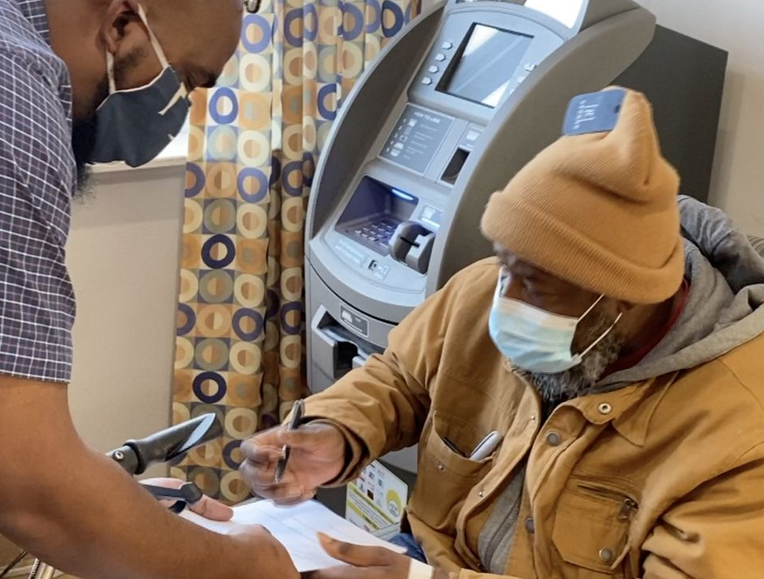
Slide 8 he alliance of disability advocates The Alliance of Disability Advocates REENTRY PROGRAM

Slide 9
Slide 9 WHO IS ADA?
ALLIANCE OF DISABILITY ADVOCATES IS A CENTER FOR INDEPENDENT LIVING (CIL) LOCATED IN RALEIGH, NC.
A CENTER FOR INDEPENDENT LIVING IS A FEDERALLY FUNDED ORGANIZATION THAT SPECIALIZES IN GIVING FREE SERVICES AND RESOURCES TO INDIVIDUALS WHO HAVE ANY DISABILITY, THE ELDERLY, AND VETERANS.
ALLIANCE OF DISABILITY ADVOCATES HAS A CATCHMENT AREA OF 5 COUNTIES: WAKE, DURHAM, JOHNSTON, ORANGE, AND FRANKLIN.

Slide 10
Slide 10 REQUIREMENTS OF A CENTER FOR INDEPENDENT LIVING (CIL)
IN ORDER TO BE A CENTER FOR INDEPENDENT LIVING, THERE ARE CERTAIN REQUIREMENTS AND REGULATIONS THAT MUST BE FOLLOWED:
51% OF THE STAFF MUST HAVE A DISABILITY.
51% OF THE BOARD OF DIRECTORS MUST HAVE A DISABILITY.
ALL PROGRAMS AND SERVICES ARE CONSUMER (CLIENT) CONTROLLED.
ALLIANCE OF DISABILITY ADVOCATES DOES NOT REQUIRE ANY MEDICAL DOCUMENTATION OR PROOF OF HAVING A DISABILITY IN ORDER FOR CONSUMERS (CLIENTS) TO OBTAIN SERVICES OR RESOURCES.
THE CONSUMER (CLIENT) MUST SELF-IDENTIFY WITH HAVING A DISABILTY BUT ARE NOT REQUIRED TO DIVULGE THE NATURE OF THE DISABILTY IF THEY CHOOSE NOT TO.

Slide 11
Slide 11 Five core services CILs are mandated to provide
(1) Information and referral services is provided in accessible formats to all individuals who contact ADANC.
(2) Independent Living Skills Training
(3) Peer Support (including cross-disability peer support)
(4) Individual and Systems Advocacy
(5) Transition Services:
Youth, and
Transition from Institution and Diversion (keeping consumers out facility-based care)

Slide 12
Slide 12 TRANSITIONAL SERVICES
INSTITUTIONAL TRANSITION
ADANC PROVIDES SERVICES TO INDIVIDUALS WITH DISABILITIES TO ASSIST WITH TRANSITIONING FROM AN INSTITUTION SUCH AS A REHAB HOSPITAL, NURSING HOME, ADULT CARE HOME, OR A CORRECTIONAL FACILITY TO A COMMUNITY SETTING. STAFF WORK WITH A TRANSITIONING INDIVIDUAL TO IDENTIFY THEIR GOALS FOR INDEPENDENT LIVING AND HELP PROVIDE THE SERVICES AND SUPPORTS NECESSARY TO MOVE FROM AN INSTITUTIONALIZED SETTING INTO THE COMMUNITY.
INSTITUTIONAL DIVERSION
ADANC PROVIDES SERVICES AND SUPPORTS TO THOSE AT RISK OF ENTERING OR RETURNING TO AN INSTITUTION SO THEY CAN STAY IN THE COMMUNITY. THE GOAL IS TO HELP THE CONSUMER IDENTIFY AT-RISK FACTORS THAT MIGHT CAUSE THEM TO GO INTO OR RETURN TO AN INSTITUTION.

Slide 13
Slide 13 Why we do Transitional services
Required by the feds
Data collection – Demographic information
Services provided
Goals achieved
Lives Impacted and Changed
Reduce Recidivism

Slide 14
Slide 14 Why successful reentry plans are vital
Despite the occasional success story of a former inmate building a successful life, research continues to show that as many as 75% of justice-involved individuals find themselves back in the criminal justice system within the first year. Successful performance management of reentry programs and other resources are critical to change those outcomes. At the end of the day, successful reentry is important for both individuals and communities.

Slide 15
Slide 15 Importance of individualized reentry plans
ADA implements the Independent Living philosophy with all the services that we offer. This is vital with reentry as well. Transitioning back into community life from any incarceration is challenging. This challenge increases in difficulty exponentially as the time of incarceration increases and availability or knowledge of resources decreases.
It’s not enough to simply offer blanket-style reentry resources to individuals pending release from incarceration.
The ratio of social workers in prisons to individuals being released requesting reentry services is an average of 45 to 1. Social workers in the prison systems are overworked with a large caseload which often leads to blanket/generic information given to these individuals, which at times is usually outdated and may not apply or address the needs of the individual.
Once an individual is released with no viable resources or positive supports, that individual will most likely reoffend and return to prison, which goes against the foundation of beliefs of ADA.

Slide 16
Slide 16 ADA REENTRY DURING COVID
The current Covid-19 pandemic has forced many organizations and programs to adapt in order to remain successful and viable. ADA Reentry is no different.
During Covid-19 ADA Reentry assisted individuals that were fortunate enough for conditional release from prison.
The main issue was the majority of these individuals were being released with no home plan, essentially making them homeless.
With CARES funding, ADA Reentry was able to support these individuals, addressing the immediate need of temporary housing and addressing the long term need of permanent housing.
Spectrum News did a story about ADA Reentry:
https://spectrumlocalnews.com/nc/charlotte/news/2020/12/30/disability-advocacy-group-revamps-prison-reentry-program

Slide 17
Slide 17 IRP process
The IRP (Individualized Reentry Plan) begins at the initial meeting with the justice involved-individual. Prior to Covid, ADA had the ability to meet face to face with our justice-involved consumers. ADA is still able to facilitate the IRP model during this pandemic with assistance from the Department of Public Safety (DPS). ADA recognizes that successful reentry doesn’t start the day someone is released from prison or jail. The best outcomes occur when there are preparation and supports before, during, and after release.
The most important facet of the IRP is listening to the individual when it comes to reentry as far as what they think they need to be successful and not return to prison. This approach allows anxieties about reentry to be expressed. ADA will sit with them, listen to their story, ask about their goals. Empowering individuals to make decisions in their reentry now gives them a voice, which is something they lost as soon as incarceration began. They are no longer a number or another face during count. Empowering individuals shows that ADA is invested in THEIR plan for success. There is no such thing as “one size fits all,” which is why ADA reentry offers a commitment to individualized reentry plans.
In practice, that might mean matching them with a therapeutic approach that appeals to their individual needs/wants. It can mean providing a range of educational and vocational opportunities, or it can mean integrating the client back with family to help create a more supportive and successful home environment.
Programs and strategies that are built on this framework targets resources to those offenders who are at higher risk of reoffending and provides individualized services to address barriers that each consumer may be expecting or experiencing.
Once the IRP is constructed, it is hand delivered and discussed at the prison with the participant to facilitate and support our consumers with a successful reentry plan.

Slide 18
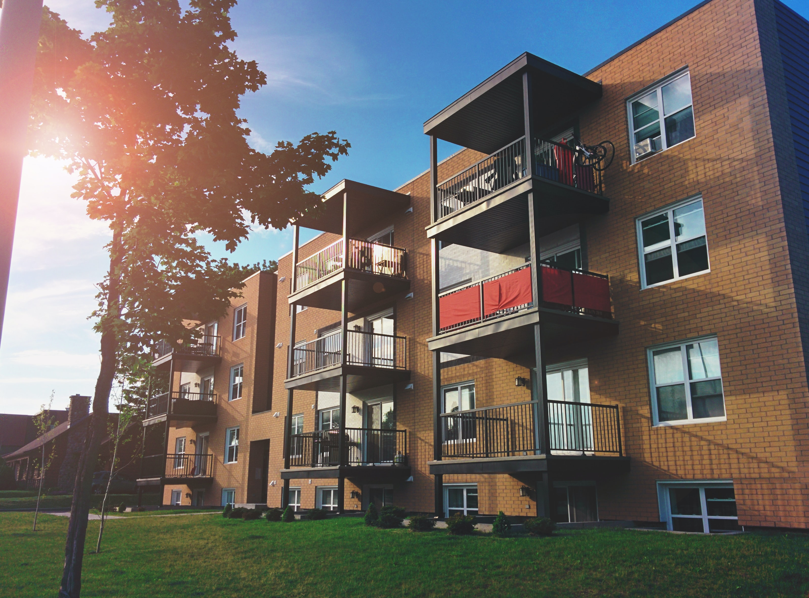
Slide 18 Resources involved with IRP
We provide and connect individuals to:
Housing Opportunities/ Information
Employment Assistance / Interview Prep Training
Suitcessful (ADA provides free business and business casual clothing to our consumers in need)
Food Pantry Resources
Benefits Assistance and Counseling
Independent Living Skills Training
Free Individualized GED Training and Testing with Duke University
Behavioral / Mental Health Resource information
Peer Recovery Support Services and Mentoring
Vital Records (Birth Certificate, Social Security Card, Identification Card)
Post-Release wrap-around services for Wake, Durham, Johnston, Franklin, and Orange county
SNAP information

Slide 19
Slide 19 Expertise in reentry
ADA has a history of providing Reentry Transitional Services since 2016. The IRP model was first tested at Butner FCI, which is located in Butner, NC. Currently, to date, over 200 individuals in Butner have benefitted from ADA Reentry IRP services, with many of the justice-involved individuals being released to the Triangle area and continuing with their Post-release Reentry Services.
Of all the individuals enrolled in the ADA Reentry Program at Butner, only 2 have reoffended and returned in the first 2 years of release. That is a 98% success rate.
It was this IRP model that attracted the North Carolina Council on Developmental Disabilities to ADA.
The North Carolina Council on Developmental Disabilities awarded ADA a 3-year grant to perform this model in 13 State Prisons in NC in 2020.

Slide 20
Slide 20 First Consumer
Meet Adrian
Adrian was raised in Baltimore MD in a violent urbanized area
Adrian was involved in illegal activity due to environmental influences
He was convicted of a felony and sentenced to 20 years of incarceration
Adrian enrolled in ADA Reentry Pre-Release, and as they say, the rest is history.
Adrian is currently Director of Operations with another CIL.
This is his story: https://youtu.be/OlDnco-ISzY

Slide 21
Slide 21 OUTCOMES/SUCCESS OF ADA NCCDD INITIATIVE
Under this current initiative from NCCDD, ADA Reentry has:
Received 155 referrals for pre-release individuals and completed 151 Individualized Reentry Plans (IRPs). The remaining referrals have future release dates.
Even with an active pandemic the success rate for this initiative is 87% without ever being able to see/contact our consumers directly until April 2022.
Many pre-release consumers are now actively receiving post-release wrap-around services and have obtained housing; have sustainable employment; have applied and received state benefits; and, most importantly, have not reoffended.

Slide 22
Slide 22 Collaborations
Successful Reentry is a multifaceted problem, and no single program can address all the needs at every stage of the process.
The range of challenges that lead to individuals returning to incarceration can include barriers to employment, housing, lack of family support, lack of problem-solving skills, unresolved emotional and mental health conditions, substance abuse recovery, isolation and lack of community integration, and many others.
Dunn Rotary Club Of NC
ADA has a partnership with Duke University and their master’s degree level students to offer free, individualized virtual or in-person (location-based) GED training and testing in addition to Duke Occupational Therapy students reviewing the data and effectiveness of the program.
Women's Club of Charlotte has joined on to assist in supporting the Reentry Suit Closet by donating business casual woman clothing.
Local Reentry Councils (LRC’s): Wake, Durham, and Orange County
Federal and State Probation/Parole
S.W.I.T (Success while in Transition)
NCCDD
Monarch
FTI360
Butner FCI
NC State

Slide 23
Slide 23 Stats on Reentry and Disability
According to NCDPS, only 55% of inmates with disabilities have aftercare plans developed prior to leaving the prison system. We assume there are many inmates with a disability who are not identified/diagnosed.
With a state recidivism rate of 47% for all inmates the likelihood of successful transition to productive community life for an incarcerated individual with a disability is extremely low without proper planning, training, and supports.

Slide 24
Slide 24 Makes Cents
According to a 2022 North Carolina News report, NC spends $52,882 a year per incarcerated individual.
Programs like ADA Reentry that have a proven record of having a high success rate in assisting with successful reentry continues to save the state money, which lowers taxes for all individuals living in the state.
ADA Reentry operates currently as structured on 300,000 a year. In conjunction with the NC News report, if ADA successfully assists with reentry for 6 individuals ADA has saved North Carolina the same amount of money it takes to run the whole program for one year. ADA has successfully transitioned over 373 individuals since 2017.

Slide 25
Slide 25 The Team
Sharif Brown Program Manager for Reentry/Certified Travel Training Instructor
Wayne Bell, Reentry Specialist/ Community Inclusion Specialist/Certified Peer Support Specialist
James Smith Reentry Specialist/ Community Inclusion Specialist/Certified Peer Support Specialist/WRAP Facilitator

Slide 26
Slide 26 Closing
Whether focused on education, employment, transitional housing, substance abuse treatment or building cognitive and emotional resources, ADA knows individualized reentry plans support successful reentry and reduce recidivism. Luckily, the increased awareness of evidence-based best practices can provide a strong foundation, and ADA believes we can assist in creating safe communities by successfully integrating formerly incarcerated individuals.
ADA is also funded by donations, volunteer hours, and grants.
ADA CONTINUES TO SEARCH FOR A FUNDER FOR THIS PROGRAM AS THE GRANT EXPIRES OCTOBER 2023.

Slide 27
Slide 27
3725 National Drive, Suite 105
Raleigh, NC 27612
Toll-Free: (877) 235-4210
Phone: (919) 591-0891 (D)
Website: www.adanc.org
Email: info@adanc.org
3109 Poplarwood Court, Suite 109
Raleigh, NC 27604
Toll-Free: (800)357-6916
Phone: (994) 920-8200
Website: www.nccdd.org
Email: info@nccdd.org

Slide 28
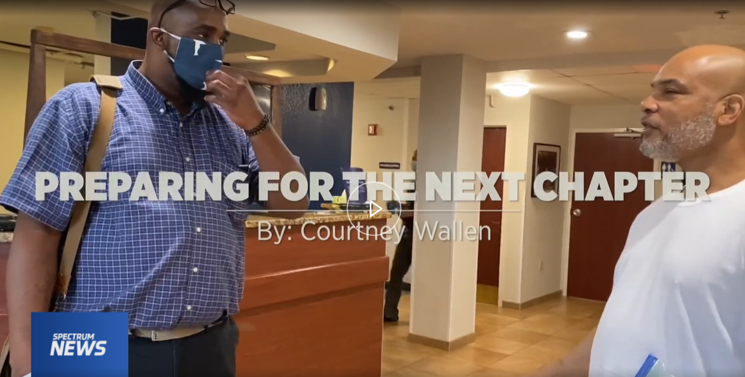
Slide 28

Slide 29
Slide 29 LINKS
A Spectrum News Story:
https://spectrumlocalnews.com/nc/charlotte/news/2020/12/30/disability-advocacy-group-revamps-prison-reentry-program
National Alliance on Mental Illness (NAMI) Presentation:
https://youtu.be/POWnTCKXHBI
IRLU Presentation:
https://us02web.zoom.us/rec/play/N8uOuLS5wTUOOQ_kEXZAT2pjbj5cbzztRQBnOiq1UZkQb4j1UPYkJbTvQg2WLMmsxjf7v-QEr0t7vk0Q.6uGR9XrqwcPlS1es?continueMode=true
Adrian Boone’s Story (first IRP reentry consumer):
https://youtu.be/OlDnco-ISzY
Initiative Webpage on NCCDD’s Website:
https://www.nccdd.org/initiatives/current-initiatives-2017/43-initiatives/1056-justice-release-reentry-and-reintegration.html
NC NEWS/FOX NEWS ARTICLE
How much does North Carolina spend for every prisoner behind bars? | FOX8 WGHP (myfox8.com)

Slide 30
Slide 30 Non-Traditional Transitions
Looking at the impact of disasters in the displacement of people with disabilities.
Betzaida Ramos Chárriez, Directora Ejecutiva, Movimiento para el Alcance de Vida Independiente (MAVI), San Juan, Puerto Rico

Slide 31
Slide 31 IMPACT OF DISASTERS ON PWDs
People with disabilities are 2-4 times more likely to suffer injury or death after disasters.
Many of those with significant disabilities never return after they are evacuated.
Many are separated from their support systems and ultimately end up in institutions.

Slide 32
Slide 32 HOW DO TRANSITIONS SERVICES PLAY INTO DISASTERS
Transition core services speak of deinstitutionalization and the prevention of institutionalization (or remaining in community).
During disasters there is an increased risk of institutionalization because of lack of supports, lack of accessible shelters, and medical complications associated with lack of energy.

Slide 33
Slide 33 MOST COMMON REACTION OF EMERGENCY PERSONNEL WITH REGARD TO PWDs
Institutionalization, because it’s
They’ll get better care
Will be less taxing on government and emergency staff
Unaware of other viable options

Slide 34
Slide 34 Strategies for preventing institutionalization in disasters
Help the individual plan ahead and plan for community integrated housing alternatives with family, friends or accessible shelters.
Train and provide guidance to shelter employees to consider other housing options and begin planning once the survivor steps into the shelter (vs when shelter is about to shut down). Assist in the relocation process to find most integrated setting. Be present in shelters so you can help identify at risk survivors.
Work with local CAGs to identify available community resources.

Slide 35
Slide 35 Situations to look out for
Non-local residents with disabilities (tourists) that may be stuck during the disaster.
Deaf and people with cognitive disabilities who are not informed or are unaware of resources available for recovery processes.

Slide 36
Slide 36 Non-Traditional Transitions
Marly Saade, PCA Program Coordinator, The Center for Disability Empowerment
Susan Hetrick, M.Ed., Executive Director, The Center for Disability Empowerment

Slide 37
Slide 37 Non-Traditional Transitions
Jeff Hughes, Executive Director, Progressive Independence

Slide 38
Slide 38 Questions & Discussion

Slide 39
Slide 39 Contact Information
Sharif Brown, Alliance of Disability Advocates (sharif@adanc.org)
Betzaida Ramos Chárriez, Movimiento para el Alcance de Vida Independiente (MAVI) (directora@mavi-pr.org)
Marly Saade, The Center for Disability Empowerment (msaade@disabilityempowerment.net)
Susan Hetrick, M.Ed., Executive Director, The Center for Disability Empowerment (msaade@disabilityempowerment.net)
Jeff Hughes, Progressive Independence (jlhughes@progind.org)

Slide 40
Slide 40 Final Questions and Evaluation Link
Any final questions?
Directly following the webinar, you will see a short evaluation survey to complete on your screen. We appreciate your feedback!
Survey link: https://uthtmc.az1.qualtrics.com/jfe/form/SV_e4fvrP3oJqC2pqS

Slide 41
>> Slide 41 IL-NET Attribution
The IL-NET is supported by grant numbers 90ILTA0002 and 90ISTA0002 from the U.S. Administration for Community Living, Department of Health and Human Services, Washington, D.C. 20201. Grantees undertaking projects under government sponsorship are encouraged to express freely their findings and conclusions. Points of view or opinions do not, therefore, necessarily represent official Administration for Community Living policy.

