Slide 1
Universal Design to Promote Inclusion in Learning
Presenters:
Richard Petty
National Center for Aging and Disability (NCAD)
Independent Living Research Utilization (ILRU)
TIRR Memorial Hermann
J. Sam Thomas
Independent Living Research Utilization (ILRU)
TIRR Memorial Hermann

Slide 2
Learning Objectives
Definition of Accessibility: The definition of accessibility and what it means.
Legislation: The major legislation regarding accessibility. Major components of ADA legislation and how it relates to digital media.
Case Examples: Case law examples which will demonstrate the impact and consequences of what are common and obvious violations.
Accessibility Examples: Examples of accessibility for digital media.
Best Practices: Best practices regarding digital media accessibility for various disabilities.

Slide 3
A Brief History
Civil Rights Act of 1964: Senator Humphrey attempted and failed to make people with disabilities a protected class
Section 504 of the Rehabilitation Act: Enacted in 1973; regulations not implemented until 1978; covered programs and services funded by the federal government
Americans with Disabilities Act: Enacted in 1990; comprehensive legislation covering employment, state and local governments, public accommodations, transportation and telecommunications
Section 508 of the Rehabilitation Act enacted in current form in 1998

Slide 4
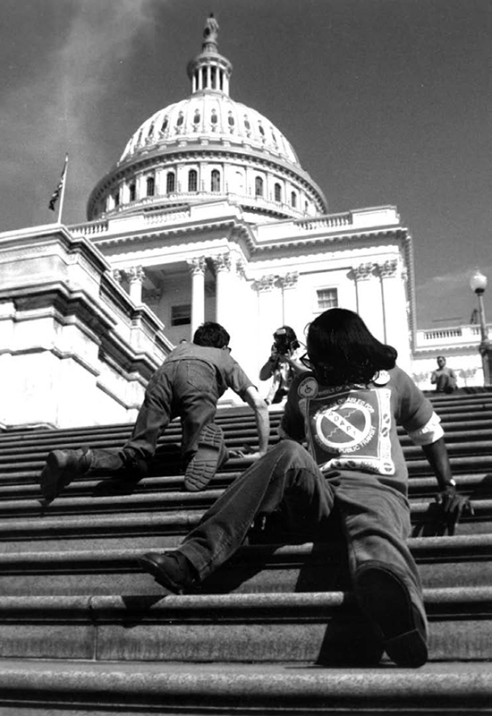
Disability Activists Occupy Federal Office Buildings—1977
“For 25 days in April 1977, a group of roughly 150 disability rights activists took over the fourth floor of a federal building in San Francisco. They would not leave, they said, until President Jimmy Carter's administration agreed to implement a four-year-old law protecting the rights of people with disabilities.”¹

Slide 5
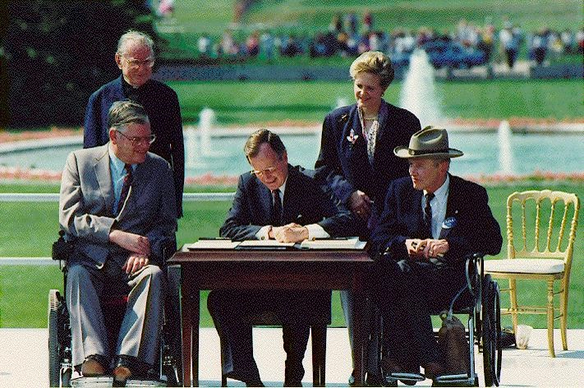
The ADA is Signed into Law
[In this July 26, 1990 file photo, President George H. W. Bush signs the Americans with Disabilities Act during a ceremony July 26, 1990, on the South Lawn of the White House. Joining the president are, from left, Evan J. Kemp, Jr., chairman of the Equal Employment Opportunity Commission; the Rev. Harold Wilke; Sandra Parrino, chairperson of the National Council on Disability; and Justin W. Dart, Jr., chairman of The President's Council on Disabilities. The Jefferson Memorial is in the background.]

Slide 6
The ADA Adapts to a Changing Technological Landscape
When the ADA was signed into law, personal computing was still taking hold and the internet was still in its infancy.
The Department of Justice noted that “the Internet had emerged as a critical means to provide access to public entities’ programs and activities,” and that government entities:
“. . . must ensure equal access to Web-based programs and activities for individuals with disabilities unless doing so would result in an undue financial and administrative burden or fundamental alteration.”²

Slide 7
The ADA Adapts to a Changing Technology Landscape, cont’d.
The Department of Education, which shares enforcement authority over public universities and other postsecondary institutions has opined that:
“The general requirements of Section 504 and the ADA reach equipment and technological devices when they are used by public entities or places of public accommodation as part of their programs, services, activities, goods, advantages, privileges, or accommodations.”³

Slide 8
Definition of Disability
The ADA defines a person with a disability as:
“a person who has a physical or mental impairment that substantially limits one or more major life activities, a person who has a history or record of such an impairment, or a person who is perceived by others as having such an impairment.” ⁴
The ADA Amendments Act of 2008 broadens and clarifies this definition to apply to any person whose physical or mental impairment(s) substantially limit:
MAJOR LIFE ACTIVITIES – include, but are not limited to, caring for oneself, performing manual tasks, seeing, hearing, eating, sleeping, walking, standing, lifting, bending, speaking, breathing, learning, reading, concentrating, thinking, communicating, and working; or
MAJOR BODILY FUNCTIONS – include, but are not limited to, functions of the immune system, normal cell growth, digestive, bowel, bladder, neurological, brain, respiratory, circulatory, endocrine, and reproductive functions.⁵

Slide 9
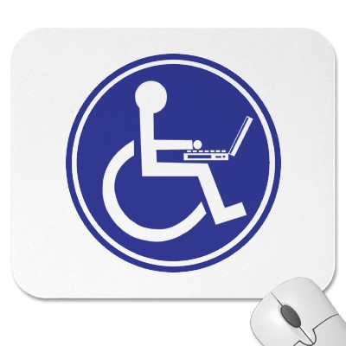
Disability and Digital Media
Disability represents a broad range of physical and mental impairments that may affect the way a person accesses digital media and other online content
There is no “check list” of disabilities for which accommodations must be made, so institutions must make adjustments to media and intuitional policies to provide access on a case-by-case basis
Nevertheless, three of the most common types of impairment that limit access to digital media and online content are:
Visual disabilities
Auditory disabilities
Motor disabilities⁶

Slide 10
Definition of Accessibility⁷
The design of products, devices, services, or environments for people with disabilities. The concept of accessible design ensures both
"direct access" (i.e. unassisted) and
"indirect access" meaning compatibility with a person's assistive technology (for example, computer screen readers ).
Accessibility is strongly related to universal design which is the process of creating products that are usable by people with the widest possible range of abilities, operating within the widest possible range of situations. This is about making things accessible to all people (whether they have a disability or not).

Slide 11
ADA and Section 504⁸
Two main federal laws govern the accessibility of public educational entities:
Title II of the Americans with Disabilities Act (ADA) and
Section 504 of the Rehabilitation Act of 1973 (as amended in 1998)
Almost all postsecondary educational institutions and state and local governments are regulated under these laws. (Elementary and secondary schools are also covered by these and other laws.)
Title II of the ADA and Section 504 have almost identical requirements:
Government entities and educational institutions must respond to the needs of individual participants.
They must make programs and services accessible to participants on request.

Slide 12
The General Requirements of the ADA and Section 504
Because the ADA and Section 504 predate the widespread use of internet technology, the statutes and their enforcing regulations are silent on the exact meaning of digital accessibility
Enforcement, therefore, has focused on applying the ADA and Section 504’s general requirements to the digital sphere, including:
Program and service accessibility⁹
Public entities are required to make reasonable modifications in policies, practices, and procedures that deny equal access to individuals with disabilities, unless a fundamental alteration in the program would result
E.g. Designing a student portal app so that students with disabilities can make use of the 24-hour services it offers

Slide 13
The General Requirements of the ADA and Section 504, cont’d
Effective communication¹⁰
Public entities are required to make reasonable modifications in policies, practices, and procedures that deny equal access to individuals with disabilities, unless a fundamental alteration in the program would result.
E.g. providing captioning for online course videos

Slide 14
Enforcement of the ADA and Section 504¹¹
Regulations prohibiting discrimination in education are enforced by the Office of Civil Rights (OCR) at the U.S. Department of Education and the U.S. Department of Justice (DOJ).
Settlements made between educational systems and the OCR in response to complaints of disability discrimination have sometimes required the educational institutions to make system-wide, proactive changes in their procurement and use of instructional materials to ensure that textbooks and educational technology are accessible to students with disabilities.¹²
These settlements may pave the way for similar settlements even for government entities not involved in education.

Slide 15
No Regulations Define Accessibility for State Government Entities
Unlike with architectural accessibility, there is no definitive set of regulations that define digital accessibility
Although there are not definitive rules, advocacy groups and regulators are not waiting to bring suit for Title II entities’ failure to make digital content accessible
There are two main sources for standards related to online content accessibility:
Section 508 of the Rehabilitation Act, a section of the Rehabilitation Act that is not expressly applicable to state entities requiring the accessibility of online content¹³
The Web Content Accessibility Guidelines (WCAG), a set of standards produced by the World Wide Web Consortium, an international non-profit entity that promulgates standards for coding and web content¹⁴

Slide 16
Section 508 of the Rehabilitation Act¹⁵
Proactive requirements of Section 508 state that all technology purchased by the federal government must be accessible whether initially intended for use by a employee with a disability or not.
In other words, technology resources must be universally accessible, i.e. designed to be fully or maximally accessible to all people, regardless of disability-related impairments¹⁶
Section 508 applies to federal agencies and departments

Slide 17
State Technology Access Laws—“Mini 508s”¹⁷
Several states have established information technology access laws modeled on Section 508 of the Rehabilitation Act.
At least 15 states have enacted “mini-508s” which mirror or directly implement Section 508 requirements.
Depending on how the individual state implements its digital accessibility laws, state entities may be subject to suit, fines, or mandatory modification of practices or procedures.
Arizona
California
Connecticut
Florida
Illinois
Indiana
Kansas
Louisiana
Minnesota
Missouri
New York
Oklahoma
Texas
Virginia
Washington

Slide 18
Section 508’s Requirements¹⁸
Section 508 Applies To ―
Software applications and operating systems (Sec. 1194.21)
Web based intranet and Internet information and applications (Sec. 1194.22)
Video and multimedia products (Sec. 1194.24) self-contained, closed products (Sec. 1194.25) – Examples are
Section 508 also applies to software applications, hardware and office equipment.

Slide 19
WCAG 2.0 Accessibility Guidelines¹⁹
The World Wide Web Consortium (W3C) has promulgated its own accessibility guidelines that provide guidance on the meaning and elements of accessible web design.
Whereas Section 508 contains requirements related to specific technologies and communications modalities, the WCAG 2.0 standards focus more on defining the meaning of accessibility broadly and how it can be implemented through design.
The Access Board is in the process of aligning 508 standards with WCAG 2.0

Slide 20
Recommendation: Follow Section 508 Standards
Standards developed for the federal government
Many states are adopting the standards in whole or in part
One federal agency (U. S. Department of Education) may require use of the federal standards in states

Slide 21
Best Practice Recommendations
Make Web pages accessible using accepted standards
Make video presentations accessible
Provide captioning for persons who are deaf or hard of hearing
Ensure that presenters describe visual content or provide audio description for content
Make PowerPoints, PDF documents and other documents accessible to persons who are blind
Make registration fair for all—avoid different schedule for those who require captioning or other accommodations

Slide 22
Best Practice — Web Page Access
“The power of the Web is in its universality. Access by everyone regardless of disability is an essential aspect.” --Tim Berners-Lee, W3C Director and inventor of the World Wide Web²⁰
Follow accepted standards (WCAG, Section 508, etc.)
Use alt tags—wherever there are images in text, an alt tag should describe the image
Provide for Keyboard Input
Use structured headings to facilitate navigation through content
Provide transcripts for podcasts and audio files
Avoid CAPTCHAs–"Completely Automated Public Turing test to tell Computers and Humans Apart"–Use alternatives²¹

Slide 23
Example of a Cluttered Web Page: Confusing for All

Slide 24
Example Image with Alt Text

Slide 25
Best Practice – Example of an Alt Tag (image of Alt Tag html code)
Example
<!DOCTYPE html> <html> <body> <h2>Spectacular Mountain</h2> <img src="pic_mountain.jpg" alt="Mountain View"style="width:304px;height:228px;"> </body> </html>

Slide 26
What a CAPTCHA Looks Like

Slide 27
Best Practice – Captioning
Communication access real-time translation (CART)-real-time stenography, or real-time captioning–the system court reporters, closed captioners, voice writers, and others use to convert speech to text.
Caption in real time
Use a qualified captioner—staff, a captioning service or court reporter.
Certifications are by National Court Reporters Association (Certified CART Provider (CCP), Certified Broadcast Captioner, Certified Realtime Reporter (CRR)
Provide transcripts as an alternative—although not a best practice
Many national services available

Slide 28
Best Practices – Resources for Captioning
WebAIM - Web Accessibility In Mind–Real-time Captioning Information
http://webaim.org/techniques/captions/realtime
National Court Reporters Association–NCRA's Style and Format Guidelines for CART Captioners
http://www.ncra.org/files/GovernmentRelations/Guidelines%20for%20CART%20Captioners.pdf
Google “Captioning for Webcasts”

Slide 29
Best Practice – Webinars and Web Conferences
Select an accessible platform
Features to look for: accessible chat; accessible PowerPoint display (text based); captioning capability
Zoom, Adobe Connect and Talking Communities are more advanced in accessibility than others, each with gaps
Use “workarounds”—post PowerPoints or send to participants, provide a separate web captioning stream, allow questions and chat through Twitter or other service, provide telephone access

Slide 30
Best Practice – PowerPoint Slides
These recommendations are from the Microsoft Web page “Creating accessible PowerPoint presentations”²²
Add alternative text to images and objects
Give every slide a unique title
Use ordinary words in hyperlink text
Use simple table structure
Include closed captions for any audio or video
Check the reading order of each slide
Think about people who are color-blind

Slide 31
Best Practices ─ PDF Files
Avoid scanned documents. If you cannot avoid them, then “remediate” them (see next slide)
Best to set up accessibility in MS Word and move to Adobe Acrobat
In Acrobat, use the Advanced Tab, Accessibility option
Tag the document to indicate the order in which the items should be read
Tag tables in the document
Add descriptions to images—illustrations, graphs, etc.
Verify and Correct Reading Order
Verify accessibility—use Adobe Acrobat feature
Optimize file²³

Slide 32
Creating Accessible PDFs
Creating Accessible Word Documents
Use Accessibility Checker in Word
Creating Accessible PDFs with Adobe Acrobat Professional/
Create Accessible PDF Files using Acrobat XI

Slide 33
Best Practice–Image of the Adobe Acrobat Accessibility Tab (In Adobe Acrobat X & XI, Go to Tools, Accessibility)

Slide 34
Best Practice – Preparing Scanned Documents
Avoid scanned documents—they are images only
They are not accessible without additional work
Best to create PDFs directly from source electronic documents (e.g. Word documents)
If you must use a scanned document, apply Optical Character Recognition (OCR) before remediation

Slide 35
Best Practice – How to Identify Scanned Image PDFs
To determine whether a document is scanned, try to select text
(Menu: Tools > Select & Zoom > Select Tool)
If the cursor looks like a plus sign (+), the document has been scanned

Slide 36
References
Disability Activists 1977
Guidance to Revisions to ADA Regulation on Nondiscrimination on the Basis of Disability in State and Local Government Services
Department of Education Dear Colleague Letter Regarding Accessibility of Classroom Materials
A Guide to Disability Rights Laws
The ADA Amendments Act of 2008: Frequently Asked Questions
An Introduction to Web Accessibility
Defining the Meaning of Accessibility
Auxiliary Aids & Services for Postsecondary Students with Disabilities
Title II Highlights Describing the General Requirements of the ADA for State & Local Government Entities
Tips for Effective Communication & Department of Justice Guidance on Effective Communication

Slide 37
References, cont’d.
Dept. of Education Disability Law Enforcement Actions & Dept. of Justice Disability Law Enforcement Actions
Accessibility Policies & Guidelines: Educational Policies and Standards
Official Section 508 Website
Official Website Content Accessibility Guidelines (WCAG) Website
Understanding Section 508
Section 508 Tutorials, Guidance, and Checklists
State Technology Accessibility Policies & Proposed 508 Standards Update and Alignment with WCAG 2.0
Section 508 Standards
WCAG Standards
The Case for Web Accessibility: A Guide Forms Accessible

Slide 38
References, cont’d. 2
Avoiding CAPTCHAs and Making Online Forms Accessible
Making Accessible PowerPoints
Making Accessible PDFs

Slide 39
Contact Information
Richard Petty – rpetty@bcm.edu
J. Samuel Thomas – josephsamuelthomas@gmail.com

