Slide 1

CIL-NET Presents…
Operating Personal Assistance Services in CILs
A National Onsite Training
The Business of PAS and the Philosophy of
Independent Living
August 16-18, 2011
St. Louis, MO.
Presenters:
Mike Oxford and Ami Weidler-Hyten
Topeka Independent Living
Resource Center, Inc.
1

Slide 2

Independent Living
Independent living
[for people with disabilities] involves
not just doing things by your self.
---Judy Heumann
control over decision making,
CIL-NET, a project of ILRU – Independent Living Research Utilization

Slide 3
Topeka Independent Living Resource Center
Mission Statement:
Topeka Independent Living Resource Center is a civil and human rights organization with a mission to advocate for justice, equality and essential services for a fully integrated
and accessible society
for all people with disabilities.
CIL-NET, a project of ILRU – Independent Living Research Utilization

Slide 4
PAS in Kansas: History & Philosophy
First & Only 1915(c) HCBS Waiver in 1982
  One size fits all SNF/ICF Waiver
  Covered residents of two institutions
    Nursing Facilities
    Intermediate Care Facilities / MR
Capped at 4 hours / Day for ICF
Capped at 6 hours / Day for SNF
Cost effectiveness formula set at less than 75% of institutional cost
CIL-NET, a project of ILRU – Independent Living Research Utilization

Slide 5
PAS in Kansas: History & Philosophy, cont’d.
Case Management and Oversight by RN’s and
Social Workers
PA’s worked for the State as “contract employees” for minimum wage
Services available M-F from 7:00 AM– 8:00 PM
Non-skilled services, only
No medical or quasi-medical services
  Strict Nurse Practice Act
CIL-NET, a project of ILRU – Independent Living Research Utilization

Slide 6
PAS in Kansas: History & Philosophy, cont’d. 2
Services were too limited
Quality was poor; lots of consumer complaints about theft, no-shows, abuse, etc.
Young folks sat up in chairs all night, all weekend
State didn’t pay taxes (Social Security contributions) for “contractors”
Attendants didn’t pay either
IRS trouble
CIL-NET, a project of ILRU – Independent Living Research Utilization

Slide 7
PAS in Kansas: History & Philosophy, cont’d. 3
By 1986, Big Trouble over Taxes
State Considered Killing the Program
Instead, in March of 1986 State Announced 3rd Party Contractor System
Immediate Stakeholder Opposition
Non-medical Attendant Task Force Appointed March of 1986
CIL-NET, a project of ILRU – Independent Living Research Utilization

Slide 8
PAS in Kansas: History & Philosophy, cont’d. 4
Non-medical Task Force findings included Principles of consumer Control and Self Direction
The State Became Full Employer of Attendants
Organizing and Advocacy Continued Toward Rights of Consumer Control and Self Direction
CIL-NET, a project of ILRU – Independent Living Research Utilization

Slide 9
Consumer Control and Self Direction
1988 Grassroots Group Drafts Legislation
Hearings and Interim Legislative Session
Law Passed in 1989 Creating Legal Rights
  Priority recipients of services shall be those “at greatest risk of being placed in an institution”
  “Individuals…shall have the right to choose the option to make decisions about, direct the provisions of and control the attendant care services…including but not limited to, selecting, training, managing, paying and dismissing of an attendant”
CIL-NET, a project of ILRU – Independent Living Research Utilization

Slide 10
Consumer Control and Self Direction, cont’d.
”Providers, where appropriate, shall include individuals in need of in-home care in the planning, start-up, delivery and administration of attendant care services and the training of personal care attendants”
CIL-NET, a project of ILRU – Independent Living Research Utilization

Slide 11
Consumer Control and Self Direction, cont’d. 2
Regulation of Nursing
“KSA 65-1124 Acts Which Are Not Prohibited. No provisions of this law shall be construed as prohibiting:”
  “(l) performance of attendant care services directed by or on behalf of an individual in need of in-home care…”
CIL-NET, a project of ILRU – Independent Living Research Utilization

Slide 12
Consumer Control and Self Direction, cont’d. 3
The Definition of “Services” in State Statute Includes “Health Maintenance Activities”
KSA 65-6201(d) “Health maintenance activities include, but are not limited to, catheter irrigation; administration of medications, enemas and suppositories; and wound care, if such activities in the opinion of the attending physician or licensed professional nurse may be performed by the individual if the individual were physically capable, and the procedure may be safely performed in the home.”
CIL-NET, a project of ILRU – Independent Living Research Utilization

Slide 13
PAS in Kansas: History & Philosophy
1977 PD Waiver
Only 3 Services
  Independent Living (IL) Counseling
  Personal Services
  Assistive Services
CIL-NET, a project of ILRU – Independent Living Research Utilization

Slide 14
PAS in Kansas: History & Philosophy
1977 PD Waiver, cont’d.
IL Counseling Provider Requirements Include at least 12 hours of Training Annually in the History and Philosophy of Independent Living
CIL-NET, a project of ILRU – Independent Living Research Utilization

Slide 15
PAS in Kansas: History & Philosophy 1977 PD Waiver – Personal Services
Definition:
-”…one or more persons assisting another person with a disability with tasks which the disabled individual would typically do for themselves (sic) in the absence of a disability.” Such services may include assisting consumers in accomplishing any …(ADL) or…(IADL) associated with the Normal Rhythms of the Day.”**
CIL-NET, a project of ILRU – Independent Living Research Utilization

Slide 16
Normal Rhythms of the Day
**Originally Normal Rhythms…was drafted to speak to individual preferences and differences around when during the day, how the service was to be performed, how often and so on. It ended including some of these values, but also being bureaucratic and medical model in nature.
CIL-NET, a project of ILRU – Independent Living Research Utilization

Slide 17
PAS in Kansas: History & Philosophy
1997 PD Waiver – Assistive Services
…service which meet an individual…need by modifying or improving a …home and through provision of adaptive equipment. Tangible equipment or hardware such as technology, assistive devices, or environmental modifications may be substituted for personal services when identified as a cost effective alternative on the …plan of care.
CIL-NET, a project of ILRU – Independent Living Research Utilization

Slide 18
Congressional Findings:
The Americans with Disabilities Act
. . . individuals with disabilities continually encounter various forms of discrimination, including outright intentional exclusion, the discriminatory effects of architectural, transportation, and communication barriers, overprotective rules and policies, failure to make modifications to existing facilities and practices, exclusionary qualification standards and criteria, segregation, and relegation to lesser services, programs, activities, benefits, jobs, or other opportunities; (42 U.S.C. §12101(a)(5)).
CIL-NET, a project of ILRU – Independent Living Research Utilization

Slide 19
Integration Mandate: ADA
“A public entity shall administer services, programs, and activities in the
appropriate to the needs of qualified individuals with disabilities.” 28 CFR § 35.130(d).
most
integrated setting
CIL-NET, a project of ILRU – Independent Living Research Utilization

Slide 20
Integration Mandate: Olmstead
“Unjustified isolation, we hold, is properly regarded as discrimination based on disability.” Olmstead v. L.C., 527 U.S. 581 (1999).
CIL-NET, a project of ILRU – Independent Living Research Utilization

Slide 21
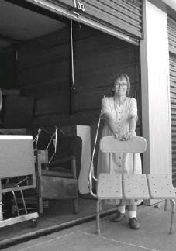
TILRC Philosophy: Donation Warehouse
CIL-NET, a project of ILRU – Independent Living Research Utilization

Slide 22
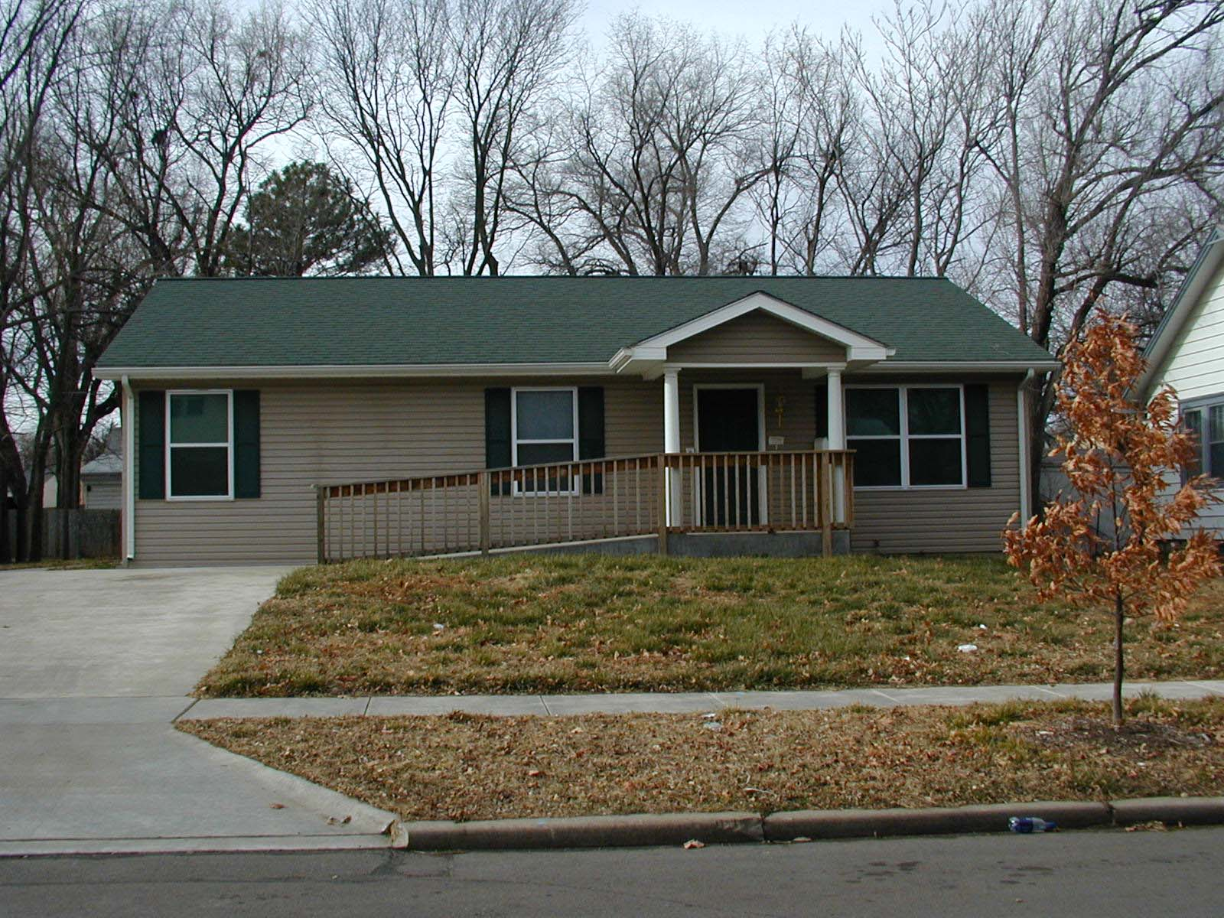
TILRC Philosophy: Freedom Path Dwelling
CIL-NET, a project of ILRU – Independent Living Research Utilization

Slide 23

TILRC Philosophy:
Outreach and Identifying Consumers
42 CFR §483.10(j)(2) The facility must provide reasonable access to any resident by any entity or individual that provides health, social, legal, or other services to the resident, subject to the resident’s right to deny or withdraw consent at any time.
CIL-NET, a project of ILRU – Independent Living Research Utilization

Slide 24

TILRC Philosophy: A Guide for Nursing Facilities: Respecting Residents’ Rights
Topeka Independent Living Resource Center
Presents
A Guide for Nursing Facilities:
Assuring the Civil Rights of Your Customers
CIL-NET, a project of ILRU – Independent Living Research Utilization

Slide 25
A Guide for Nursing Facilities:
Respecting Residents’ Rights
Rights of Residents
 To be treated with dignity and respect.
Make informed choices about every aspect of
their lives.
 Reside in the most integrated setting.
 Choose their own medical care.
Obtain medically necessary devices and
equipment.
Manage their own finances.
Access information from any entity or individual
that provides health, social, legal, or other
services.
CIL-NET, a project of ILRU – Independent Living Research Utilization

Slide 26
A Guide for Nursing Facilities: Respecting Residents’ Rights, cont’d.
Receive information regarding where they may live
and what kind of long term care services they may
receive.
Choose not to talk with an advocate, case manager,
social worker or any other provider.
 Access Home and Community Based Services.
Live where they want, with whomever they want,
without judgment or interference.
CIL-NET, a project of ILRU – Independent Living Research Utilization

Slide 27
TILRC Philosophy:
Move-Out Plans & Freedom Packet
All move-outs will include a completed Move-Out/Freedom Plan to assure necessary supports, supplies and advocacy have been addressed/explored. All staff involved with any aspect of a move-out will utilize a Move-Out Plan. Plans will be used for consumers moving out of the following situations:
          Nursing Home
          Intermediate Care Facility for People with Development Disabilities
          Intermediate Care Facility for People with Mental Illness
CIL-NET, a project of ILRU – Independent Living Research Utilization

Slide 28
TILRC Philosophy:
Move-Out Plans & Freedom Packet, cont’d.
Group Living Environments (Group homes, adult care homes)
    Assisted Living Facilities
    State Hospitals
    Out-of-State Consumers
CIL-NET, a project of ILRU – Independent Living Research Utilization

Slide 29
TILRC Philosophy: Move-Out Plans
& Freedom Packet, cont’d. 2
The Move-out Plan may be utilized with people in the following situations, when necessary for successful coordination of our advocacy assistance:
      Homeless Shelters
      Battered Women's Shelter Houses
      Drug and Alcohol Rehab/Detox Programs
      Individuals moving out on their own for the first time
      People who are homeless
CIL-NET, a project of ILRU – Independent Living Research Utilization

Slide 30
TILRC Philosophy: Move-Out Plans & Freedom Packet, cont’d. 3
Using the move-out plan assures we have explored and offered a variety of advocacy, service, and support options helps to identify possible Olmstead violations. The Plan includes all individual checklists and a completed Freedom Check-List, all completed prior to actual move-out.
CIL-NET, a project of ILRU – Independent Living Research Utilization

Slide 31
TILRC Philosophy: Move-Out Plans & Freedom Packet, cont’d. 4
Intake and Background Information
  Housing
  Personal Attendant Services
  Durable Medical Equipment/Assistive Technologies
  Medical Providers
  Prescription Medications
  Utilities
  Household Items
  Transportation
CIL-NET, a project of ILRU – Independent Living Research Utilization

Slide 32

TILRC Philosophy:
Creative Thinking and Problem Solving
CIL-NET, a project of ILRU – Independent Living Research Utilization

Slide 33
TILRC Philosophy:
Move-Out Plans & Freedom Packet, cont’d.
Group Living Environments (Group homes, adult care homes)
    Assisted Living Facilities
    State Hospitals
    Out-of-State Consumers
CIL-NET, a project of ILRU – Independent Living Research Utilization

Slide 34
TILRC Philosophy:
Move-Out Plans & Freedom Packet, cont’d.
Group Living Environments (Group homes, adult care homes)
    Assisted Living Facilities
    State Hospitals
    Out-of-State Consumers
CIL-NET, a project of ILRU – Independent Living Research Utilization

Slide 35
TILRC Philosophy:
Move-Out Plans & Freedom Packet, cont’d.
Group Living Environments (Group homes, adult care homes)
    Assisted Living Facilities
    State Hospitals
    Out-of-State Consumers
CIL-NET, a project of ILRU – Independent Living Research Utilization

Slide 36
For More Information
Contact:
  Mike Oxford and Ami Weidler-Hyten
  Topeka Independent Living Resource Center, Inc.
  501 SW Jackson St., Ste. 100
  Topeka, KS. 66603
  v/tty: 1-800-443-2207
  www.tilrc.org
CIL-NET, a project of ILRU – Independent Living Research Utilization

Slide 37
CIL NET Attribution
Support for development of this training was provided by the U.S. Department of Education, Rehabilitation Services Administration under grant number H132B070002-10. No official endorsement of the Department of Education should be inferred. Permission is granted for duplication of any portion of this PowerPoint presentation, providing that the following credit is given to the project: Developed as part of the CIL-NET, a project of the IL NET, an ILRU/NCIL/APRIL National Training and Technical Assistance Program.
CIL-NET, a project of ILRU – Independent Living Research Utilization

