Slide 1
CIL-NET Presents…
Outcome Measures for CILs
A National Onsite Training
Analyzing Outcome Information
September 13-15, 2011
Portland, OR
Presenters:
Mike Hendricks, Ph.D.
Bob Michaels
1

Slide 2



The Yellow Brick Road – Step 8
Sources and Methods
Measurable Indicators
Gathering Outcome Information
Choosing Outcomes
to Measure
Storing Outcome Information
Using Outcome Information
Logic
Models
Analyzing Outcome Information
Outcomes
&
Outcomes Mgmt.

Slide 3
Three Simple Steps
“Clean” the raw information
“Run the numbers”
Analyze open-ended questions

Slide 4
Step 1:
“Clean” the Raw Information
Look at the answers question-by-question
-- Were answers to any questions “wacky”?
-- Do any questions need to be thrown out?
Look at the answers client-by-client
-- How many gave inconsistent answers?
-- Do any clients need to be thrown out?
-- Or a specific question for a specific client?

Slide 5
Step 2:
“Run the Numbers”
A lot easier than you probably think
For each indicator:
-- First, describe your overall performance on
each outcome
-- Then, see what affects the outcomes (gender, ethnicity, disability, CIL size, etc.)
Graphics are especially useful
Let’s walk through an example….

Slide 6
At-Risk Teen Mentoring Program
At-risk teens graduate from high school.
At-risk teens achieve
passing grades.
At-risk teens meet district attendance requirements.
At-risk teens
earn better grades.
At-risk teens attend school regularly.
At-risk teens complete homework regularly.
Mentors meet with at-risk teens for an hour each week. Mentors stress the importance of education, encourage school attendance, occasionally help with homework.

Slide 7
At-Risk Teen Mentoring Program, cont’d.
At-risk teens graduate from high school.
# and % of teens who receive a diploma on time
At-risk teens achieve
passing grades.
# and % of teens who earn a C or better overall
At-risk teens meet
district attendance
requirements
# and % of teens who avoid attendance problems with the district
At-risk teens earn
better grades.
# and % of teens who earn better grades in the semester after the intervention than before
At-risk teens attend
school regularly.
# and % of teens who attend school at least 80% of the time
At-risk teens complete
homework regularly.
# and % of teens who finish their homework at least three days out of the week
Mentors meet with at-risk teens for an hour each week. Mentors stress the importance of education, encourage school attendance,
occasionally help with homework.

Slide 8
Outcomes for all teens
Too
early
At-risk teens graduate from high school.
Too
early
At-risk teens achieve
passing grades.
At-risk teens meet
district attendance
requirements.
55%
Too
early
At-risk teens earn
better grades.
At-risk teens attend
school regularly.
60%
80%
At-risk teens complete
homework regularly.
Mentors meet with at-risk teens for an hour each week. Mentors stress the importance of education, encourage school attendance,
occasionally help with homework.

Slide 9
Outcomes for girls vs. boys
At-risk teens graduate from high school.
At-risk teens achieve
passing grades.
G: 45%
At-risk teens meet
district attendance
requirements.
B: 70%
At-risk teens earn
better grades.
At-risk teens attend
school regularly.
G: 80%
B: 80%
At-risk teens complete
homework regularly.
Mentors meet with at-risk teens for an hour each week. Mentors stress the importance of education, encourage school attendance,
occasionally help with homework.

Slide 10
Outcomes for juvenile justice system teens vs. other teens
At-risk teens graduate from high school.
At-risk teens achieve
passing grades.
At-risk teens meet
district attendance
requirements.
At-risk teens earn
better grades.
Other:
75%
Other:
95%
At-risk teens attend
school regularly.
At-risk teens complete
homework regularly.
JJS:
30%
JJS:
35%
Mentors meet with at-risk teens for one hour each week. Mentors stress the importance of education, encourage school attendance,
occasionally help with homework.

Slide 11
Outcomes for women vs. men mentors
At-risk teens graduate from high school.
At-risk teens achieve
passing grades.
W: 35%
At-risk teens meet
district attendance
requirements.
M: 80%
At-risk teens earn
better grades.
At-risk teens attend
school regularly.
W: 90%
M: 70%
At-risk teens complete
homework regularly.
Mentors meet with at-risk teens for an hour each week. Mentors stress the importance of education, encourage school attendance,
occasionally help with homework.

Slide 12
Outcomes if parents attend teacher conferences vs. not
At-risk teens graduate from high school.
Yes
75%
No
45%
At-risk teens achieve
passing grades.
At-risk teens meet
district attendance
requirements.
At-risk teens earn
better grades.
At-risk teens attend
school regularly.
At-risk teens complete
homework regularly.
Mentors meet with at-risk teens for one hour each week. Mentors stress the importance of education, encourage school attendance,
occasionally help with homework.

Slide 13
Step 3:
Analyze open-ended questions
A way to summarize words (not numbers)
Often called “content analysis”
Can be done manually or by computer
Adds a deeper understanding to the numbers
you’ve already analyzed

Slide 14

NCIL Outcome Measures Project
Analyzing Outcome Information

Slide 15
Consumers Averaged 46-50 Years Old

Slide 16
Most Consumers Were White

Slide 17
Consumers Had Various Disabilities

Slide 18
Outcome Findings for Indicator #1
# and % of consumers served by the CIL within the last nine (9) months of the past federal fiscal year who can list at least one (1) specific skill, type of knowledge, or resource they have now that they didn’t have before approaching the CIL

Slide 19
Outcome Findings for Indicator #2
# and % of consumers served by the CIL within the last nine (9) months of the past federal fiscal year who can list at least one (1) specific way in which they are more independent than when they approached the CIL

Slide 20
Outcome Findings for Indicator #3
# and % of PWD contacting the CIL during the last nine (9) months of the past federal fiscal year who report they have the information they requested from the CIL

Slide 21
Outcome Findings for Indicator #4
# and % of PWD contacting the CIL during the last nine (9) months of the past federal fiscal year who report they used a new resource they learned about from the CIL’s I&R efforts

Slide 22
Outcome Findings for Indicator #5
# and % of consumers served by the CIL within the last nine (9) months of the past federal fiscal year who can list at least one (1) specific personal advocacy activity they engaged in

Slide 23
Outcome Findings for Indicator #6
# and % of consumers served by the CIL within the last nine (9) months of the past federal fiscal year who can list at least one (1) specific systems advocacy activity they engaged in

Slide 24
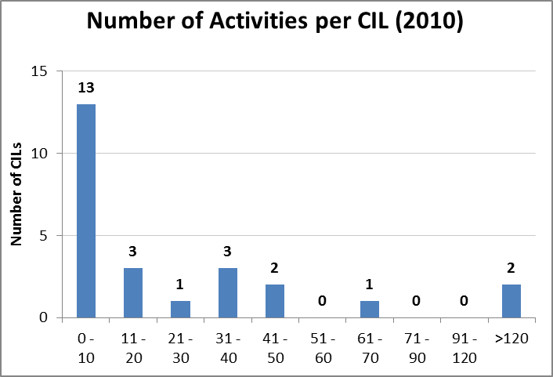
Outcome Findings for Indicator #7
# of activities conducted (such as surveys, public meetings, focus groups, polls) during the past calendar year to identify or confirm the primary barriers/problems in the community that prevent PWD from leading more independent lives

Slide 25
Outcome Findings for Indicator #8
Presence within the CIL’s annual plan of a separate section containing an explicit systems advocacy workplan

Slide 26
Outcome Findings for Indicator #9
# positive changes achieved or negative changes prevented during the past calendar year in legislation, policies, practices, or services at the local, state, or federal level that address the barriers/problems identified by the Center’s consumers

Slide 27
Outcome Findings for Indicator #10
# and % of consumers served by the CIL within the past calendar year who moved out of an institution and into a self-directed, community-based setting
Responses from 27 CILs
# in Institution | 1527
# who moved | 460
% who moved | 30%
% who did not move out | 70%

Slide 28
Outcome Findings for Indicator #11
# and % of consumers served by the CIL within the past calendar year who remained in a self-directed, community-based setting on December 31 despite having been at risk of moving into an institution
Responses from 19 CILs
Total # at risk | 4409
Total # in Self-Directed | 3743
% in Self-Directed | 85%
% in Institution | 15%

Slide 29
We also gave each CIL its own, confidential report showing how that CIL’s outcomes compared to the outcomes of all the CILs combined.

Slide 30
Sample Confidential Outcomes Report to a CIL
Outcome Indicator # and Brief Definition | All 28 CILs | CIL #XXX
1. % consumers who have gained new skills, knowledge, or resources | 70% Yes | 54% Yes
2. % consumers who have become more independent | 51% Yes | 54% Yes
3. # goals achieved by consumers | Not Measured This Year
4. % I&R callers who got the information they wanted | 72% Yes | 96% Yes
5. % I&R callers who used a new resource they learned from us | 52% Yes | 88% Yes
6. % consumers who advocated on their own behalf | 58% Yes | 63% Yes
7. % consumers who advocated for changes in the community | 28% Yes | 33% Yes
8. # activities the CIL conducted to confirm or identify the primary barriers in the community | See page 8 of full report | 25
9. CIL has an explicit systems advocacy workplan | 43% Yes | No
10. # positive changes achieved or negative changes prevented by systems advocacy | See page 10 of full report | 14
11. % institutionalized consumers who moved out of their institution and into the community | See page 11 of full report | 43%
12. % at-risk consumers who remained in a community-based setting | See page 12 of full report | 86%
Number of CIL Consumers used to calculate these statistics |  | 24
Number of CIL I&R Callers used to calculate these statistics |  | 26

Slide 31
A Good Reference
Analyzing Outcome Information, by H.P. Hatry, J. Cowan & M. Hendricks, the Urban Institute, 2004.
http://www.urban.org/UploadedPDF/310973_OutcomeInformation.pdf

Slide 32
For more information
Contact:
  Mike Hendricks – MikeHendri@aol.com
  Bob Michaels – bobmichaels@cox.net

Slide 33
CIL-NET Attribution
Support for development of this training was provided by the U.S. Department of Education, Rehabilitation Services Administration under grant number H132B070002-10. No official endorsement of the Department of Education should be inferred. Permission is granted for duplication of any portion of this PowerPoint presentation, providing that the following credit is given to the project: Developed as part of the CIL-NET, a project of the IL NET, an ILRU/NCIL/APRIL National Training and Technical Assistance Program.

