Slide 1
CIL-NET Presents…
Outcome Measures for CILs
A National Onsite Training
Logic Models
September 13-15, 2011
Portland, OR
Presenters:
Mike Hendricks, Ph.D.
Bob Michaels
1

Slide 2



The Yellow Brick Road – Step 2
Sources and Methods
Measurable Indicators
Gathering Outcome Information
Choosing Outcomes
to Measure
Storing Outcome Information
Using Outcome Information
Logic
Models
Analyzing Outcome Information
Outcomes
&
Outcomes Mgmt.

Slide 3


Essential Components of a Program
ACTIVITIES
OUTCOMES
INPUTS
OUTPUTS
Resources dedicated to or consumed by the program
What the program does with inputs to fulfill its mission
The volume of work accomplished by the program
Benefits or changes for participants during or after program activities
money
staff & staff time
volunteers & volunteer time
facilities
equipment & supplies
feeding and sheltering homeless families
providing job training
educating teachers about signs of child abuse
counseling pregnant women
number of classes taught
number of counseling sessions conducted
number of educational materials distributed
number of hours of service delivered
number of participants served
new knowledge
increased skills
changed attitudes or values
modified behavior
improved condition
altered status

Slide 4
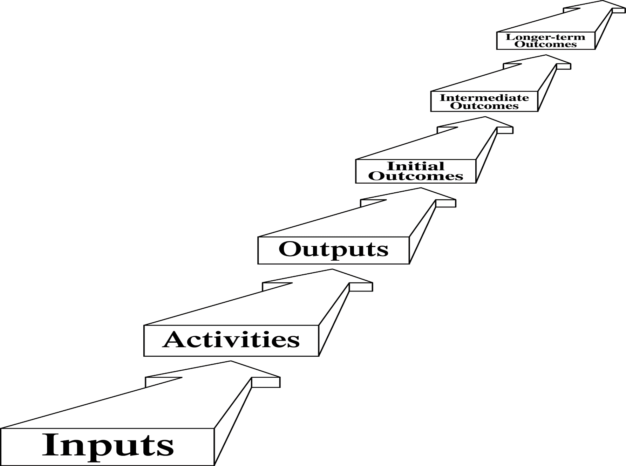
Inputs through Outcomes: The Conceptual Chain

Slide 5
Logic Model
A way to show visually, on one page:
A program’s resources (inputs)
What a program does (activities)*
How hard a program is working (outputs)
What it’s trying to achieve (desired outcomes)*
In what order (different levels of outcomes)*
* Key elements

Slide 6
IF → THEN Thinking
THEN . . . this outcome
THEN . . . this outcome – IF…
THEN . . . this outcome – IF…
IF . . . these activities

Slide 7
At-Risk Teen Mentoring Program
At-risk teens graduate from high school.
At-risk teens achieve
passing grades.
At-risk teens meet district attendance requirements.
At-risk teens
earn better grades.
At-risk teens attend school regularly.
At-risk teens complete homework regularly.
Mentors meet with at-risk teens for an hour each week. Mentors stress the importance of education, encourage school attendance, occasionally help with homework.

Slide 8
Ways a Logic Model Is Useful –
All By Itself
Make the program’s design and theory very explicit
Ensure a shared vision inside the program
Communicate the program’s rationale to outsiders
Orient workers to emphasize what’s important

Slide 9
Ways a Logic Model Is Useful –
All By Itself, cont’d.
Help allocate resources properly to different activities
Stimulate a discussion of how to define and measure success
Help identify which desired outcomes should be measured

Slide 10
Useful Tip #1:
Why?
Outcome
What else?
How?

Slide 11
At-Risk Teen Mentoring Program
At-risk teens graduate from high school.
At-risk teens achieve
passing grades.
At-risk teens meet district attendance requirements.
At-risk teens
earn better grades.
At-risk teens attend school regularly.
At-risk teens complete homework regularly.
Mentors meet with at-risk teens for an hour each week. Mentors stress the importance of education, encourage school attendance, occasionally help with homework.

Slide 12
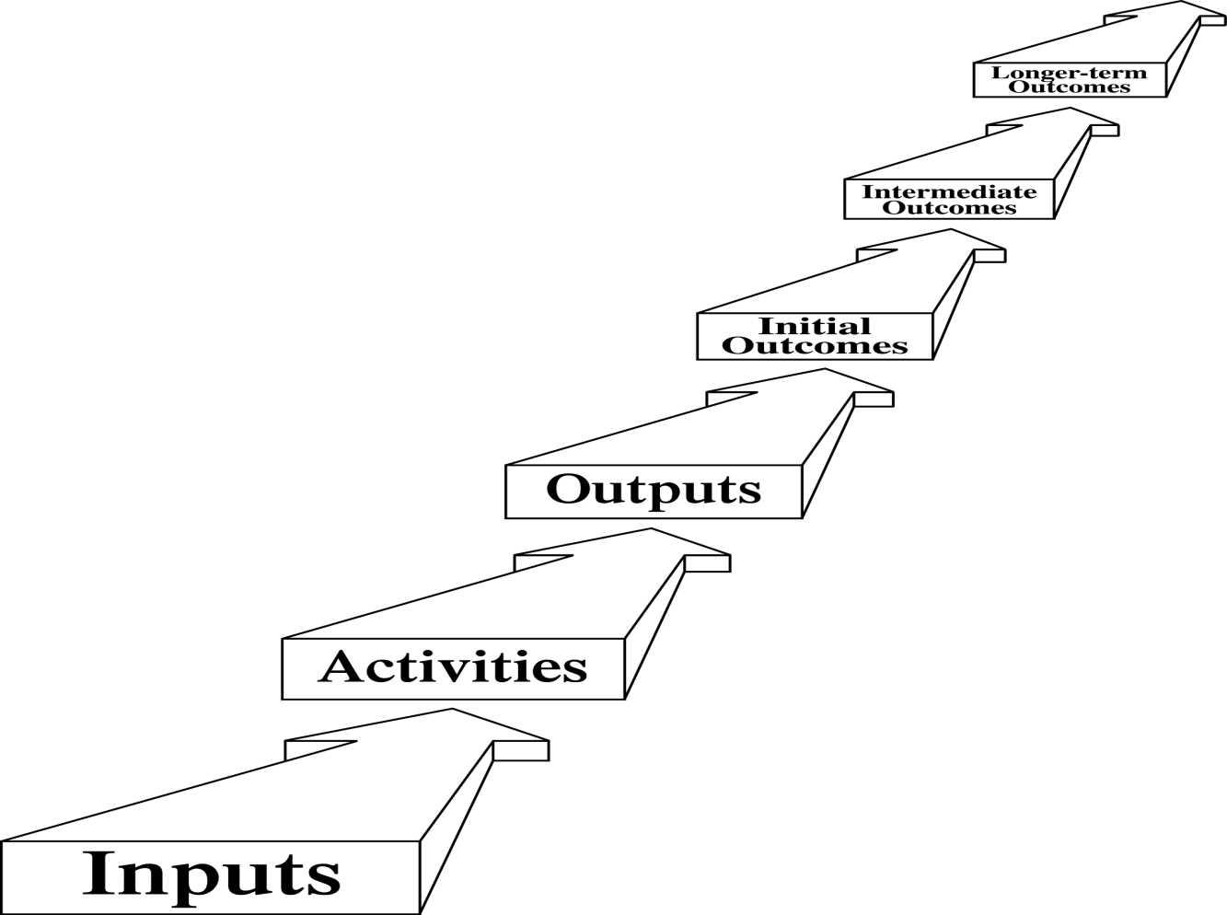
Useful Tip #2:
How far up to go ?
Far enough to show
meaningful change
for clients
Not so far out that your program can’t reasonably influence the outcome

Slide 13

NCIL Outcome Measures Project
Logic Model

Slide 14
Proposed Logic Model for the CIL Program
PWD are integrated into American Society
PWD participate in communities to the extent they wish
Communities are more accessible – Housing, Transportation, Information, Employment, Education, AT, Health Care, etc.
Ultimate Outcomes
PWD regard themselves as more independent
PWD are more independent
Communities have more resources that support independence
Methods & practices promote independence
Intermediate Outcomes
v
PWD make their own choices
PWD advocate for increased community supports
Decision- makers act on our agenda
PWD have skills/ knowledge/resources to support their choices
PWD see different possibilities
PWD get the information they need
A consumer agenda for change exists
Active coalitions exist around our issues
Initial Outcomes
Barriers, problems identified
v
v
Activities
IL Services
Information and Referral
v
Systems Advocacy

Slide 15
IL Services Stream
PWD regard themselves as more independent
PWD are more independent
PWD make their own choices
PWD have skills/ knowledge/resources to support their choices
IL Services – Peer Support, Skills Training, Transition Assistance, Individual Advocacy

Slide 16
I & R Stream
PWD advocate for increased community supports
PWD see different possibilities
PWD get the information they need
Information and Referral

Slide 17
Systems Advocacy Stream
Communities have more resources that support independence
Methods & practices promote
independence
Decision-makers act on our agenda
A consumer agenda for change exists
Active coalitions exist around our issues
Barriers, problems identified
Systems Advocacy

Slide 18
Ultimate Outcomes
PWD are integrated into American Society
Communities are more accessible – Housing, Transportation, Information, Employment, Education, AT, Health Care, etc.
PWD participate in communities to the extent they wish

Slide 19
Proposed Logic Model for the CIL Program
PWD are integrated into American Society
PWD participate in communities to the extent they wish
Communities are more accessible – Housing, Transportation, Information, Employment, Education, AT, Health Care, etc.
Ultimate Outcomes
PWD regard themselves as more independent
PWD are more independent
Communities have more resources that support independence
Methods & practices promote independence
Intermediate Outcomes
v
PWD make their own choices
PWD advocate for increased community supports
Decision- makers act on our agenda
PWD have skills/ knowledge/resources to support their choices
PWD see different possibilities
PWD get the information they need
A consumer agenda for change exists
Active coalitions exist around our issues
Initial Outcomes
Barriers, problems identified
v
v
Activities
IL Services
Information and Referral
v
Systems Advocacy

Slide 20

Your Turn
Arrange the index cards into a reasonable logic model

Slide 21
For more information
Contact:
  Mike Hendricks – MikeHendri@aol.com
  Bob Michaels – bobmichaels@cox.net

Slide 22
CIL-NET Attribution
Support for development of this training was provided by the U.S. Department of Education, Rehabilitation Services Administration under grant number H132B070002-10. No official endorsement of the Department of Education should be inferred. Permission is granted for duplication of any portion of this PowerPoint presentation, providing that the following credit is given to the project: Developed as part of the CIL-NET, a project of the IL NET, an ILRU/NCIL/APRIL National Training and Technical Assistance Program.

