Slide 1

Building an Effective Peer Support Program:
A Proven Volunteer Model
Implementing an Effective Peer Support Program
September 23, 2014
1:30 p.m. – 4:15 p.m.
Presenters:
Amina Kruck
April Reed
1

Slide 2
Mentor/Mentee Recruitment & Selection
Mentor Recruitment—Ongoing outreach for new mentors is important in maintaining a diverse and active mentor list
  Volunteers call Center, view the website looking for opportunities
  Agency newsletter articles, local publications, and community outreach presentations
  Referrals from Center staff
  Consumers who received mentoring volunteer to give back what they received

Slide 3
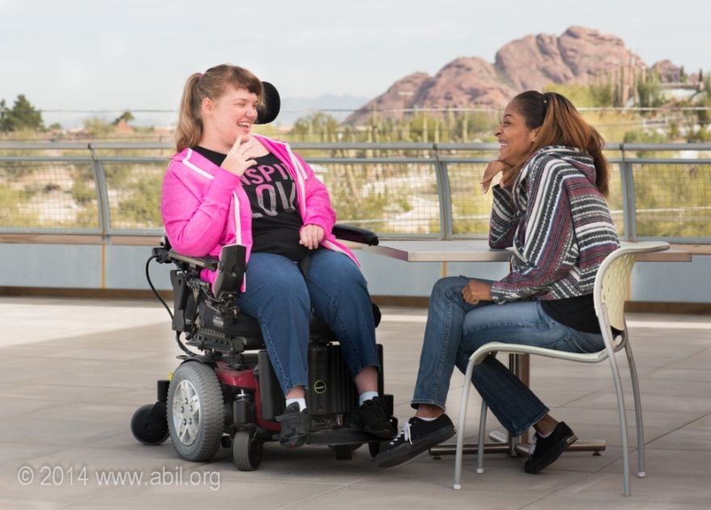
Mentor/Mentee Recruitment & Selection, cont’d.
Mentor Recruitment Tips
  Outreach presentations at support groups
  Connect with your university’s Disability Resource Center for potential mentors

Slide 4
Mentor/Mentee Recruitment & Selection, cont’d. 2
Mentee recruitment—Mentees are consumers, already working with Center staff, such as ILS staff
Policies and Procedures—Create program paperwork specific to the Peer Mentor (PM) Program
    Consumer Request for a Peer Mentor form (Peer Mentor Training Manual, pages 123-124)
    Sign a confidentiality release specific to the PM Program

Slide 5
Mentor/Mentee Recruitment & Selection, cont’d. 3
Mentee Recruitment Tips
  An application and screening tool helps ensure that the individual is appropriate for mentoring services and gives the mentor information on the mentee’s needs
  Form should explain the program and provide the opportunity for informed consent.

Slide 6
Marketing the Peer Mentor Program
Create a brochure or flyer with a clear message
Make it easy for applicants to learn about the program and access the application on your website
Explore opportunities to network and share with other programs and services in the community (e.g. hospitals, churches, community center)

Slide 7
Marketing the Peer Mentor Program, cont’d.
Work with other Center staff so that everyone understands the program and can help with marketing and recruitment
  Create opportunities for the staff to meet the mentors
    Have mentors share at a staff meeting
    Have mentors volunteer at event or attend Center programs

Slide 8
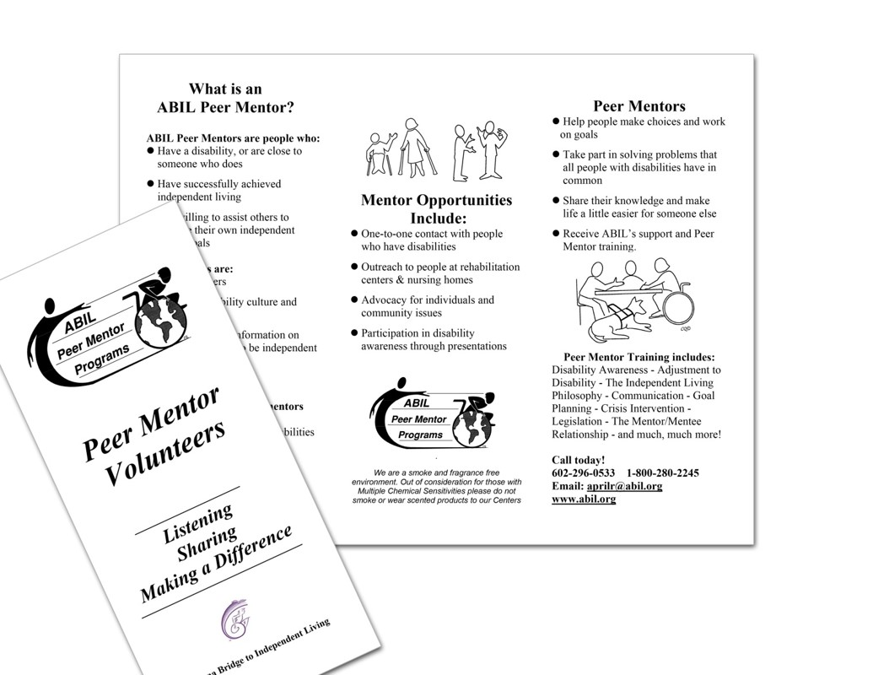
Marketing the Peer Mentor Program, cont’d. 2

Slide 9

Marketing the Peer Mentor Program, cont’d.3

Slide 10
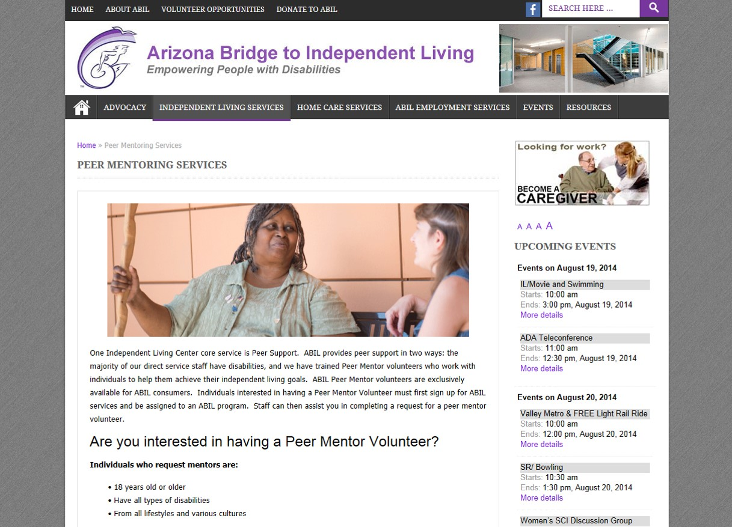
Marketing the Peer Mentor Program, cont’d.4

Slide 11
Peer Mentor Qualifications
Peer mentors must―
  Be at least 18 years old
  Complete an application and provide character references
Program Application Form (see pages 121-122)
  Criminal background
  Days of availability
  Areas of mentor’s interest
    Matches questions asked on consumer request form, (see pages 123-124)

Slide 12
Peer Mentor Qualifications, cont’d.
Complete a phone or in-person interview with Volunteer Coordinator or staff person coordinating the services
  Applicants can learn more about the expectations of the program
  Explore applicant’s interests and skills they can share with a mentee

Slide 13
Peer Mentor Qualifications―
Character Reference Form
Character Reference Form
  Important to check character references even if the person is well known through CIL staff
  Asks information about the applicant, such as:
    length of time they have known each other
    if they have abused drugs and/or alcohol
    if they were involved in a felony or crime
    dependability
    patience
    concern for and respect of others

Slide 14
Peer Mentor Qualifications―
Mentor Rules & Guidelines Form
Have a Mentor Rules & Guidelines Form (see pages 108-109) that sets boundaries and establishes expectations
  Mentor must sign at Peer Mentor Training agreeing to―
    maintain consumer confidentiality
    report any consumer suicidal or homicidal thoughts or suspicion of abuse
    maintain proper mentor/friendship relationship (No mentor/mentee dating!)

Slide 15
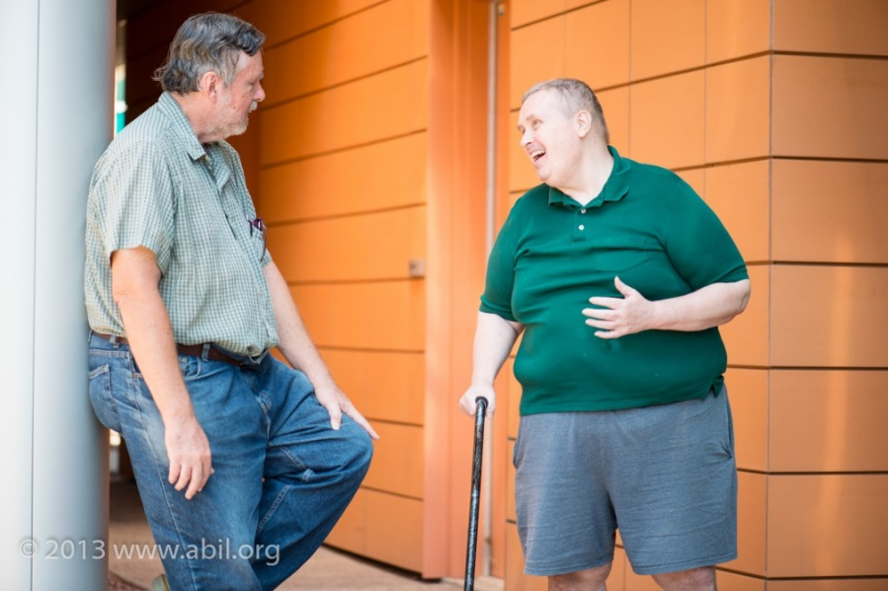
Peer Mentor Qualifications―
Keeping in Contact
  Have regular contact with mentee
    Mentors must agree to be in touch with a mentee a minimum of two times a month. Contact can be by phone, email, or in person.

Slide 16
Peer Mentor Qualifications―
Volunteer Duty to Report Policy Form
Volunteer Duty to Report Policy Form (see pages 103-104 )
  Mentor must sign the Volunteer Duty Report at the Peer Mentor Training
  Outlines requirements for mentors if their mentee reports feeling suicidal, homicidal, or reports any incident of abuse

Slide 17
Peer Mentor Qualifications―
Background Check
Background check
  Mentors must sign a Criminal Self-Disclosure form indicating that they have no felony convictions
  Mentors must successfully complete a fingerprint and background check
    Procedure if they do not pass
Mentors covered under ABIL’s liability policy

Slide 18
Peer Mentor Qualifications―
Character References
Always check character references even if the person is someone well known to the Center
Background checks are vital for the safety and protection of your mentors, mentees, and Center
  Check Center's liability insurance and funders to see type of fingerprint and background check they require
  Different types of background checks and costs can vary greatly by state

Slide 19
Peer Mentor Qualification Tip
Have your application and other forms in place before you start recruiting.
  What characteristics are important for a mentor to have? Have a Mentor Job description.
  Writing your Rules and Guidelines policy first will help you focus on what skills and abilities your mentors should exhibit.

Slide 20
ABIL Orientation and Training
Mandatory for all mentors
CIL staff assist in presenting the curriculum
Participants get to meet each other and learn why others are interested in mentoring
Peer mentor panel—current mentors share their mentoring experiences and answer questions
Participants receive a training manual
  Tip: Orientation training is a good opportunity to evaluate volunteer’s potential for 1-1 mentoring.

Slide 21
ABIL Orientation and Training, cont’d.
Though most participants have a disability, many are unfamiliar with Independent Living Philosophy, People First Language etc.
  This must be provided in the training in addition to the information on mentoring

Slide 22
ABIL Peer Orientation and Training, cont’d. 2
Volunteer Duty to Report Policy Form
  Mentor must sign the Volunteer Duty Report at the Peer Mentor Training
  Outlines requirements for mentors if their mentee reports feeling suicidal, homicidal, or reports any incident of abuse

Slide 23
ABIL Peer Orientation and Training, cont’d. 3
Crisis Intervention or “Pass the Buck” policy describes the ABIL Volunteer Duty to Report Policy
    Peer Mentors are required to notify the Volunteer Coordinator immediately about any expressions of threat to self (suicidal) or threat to others (homicidal). If supervisor cannot be reached immediately, volunteer will seek out another ABIL supervisor to report the incident.

Slide 24
ABIL Peer Orientation and Training―
Mentor Training Manual
Mentor Training Manual Break Down
  Independent Living Philosophy
  ABIL
  Adaptation to Disability
  Disability Liberation and Awareness
  Self Advocacy
  Language and Etiquette
  Goal Planning

Slide 25
Ongoing Training and Development
Training as opportunity to get to know the mentors better and make sure they are good fit for your program
Provide a manual that mentors can refer to at anytime after the training. The manual helps set the expectations for the mentors.
Don’t be afraid to train mentors on the hard topics (i.e., crisis intervention, liability)
Volunteers need to know who you are and what you believe. Devote part of your training to teaching IL philosophy, disability history, and the core programs.

Slide 26
ABIL Mentor Supervision
Mentors need to be treated individually
Some need little supervision
Others are just one step ahead of their mentees and need more support
Some mentors do not like working one-on-one but really enjoy community advocacy
  Many enjoy participating in Disability Awareness Presentations, and the Group Mentoring Sessions

Slide 27
Peer Mentor Program Coordination
Centers need to document in the Consumer Service Record (CSR) peer support/mentoring was provided and whether it was individually or in a group.
  Document mentor/mentee contact and progress of match and work on mentee’s goals
Track volunteer hours which can be used as in-kind donations for purposes of program funding matches

Slide 28
Peer Mentor Program Coordination, cont’d.
Meet regularly with referring staff to maintain open communication and ensure that staff understand the role of the peer mentors, and that staff mentee referrals are appropriate

Slide 29
Ongoing Maintenance and Support
At ABIL the Volunteer Coordinator (VC) is the primary contact and support for all the mentors
  It is critical that mentors feel comfortable contacting the coordinator with any questions or concerns
  Mentors stay active longer if they have a trusting, interactive relationship with the coordinator
VC Supervision: Volunteer Coordinator needs supervisory support to discuss difficult situations as they come up.

Slide 30
ABIL Peer Mentor Recognition
Value in celebrating and recognizing accomplishments
Annual holiday event in December to which staff, mentors and mentees are invited
  Mentors and mentees encouraged to attend together
  Visa gift cards and pocket calendars with the ABIL logo given to mentors as holiday gifts

Slide 31
ABIL Peer Mentor Recognition, cont’d.
The “Spirit of ABIL” Awards
  Award reception and luncheon honoring peer mentor volunteers
  Recognize peer mentors for one year, five year, and ten years of service
  Award an individual with “Peer Mentor Volunteer of the Year”―recipients are given plaques, certificates, and gift cards in recognition of service
Regular recognition
  Feature mentor/mentee stories in monthly newsletter on a quarterly basis

Slide 32
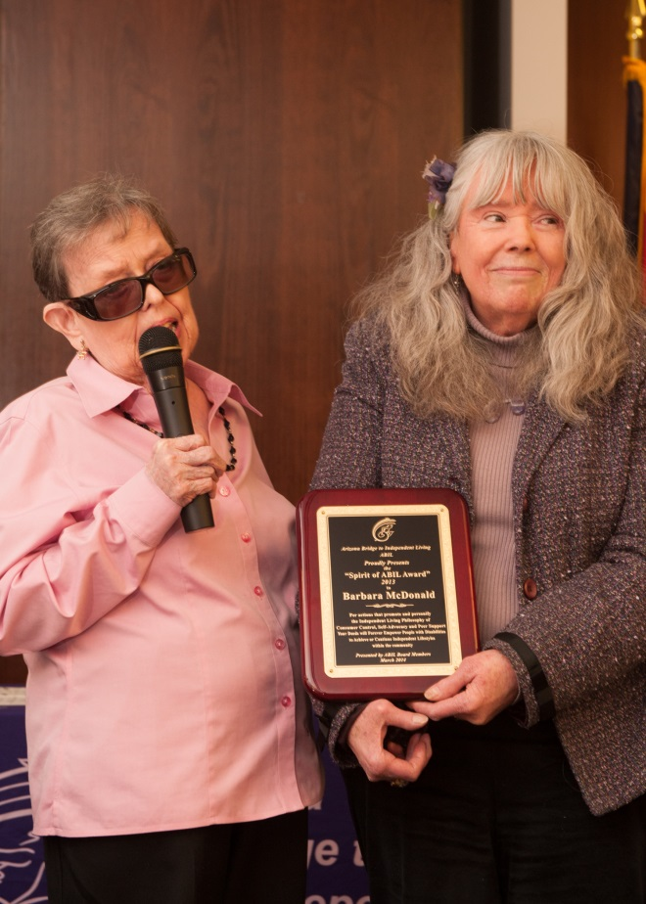
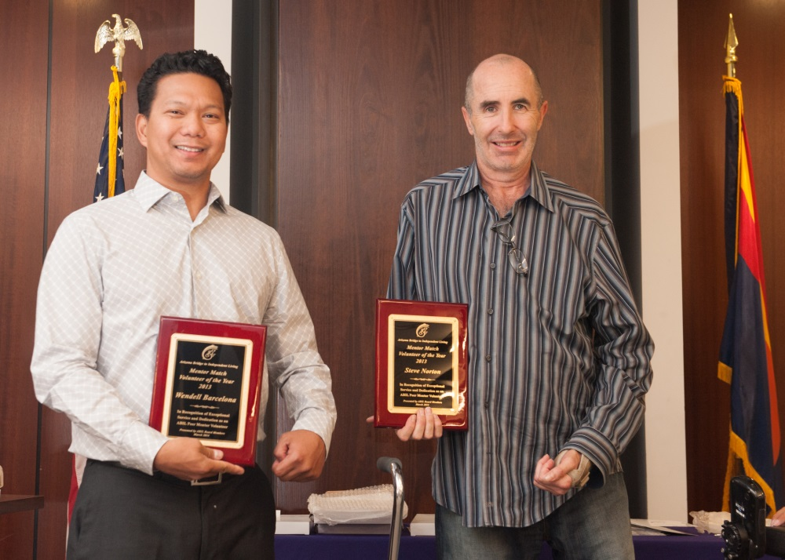
2013 Spirit of ABIL Award Winners

Slide 33
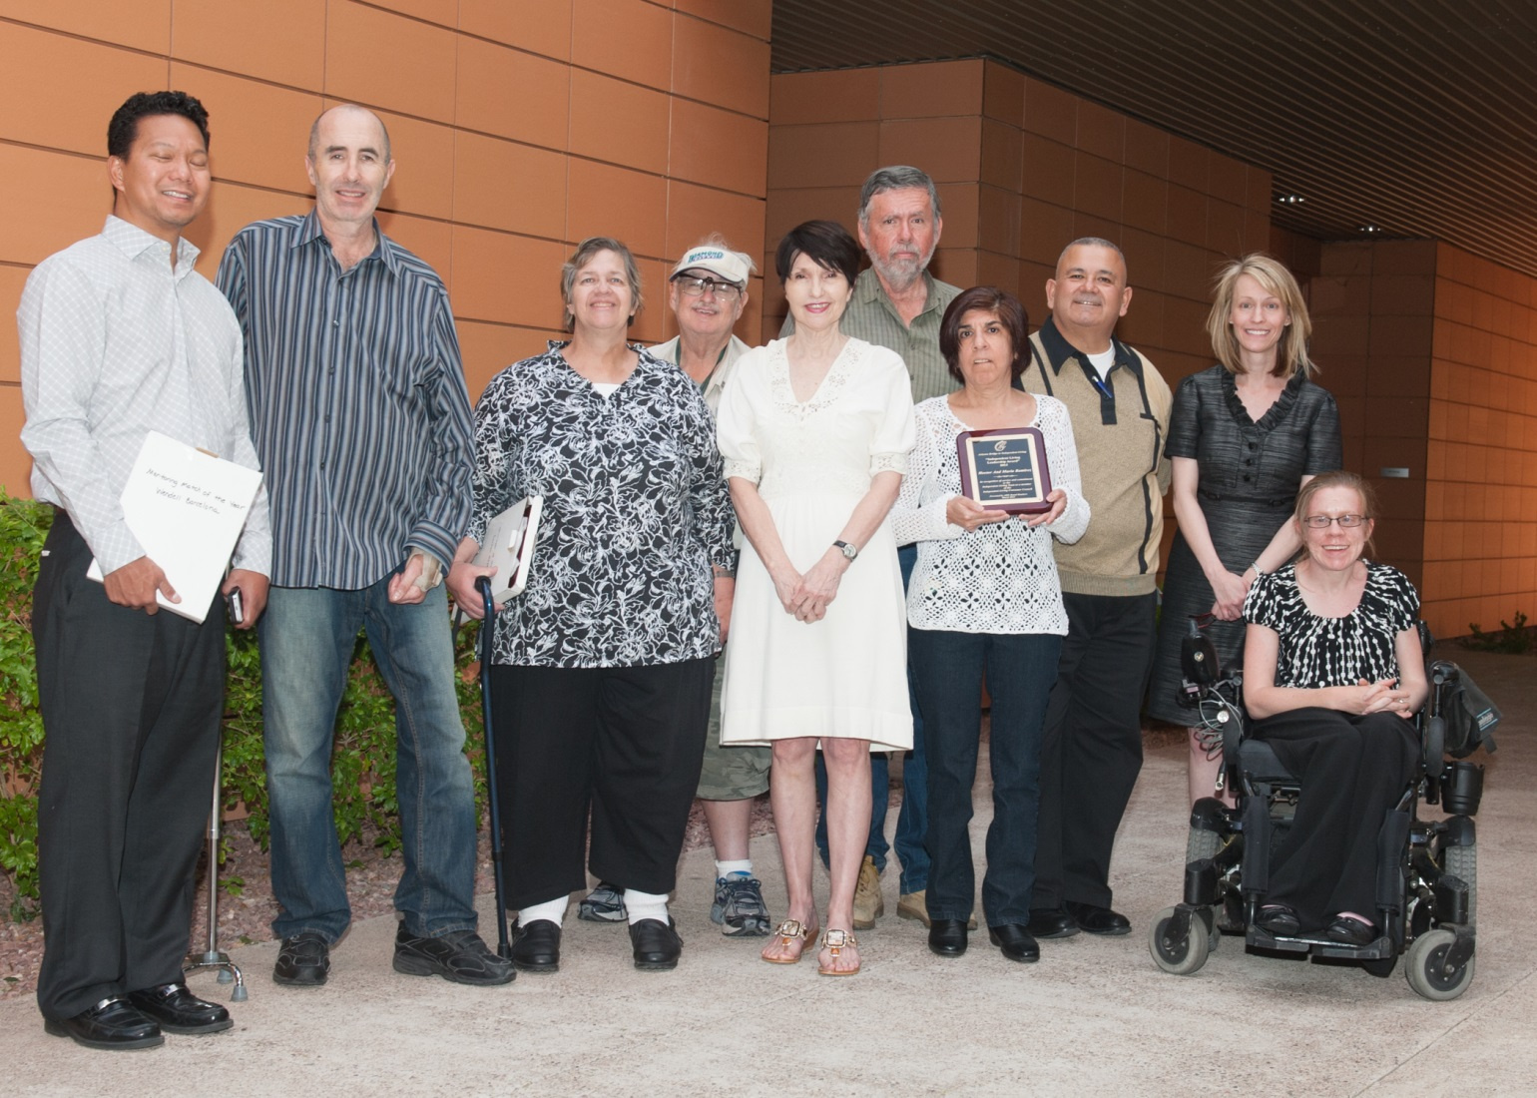
Spirit of ABIL 2013, cont’d.

Slide 34
ABIL Mentor Program Evaluation
Effectiveness of program relies on consistent evaluation of both the mentor and mentee experiences
Surveys are typically conducted at one, three, and six months from the date of the initial meeting
  Volunteer coordinator surveys mentors
  Staff working with consumers survey mentees

Slide 35
ABIL Mentor Program Evaluation, cont’d.
Early evaluation is correlated to match success
Program modifications based on feedback from mentors and mentees
We also have an evaluation form that group mentoring participants will complete
  Obtain feedback on experience and collect ideas for group activities and presentations

Slide 36
ABIL Mentor Program Evaluation, cont’d. 2
Participants are sent a link to the evaluation form
Completed form is uploaded to google docs
Responses are then copied into an Excel report and reports can be run from these charts.
Formal Program Evaluation Report is completed at least once a year and findings disseminated to staff

Slide 37
For more information
Contact:
  Amina Kruck – aminak@abil.org
  April Reed – AprilR@abil.org

Slide 38
CIL-NET Attribution
Support for development of this training was provided by the U.S. Department of Education, Rehabilitation Services Administration under grant number H132B120001. No official endorsement of the Department of Education should be inferred. Permission is granted for duplication of any portion of this PowerPoint presentation, providing that the following credit is given to the project: Developed as part of the CIL-NET, a project of the IL-NET, an ILRU/NCIL/APRIL National Training and Technical Assistance Program.

