Slide 1

Building an Effective Peer Support Program:
A Proven Volunteer Model
Mechanics of a Volunteer Peer Support Program
September 23, 2014
11:00 a.m. – 12:00 p.m.
Presenters:
Amina Kruck
April Reed
1

Slide 2
Mechanics of a Peer Mentor Program
Receives mentee referrals from other ABIL programs
Over the years has expanded to partner with additional programs at ABIL that serve a variety of needs
Now mentoring other programs outside ABIL and other CILs

Slide 3
Mechanics of a Peer Mentor Program, cont’d.
Early Intervention program works with local rehabilitation centers and hospitals to outreach to individuals who are newly injured or diagnosed with a disability
The Community Living Options program works with higher functioning adults with Developmental Disabilities who do not qualify for services from the Arizona Division of Developmental Disabilities

Slide 4
Mechanics of a Peer Mentor Program, cont’d. 2
The Empowering Youth in Transition program brings in community resources to schools to teach IL skills to young adults with disabilities
Community Reintegration program assists adults in gaining confidence, knowledge, resources and support needed to move out of nursing homes
ABIL Employment Services is an employment network through the Ticket to Work program helping Social Security Beneficiaries find substantial gainful employment

Slide 5
Who are ABIL Volunteer Peer Mentors?
Individuals with disabilities who―
  are already living independently
  are integrated into their community
  have a desire to help others do the same
Are people who―
  have “been there”
  can be called after business hours
  offer friendship and encouragement
  are eager to listen
  have hard-earned wisdom
  are willing to confront bureaucracy (advocate for system change)

Slide 6
ABIL Mentors are NOT…
Peer Mentors are NOT, nor do they try to be, medical professionals, counselors or therapists.

Slide 7
Who are ABIL Mentees?
Individuals with disabilities who―
  Are ABIL consumers who have been through an initial application process with a consumer service record
  Are working one-on-one with an ABIL staff on specific goals they have identified
Not every ABIL consumer is referred to participate in the Peer Mentor Program. Consumers must be ready and committed to full participation with a mentor

Slide 8
What do ABIL Mentors Do?
Work with any ABIL consumer who is adapting to a disability or seeking to increase their independence
Help newly disabled individuals adapt to living with a disability
Have regular contact with mentee
  Mentors must agree to be in touch with a mentee a minimum of two times a month

Slide 9
What do ABIL Mentors Do? cont’d.
Teach specific Independent Living skills
  Budgeting, using public transportation, increasing self-esteem
  Role model and teach self advocacy skills
Assist in finding and connecting to community resources
Provide support and encouragement
Advocate with service providers

Slide 10
Additional Mentor Volunteer Opportunities
Give Disability Awareness Presentations for schools, organizations, or groups
  Share their personal stories of living with a disability
  Provide explanations of assistive devices and technologies they use in everyday living
  Discuss disability etiquette and people first language
  Describe what Independent Living and empowerment mean to them

Slide 11
Mentor Volunteer Opportunities, cont’d.
Group Mentoring Sessions
  Participate in monthly discussion groups with mentees and other consumers
  Mentors speak on IL topics and share personal stories and experiences as individuals with disabilities
  Mentees ask questions and learn about community resources

Slide 12
Mentor Volunteer Opportunities, cont’d 2
Group Volunteer Activity
  Provide technical and clerical support to ABIL programs
  ABIL holds monthly group volunteer activity that mentors can attend with their mentees
  Mentors assist mentees in learning technical and clerical skills, and assist them in integrating into this social setting

Slide 13
Mentor Volunteer Opportunities, cont’d. 3
Community Advocacy
  Often get involved in community advocacy, join ABIL’s Empower! Advocacy listserv, and attend ABIL-sponsored advocacy and community resource workshops
Community Outreach
  Assist staff at community events and provide media interviews on a variety of topics

Slide 14
Paid or Volunteer?
Programs vary by Center, some train and pay qualified mentors
Each Center must consider what will work best for their consumers and what can be maintained by their staff
Some CILs may have opportunity for reimbursement that is not available in other states

Slide 15
Paid or Volunteer? cont’d. 2
ABIL believes that mentors should be volunteers for several reasons:
  May mean more to the mentee if their mentor is someone who chooses to be with them
  Mentors being there voluntarily help to contradict the disempowering role of “patient” many mentees experience
  Mentors can be available to the mentee more than business hours (evenings and weekends)

Slide 16
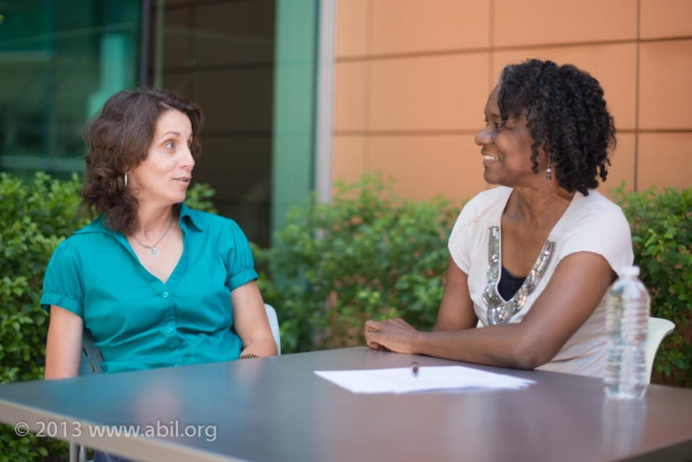
Paid or Volunteer? cont’d. 3
  The relationship can be a natural extension of the community where friends help friends without expecting to be paid for it

Slide 17

ABIL’s Funding
A 501(c)(3) non-profit corporation, sponsored/funded by: AZ DES/RSA & AZ DES/DDD, Community Development Block Grants, DBG, Pacific Disability & Business Technical Assistance Center, U.S. Department of Education (DOE)/Rehabilitation Services Administration (RSA), U.S. Social Security Administration, Valley of the Sun United Way.
The Peer Mentor Program is funded by Rehab Act DOE Part C funds.

Slide 18
Note on Funding
Some may be able to explore funding through Medicaid or state funds
  Definitions of peer support can vary from state to state
    Review the requirements at your state’s Board of Behavioral Health
    Review your state’s Department of Health Services.
      e.g. Arizona’s Regional Behavioral Health Authorities each have slightly different descriptors

Slide 19
Funding, cont’d.
  In 2007 the Director of the Centers for Medicare & Medicaid Services informed State Medicaid Directors that the minimum requirements for peer support services are supervision, care coordination, and training/certification of peers who provided the peer support.
  http://downloads.cms.gov/cmsgov/archived-downloads/SMDL/downloads/SMD081507A.pdf

Slide 20
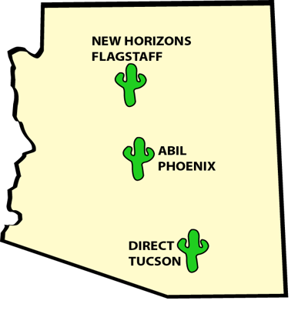
Arizona Demographics
State population of 6,443,654
Source: 2012 ACS, US Census Bureau
755,997 are individuals with disabilities
Source: 2012 ACS, US Census Bureau
The prevalence rate of disability is 11.7%
  Source: 2012 ACS, US Census Bureau
5 CILs

Slide 21
Arizona Demographics, cont’d.
ABIL serves Maricopa, Pinal and Gila Counties.
Maricopa County is one of the largest counties in the nation, with an estimated population of 3.9 million people and 9,200 square miles
Source: 2012 ACS, US Census Bureau
  387,616 are individuals with disabilities
        Source: 2012, ACS, US Census Bureau
We learned the most productive way to provide disability role modeling and IL skills instruction is to have a solid volunteer base

Slide 22
ABIL: Barriers to Program
Inappropriate referrals
Making effective matches
  Mentors ready to take self-responsibility
Role of the mentor
Inappropriate behavior of mentors or mentees
Ongoing need for new mentors
Transportation

Slide 23
Barriers to Mentor Programs, cont’d.
Funding for dedicated staff person to coordinate program
Service area
  Rural area vs. Urban
  Technology
  Transportation
Volunteer Coordinator—wrong person for the job, lack of appropriate temperament and skills

Slide 24
Effective Volunteer Peer Support Program Components
Recruitment
Mentor qualifications
Mentor training
Mentor supervision
Mentor recognition
Program evaluation

Slide 25
For more information
Contact:
  Amina Kruck – aminak@abil.org
  April Reed – AprilR@abil.org

Slide 26
CIL-NET Attribution
Support for development of this training was provided by the U.S. Department of Education, Rehabilitation Services Administration under grant number H132B120001. No official endorsement of the Department of Education should be inferred. Permission is granted for duplication of any portion of this PowerPoint presentation, providing that the following credit is given to the project: Developed as part of the CIL-NET, a project of the IL-NET, an ILRU/NCIL/APRIL National Training and Technical Assistance Program.

