Slide 1
Building an Effective Peer Support Program: A Proven Volunteer Model General Overview of Peer Support and ABIL Program
September 23, 2014
10:00 a.m. – 10:45 a.m.
Presenters:
Amina Kruck
April Reed
1

Slide 2
Definition of Peer Support
Peer support is a Core Service and thus is offered at every Center for Independent Living
How we do that varies by Center
Paid staff, volunteer peer support mentors
One-on-one meetings, groups, or a mixture of both
Each Center must consider what will work best for their consumers and what can be maintained by their staff

Slide 3
What do the Regulations say on Peer Support?
Tittle VII and the Standards and Indicators
Cross-disability counseling included
IL services include peer counseling
The program is to promote a philosophy of peer support

Slide 4
What Do the Regulations Say on Peer Support? cont’d.
The CIL shall promote the development of peer relationships and peer role models
Provide evidence in its annual performance report that it promotes the development of peer relationships and peer role models among individuals with significant disabilities
e.g. by using individuals with significant disabilities who have achieved IL goals as instructors in its training programs or as peer counselors

Slide 5
Definition of Volunteer Peer Mentor Program
Peer Support as an organized Peer Support Program
An organized Volunteer Peer Mentor Program trains and supervises volunteers who act as role models and coaches for others with disabilities
This does not include part-time staff, or paid Independent Living Specialists or Advocates
This does not replace staff providing peer support as appropriate, but is an additional support for the consumers

Slide 6
CIL Mentoring Nationally
Programs vary from Center to Center
In a 2008 CIL-NET survey, 61.3% of the respondents stated that they offered an organized peer mentor program
53.7% stated they had a formal training program/curriculum for their peer mentors
ILRU, December 2008, Peer Support Services in Centers for Independent Living

Slide 7
CIL Mentoring Nationally, cont’d.
38.7% of respondents indicated they do NOT have a peer support program, and of that group, 53.2% said they once DID have an organized program but found it difficult to maintain
ILRU, December 2008, Peer Support Services in Centers for Independent Living

Slide 8
Types of Mentoring
Mentoring can be one-to-one or in a group
Methods―in person, phone, email, social media, e-mentoring list servs, and online only groups
Of the Centers that provided peer support, 65% provided one-on-one peer support, 90% provided group support
RTC:Rural, June 2011, Peer Support in Centers for Independent Living: What Do We Know?

Slide 9
Overview of Peer Support
We know it works
Strong research supports the peer support model
Other groups have also successfully utilized peer support models
AA and other 12 Step programs
Weight Watchers
Mental health community

Slide 10
ABIL Today
One of 5 CILs in Arizona
Has 100 staff members, over 2000 personal assistants and dozens of volunteers
To help consumers achieve self-sufficiency, ABIL offers comprehensive programs including the four core services―independent living skills instruction; information and referral; peer support; advocacy (individual and systems change)

Slide 11
Additional Programs
ADA Services
Benefits2Work―SSA Work Incentives Planning and Assistance (WIPA)
Community Living Options
Community Reintegration
Early Intervention/ Outreach to Rehab Centers
Employment Services―Ticket Employment Network
Empowering Youth in Transition
Home Modification
Living Well with a Disability
Personal Assistant Services
Reintegration from Nursing Homes
This Is My Life
Socialization Through Recreation
Sports & Fitness Center

Slide 12
Arizona Bridge to Independent Living

Slide 13
History
Arizona Bridge to Independent Living (ABIL) in Phoenix, Arizona
Founded in 1981
Provides Advocacy and Programs by and for People with Disabilities
Mission Statement: ABIL offers and promotes programs designed to empower people with disabilities to take personal responsibility so they may achieve or continue independent lifestyles within the community

Slide 14
Peer Mentor Program
Began in 1990
Justification for the program
ABIL had a large service area with few staff
We knew consumers and community members who had untapped knowledge and resources that they could share with others
CIL leadership had utilized a peer mentor and found it a beneficial experience

Slide 15
Peer Mentor Program, cont’d.
Staff researched other programs
Researched successful community volunteer programs locally & what other CILs were doing & found that most were providing peer support through their paid staff
Staff support
Several staff who had utilized a peer mentor during their own personal experiences with disabilities felt it was a valuable experience
Community Integration Unit manager had a Masters of Counseling and a background in peer counseling

Slide 16
Volunteer Peer Mentor Program Goals
Provide qualified peer mentors to teach independent living skills
Support ABIL consumers in reaching their independent living goals
Support ABIL staff and programs

Slide 17
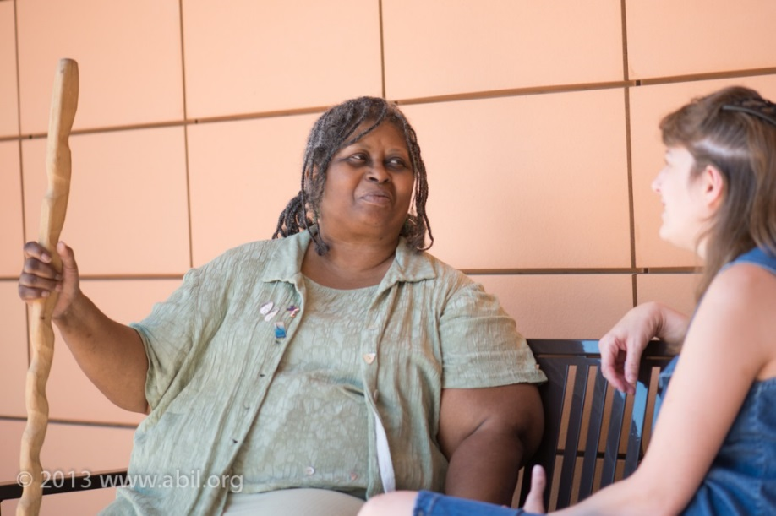
ABIL’s Mentoring Vision
Peer mentors can utilize their own personal experience with living with a disability to empower others in reaching their independent living goals

Slide 18
Peer Mentor Program History
Early Years of the Program
Successes
Training
We had mentor interest
Challenges
Staff buy in
Getting the numbers and hours to justify staff time
Transitioning Coordinators

Slide 19
Peer Mentor Program
Peer Mentor Program Today
40 active mentors who volunteered 2100 hours during FY 12-13
Providing one-on-one mentoring, group mentoring, and giving disability awareness presentations in local elementary schools
Some of the mentors, along with other volunteers, provided an additional 10,200 hours of technical and clerical support to ABIL programs

Slide 20
Volunteer Coordinator is…
The Volunteer Coordinator is coach, cheerleader, supervisor, and often a mentor to the mentors themselves

Slide 21
Who Coordinates ABIL’s Volunteer Mentoring Services?
ABIL designated a full time staff person
Effective Volunteer Coordinator qualities
Funded by Rehab Act DOE Part C funds
The Volunteer Coordinator coordinates the Peer Mentor Program
Responsible for the recruitment, orientation, and training of mentors
Organizes matches
Conducts program evaluations
Volunteer support and recognition

Slide 22
Volunteer Coordinator Traits
Volunteer Coordinator—Your program totally depends upon the right person coordinating it. This is a highly skilled role, somewhat like a human resource coordinator with counseling or social work skills and training.
Adequate mentor support and/or match evaluation skills
Organizational, communication and collaboration skills
Good coaching, motivational, judgment and assessment skills
Commitment to ongoing professional development
Good IL Philosophy—helping vs. dependency

Slide 23
For more information
Contact:
Amina Kruck – aminak@abil.org
April Reed – AprilR@abil.org

Slide 24
CIL-NET Attribution
Support for development of this training was provided by the U.S. Department of Education, Rehabilitation Services Administration under grant number H132B120001. No official endorsement of the Department of Education should be inferred. Permission is granted for duplication of any portion of this PowerPoint presentation, providing that the following credit is given to the project: Developed as part of the CIL-NET, a project of the IL-NET, an ILRU/NCIL/APRIL National Training and Technical Assistance Program.

