Slide 1

Building an Effective Peer Support Program:
A Proven Volunteer Model
Build Awareness, Skills, and Commitment of Mentors
September 24, 2014
9:30 a.m. – 12:00 p.m.
Presenter:
April Reed
1

Slide 2
Building Mentor Awareness, Skills, and Commitment―Mentor Training Manual
Mentor Training Manual Overview
Curriculum Breakdown
  Independent Living Philosophy (see pgs 8-17)
    History of Independent Living―ABIL shows Ed Roberts’ 60 Minutes interview
  Arizona Bridge to Independent Living (see pgs 18-23)
    History of ABIL, mission statement, break down of ABIL programs
    Mentors need to know the agency
  Information and Referral (see pgs 24-25)

Slide 3
Mentor Training Manual―
Volunteer Program Introduction
Volunteer Program Introduction (see pgs 27-30)
  Began discussing some basic mechanics of the program
  Peer Mentor Panel―current mentors discuss their experiences

Slide 4
Mentor Training Manual―
Adaptation to Disability
Adaptation to Disability (see pgs 31-36)
    Discussion of the grieving process based on Kubler-Ross
    Many mentees, particularly those who are newly injured will be facing these issues

Slide 5
Mentor Training Manual―
Communication
Communication (see pgs 37-47)
  Self-evaluation (see pgs 38-39), discussion of communication style, non-verbal communication, paraphrasing and reflective statements

Slide 6
Mentor Training Manual―
Language & Etiquette, Helping vs Dependency
Language and Etiquette (see pgs 48-56)
  People First language (see pgs 50-52)
  Etiquette tips for various disabilities (pgs 54-56)
Helping vs. Dependency (see pgs 57-62)
  Discussion of the rules in helping, the mentor’s role, and balance between helping and dependency

Slide 7
Mentor Training Manual―
Disability Awareness and Liberation
Disability Awareness (see pgs 64-79)
  Disability is universal
Disability Liberation (see pgs 70-77)
  Discussion of negative stereotyping, internalized operation, and keys to contradict oppression

Slide 8
Mentor Training Manual―
Self Advocacy & Goal Planning
Self Advocacy (see pages 78-88)
  Tips for effective advocacy, advocacy resource list (see pgs 80-88)
Goal Planning (see pgs 89-97)
  Tips for effective goal setting, sample goal setting worksheets (see pgs 95-97)

Slide 9
Mentor Training Manual―
Crisis Intervention
Crisis Intervention (see pgs 98-104)
  This is called the “Pass the buck policy”
  Describes ABIL’s Volunteer Duty to Report Policy (signature form pgs 103-104)
    Peer Mentors are required to notify Volunteer Coordinator immediately about any expressions of threat to self (suicide) or others (homicide). If supervisor cannot be reached immediately, volunteer will seek out another ABIL supervisor to report the incident.

Slide 10
Mentor Training Manual―
Volunteer Forms
Volunteer Forms (see pgs 105-116)
  Volunteer Position Description (pgs 106-107)
  Rules and Guidelines for Peer Mentoring (signature form pgs 110-111)
  Volunteer Time Sheet (pg 112)
  Volunteer Mileage Reimbursement (pg 113)

Slide 11
Mentor Training Manual―
Volunteer Coordinator
Volunteer Coordinator does training one-on-one with mentors as needed
  Example: Mentor learning about a new disability, or community resource
  Coaching mentees through challenging situations

Slide 12
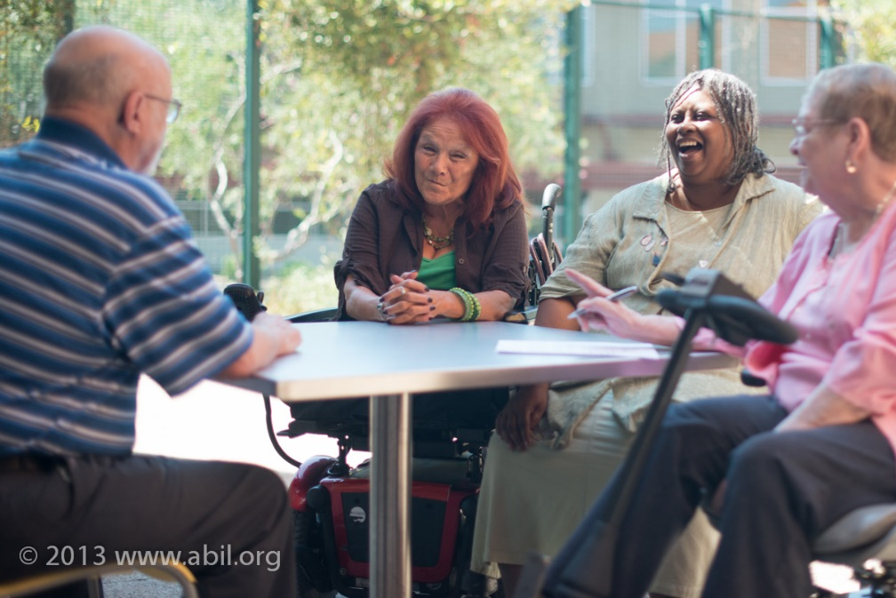
Mentor Training Manual―
Mentor Participation
Mentor participation in monthly mentoring group also provides an opportunity for continued development of skills and awareness.

Slide 13
Ongoing Training and Development
Follow‑up training opportunities include:
  Self‑advocacy, legislative advocacy, and community resource workshops, or Disability Liberation/ Attitudinal Barriers workshops
At ABIL, the Volunteer Coordinator does training one-on-one with mentors as needed
  Coaching Mentor to learn about a new disability, or community resource
  Coaching mentees through challenging situations

Slide 14
Mentoring Group
Coordinator facilitates the group and develops presentations based on group interest
Best described as a growth group or discussion group

Slide 15
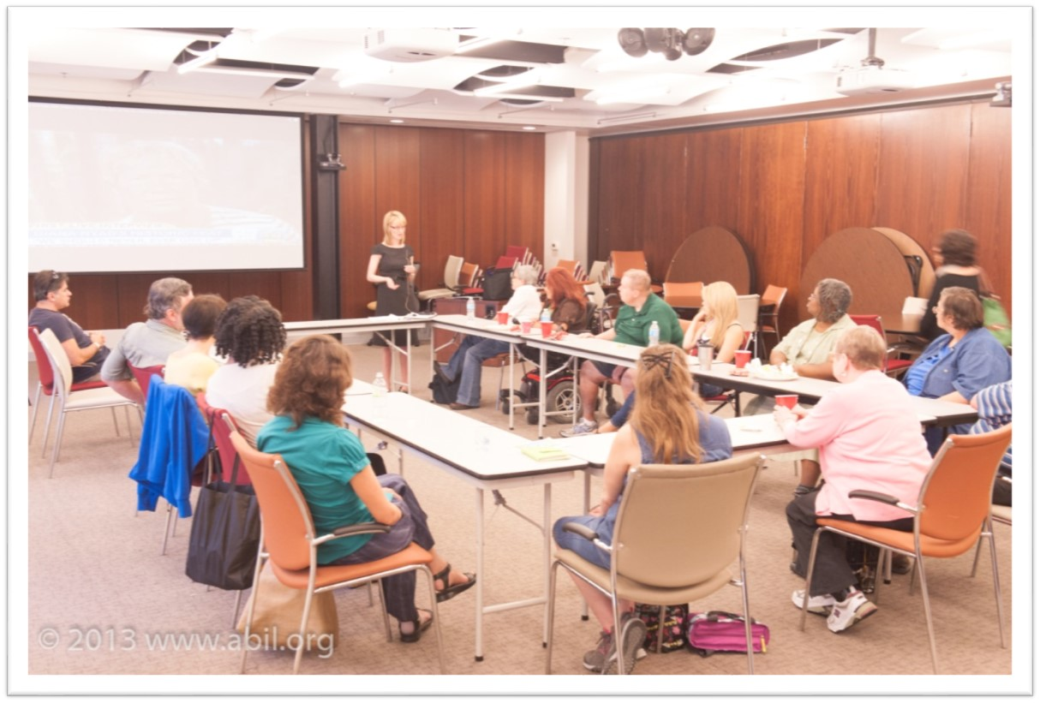
Mentoring Group Meeting

Slide 16
Mentoring Group, cont’d.
Topics of the group have included―
  Resilience
  Good Coach vs. Bad Coach, identifying negative self-talk
  Stress management, time management
  Disability History and the ADA
  Self-Advocacy
  Avoiding scams and fraud

Slide 17
Mentoring Group, cont’d.2
Guest speakers are recruited to present on issues that are outside of the Coordinator’s expertise
  e.g. end of life planning; living wills
Various staff have come to present their stories of living well with a disability

Slide 18
Mentoring Group, cont’d.3
Mentors have presented on various topics where they have expertise
  Mentor who is a Chef and a mentor who is a Fitness Instructor facilitated a group on healthy nutrition and cooking
  Mentors learned about and presented on an important figure in disability history

Slide 19
Mentoring Group, cont’d.4
Newly trained mentors are encouraged to attend at least one of the groups
  Meet long-time mentors and have a chance to interact and benefit from their experience
  Opportunity to listen to mentees and hear about common fears and concerns
  Increase their knowledge of various disabilities, community, and advocacy issues

Slide 20
Mentoring Group, cont’d. 5
Other benefits of the mentoring group
  Allowed many of the mentors to get to know each other better, and create a support system
  Mentees benefit from the perspective of many mentors and different life experiences

Slide 21
Matching Mentors with Mentees
In matching, ABIL considers a variety of factors including: sex, age, disability, skill, experience, background
What’s the purpose of the match?
  e.g. disability awareness, recreation, skill
Matches are of same gender
  Survey of mentors and mentees found this was preferred
  May reduce safety concerns

Slide 22
Matching Mentors with Mentees, cont’d.
Staff submits a request for a peer mentor to the Coordinator
Coordinator will review mentor list and contact the mentor to discuss the potential match
It is the mentor’s choice whether or not to accept the match
  If the mentor declines the match, the Volunteer Coordinator will continue searching the mentor list

Slide 23
Matching Mentors with Mentees, cont’d. 2
If at all possible, will introduce the mentor and mentee in person, along with the referring Staff person
  Ensure comfort of both parties
  Discuss how they will be in contact
    If social media (e.g. Facebook) will be one type of communication we discuss the limits of social media and remind them to update their privacy settings

Slide 24
Matching Mentors with Mentees, cont’d.3
Review the Program Information form pgs 121-122, which outlines what the mentee can expect when they are matched with a mentor
    Confidentiality
    Each arrange own transportation
Matches vary in the length of time depending on the goals and type of work
Matches can continue as long as both mentor and mentee are in agreement, and there are independent living goals to work on.

Slide 25
Matching Mentors with Mentees, cont’d. 4
Common Reasons for Matches Ending
  Mentor or mentee become ill
  Mentor or mentee schedules change
  Mentee dependency
Sometimes matches don’t work
  We encourage mentors and mentees to let us know by conducting evaluations
  We may re-match depending on the circumstances

Slide 26
Matching Mentors with Mentees, cont’d. 5
When the match is nearing completion the Volunteer Coordinator will begin discussing with the mentor and staff how to transition the mentee out of the program
  Mentor and mentee have time to review accomplishments
  Discuss how the mentee will move forward
  Some may choose to follow up occasionally after the match is over

Slide 27
E-mentoring
Many programs are exploring the use of online mentoring formats
There are many benefits that have been identified
  Connecting people who have been isolated due to location or other challenges (e.g. transportation, lack of child care)
  Connecting to people you would not have the opportunity to meet in your day-to-day life
  More people have access to the technology

Slide 28
E-mentoring, cont’d.
Drawbacks to using e-mentoring:
  Information overload or Internet stress
  Vulnerability
  Privacy
  Users may disengage in conversations

Slide 29
E-Mentoring and Disability
A study published in the journal of Psychiatric Services, found that “fear of being hospitalized or of taking medication was associated with more than eight times greater odds of Internet support use.”
The study also found that no insurance coverage was also a strong factor.
Townsend, L., Gearing, R.E., Polyanskaya, O., (2012), Influence of Health Beliefs and Stigma on Choosing Internet Supports Over Formal Mental Health Services. Psychiatric Services, 63(4), 370-376

Slide 30
E-Mentoring and Disability, cont’d.
E-mentoring won’t be beneficial for every group of people with disabilities
  Individuals needing hands-on instruction
  Weight loss goals
  Individuals who do not have computer skills

Slide 31
Models of E-Mentoring
Structured vs Unstructured
  Structured―have preselected questions or discussion topics for the group
  Unstructured―groups do not follow any format. Close to what would spontaneously form on the Internet in your typical chat room.
Kaplan, K., Salzer, M.S, Soloon, P., Brusilovskiy, E., Cousounis, P., (2011), Internet Peer Support for Individuals with Psychiatric Disabilities: A Randomized Controlled Trial. Social Science & Medicine, 72, 54-62

Slide 32
Models of E-Mentoring, cont’d.
Moderated vs UnModerated
  Moderated―professional/staff facilitates the discussions
  UnModerated―no oversight of professional/staff on conversations
Kaplan, K., Salzer, M.S, Soloon, P., Brusilovskiy, E., Cousounis, P., (2011), Internet Peer Support for Individuals with Psychiatric Disabilities: A Randomized Controlled Trial. Social Science &Medicine, 72, 54-62

Slide 33
Models of E-Mentoring, cont’d. 2
Some programs are choosing to build their program around existing social network platforms that are available for fee
  Have chat rooms, bulletin boards, and email system
  Have secure log-ins, more security features to protect privacy
    Third party options Ability Online or MentorNet
Masuda, J., Anderson, S., Letourneau, N., Morgan, V.S., Stewart, M., (2013), Reconciling Preferences and Constraints in Online Peer Support for Youth With Asthma and Allergies. Health Promotion Practice, 14 (5), 741-750

Slide 34
E-Mentoring and Youth
When working with minors, online conversations between mentors and mentees must be monitored
  Mandatory court reporting
  Parental consent
Masuda, J.R., Anderson, S., Letourneau, N., Morgan, V. S., Stewart, M., (2012), Reconciling Preferences and Constraints in Online Peer Support for Youth With Asthma and Allergies. Health Promotion Practice, 14, 741-750

Slide 35
E-Mentoring and Youth, cont’d.
A structured program is necessary in order to protect privacy.
  One research project did not have mentors and mentees exchange any personal contact information and all contact was made through the chat room, and email system of the program.
Masuda, J.R., Anderson, S., Letourneau, N., Morgan, V. S., Stewart, M., (2012), Reconciling Preferences and Constraints in Online Peer Support for Youth With Asthma and Allergies. Health Promotion Practice, 14, 741-750

Slide 36
E-Mentoring and Youth, cont’d. 2
Examples:
  Do-It Mentoring (Disabilities, Opportunities, Internetworking, and Technology)
    Created by the University of Washington. Any youth with a disability can apply to join at www.washington.edu/doit/
  E-Connect
    Created by the University of Minnesota School http://ici.umn.edu/e-connect/
    Mentoring from community employers by email and in-person with teachers as supervisors

Slide 37
E-mentoring Program Coordination
Have all of the same components of an effective traditional mentoring program (i.e. recruitment, training, policies, procedures, documentation, supervision, evaluation).
One on one matches and groups online still benefit from staff support.
  Discussion topics
  Reminders to stay in contact or join in at the scheduled discussion time

Slide 38
E-Mentoring Program Coordination, cont’d.
Several programs created customized discussion topics that the e-mentoring pairs or e-mentoring groups received based on the goals of each match.
Customized “coaching messages” were sent to remind participants to stay in contact.
Boyle Single, P., Single, R. M., (2005), E-mentoring for Social Equity: Review of Research to Inform Program Development. Mentoring and Tutoring, 13 (2), 301-320

Slide 39
E-Mentoring Conclusions
Protect confidentiality
Explore e-mentoring options for those individuals who you would otherwise not be able to reach through traditional mentoring
Additional research needs to be done on the outcomes of e-mentoring

Slide 40
Social Media and Mentoring
Centers are advertising events, grassroots organizing, fund raising, advocacy alerts, etc.
Some Centers are using blogs
  Centers would want to make sure that the blog is written by a person that they trust and role models IL http://independentlivingideal.blogspot.com/p/principles-of-independent-living.html

Slide 41
Social Media and Mentoring, cont’d.
The main concern in using social media as a tool for peer mentoring is confidentiality
Centers should develop a social media policy and procedure for the mentors
Access whether this contact is possible for the particular match

Slide 42
Social Media and Mentoring, cont’d.2
Facebook has several levels of privacy settings
  Wall is public
  Instant Messaging (IM) or sending emails is more private
  Default settings are always set to the most open level of privacy
    Users must choose to have the higher level of privacy
    Often changing security options, users must be vigilant to ensure they are protecting their information

Slide 43
Social Media and Mentoring, cont’d. 3
LinkedIn may be easier to create confidential discussions
  Simpler platform and may be more accessible than Facebook
  Recommended for youth and job seekers to do professional and job networking
Twitter―security can be set to protect your tweets

Slide 44
Social Media and Mentoring, cont’d.4
ABIL matches are using social media on a case-by-case basis
Discuss with mentor and mentee our confidentiality requirements specific to social media
  e.g. mentor cannot post about what they discussed in a meeting with their mentee; refer to the mentee by name
  Limit social media contacts to general conversation
  More personal or in-depth conversations should be done offline

Slide 45
Peer Mentoring Impact on our Advocacy Efforts
We started the mentoring group in 2007. We anticipated that the group could―
  Provide a positive activity for mentors and mentees that were currently matched
  Keep mentors involved who weren’t currently matched one-on-one
  Attract mentees who might prefer the group setting
  Serve as a good first step for those still in nursing home settings

Slide 46
Peer Mentoring Impact on our Advocacy Efforts, cont’d.
  What we have also seen
    Mentors have become more tied in and aware of what events and activities are going on at ABIL
    Mentors have developed an inner commitment to improving circumstances and removing barriers for others with disabilities
    More of our mentors taking an active role in the CIL’s advocacy efforts
      Disabilities Treaty advocacy
      Participating in annual Legislative Training
      Light Rail stop closer to ABIL

Slide 47
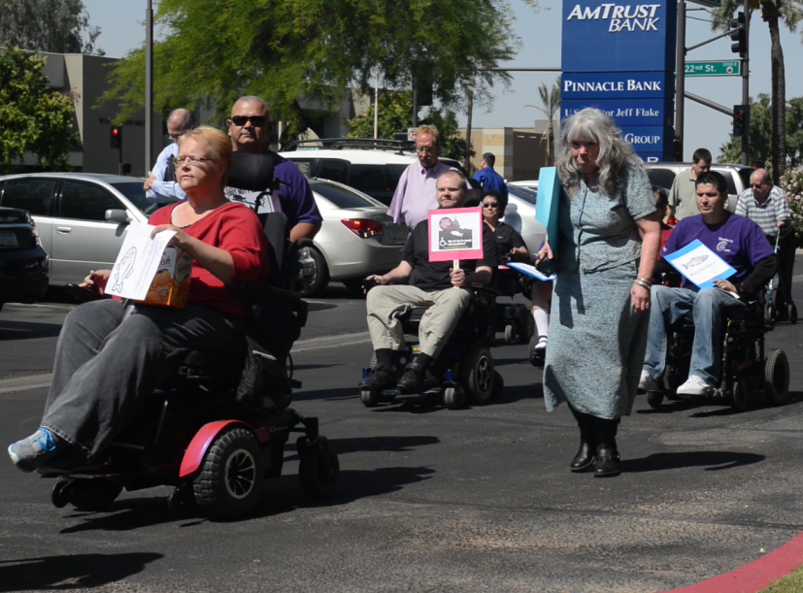
Advocating for the Convention on the Rights of Persons with Disabilities (CRPD)

Slide 48
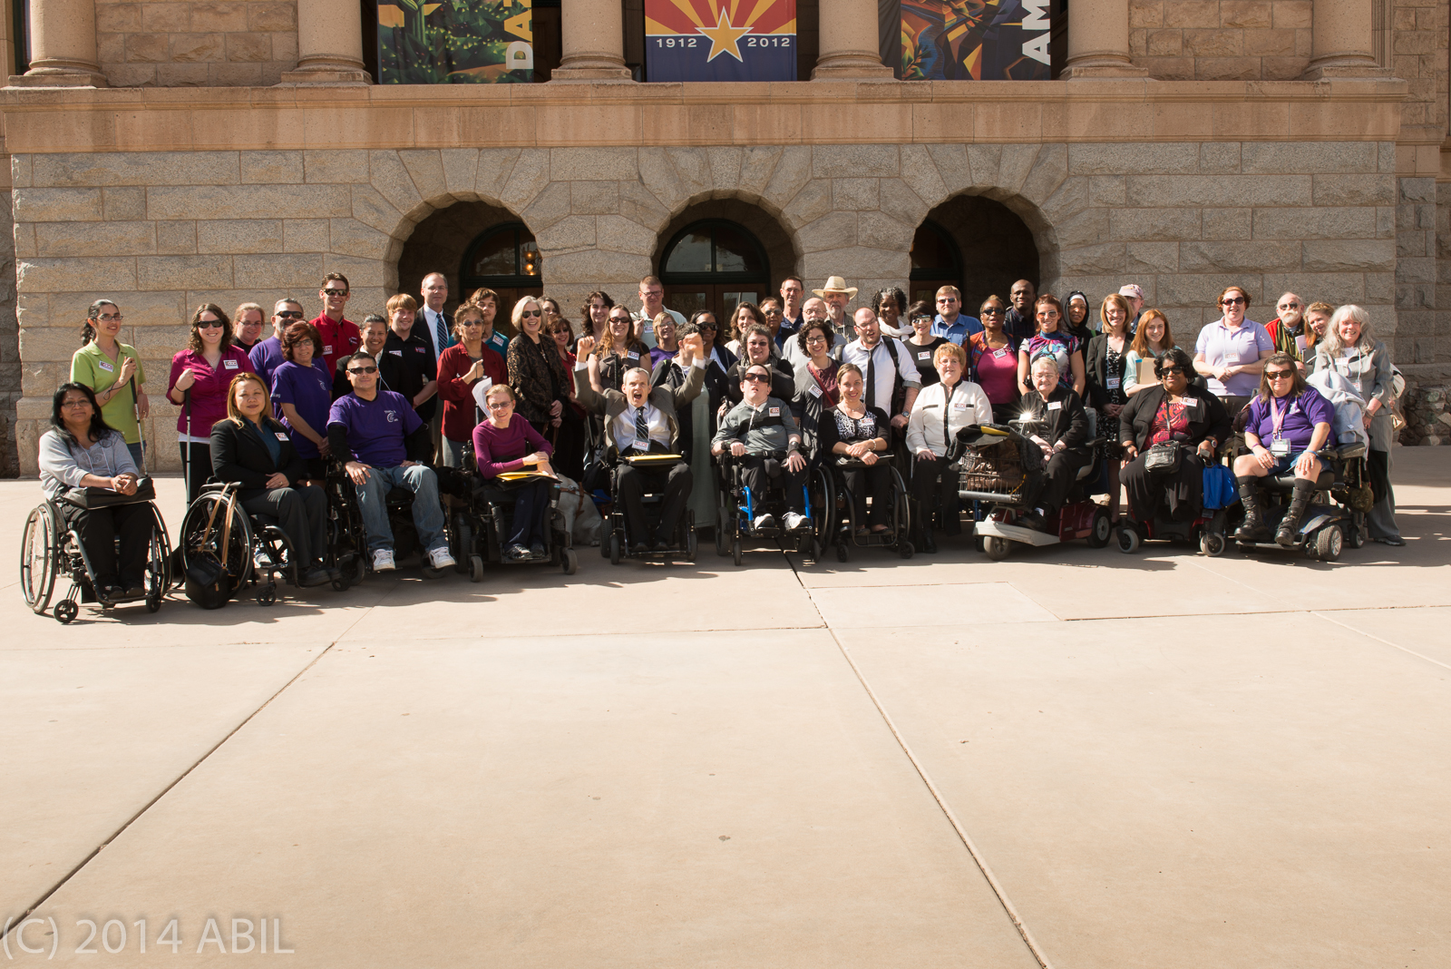
2014 Legislative Awareness Day at the Capitol

Slide 49
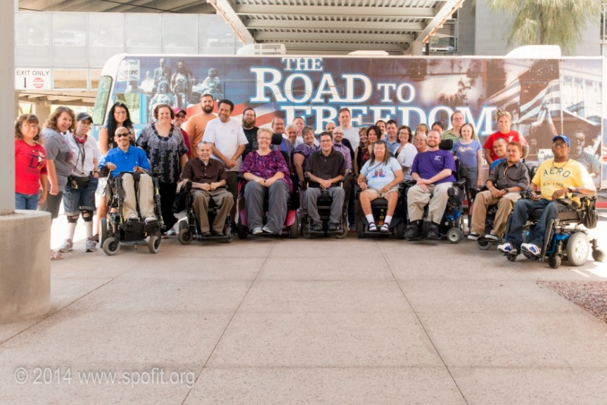
Peer Mentoring Impact on our Advocacy Efforts, cont’d.2
  Mentors have expanded their activities into―
    Legislative advocacy
    Get Out the Vote efforts
    Giving input at Community Forums
    Supporting each other on personal advocacy issues

Slide 50
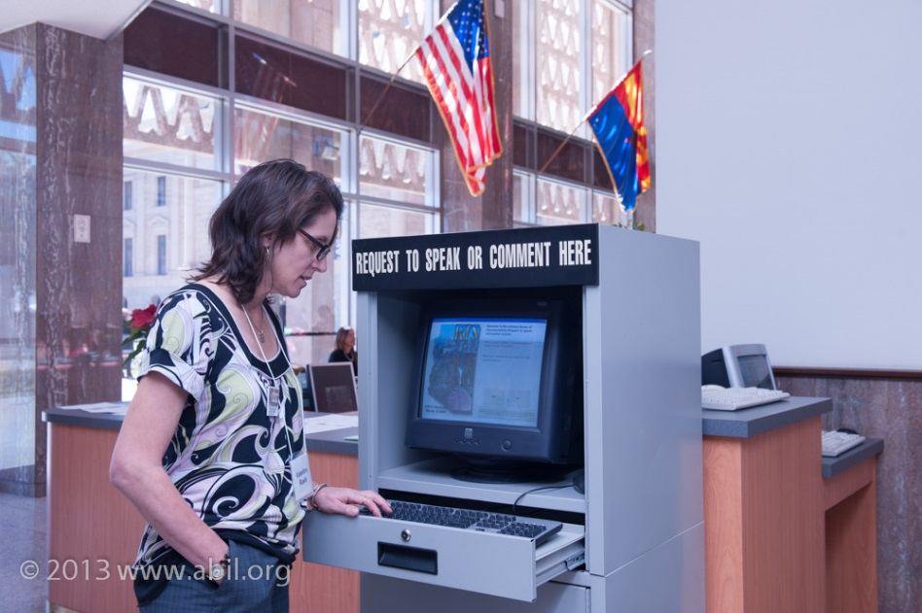
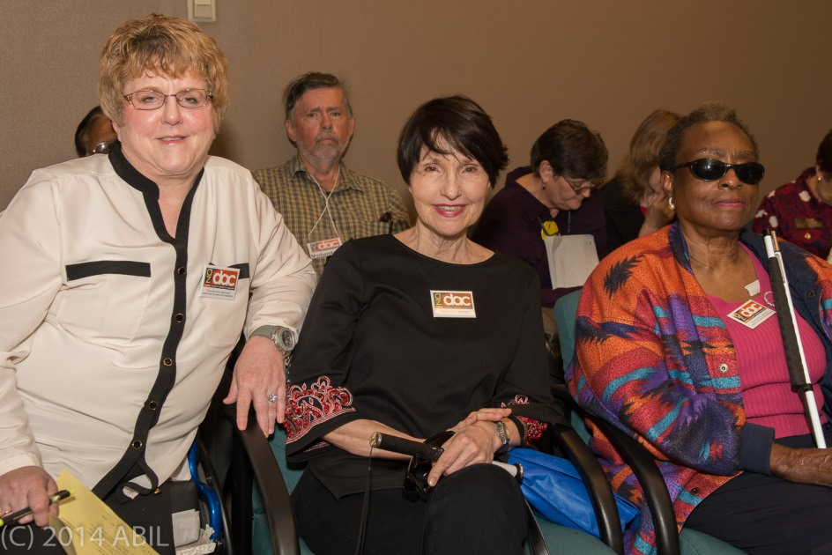
2014 Legislative Awareness Day, cont’d.

Slide 51
For more information
Contact:
  Amina Kruck – aminak@abil.org
  April Reed – AprilR@abil.org

Slide 52
CIL-NET Attribution
Support for development of this training was provided by the U.S. Department of Education, Rehabilitation Services Administration under grant number H132B120001. No official endorsement of the Department of Education should be inferred. Permission is granted for duplication of any portion of this PowerPoint presentation, providing that the following credit is given to the project: Developed as part of the CIL-NET, a project of the IL-NET, an ILRU/NCIL/APRIL National Training and Technical Assistance Program.

