Slide 1
New Community Opportunities Center at ILRU Presents…
Expanding CIL Capacity through Youth Transition Services: Collaborating with School Districts and Vocational Rehabilitation
Overview of Three Example CILs
August 12, 2014
9:30 a.m. – 10:15 a.m.
Presenters:
Amy Beck
Peter Darling
David Hancox
New Community Opportunities Center at ILRU – Independent Living Research Utilization

Slide 2
Amy Beck Lehigh Valley Center for Independent Living
New Community Opportunities Center at ILRU – Independent Living Research Utilization

Slide 3
LVCIL overview…
Founded in 1990 by Operation Overcome and Carl F. Odhner
Service Area is based in Lehigh & Northampton Counties
Staffing has more than tripled since 2008 from 11 to 37
14-15 Budget is $2,358,270, representing 17 Funders
Our active consumer base has
grown by 57% since transition
services began
Necessitating our relocation to
space 4x our current space!
New Community Opportunities Center at ILRU – Independent Living Research Utilization

Slide 4
Our consumers…
Age range
Income
Gender
Marital Status
Disability types
Veteran Status
Race/Ethnicity
New Community Opportunities Center at ILRU – Independent Living Research Utilization

Slide 5
Our Staff and Board…
Board of Directors (13-18)
Staff (37)
Executive Director
(Also a voting Member of Board)
Directors:
(4) Development, Employment Services,
Finance, Transition
Program Managers:
(2) Housing & Veterans Services, SLIRS & Waiver Services
Secondary Leaders:
(5) Support Specific Programs, provide managerial back-up
Administrative Fiscal & Clerical:
(5) Cross training is essential
Non Managerial Direct Service Staff (21)
Summer Youth Program Seasonal Staff (2)
New Community Opportunities Center at ILRU – Independent Living Research Utilization

Slide 6
LVCIL Programs Include…
Core Services
Housing Counseling/Homelessness Prevention
Supportive Services for Veterans Families
24/7 Sign language Interpreter Referral Service (FFS)
Waiver Supports Coordination
New Community Opportunities Center at ILRU – Independent Living Research Utilization

Slide 7
LVCIL Programs Continued…
S2L Transition Services
The S2L Group (FFS)
Real World Lehigh Valley (FFS)
Road to Graduation
Leadership in Schools Project
Transition Advocacy Project
Career Path Employment
Services (FFS)
LIFE School-based Services (FFS)
All LVCIL programs listed on LVCIL Fact Sheet
New Community Opportunities Center at ILRU – Independent Living Research Utilization

Slide 8
For more information: Visit Our website at www.lvcil.org
Amy Beck, Executive Director, Lehigh Valley Center for Independent Living
Office: (610) 770-9781
TTY: (610) 770-9789
Email: AmyBeck@lvcil.org
New Community Opportunities Center at ILRU – Independent Living Research Utilization

Slide 9
Peter Darling Granite State Independent Living
New Community Opportunities Center at ILRU – Independent Living Research Utilization

Slide 10
About GSIL
Founded in 1980, Granite State Independent Living (GSIL) is a statewide nonprofit organization.
Advocacy
Information
Support
Education
We are New Hampshire’s only Independent Living Center, a place to turn for resources that support and promote life with independence for people with disabilities and seniors.
New Community Opportunities Center at ILRU – Independent Living Research Utilization

Slide 11
About GSIL, cont’d.
Home Care Programs
Community-Based Support
Employment Services
With the assistance of many community partners, we assist people with tools for living life independently, so they can change their lives for the better. While much has changed over the years, one thing remains the same:
GSIL is committed to the principle of personal choice and direction.
New Community Opportunities Center at ILRU – Independent Living Research Utilization

Slide 12
GSIL Programs and Services
GSIL offers a wide array of services through a number of different program headings. We currently manage these programs/services through 2 distinct operational departments:
Community Economic
Long-Term Supports
New Community Opportunities Center at ILRU – Independent Living Research Utilization

Slide 13
GSIL Programs & Services, cont’d.
Community Economic Development (CED)
COMMUNITY-BASED
Disability Services & Support
Disability Rights & Advocacy
Home Access Modification
Information & Referrals
Transportation Services
EMPLOYMENT SERVICES
Job Placement Services
Ticket to Work Employment
Financial Planning & Benefits
ID/DD Employment Services
Student Transition Services
New Community Opportunities Center at ILRU – Independent Living Research Utilization

Slide 14
GSIL Programs & Services, cont’d. 2
Long Term Support (LTS)
HOME CARE SERVICES
Senior Care Services
Personal Care Disability Services
Support for Family, Friends & Caregivers
In-Home Rehabilitation Services
Nursing Facility Transition Services
Home Care Attendant Registry
New Hampshire Spinal Cord Injury Association – State Chapter
New Community Opportunities Center at ILRU – Independent Living Research Utilization

Slide 15
GSIL By the Numbers
Size – 7 Strategic office locations
Staffing – 97 GSIL Employees
80 Full time staff
17 Part time staff
Staffing – 820 Personal Care Attendants
Budget – $16,786,000 = GSIL Operating budget (FY14)
New Community Opportunities Center at ILRU – Independent Living Research Utilization

Slide 16
GSIL Funding Sources (FY13)
78.26% = Medicaid – Personal Care Payments
5.45% = Personal Care Fee for Service – Private Pay
5.63% = Title VII, Part C Federal Grants
1.05% = Title VII, Part B State Grant
0.84% = Contributions – Public Support & Fundraising Events
1.63% = BOND Contract – Benefit Planners
0.92% = Ticket to Work – Fee for Service
0.39% = Grants from Trusts and Foundations
1.54% = Earn and Learn Program
0.55% = Employment Program – Vocational Rehabilitation
1.32% = Area Agency Contracts – for Day Programs
2.41% = Other
New Community Opportunities Center at ILRU – Independent Living Research Utilization

Slide 17
For more information: Visit our website at www.gsil.org
Peter Darling, VP Community Economic Development Services
163 Manchester Street, Suite 3, Concord, NH 03301
Office: (603) 228-9680 (800) 826-3700
V/TTY: (888) 396-3459 pdarling@gsil.org
New Community Opportunities Center at ILRU – Independent Living Research Utilization

Slide 18
David Hancox Metropolitan Center for Independent Living
New Community Opportunities Center at ILRU – Independent Living Research Utilization

Slide 19
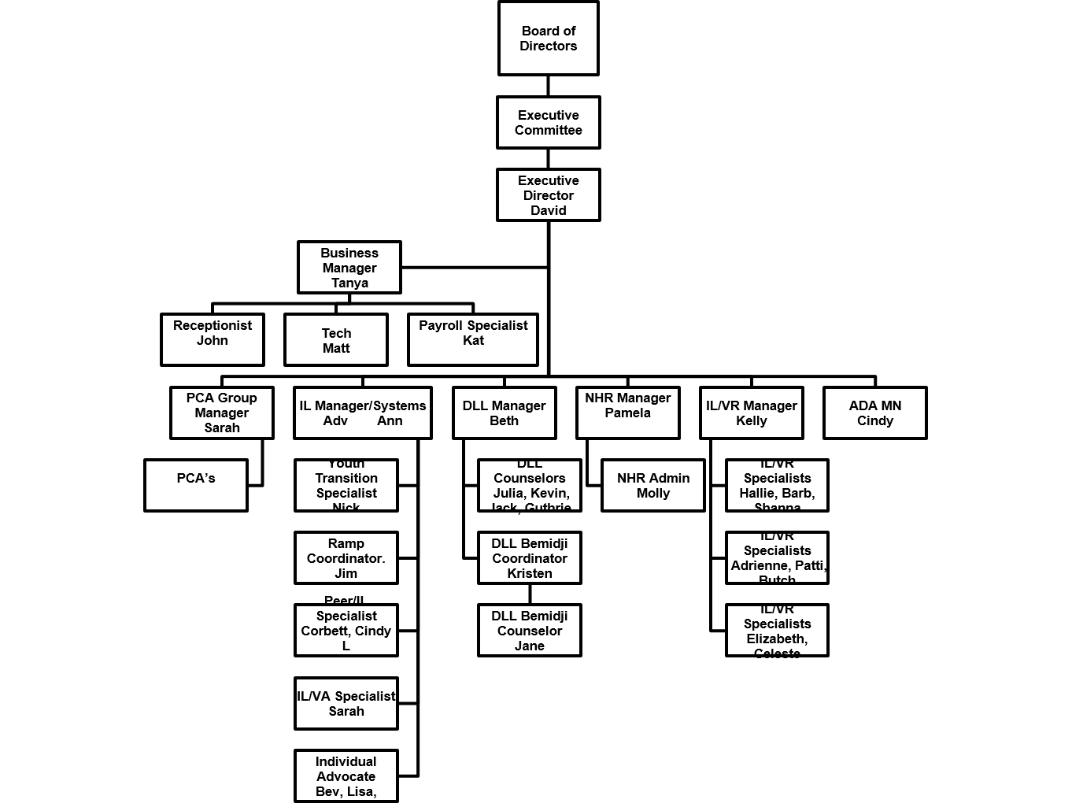
MCIL Organization Chart
New Community Opportunities Center at ILRU – Independent Living Research Utilization

Slide 20
MCIL Funding (from 2013 – 704 report)
Title VII, Ch. 1, Part B Program Funds
$21,125.00
(B) Title VII, Ch. 1, Part C
$138,544.00
(C) Title VII, Ch. 2
$0
(D) Other Federal Funds (SILC ARRA; ARRA; IL/VR Collaboration)
$623,037.00
State Government Funds
$345,901.00
New Community Opportunities Center at ILRU – Independent Living Research Utilization

Slide 21
MCIL Funding (from 2013 – 704 report), cont’d.
Local Government Funds
$0
Foundations, Corporations, or Trust Grants
$0
Donations from Individuals
$2,113.00
Membership Fees
$0
New Community Opportunities Center at ILRU – Independent Living Research Utilization

Slide 22
MCIL Funding (from 2013 – 704 report), cont’d. 2
Investment Income/Endowment
$1,322.00
Fees for Service (program income, etc.) (PCA, NHR, DLL)
$3,361,461.00
Other resources (in-kind, fundraising, etc.)
$5,432.00
New Community Opportunities Center at ILRU – Independent Living Research Utilization

Slide 23
MCIL Funding (from 2013 – 704 report), cont’d. 3
Total income = (A)+(B)+(C)+(D)+(E)+(F)+(G)+(H)+(I)+(J)+(K)+(L)
= $4,498,935.00
Amount of other government funds received as pass through funds to consumers (include funds, received on behalf of consumers, that are subsequently passed on to consumers, e.g., personal assistance services, representative payee funds, or Medicaid funds)
= $2,160,645.00
Total Income (Section 4) <minus> amount paid out to Consumers (Section 5) = Net Operating Resources
= $2,338,290
New Community Opportunities Center at ILRU – Independent Living Research Utilization

Slide 24
MCIL Staffing
37 program staff
4 Administrative Staff
9 Core Services Staff (includes 2 Youth Tran.)
10 Disability Linkage Line Staff
9 IL/VR Program Staff
4 Nursing Home Coordination Relocation Staff
1 ADA Specialist Staff
250 PCAs
New Community Opportunities Center at ILRU – Independent Living Research Utilization

Slide 25
MCIL Programs
IL Skills Education
Peer Mentorship
Systems Advocacy
Individual Advocacy
Information, Referral and Assistance (DLL)
Ramp/Home Modifications
Youth Transition
IL/VR Collaboration
Nursing Home Relocation Coordination
Veteran’s Services (Ramp and Mentorship)
PCA Services
ADA Technical Assistance and Education
New Community Opportunities Center at ILRU – Independent Living Research Utilization

Slide 26
MCIL Service Delivery Total―43,517
Advocacy/Legal Services (237)
Assistive Technology (5)
Communication Services (1)
Counseling & Related Services (11)
Housing, Home Mod, & Shelter (167)
IL Skills and Life Skills (778)
I & R and Assistance (33,801)
Peer Counseling (165)
Mobility Training (3)
Personal Assistance Services (112)
Transportation Services (7)
Youth Services (490)
Vocational Services (1100)
Recreational Services (12)
Nursing Home Relocation (218)
Other Services (279)
Family Services (0)
Mental restoration (2)
New Community Opportunities Center at ILRU – Independent Living Research Utilization

Slide 27
For more information: Visit our website at www.mcil-mn.org
David Hancox, Executive Director, Metropolitan Center for Independent Living
530 North Robert Street
St. Paul, Minnesota 55101
Office: (651) 603-2012 voice/fax
TTY: (651) 603-2001
E-mail: davidh@mcil-mn.org
New Community Opportunities Center at ILRU – Independent Living Research Utilization

Slide 28
Slide 17 New Community Opportunities Attribution
This training is presented by the New Community Opportunities Center, a national training and technical assistance project of ILRU, Independent Living Research Utilization. Support for development of this presentation was provided by the U.S. Department of Education, Rehabilitation Services Administration under grant number H400B100003. No official endorsement of the Department of Education should be inferred. Permission is granted for duplication of any portion of this slide presentation, providing that the following credit is given to the project: Developed as part of the New Community Opportunities Center at ILRU.
New Community Opportunities Center at ILRU – Independent Living Research Utilization

