Slide 1
New Community Opportunities Center at ILRU Presents…
Expanding CIL Capacity through Youth Transition Services: Collaborating with School Districts and Vocational Rehabilitation
How the 3 Centers are Involved with Vocational Rehabilitation and School Districts, cont’d.
August 12, 2014
3:15 p.m.–4:30 p.m.
Presenters:
David Hancox
Abbie Wells-Herzog
New Community Opportunities Center at ILRU – Independent Living Research Utilization

Slide 2
VR/IL Project – Impetus
Vocational Rehabilitation Services and the Minnesota Association of Centers for Independent Living agreed to develop a substantial collaboration between Centers and VRS.
New Community Opportunities Center at ILRU – Independent Living Research Utilization
2

Slide 3
VR/IL Project – Vision
  To build local service capacity in mutual partnership to advance the employment and independent living of Minnesotans who require both vocational rehabilitation and independent living to achieve their goals for working and living in the community.
New Community Opportunities Center at ILRU – Independent Living Research Utilization
3

Slide 4
VR/IL Project – History
Statewide planning meeting occurred in 2007 between VRS staff and Center staff to identify statewide issues and unmet needs that could be addressed through collaboration
Continued dialogue and exploration resulted in the submission of eight unique collaborative proposals
Each collaborative proposal was defined by local needs and approved by both VRS and IL staff
New Community Opportunities Center at ILRU – Independent Living Research Utilization
4

Slide 5
How it Works
IL needs are assessed during intake process, simultaneous to the consumer’s VR needs.
Services occur simultaneously, in a parallel fashion.
Progress and outcomes are reported in Workforce 1; an internal data base.
Frequent and regular communication is critical between the IL Specialist and VR Counselor to ensure appropriate progress and reporting.
Critical piece is the co-location, creating immediacy of availability. MCIL staff are embedded at the workforce centers—an integral part of that team.
New Community Opportunities Center at ILRU – Independent Living Research Utilization
5

Slide 6
VR/IL Project – Funding
Request for proposal process (RFP)
VRS/Social Security Program Income
Initially a three-year period
Funding was defined by local needs, rather than a prescribed dollar amount
New Community Opportunities Center at ILRU – Independent Living Research Utilization
6

Slide 7
First Three Years
Time-limited demonstration project
Future of the collaboration depends on the success of local projects and impact on employment
Collaborators were given considerable latitude to define the scope of services
A wide variety of services and service models were submitted
New Community Opportunities Center at ILRU – Independent Living Research Utilization
7

Slide 8
Year 4 (Change and Challenge)
Decline in program income
Looming state budget crisis
Refocusing the collaboration
Funding for 9-month projects
Targeting VRS consumers
Emphasis on co-location
New Community Opportunities Center at ILRU – Independent Living Research Utilization
8

Slide 9
Year 5 (Uncertainty to Stability)
Funding becomes available to continue all eight collaborations
Continued co-location model and services to VRS consumers
Impact and effectiveness of collaboration becomes apparent in increased employment outcomes
VRS and IL staff recognize collaboration as both helpful and essential
Key legislators see positive impact on customer success and support continuing the collaboration
New Community Opportunities Center at ILRU – Independent Living Research Utilization
9

Slide 10
Year 6 and Today
Eight locally developed collaborations exist
Co-location or alternative co-location models are part of every collaboration
Tracking and reporting systems in place
Data is collected on a quarterly basis
Evaluation and monitoring is conducted annually
New Community Opportunities Center at ILRU – Independent Living Research Utilization
10

Slide 11
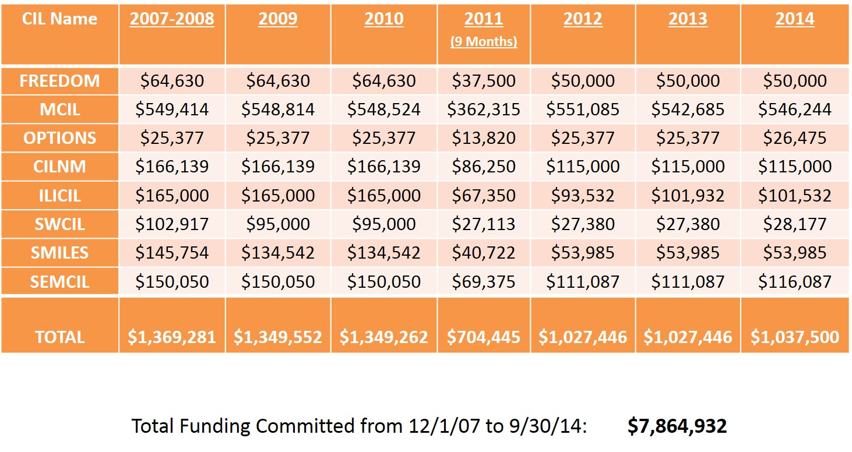
Funding History
New Community Opportunities Center at ILRU – Independent Living Research Utilization

Slide 12
Tracking IL Services and Outcomes
During demonstration phase (2008-2010) VRS and Centers did not share a common reporting system that could dependably track services and outcomes.
Quarterly reports from Centers and the experience of VRS counselors suggested a positive impact on consumers – but no hard data.
In 2011 VRS and Centers implemented a concurrent reporting system that showed potential impact of the collaboration on increasing employment outcomes.
New Community Opportunities Center at ILRU – Independent Living Research Utilization
12

Slide 13
VR/IL Project – Example Services
School-to-work transitions
Pre-employment preparation
Persons with MI, ASD, Veterans
Employment-related ADA issues
Non-vocational skills necessary for successful employment (soft-skills)
Housing
Bus Training
Connecting to other resources: County, housing, SSA, health care, social services, applications for state ID, SS cards
New Community Opportunities Center at ILRU – Independent Living Research Utilization
13

Slide 14

Success Story Jordan Feldick
New Community Opportunities Center at ILRU – Independent Living Research Utilization
14

Slide 15
Consumers Exiting After Receiving
VR and IL Services
FFY | Consumers with an IPE | Exiting With Employment Outcomes | Exiting Without Employment | Employment Rate | Employment Rate for all Other Consumers
2011 | 118 | 83 | 35 | 70.3% | 61.0%
2012 | 443 | 276 | 167 | 62.3% | 56.1%
2013 | 618 | 411 | 207 | 66.5% | 58.5%
Totals | 1,179 | 770 | 409 | 65.3% | 58.8%
New Community Opportunities Center at ILRU – Independent Living Research Utilization
15

Slide 16
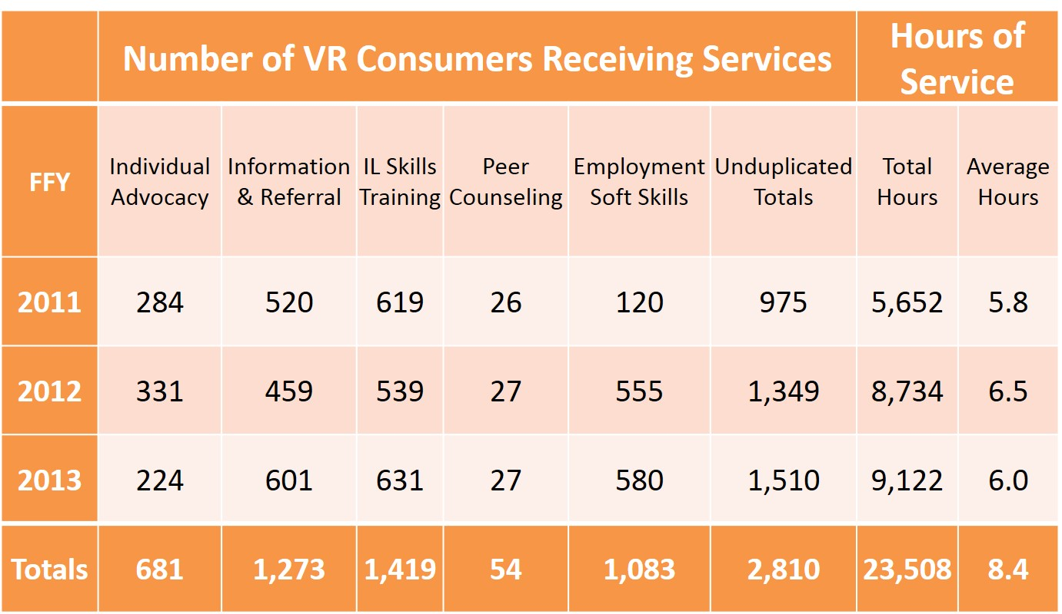
VR/IL Collaboration Summary of Services (January 1, 2011 - September 30, 2013)
New Community Opportunities Center at ILRU – Independent Living Research Utilization
16

Slide 17
VRS/IL Project – Survey Results
1. Responses to the survey of VRS staff are an accurate reflection of VRS staff perception.
All field staff received the survey and a sufficient proportion responded to allow a generalization of all VRS staff. A moderate to high response proportion (76%) of VRS staff responded, with almost equal distribution across the different categories of staff positions.
New Community Opportunities Center at ILRU – Independent Living Research Utilization
17

Slide 18
VRS/IL Project – Survey Results, cont’d.
VRS staff had a positive perception of the Collaboration.
Overall Success: About 90% of VRS staff indicated that they Strongly Agree or Agree that collaboration was ‘successful’. This perception was reflected across all categories of VRS staff positions, & did not differ for direct (counselor, VR Tech) or indirect (manager, supervisor) involvement in the Collaboration by VRS staff.
Communication And Coordination: On the six survey items assessing communication and coordination in the collaboration, at least 70% of VRS staff responded that Almost Always or Often good communication or coordination occurred.
New Community Opportunities Center at ILRU – Independent Living Research Utilization
18

Slide 19
VRS/IL Project – Survey Results, cont’d. 2
VRS staff had a positive perception of the Collaboration continued
Consumer/Staff Benefits: An average of 90% of VRS staff indicated that Almost Always or Often, their knowledge of IL increased and that consumers benefitted, including being better prepared to address vocational goals.
New Community Opportunities Center at ILRU – Independent Living Research Utilization
19

Slide 20
VRS/IL Project – Survey Results, cont’d. 3
3. VRS staff who experienced co-location of CIL staff were more likely to have a positive perception of the collaboration.
Although high percentage of all VRS staff indicated satisfaction with collaboration and perceived it to be successful, comparison between those where there was co-location of CIL staff with those not experiencing co-location exposed meaningful differences.
VRS staff experiencing co-location were almost unanimous (99%) that Almost Always or Often, they perceived that consumers and VRS staff benefitted from the Collaboration.
VRS staff experiencing co-location felt that, Almost Always or Often: Consumers were more likely to discover services of which previously unaware.
New Community Opportunities Center at ILRU – Independent Living Research Utilization
20

Slide 21
VRS/IL Project – Summary
Purpose
  Advance the employment and independent
  living of Minnesotans who require both
  VR and IL to achieve employment, independent
  living and community integration
Funding
  VRS program income funds
Past efforts
  Yes they have been tried and tried. We learned, and now we’re back with a better collaborative and invested plan
New Community Opportunities Center at ILRU – Independent Living Research Utilization
21

Slide 22
VRS/IL Project – Summary, cont’d.
Service needs
  Transition-age, pre-employment, ADA issues, soft skills
Target population
  DEED VRS consumers
Service delivery
  Staff co-located in VRS offices and/or readily available on a regular basis
  From 2011 to 2013—2,810 VR consumers received IL services in the collaboration. A total of 23,508 hours of service was provided.
New Community Opportunities Center at ILRU – Independent Living Research Utilization
22

Slide 23
A True Collaboration
This is collaboration, not a competition.
New Community Opportunities Center at ILRU – Independent Living Research Utilization
23

Slide 24
Living into Vision of Rehab Act
Rehabilitation Act of 1973, as amended. Sec. 2(a)(4) and Sec.2 (a)(6)
Congress finds that—increased employment of individuals with disabilities can be achieved through implementation of…activities carried out under the vocational rehabilitation program established under title I, and through the provision of independent living services, support services, and meaningful opportunities for employment in integrated work settings…
Congress finds that—the goals of the Nation properly include the goal of providing individuals with disabilities with the tools necessary to—
    (A) make informed choices and decisions; and
    (B) achieve equality of opportunity, full inclusion and integration in society, employment, independent living, and economic and social self-sufficiency. . .
New Community Opportunities Center at ILRU – Independent Living Research Utilization
24

Slide 25

Success Story: Matthew Collins
New Community Opportunities Center at ILRU – Independent Living Research Utilization
25

Slide 26
Contact
David Hancox
davidh@mcil-mn.org
Abbie Wells-Herzog
Minnesota Department of Employment/Economic Development
abbie.wells.herzog@state.mn.us
New Community Opportunities Center at ILRU – Independent Living Research Utilization
26

Slide 27
Slide 17 New Community Opportunities
Attribution
This training is presented by the New Community Opportunities Center, a national training and technical assistance project of ILRU, Independent Living Research Utilization. Support for development of this presentation was provided by the U.S. Department of Education, Rehabilitation Services Administration under grant number H400B100003. No official endorsement of the Department of Education should be inferred. Permission is granted for duplication of any portion of this slide presentation, providing that the following credit is given to the project: Developed as part of the New Community Opportunities Center at ILRU.
New Community Opportunities Center at ILRU – Independent Living Research Utilization
27

