Slide 1
New Community Opportunities Center at ILRU Presents…
Expanding CIL Capacity through Youth Transition Services: Collaborating with School Districts and Vocational Rehabilitation
Transitioning from Grant Funding to Fees-for-Service
August 14, 2014
9:15 a.m. – 10:30 a.m.
Presenters:
Amy Beck & Cara Steidel
Peter Darling & Maureen O’Donnell
David Hancox
New Community Opportunities Center at ILRU – Independent Living Research Utilization

Slide 2
Amy Beck & Cara Steidel Lehigh Valley Center for Independent Living
New Community Opportunities Center at ILRU – Independent Living Research Utilization

Slide 3
LVCIL’s Journey from Grant ONLY funding to FFS
How did we analyze our capacity to make the change?
LVCIL Board wanted less reliance on grants
Sign Language Interpreter Referral Service – had community buy-in
Needs, both LVCIL & community needs drove us to it
A start-up grant made the difference
ALL of this was because of our long standing relationship with OVR
On some levels, we were not prepared
Had 2-year, start-up grant
New Community Opportunities Center at ILRU – Independent Living Research Utilization
3

Slide 4
Transition to Fee for Service Ventures
How it all started…
Took 2 attempts to get a grant, but we persevered
Original 4-year DDC project gave us space and time to think and plan
Allowed us to build connections, locale, regional and statewide
Momentum came from consumers and their families
Saw the myriad of needs
Community believed in us, and reinforced the vast need for services
New Community Opportunities Center at ILRU – Independent Living Research Utilization
4

Slide 5
Developing the FFS Employment Services
OVR Innovation & Expansion Grant – began in 2011
We knew we could do it better!
The IL Philosophy
Person Centered Approach
CIL environment
Open communication with OVR
Added the Skills Group element
Hired the right people!
New Community Opportunities Center at ILRU – Independent Living Research Utilization
5

Slide 6
How did LVCIL start other FFS Transition Services?
We were planning a Transition House
The community wanted a community-based service, not a house
The right Board member dropped our name
We were used by some, but led to great growth for participants
And we also started Waiver Services….
What has the impact been?
New Community Opportunities Center at ILRU – Independent Living Research Utilization
6

Slide 7
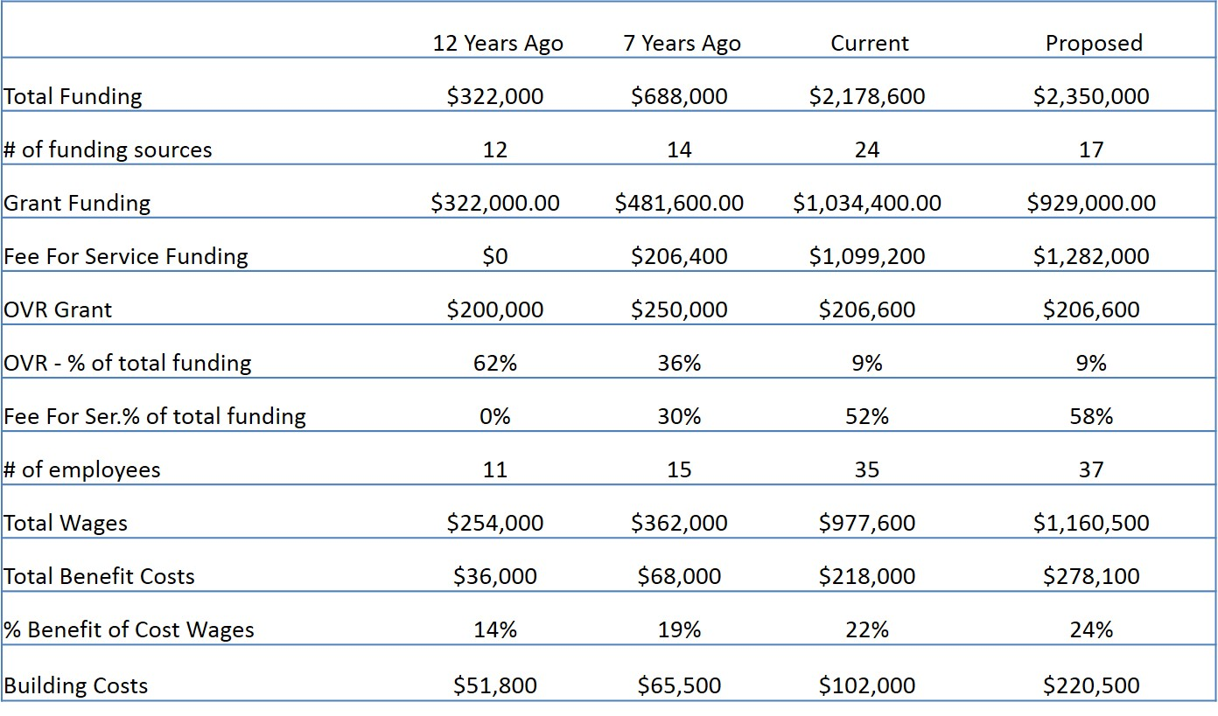
Examination of how transition changed LVCIL
New Community Opportunities Center at ILRU – Independent Living Research Utilization
7

Slide 8
How do we plan to support our operations?
Intentional Smart Growth!
Managerial Strategy Sessions (Sometimes during hurricanes…)
LVCIL Main Frame Process
Asking the Hard Questions!
Organizational revisions
Hold every opportunity up against our mission
Our Board had to transition
New Community Opportunities Center at ILRU – Independent Living Research Utilization
8

Slide 9
The Truth About Growing FFS and LVCIL
Everything changed
Change is not easy for everyone
Many staff roles evolved, including the ED
New procedures, requirements, policies and worries
Clearances
Daily procedures
Staffing Plan A, B & C
Greater need for Admin Support to Manage 35+ employees’ needs
Higher level of risk, higher scrutiny – check your insurance!
New Community Opportunities Center at ILRU – Independent Living Research Utilization
9

Slide 10
LVCIL Assets Which Made Our Growth Possible
Our ED and Board were not afraid of change
Excellent Director of Finance & Board Treasurer
Inherent belief we could provide better services
Our Person-Centered Approach
Open Communication
Open Door Policy
New Community Opportunities Center at ILRU – Independent Living Research Utilization
10

Slide 11
How does LVCIL stay in the Role of Advocate?
It can be challenging!
Sign Language Interpreter Referral Service Example
Keeping some distance between our roles and staff functions
If there is a conflict, be forthright about it
Find another advocate if needed
Open communication with OVR, and all funders
New Community Opportunities Center at ILRU – Independent Living Research Utilization
11

Slide 12
Contact
Amy Beck, Executive Director
Email: AmyBeck@lvcil.org
Cara Steidel, Director of Finance
CaraSteidel@lvcil.org
Lehigh Valley Center for Independent Living
Office: (610) 770-9781
TTY: (610) 770-9789
New Community Opportunities Center at ILRU – Independent Living Research Utilization
12

Slide 13
Peter Darling Maureen O’Donnell Granite State Center for Independent Living
New Community Opportunities Center at ILRU – Independent Living Research Utilization

Slide 14
How did GSIL analyze its capacity to move beyond grant to contracts/fee for service?
The “CORE ELEMENTS” really focused GSIL staff and the entire program.
The “ADVISORY GROUP” (which existed for a full year prior to moving from grant funding) focused on the elements at each meeting at their monthly meetings.
New Community Opportunities Center at ILRU – Independent Living Research Utilization

Slide 15
What planning process did GSIL go through?
All aspects and implications of operating Earn & Learn as a post grant program had to be considered.
The board of GSIL was fully aware and signed off on all grant funding prior to the acceptance of funds.
Our finance department assisted in our assessment of the real Earn & Learn costs and was active in helping to develop rates for each of our funding partners – school district and NHVR.
Staff roles and responsibilities were clearly identified and job titles and descriptions changed.
New Community Opportunities Center at ILRU – Independent Living Research Utilization

Slide 16
What assets did GSIL bring to the table in establishing fees for service?
GSIL brought a long history of working in a fee for service environment, especially with NHVR.
GSIL has experience in identifying program value to its customers as well as the delivery of high impact outcomes.
GSIL has a long history and deep commitment of working collaboratively.
New Community Opportunities Center at ILRU – Independent Living Research Utilization

Slide 17
How did charging for services affect the CIL’s role as advocate?
GSIL has found that the Earn & Learn program philosophy (self-efficacy), their treatment of the students and the weaving of “soft skills” training throughout all activities has been very powerful and empowering for students. This has helped make them better self-advocates and prepared them to live more productive and independent lives.
Perhaps our biggest weakness/regret is not having the ability to individualize the course offerings of each student.
New Community Opportunities Center at ILRU – Independent Living Research Utilization

Slide 18
Contact
Peter Darling - pdarling@gsil.org
Maureen O’Donnell - modonnell@gsil.org
Granite State Independent Living
Office: (603) 228-9680 (800) 826-3700
V/TTY: (888) 396-3459
New Community Opportunities Center at ILRU – Independent Living Research Utilization

Slide 19
David Hancox Metropolitan Center for Independent Living
New Community Opportunities Center at ILRU – Independent Living Research Utilization

Slide 20
What planning process did MCIL go through?
Examination of gaps in transition services.
Early identification of Youth Transition as an emerging issue.
Exploitation of long-term relationships at MN DOE, ISDs and U of M. This lead to discussions on how best to pursue these needs in a collaborative fashion.
Organizational commitment to preparing the next generation for leadership and participatory roles in the community.
New Community Opportunities Center at ILRU – Independent Living Research Utilization

Slide 21
How did MCIL move from grant to fee-for-service model?
Long term relationship building with MN DOE, and MN ISDs.
Addition of Transition Services to our core service mix, with state funding support. (In legislative year 1994, the Minnesota Senate Education Finance Committee allocated $250K, with the requirement that the funds be transferred to VR. Beginning in SFY 1995-96, the $250K was included in our core service allocation, providing a safe base to begin a move from grant to fee-for service model.)
Demonstration of MCIL’s value through special grant collaborations, presentation of student survey data, and creation/presentation of supportive curriculum.
New Community Opportunities Center at ILRU – Independent Living Research Utilization

Slide 22
MCIL Assets Which Made Our Change to Fee-for-Service Possible
Qualified staff
Non threatening attitude, i.e. we consistently present ourselves as a resource or asset, not as outside entity coming in to judge or change their program.
Flexibility
Access to national resources
An ability to demonstrate that we are value added, and “indispensable”
New Community Opportunities Center at ILRU – Independent Living Research Utilization

Slide 23
How does MICL stay in the Role of Advocate?
Consistent representation of the consumer and his/her interests—even explaining to the parents, at times, that we are not their advocate.
Consistently demonstrating the IL philosophy via our person-centered approach.
Assuring, via gentle reminders, that all discussion and decision include the consumer and his/her opinion. “Nothing about us, without us.”
Keep it simple….again, a non threatening approach.
New Community Opportunities Center at ILRU – Independent Living Research Utilization

Slide 24
Contact
David Hancox - davidh@mcil-mn.org
Metropolitan Center for Independent Living
Office: (651) 603-2012 voice/fax
TTY: (651) 603-2001
New Community Opportunities Center at ILRU – Independent Living Research Utilization

Slide 25
Slide 17 New Community Opportunities Attribution
This training is presented by the New Community Opportunities Center, a national training and technical assistance project of ILRU, Independent Living Research Utilization. Support for development of this presentation was provided by the U.S. Department of Education, Rehabilitation Services Administration under grant number H400B100003. No official endorsement of the Department of Education should be inferred. Permission is granted for duplication of any portion of this slide presentation, providing that the following credit is given to the project: Developed as part of the New Community Opportunities Center at ILRU.
New Community Opportunities Center at ILRU – Independent Living Research Utilization

