Slide 1
New Community Opportunities Center at ILRU Presents…
Expanding CIL Capacity through Youth Transition Services: Collaborating with School Districts and Vocational Rehabilitation
Analyzing Costs and Setting Rates for Services
August 14, 2014
10:45 a.m. – 12:00 p.m.
Presenter:
Cara Steidel
New Community Opportunities Center at ILRU – Independent Living Research Utilization

Slide 2
Analyze Costs and Set Rates for Service
Setting rates for service is a collaborative effort between executive, program, and finance directors.
New Community Opportunities Center at ILRU – Independent Living Research Utilization
2

Slide 3
Think Ahead
Start thinking FFS on Day 1 of the Grant Period
Research and become aware of:
  Similar programs in the community
  Prevalent rate for the service
  The uniqueness of your program
  Things you would do differently now that you have actual experience
New Community Opportunities Center at ILRU – Independent Living Research Utilization
3

Slide 4
Look at Numbers
Converting plans, ideas and assumptions to numbers
Use the grant budget as the starting point
Revise the grant budget based on actual experience
Make intelligent assumptions
New Community Opportunities Center at ILRU – Independent Living Research Utilization
4

Slide 5
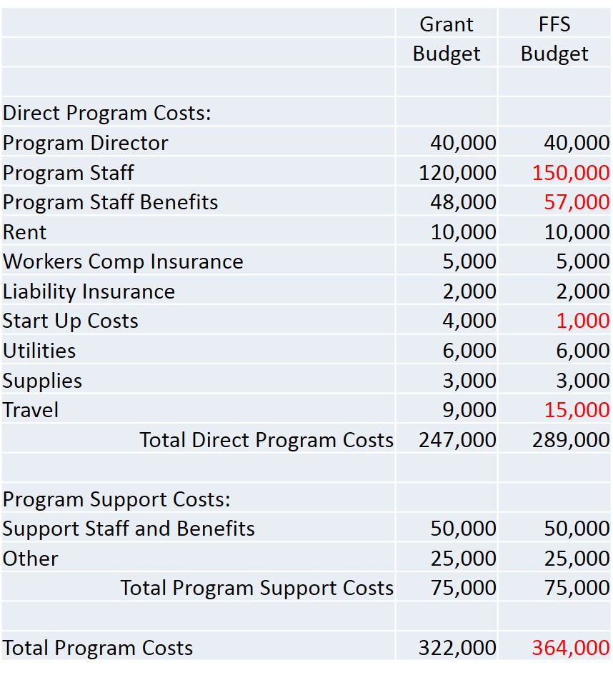
Use Grant Budget as Starting Point
5

Slide 6
Analyze Minimum Costs
Determine the minimum costs of the program
6

Slide 7
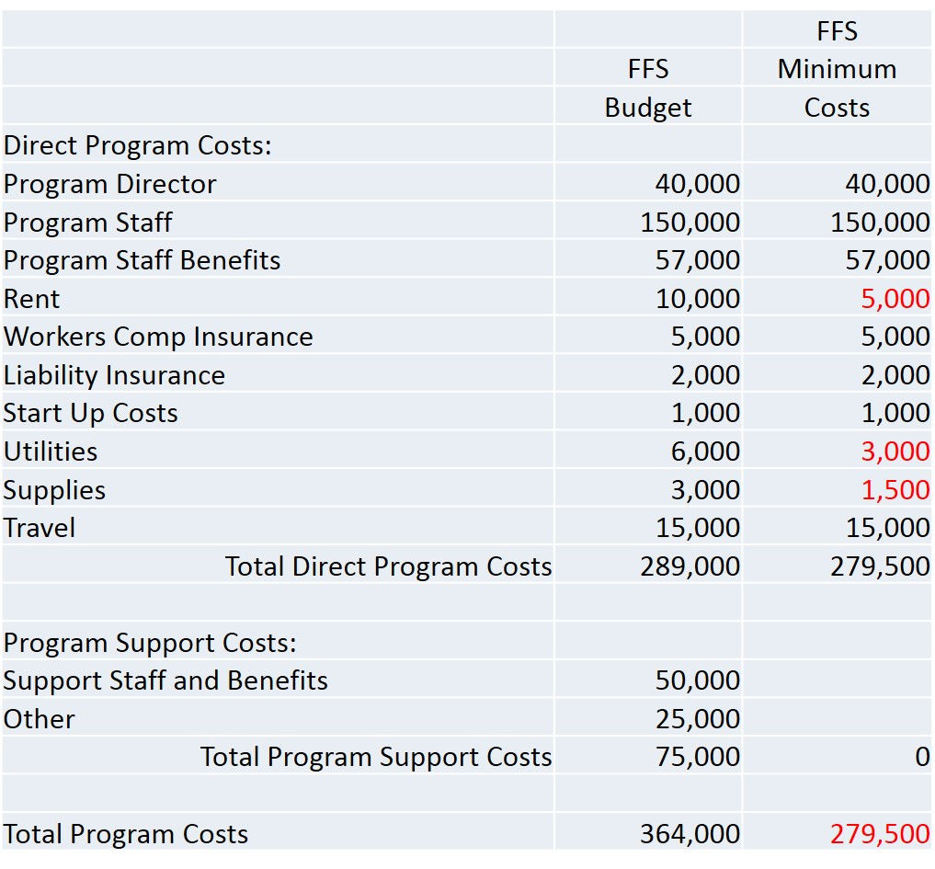
Make Projections for FFS Budget
7

Slide 8
Convert to Billable Hours
Calculate available billable hours
8

Slide 9
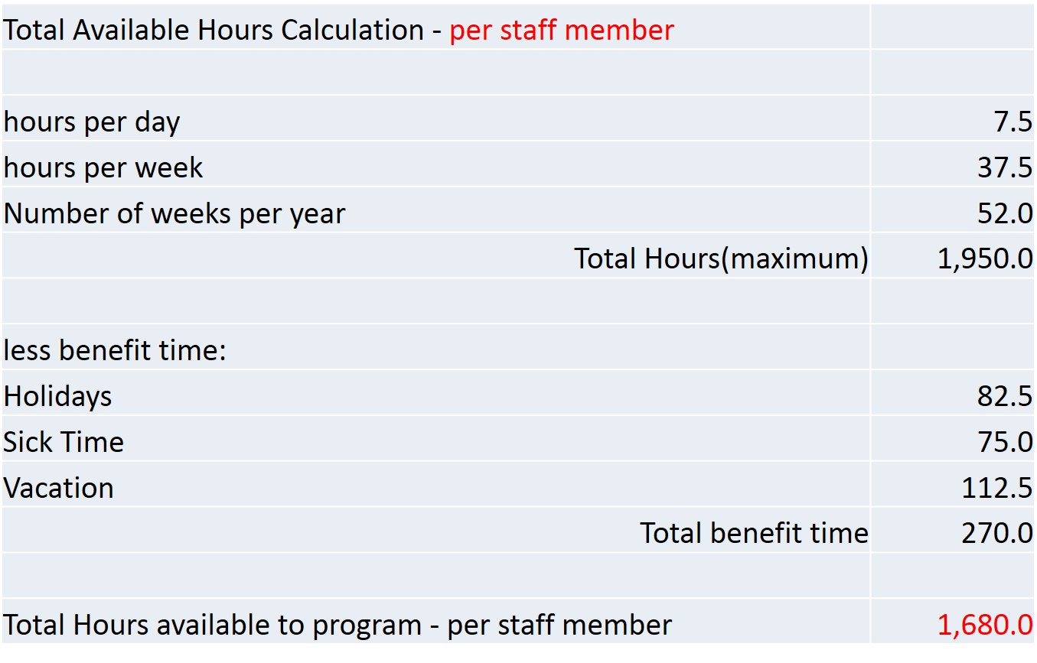
Do Calculations
9

Slide 10
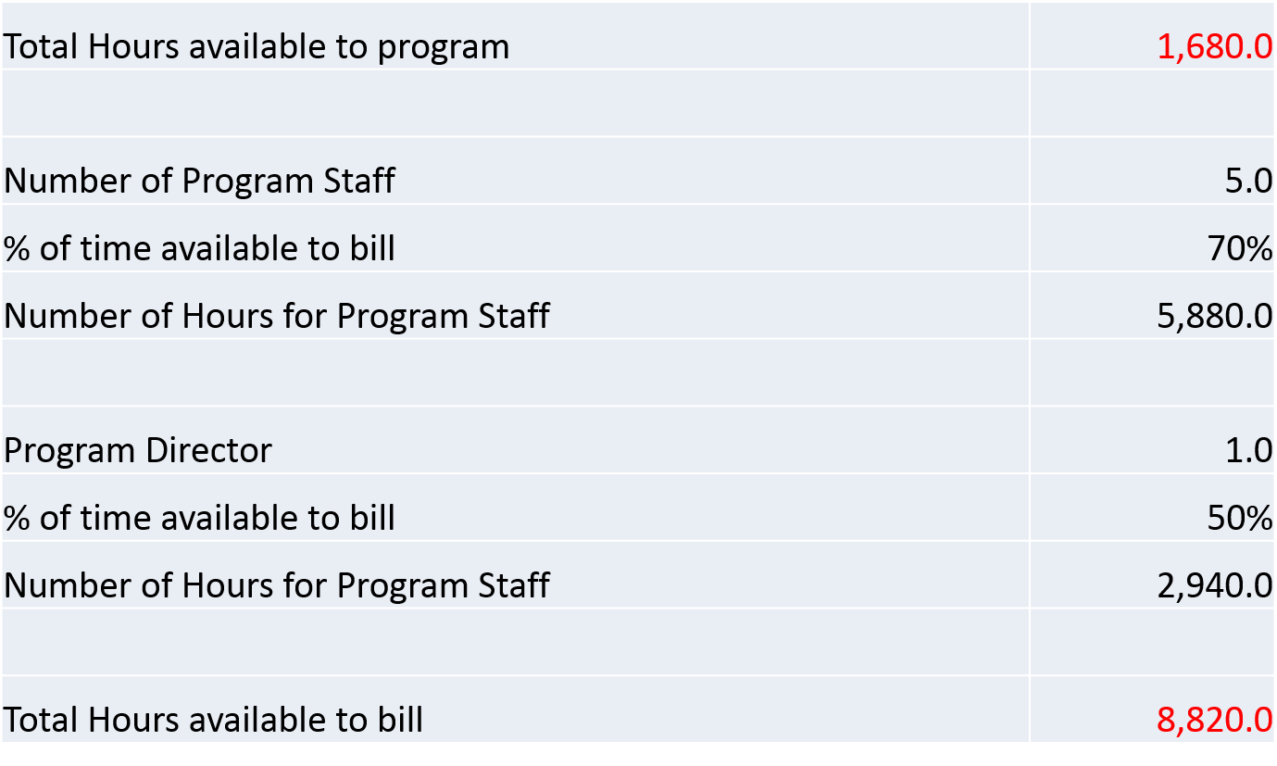
Do Calculations, cont’d.
10

Slide 11
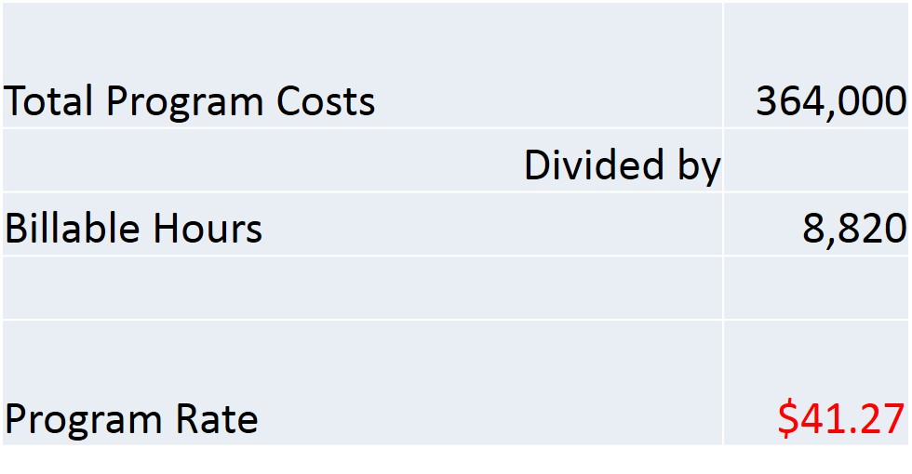
Determine Program Billable Rate
11

Slide 12
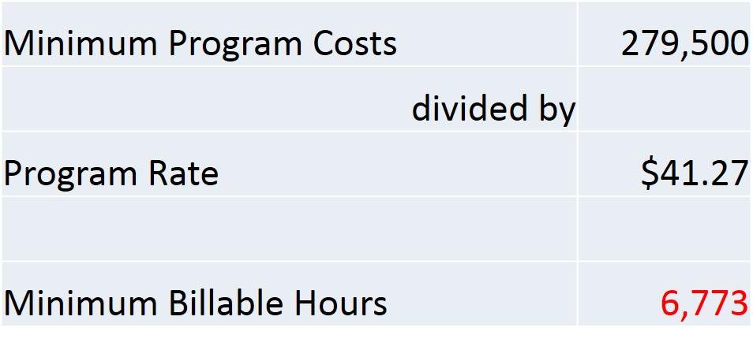
Calculate Required Minimum Billable Hours
12

Slide 13
Monitor Cash Flow & Collections
Cash Flow considerations
  Line of Credit
  Type of customer that will utilize services
Collections
  Establish policy before providing service
  What is the customers cash source?
  Plan on having bad debts
13

Slide 14
Contact
Cara Steidel – Director of Finance
CaraSteidel@lvcil.org
Lehigh Valley Center for Independent Living
Office: (610) 770-9781
TTY: (610) 770-9789
New Community Opportunities Center at ILRU – Independent Living Research Utilization
14

Slide 15
Slide 17 New Community Opportunities
Attribution
This training is presented by the New Community Opportunities Center, a national training and technical assistance project of ILRU, Independent Living Research Utilization. Support for development of this presentation was provided by the U.S. Department of Education, Rehabilitation Services Administration under grant number H400B100003. No official endorsement of the Department of Education should be inferred. Permission is granted for duplication of any portion of this slide presentation, providing that the following credit is given to the project: Developed as part of the New Community Opportunities Center at ILRU.
New Community Opportunities Center at ILRU – Independent Living Research Utilization

