Slide 1

Independent Living Research Utilization

Slide 2
Introduction to Intersectionality
Keri Gray

Slide 3
Framing Today’s Dialogue
Inclusion as a value not as a profit
Inequities
Intersectionality

Slide 4
Three questions
How do I practice disability inclusion through a framework of intersectionality?
What is the status quo?
What are best practices in enhancing our CILs’ diversity and inclusion efforts?

Slide 5
Defining Intersectionality
Intersectionality is a framework that describes how people with multiple marginalized identities experience discrimination and violence.
Intersectionality refers to the interconnected nature of race, gender, sexual orientation, etc. with disability.
Identity politics generates violence in movements, social justice spaces, and D&I initiatives.

Slide 6
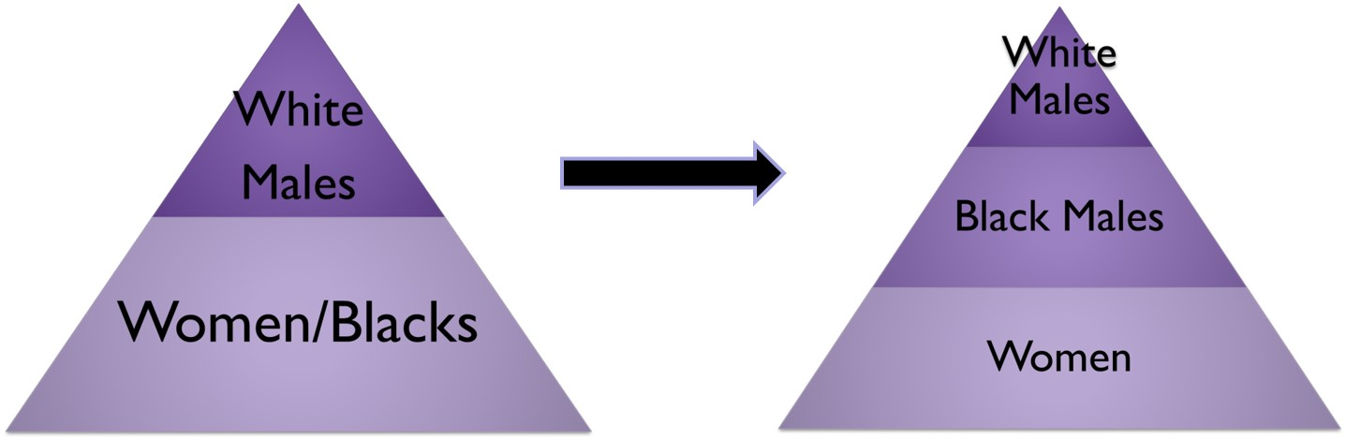
Discrimination through Social Movements
The Suffrage Movement
  Post Reconstruction, a devastating question was posed, “Is it more important that [Blacks] should vote than that women should vote?” (Quarles, 1940, p. 38).

Slide 7
Legal Discrimination
DeGraffenreid v. General Motors Assembly Division (1976)
  This action was filed by the plaintiffs seeking a determination that the "last hired-first fired" lay-off policies of the defendants discriminate against them as black women, and are therefore a perpetuation of past discriminatory practices.
  Sadly, the court found that Black women “should not be allowed to combine statutory remedies to create a new ‘super remedy’. . . this lawsuit must be examined to see if it states a cause of action for race discrimination, sex discrimination, or alternatively either, but not a combination of both” (p.84).

Slide 8
Why do I keep hearing the word intersectionality??
Notes:
Unfortunately it’s not a pretty story

Slide 9
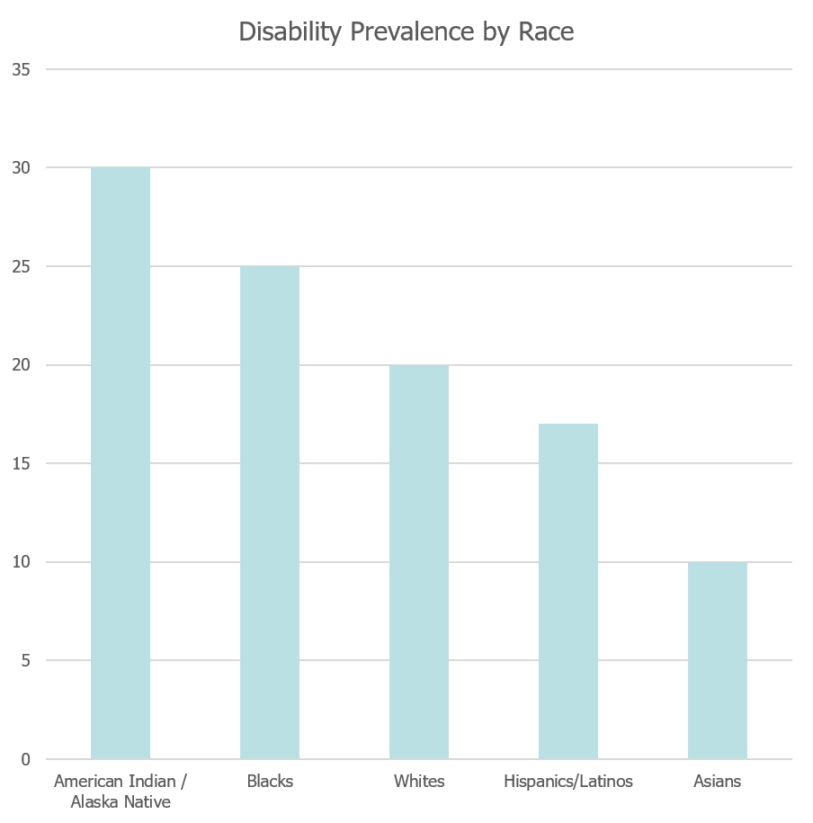
The numbers
Notes:
Double check updates on these stats

Slide 10
The numbers, cont’d.
In raw numbers, over 10.8 million non-institutionalized persons with disabilities (PWD) aged 5 and over are estimated to be members of ethnic minorities” (Yee, 2011, p. 1).
Additionally, “among lesbian, gay and bisexual adults, 30% of men and 36% of women have a disability.”
Notes:
Double check updates on these stats

Slide 11
Disparities experienced by Black women
About 22 percent of Black women have experienced rape. Forty percent of Black women experience intimate partner violence in their lifetime.
Black women are killed at a higher rate than any other group of women.
The median annual earnings for full-time black women workers is just over $36,000—an amount 21 percent lower than that of white women, reflecting black women’s disproportionate employment in low-wage service and minimum and sub-minimum wage jobs.
Notes:
Although black women have a longer history of sustained employment, the median annual earnings for full-time black women workers is just over $36,000—an amount 21 percent lower than that of white women, reflecting black women’s disproportionate employment in low-wage service and minimum and sub-minimum wage jobs. Black families, however, are more reliant on women’s incomes than other families are since 80 percent of black mothers are breadwinners in their families.

Slide 12
Disparities experienced by Black women, cont’d.
Black women are 3 to 4 times more likely to die from complications during pregnancy or childbirth.
Black women are more diagnosed and have a higher death rate in heart diseases, stroke, cancer, asthma, influenza and pneumonia, sickle cell disease, fibroids, diabetes, HIV/AIDS, and mental health conditions.
Notes:
Although black women have a longer history of sustained employment, the median annual earnings for full-time black women workers is just over $36,000—an amount 21 percent lower than that of white women, reflecting black women’s disproportionate employment in low-wage service and minimum and sub-minimum wage jobs. Black families, however, are more reliant on women’s incomes than other families are since 80 percent of black mothers are breadwinners in their families.

Slide 13
Disabled people of color are experiencing injustice, discrimination, and violence at alarming rates.
Notes:
This is why we do this work. To lift our people up. But we need to see the folks who are being left behind.
Reminder that we need to see Inclusion as a value not as a profit

Slide 14
Intersectionality, cont’d.
Intersectionality (disability inclusion framework) – We must expand beyond working with disabled folks that are the easiest to assimilate into our already existing culture. This means we should not predominantly recruit or work with (or have on our staffs and boards) disabled folks that are of the most privileged race, gender, sexual orientation, etc. The majority of people with disabilities are also people who are low/no income, indigenous, people of color, immigrants, LGBTQ, and more. ~Keri Gray

Slide 15
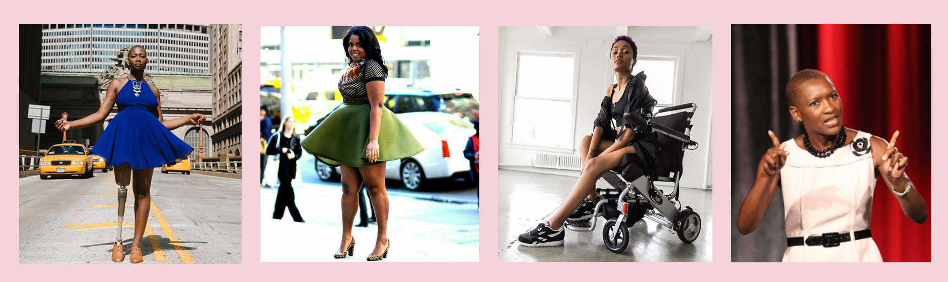
Black Culture and Joy

Slide 16
Even me, Lord
Notes:
We hope that you would create programs and initatives that what see the absolute value that we bring to your spaces.

Slide 17
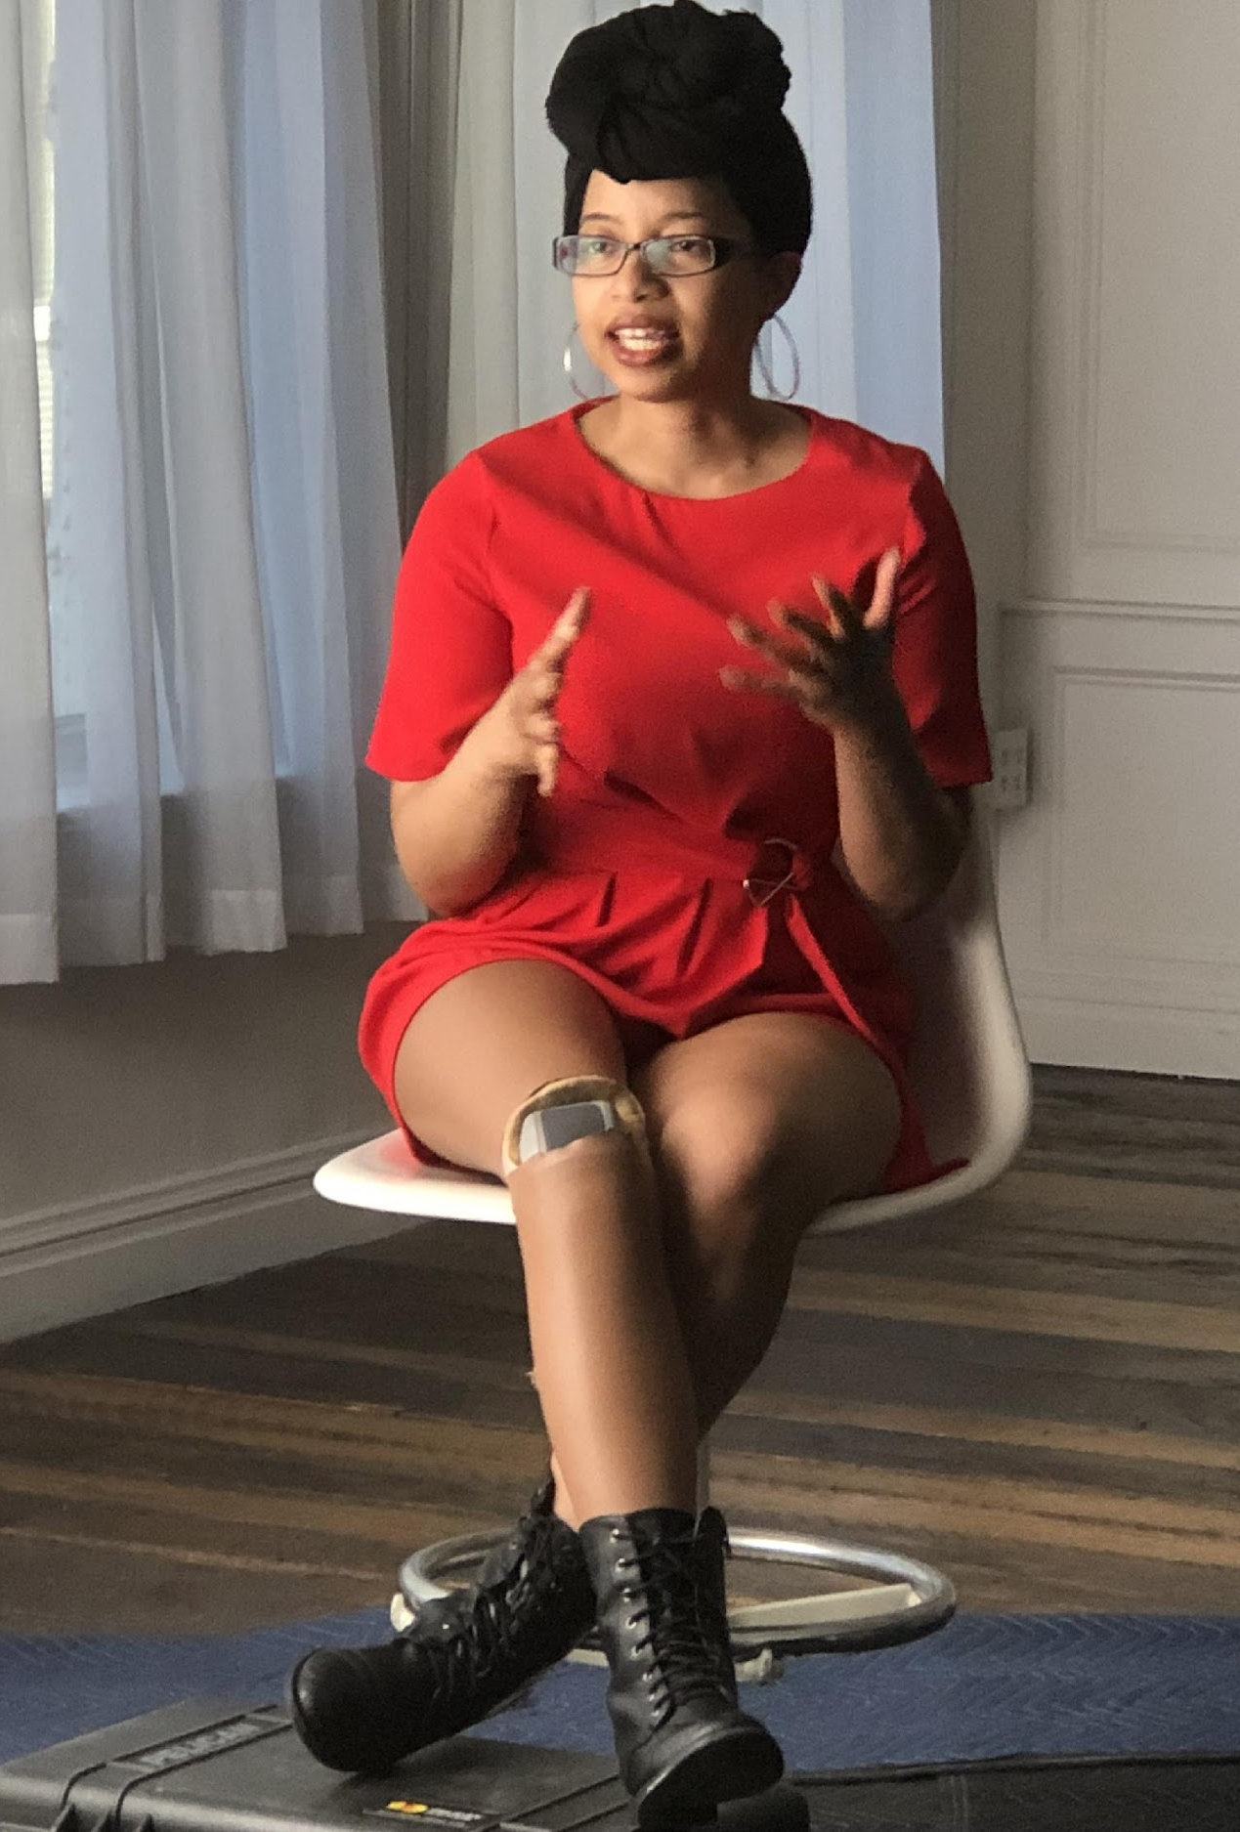
What feeds my fire
On the job, must I hide my curves and my fro and my prosthetic scars? Can I bring the melanin of my culture AND the slower limp in my walk to work? Though not discussed enough, these are questions that our staff and clients ask every time they have a job interview or when they move to elevate their careers. How much do I share? How much do I hide? I believe now is the time to transform our employment settings. I believe our success is heightened when we acknowledge our personal & social dynamics have an impact on our professional aspirations. It is a profitable investment and it’s simply valuable to feed into our whole selves. I am a professional who is Black, who is a woman, and who is disabled. And that feeds my fire 🔥

Slide 18
What are best practices in enhancing our CILs diversity and inclusion efforts?
Notes:
Allie
both how we understand youth transition and how to approach

Slide 19
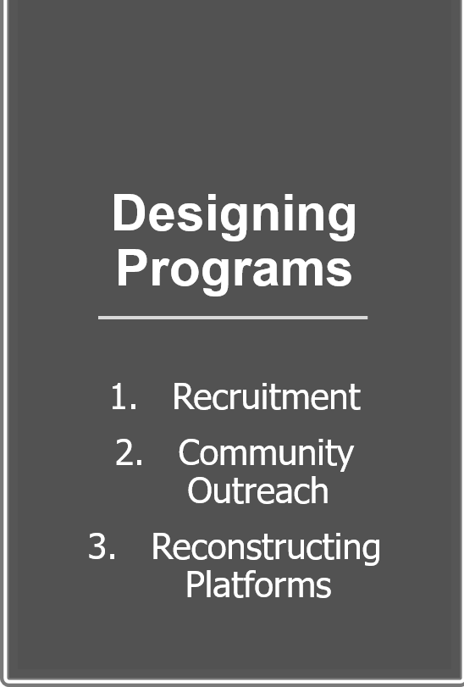
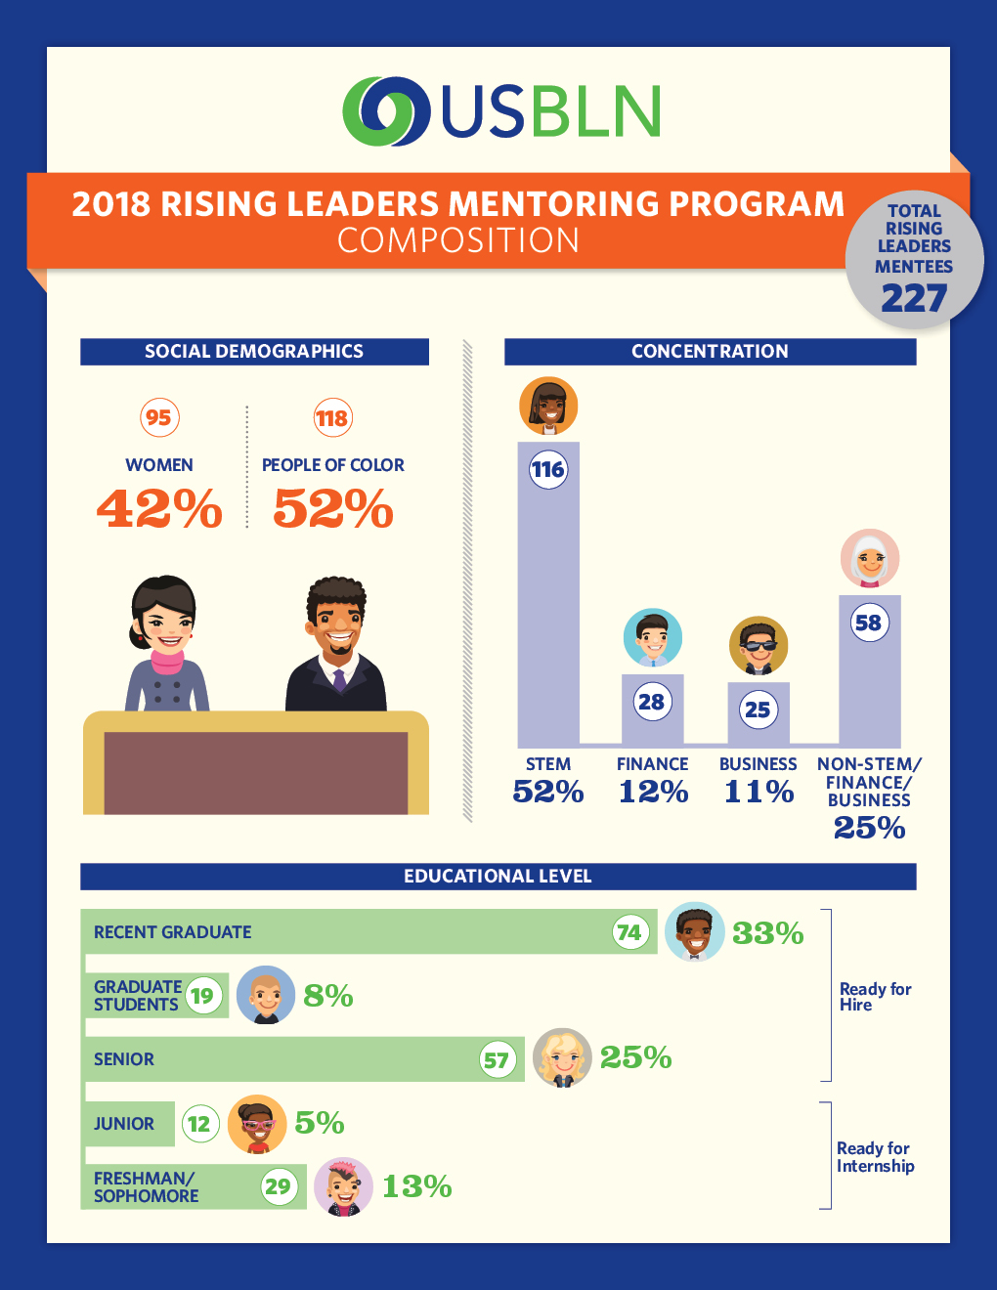
Designing Programs
Notes:
Give example of Disability:IN recruitment efforts and stats. AAPD program stats.
Community outreach is about the diversity of the stakeholders that you work with. We strove to have mentors of color. Folks in the LGBTQ community, women and all types of folks to support our efforts (advancing our young folks).
Literally just leave space for their voices, stories, ideas, our work to help our organizations go to even higher heights. Ie- NextGen plenaries, We Can’t Breathe NCIL mixer, etc

Slide 20
Organizational Branding
What is your mission and message?
Do you have messaging that resonates with people with disabilities from a variety of cultural backgrounds?
Are your events and speakers a reflection of the social demographics of people with disabilities?

Slide 21
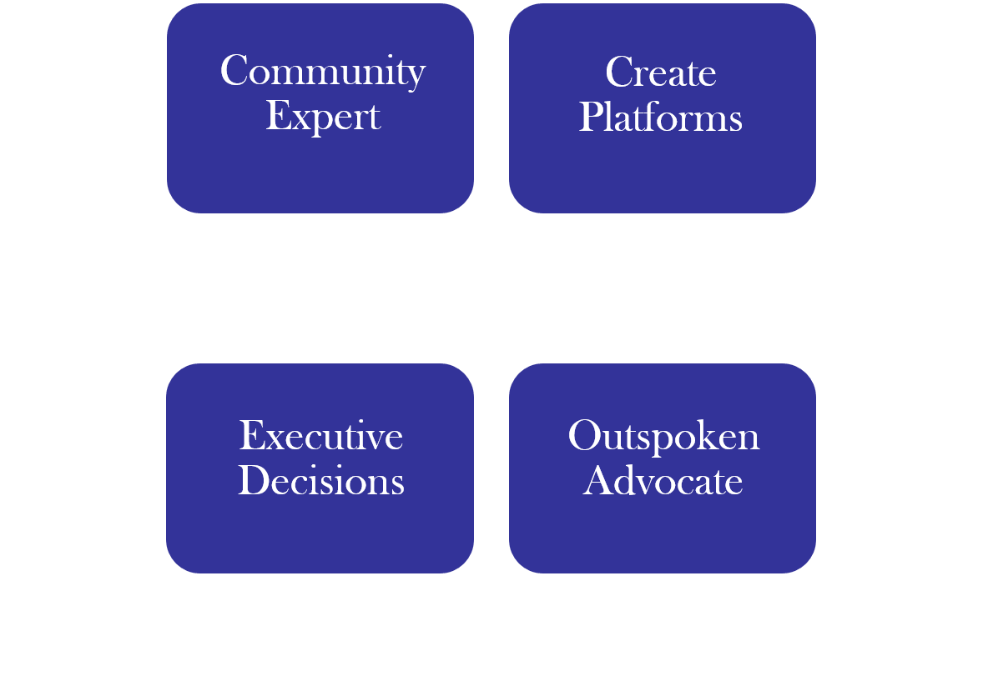
Identify Your Role

Slide 22
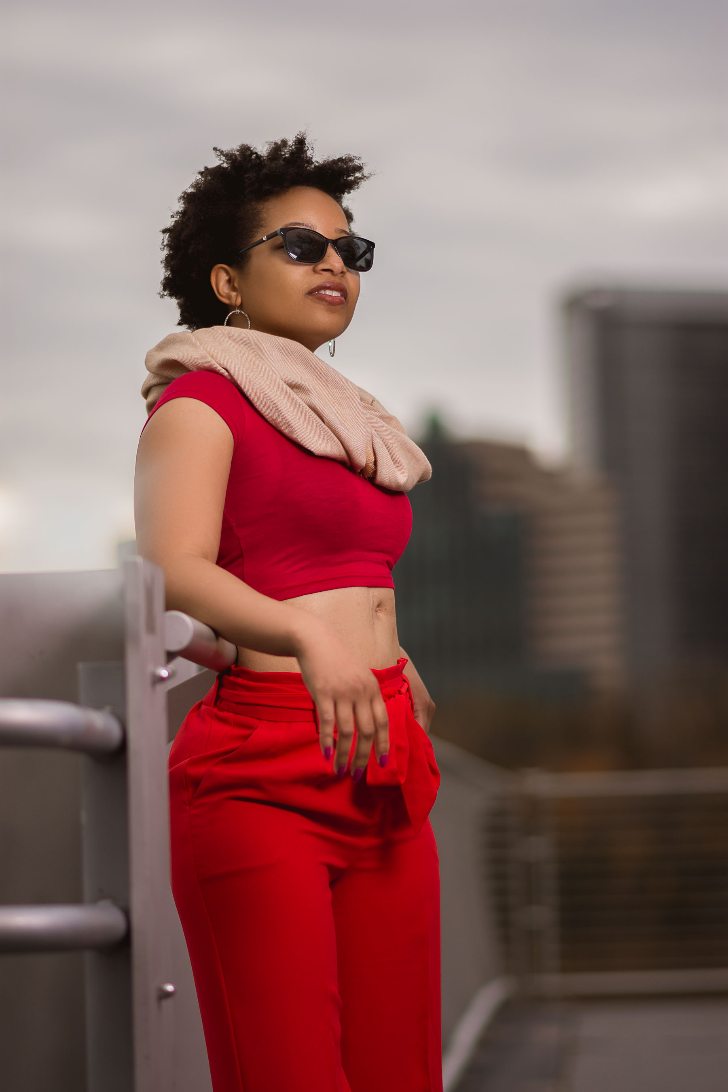
Freedom
Freedom is a journey that requires much sacrifice and an unrelenting confidence in your movement (even if you don’t know your exact destination). I’m constantly thinking about freedom and the dream. Dreams that are bold enough to envision our communities and businesses as inclusive of ALL people. A dream that still calls for us to examine the content of our character and skillset rather than have pre-conceived notions about our melanin, curves, and crip walks. In 2019, I hope we bring back the wisdom that says to Let Go and Let God. In this year, I hope we let go of all the baggage and all the haters that tell us our message and ideas are too loud. To all my people hungry to showcase the beauty of your culture, never allow the struggles to break you.

Slide 23
Resources
The African American Policy Forum – http://aapf.org/publications
Disability, Diversity, and Intersectionality in CILs – www.cil-diversity.org
The Leadership Conference – https://civilrights.org/
Color of Change – https://colorofchange.org/
National Urban League – https://nul.org/

Slide 24
Sources
https://www.cdc.gov/ncbddd/disabilityandhealth/features/key-findings-community-prevalence.html
https://www.cdc.gov/ncbddd/disabilityandhealth/women.html
https://dredf.org/public-policy/health-access-to-care-old/health-and-health-care-disparities-among-people-with-disabilities/
https://www.aclu.org/blog/racial-justice/race-and-criminal-justice/legal-system-has-failed-black-girls-women-and-non
https://www.epi.org/blog/black-womens-labor-market-history-reveals-deep-seated-race-and-gender-discrimination/
https://www.minorityhealth.hhs.gov/omh/browse.aspx?lvl=3&lvlid=61
https://nwlc.org/blog/racism-in-health-care-for-black-women-who-become-pregnant-its-a-matter-of-life-and-death/
https://dredf.org/public-policy/health-access-to-care-old/health-and-health-care-disparities-among-people-with-disabilities/
https://www.cdc.gov/ncbddd/disabilityandhealth/materials/infographic-disabilities-ethnicity-race.html

Slide 25
Activity
Notes:
Practice having a staff meeting where inequalities in people of color participating gets brought up. Two scenarios- calm questions and responding to Black rage.

Slide 26
Contact Information
Keri Gray
  gray.keri.12@gmail.com
  Twitter: @keri_gray
  Instagram: @kerigray90

Slide 27
CIL-NET Attribution
This project is supported by grant number 90ILTA0001 from the U.S. Administration for Community Living, Department of Health and Human Services, Washington, D.C. 20201. Grantees undertaking projects under government sponsorship are encouraged to express freely their findings and conclusions. Points of view or opinions do not, therefore, necessarily represent official Administration for Community Living policy.

