Slide 1

Independent Living Research Utilization

Slide 2
Susan Dooha
Kim Gibson
Reyma McCoy McDeid
Ron Halog
An American Journey: CIL Stories

Slide 3
CIDNY and Susan Dooha’s Story

Slide 4
We believe our mission includes a mandate to remove barriers that are embedded in law, policy, structure, and practice; and it is these barriers that result in disparities for people with disabilities, which are much more extreme depending on your race and ethnicity.
~ Susan Dooha, Executive Director
Center for Independence of the Disabled in NY (Manhattan)

Slide 5
Susan’s Journey to Disability, Diversity & Intersectionality
Hometown Detroit:
  Great Migrations from the south, immigrants from the Middle East, Mexico, China.
  Discrimination huge issue in Detroit in housing; police; schools; jobs.
  Prominent leaders on local, state and national stage are racially/ethnically diverse including Grace Lee Boggs, Coleman Young, John Conyers, George Crockett.

Slide 6
Susan’s Journey to Disability, Diversity & Intersectionality, cont’d.
Community organizing and political action were family activities and diversity was highly valued:
  Schools segregated--so sent to integrated school.
  Civil rights marches and meetings.
  Community organizing on issues affecting the poor, Black, and Hispanic/Latinx communities.
  Electoral politics.

Slide 7
Susan’s Journey to Disability, Diversity & Intersectionality, cont’d. 2
Experienced discrimination against my friends who were Black:
    Physical threats and actions
    Exclusionary cultural norms
    microaggressions
Government and nonprofit jobs that focused on disability, race, ethnicity, LGBT and gender equity.
CIDNY in 2002.

Slide 8
CIDNY Pioneers start by including people who were Hispanic/Latinx on the Board of Directors
Strong beginnings in 1978 on a shoestring:
CIDNY’s first Executive Director was proud of both his disability and Puerto Rican identities.
Another CIDNY leader was Hispanic/Latinx, Eduardo Drogue, who was a Panamanian American man with a disability.
In 1980s Board included a Black Board member and Black staff members.

Slide 9
CIDNY Pioneers progress in reflecting the community...in a limited way...
From 1978-2002:
  Limited diversity on board, staff and management--less than half of the staff were Black, Hispanic/Latinx.
  Few Hispanic/Latinx and no Asian Americans.
  Personnel policies only policies that speak to race/ethnicity and reflect affirmative action orientation.
  Strong focus on increasing the kinds of disabilities represented.

Slide 10
CIDNY Has an AHA moment and escalates change on purpose...
From 2002-2019:
CIDNY observes its own lack of effectiveness in reaching Asian American communities.
Policies and practices start to change:
  Community outreach and relationship building;
  Language capacity;
  Materials in translation;
  All policies shift to have a diversity focus.

Slide 11
CIDNY’s AHA! moment continues by getting the Board and top managers “onboard”...
Foundation and other funders increase emphasis on diversity new information to Board.
Board diversity increases and includes Black, Hispanic/Latinx, and Asian American members.
Staff diversity expands at management level in same way.
CIDNY begins tracking the diversity of the community more thoroughly by using research from UNH projects and CIDNY shares with Board and staff.

Slide 12
CIDNY AHA! moment continues with intentional recruitment for Board and staff...
Intentional recruiting of staff and volunteers increased representation of Black, Asian-American and Latinx individuals on the Board of Directors.
Emphasis on diversity in hiring. Bring advocates/volunteers into increasing positions of authority.
Asian-American, Latinx, and Black management and “front-line” staff with disabilities bring important perspectives to our work.

Slide 13
CIDNY AHA! moment continues with partners, policies and training...
Engage coalition partners around issues we share including: health coverage for immigrants; housing; etc.
Agency policies reviewed and added to ensure language access; emphasize racial/ethnic diversity in hiring practices.
Rights and responsibilities policy for consumers emphasize diversity.
Racial/ethnic diversity training added to annual trainings.

Slide 14
CIDNY AHA! moment continues with an emphasis on language...
Bi-lingual/bi-cultural staff increase substantially; interpreter line as backup.
Translation of basic materials into Spanish; Russian; Haitian Creole; Korean; Chinese; Bengali; Italian; Arabic; Polish.
Outreach plan includes race, ethnicity and language focus to ensure bilingual staff are available, materials are in appropriate languages.

Slide 15
Center for Independence of the Disabled in New York (CIDNY) Today
People with disabilities working with CIDNY reflect the demographic mix of the community.
Our staff reflect the diversity of the community. 75% are Black, Latinx/Hispanic, Asian American. 66% of managers are Black, Latinx/Hispanic, Asian American.
58% are bilingual and bicultural and speak 23 languages including 10 of the top 12 languages in the City.
Materials are in translation in Russian, Korean, Chinese, Spanish, Haitian Creole, Bengali, Italian, Arabic, Polish.

Slide 16
Kim Gibson and disABILITY LINK’s Story

Slide 17
One of the major practices here is the inclusion of all people that starts at the front door to say “is it inviting to all?”
~ Kim Gibson, Executive Director disABILITY LINK (Atlanta, GA)

Slide 18
Kim’s Journey to Disability, Diversity & Intersectionality
Personally invested in creating a diverse CIL due to experiences.
Served as Executive Director (ED) in a wide variety of CILs.
Looked at CIL staffing, board membership, and consumer population by taking an inventory.
Committed to the value of individuals.

Slide 19
Kim’s Journey to Disability, Diversity & Intersectionality, cont’d.
Included data related to ethnicity, race, gender, religion, sexual orientation, and disability.
Compared our annual performance reports to our service area population.
Listened to consumer input and prior surveys.

Slide 20
Basic Considerations – disABILITY LINK
Diverse Groups | Community | Consumers | Staff | Board
Caucasian | 10.8% – 63.5% | 22% | 35.7% | 33%
African-American | 23% to 71% | 70% | 52% | 4.4%
disABILITY LINK looked at the stats of consumers and compared them to staff and board at all levels. Also looked at different diversity issues including sexual orientation, age, religion, etc.

Slide 21
Basic Considerations – disABILITY LINK
Importance of buy-in from management / staff
  Empowered staff to reach out and bring ideas. This Resulted in developing groups focused on LGBTQIAP, musical groups, non-denominational groups, Respect Institute, Hearing Voices, mental health, refugee groups and outreach.
Budget considerations
  Utilize volunteers – disABILITY LINK has not had to take into account any increase in budget simply because it became part of the core of what we do.
Advocacy with entities that don’t provide disability services
  “Us Protecting Us” a collaboration with a variety of social justice organizations, including Black Lives Matter.

Slide 22
Gaining Insight and Feedback
Promoted feedback from the community with surveys for interest and comments.
Invited feedback and ideas from communities, consumers, staff, and board members.
Completed strategic plan involving staff, consumers, and board members that included diversity and inclusion.

Slide 23
Close Look at Our Populations
Intentional outreach to different populations such as the refugee population, Jewish population, Muslim population, Hispanic Population, and other underserved populations of diversity to gain insights.
  Clarkston, a small city of about 13,000, is “the most ethnically diverse square mile in America,” is no idle boast. According to census data, more than 50 languages are spoken there, likely because of the city’s willingness to serve as a refugee resettlement community since the 1990s.

Slide 24
Ongoing efforts
Continually looking at our programs and revising to populations.
Used Data to identify the different diversity groups. We continue to do this and currently:
  Atlanta is also home to one of the highest LGBTQ+ populations per capita, which is 19th among major US metropolitan areas. An estimated 4.2% of Atlanta's metro population is gay, lesbian or bisexual.
  Atlanta is also the 2nd largest majority black metro area in the country.
    Data reference: http://worldpopulationreview.com/us-cities/atlanta-population/

Slide 25
CICIL and Reyma McCoy McDeid’s Story

Slide 26
Going into a community with a ‘helping hands strikes again’ perspective oftentimes does more harm than good…. You have to go in with humility and the expectation that you will have to ask the community you’re trying to help for help yourself.
~ Reyma McCoy McDeid, Executive Director
Central Iowa Center for Independent Living (Des Moines, IA)

Slide 27
The Beginning…
1990: Central Iowa Center for Independent Living (CICIL) is formed in the basement of an original board member’s home. Although the staff and board fulfilled the federal mandate regarding maintaining a 51%+ disabled team, CICIL struggled in terms of other indicators of diversity, including race, gender, and sexual orientation.
1991: CICIL moves into a dedicated – and tiny – space in downtown Des Moines. Annual CSRs: 15
1997: CICIL moves to a 2,000 square foot space – also in downtown Des Moines. Annual CSRs: 70

Slide 28
The Beginning…,cont’d.
1995 – 2015: CICIL struggled to maintain adequate client records, resulting in an ACL audit in 2008 and, ultimately, a loss of Subchapter (Part) B and State funding in 2013. Major issues:
  All documentation was captured on paper.
  Lack of standardization regarding captured information.
  Gross disorganization of and no central location for client files.

Slide 29
The Middle…
1995 – 2008: CICIL transitioned client services and supports mostly over to volunteer staff, resulting in a large number of clients discontinuing services.
Simultaneously, patrons of the local homeless shelter began to converge at CICIL on a daily basis, thus further alienating remaining CICIL clients.

Slide 30
The Middle…cont’d.
ACL’s 2008 audit had several recommendations, including:
  Relocation to a geographic area more conducive to the provision of services to CICIL’s intended demographic.
  Need for a diverse staff more closely resembling the racial/gender demographics for CICIL’s service area.
  Limiting the provision of services, save peer support, to PAID and TRAINED staff.

Slide 31
The End?
Summer, 2013: Concerned advocates confronted CICIL’s board of directors regarding the organization’s operations.
October, 2013: CICIL’s executive director retired, leaving the organization’s associate director as interim executive director.
October, 2013-October, 2014: CICIL’s associate director urges the board to hire him as executive director, threatening to sue if not promoted.
October, 2014: The board eliminates the associate director position, ending the associate director’s tenure.

Slide 32
The End? cont’d.
January, 2015: CICIL’s board hires interim executive director.
October, 2014-August, 2016: CICIL’s former associate director attempts to file multiple lawsuits and civil rights complaints. Complaint was dismissed in May, 2015.

Slide 33
The End? cont’d. 2
May, 2015: Board met to discuss dissolving the organization; decided to hire a permanent executive director after it received notice that the organization would be re-eligible for Subchapter (Part) B and State funding.
September, 2015: CICIL’s board hired the organization’s current executive director.
September 19th, 2015: CICIL’s new executive director attended CICIL’s monthly board meeting – six hours long.
September 24th, 2015: CICIL’s new executive director broke up a fist fight and walked in on an individual consuming drugs in the bathroom.

Slide 34
The End? cont’d. 3
September, 2015: CICIL had four full-time staff and four part-time volunteers. None had training specific to direct supports; paid staff stayed in their locked offices due to fear of assault by the homeless individuals who spent their days at the organization. Volunteer staff were typically homeless people.
September 28th, 2015: CICIL’s office manager quit without notice, changing the passwords to CICIL’s grants.gov and PMS accounts before departure, delaying access to funding in the immediate future.

Slide 35
Another Beginning…
October 1st, 2015: CICIL’s executive director closed the organization for two weeks to organize client files, secure a third party accounting firm, scrutinize financials, and train staff.

Slide 36
CICIL, Reborn.
Regained Subchapter (Part) B and State funding in 2016.
Put client records into order. Purchased access to CilSuite.
Conducted a financial audit; commenced presenting CICIL’s board with accurate expenditure records.
Transitioned staff and board to make space for employees whose skills and qualifications more closely aligned with client need.
Resolved all legal complaints with former associate director.
Relocated organization to a more appropriate geographic location.

Slide 37



CICIL’s evolution…
1995
2016
1990

Slide 38
CICIL, Reborn
Began contracting with the state’s vocational and rehabilitation division to provide supported employment services.
Hired two of the state’s best supported employment specialists.
Rolled out “Try Transition!”, a summer work experience program for disabled high school students.
“Iowa Disability Votes COUNT!” is born to educate disabled voters on their rights.
Developed a strong relationship with state and federal legislators and became known as a point of contact for lawmakers who have questions concerning policy impact on disabled people.

Slide 39
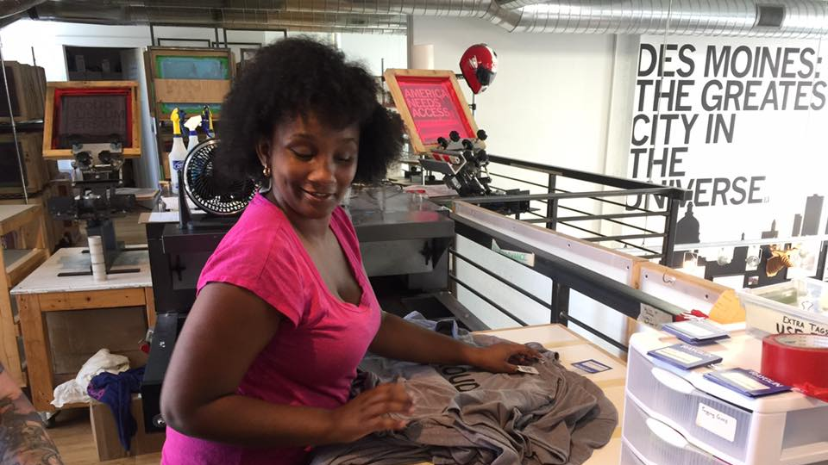
Try Transition!

Slide 40
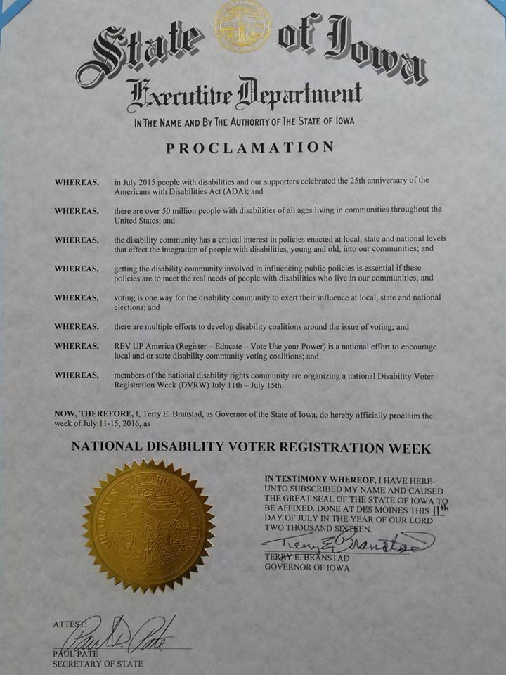
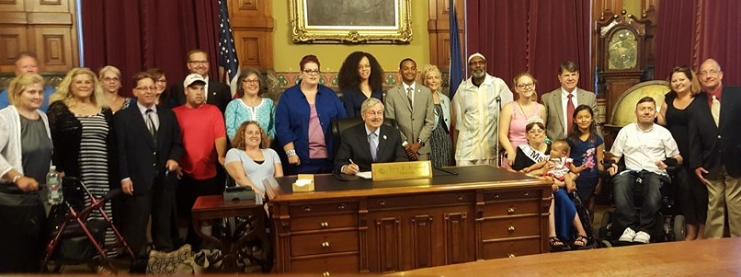
National Disability Voters Registration Week

Slide 41
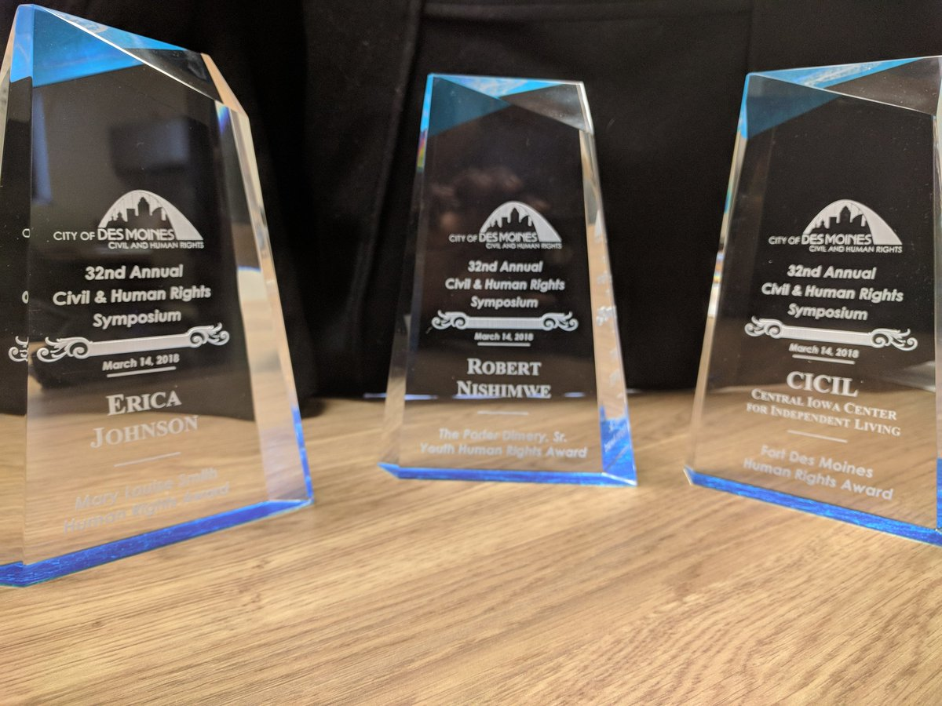
2018: CICIL wins Organization of the Year Honor!
From the City of Des Moines

Slide 42
CICIL, pre-2015:
100% of staff were disabled.
100% of board were disabled.
100% of staff were white.
100% of board were white.
48% of clients were white.
46% of clients were black.
Board meetings are monthly and last between 3 and 8 hours long.

Slide 43
CICIL, Today…
100% of staff are disabled.
57% of board are disabled.
28% of board are parents of disabled children.
33% of staff are people of color.
50% of board are people of color, including black, Latinx, and Asian American individuals.
48% of clients are white.
52% of clients are black or other people of color.
Board meetings are every other month and last 1.5 hours.

Slide 44
What We at CICIL Know for Sure
Our success is rooted in viewing disability from an intersectional vantage point. Personnel decisions, board recruitment, client support philosophy, and policies/procedures/guidelines are infused with intersectionality and cultural competence.
We take our unique position as disabled professionals serving disabled people very seriously and offer our expertise to sister providers and other stakeholders on a regular basis.
The keys to full inclusion of disabled people‒especially those that are multiply marginalized‒into society are financial independence and political action. We strive to be a hub for both.

Slide 45
Organizational Infrastructure ‒ CICIL
Formed in 1990.
Serves Des Moines, IA, and surrounding areas.
Most diverse racial demographics in IA.
Historically, staff and board has been 100% white.

Slide 46
Organizational Infrastructure ‒ CICIL, cont’d.
2008 – RSA recommends that CICIL set an infrastructure that allows support of diverse client base.
2014 – RSA reiterates 2008 recommendations.
2015 – Leadership Transition.
Should CICIL close or restructure?
Original ED retired, current ED hired.
Major board transitions
Staff resignations

Slide 47
Organizational Infrastructure ‒ CICIL Rebuilt
“Clean slate” at CICIL
CICIL is rebuilt with intersectionality as its focus.
2018 – CICIL awarded Organization of the Year Award from the Des Moines Civil and Human Rights Commission.

Slide 48
CRIL and Ron Halog’s Story

Slide 49
Instead of having people go to us, we’ve started to go to them….If you really want to make an impact go out to the community, find out who is out there and find out the community you want to work with.
~ Ron Halog, Executive Director
Community Resources for Independent Living (Hayward, CA)

Slide 50
Ron’s Journey to Disability, Diversity & Intersectionality
Born in Livermore CA, raised in Pleasanton, CA.
Filipino family living in a rural, agricultural community in California in the 50’s and 60’s.
Mom and Dad and my 3 older sisters immigrated from the Philippines, my brother and I were born in California.
They wanted me and my brother and sisters to only speak English so that we fit in the community.
My journey shaped my beliefs, “a person is judged on their character not the color of their skin.”

Slide 51
Ron’s Journey to Disability, Diversity & Intersectionality, cont’d.
Education was very important to my parents. They wanted all the children to graduate from college.
My mom always told me: “respect the person first, if they disrespect you, don’t respect them.”
I had great friends growing up, but also had others who didn’t like me because of my skin color.
Growing up, I was called names and picked on.
As I grew, I learned to fight, both physically and verbally; my first taste of self advocacy.
I learned that we are all different, but with similar wants and dreams.

Slide 52



CRIL… not KRILL

Slide 53
Community Resources for Independent Living (CRIL), cont’d.
CRIL turned 40 this year, we were established in 1979.
CRIL is a non-profit 501 (c) 3 Organization
CRIL is 1 of 28 ILC’s in California.
CRIL’s Service Area is Central, Southern, and Eastern Alameda County in California.
We serve the following cities: Hayward, Castro Valley, San Leandro, San Lorenzo, Fremont, Union City, Newark, Sunol, Livermore, Pleasanton, and Dublin.
3 offices; Main office is in Hayward with offices in Fremont (FRC, Family Resource Center) and Livermore (Multi-Service Center)

Slide 54
Community Resources for Independent Living (CRIL), cont’d. 2
CRIL serves approximately 950 people a year with just 12 staff.
CRIL serves anyone with a disability (mental illness, substance abuse, intellectual / developmental disabilities, etc.), and seniors with functional limitation.
Other services CRIL provides outside of our federal and state core services include: Emergency / Disaster Preparedness Training, Assistive Technology – Device Lending Demonstration Center, CalFresh Application assistance, Van Share Service – Wheelchair Accessible Vans.

Slide 55
How Did We Prepare our Organization for the Journey?
Community Resources for Independent Living (CRIL)
1st - We took a close look at our current staff – are we reaching out to all communities in our county?
  Who were we connected with and how do we strengthen that connection?
2nd - We looked at groups that we were not serving and asked why we weren’t serving them?
  We then looked at Alameda County demographics. It is one of the most diverse counties in America.
  We asked ourselves, how does our staff and consumer base match the county’s percentages?

Slide 56
How Did We Prepare our Organization for the Journey? cont’d.
3rd - We made plans and took steps to address this short fall:
  Needed staff who can speak the language.
  Developed written material in specific languages.
  Introduced ourselves to other organizations that serve the specific population – potential collaboration.
  Reviewed our services and targeted services that could benefit other organizations – how to link our services with the population, what needs are we not meeting? Promoted our non-core services.

Slide 57
How Did We Prepare our Organization for the Journey? cont’d. 2
Getting to the right “tables”:
Time to get uncomfortable – go to meetings and share your services. Give a lot of presentations and trainings.
A flyer is great but it won’t bring people to you; you need to go to them.
Word of mouth always works best – especially if a consumer was successful in the goal or enjoyed your training / presentation. (find housing, a job etc.)
Go to the people, don’t wait for them to come to you.
Use your services as a tool to get to groups; Device Lending, Emergency Preparedness Training, etc.

Slide 58
Contact
Susan Dooha
sdooha@cidny.org
Kim Gibson
Kgibson@disabilitylink.org
Ron Halog
ron.halog@crilhayward.org
Reyma McCoy McDeid
Reyma@CICIL.org

Slide 59

Disability, Diversity and Intersectionality for Centers for Independent Living
Day 1 Wrap Up
Facilitator:
Stan Holbrook
August 20, 2019
Atlanta, Georgia

Slide 60
CIL-NET Attribution
This project is supported by grant number 90ILTA0001 from the U.S. Administration for Community Living, Department of Health and Human Services, Washington, D.C. 20201. Grantees undertaking projects under government sponsorship are encouraged to express freely their findings and conclusions. Points of view or opinions do not, therefore, necessarily represent official Administration for Community Living policy.

