Slide 1

Independent Living Research Utilization

Slide 2

Disability, Diversity and Intersectionality in
Centers for Independent Living
Day 1 Review
Facilitator:
Stan Holbrook
August 21, 2019
Atlanta, Georgia

Slide 3
Why Words Matter:
Addressing Microaggressions to Create a Welcoming Environment
Brooke Curtis and Stan Holbrook

Slide 4
Thought-Provoking Quote
“What they call you is one thing. What you answer to is something else.” ~ Lucille Clifton

Slide 5
What You Will Learn
Micro-aggressive behavior is a form of aversive racism, ableism, and other “isms.“
The real-life effects of microaggressions on those who are the target.
How to avoid committing microaggressions and how to handle micro-aggressive behavior if you are the target.

Slide 6
Microaggressions Defined
Subtle, verbal and nonverbal slights and insults based on gender, ethnic, and other stereotypes.
Communicate hostile, derogatory, or negative viewpoints.
Can be intentional or unintentional.
“Micro” applies to the subtlety not the impact.

Slide 7
Microaggressions Defined, cont’d.
Microaggression goes beyond race and touches all marginalized populations including:
  Race
  Gender/Gender preference/Sexual Orientation
  Ethnicity
  Disability Status
  Labor Roles & Social Class
  Age
“Racial, gender, and sexual orientation microaggressions are active manifestations and/or a reflection of our worldviews of inclusion/exclusion, superiority/inferiority, normality/abnormality, and desirability/undesirability” (Sue, 2010).

Slide 8
Terminology
Racism – “a system of power, a system of structuring opportunity and assigning value based upon the social interpretation of how someone looks (what we call “race”). Unfairly disadvantages some individuals and communities, while unfairly giving advantages to other individuals and communities” (Jones, 2003).
Privilege – gives advantages, favors, and benefits to members of dominant groups at the expense of members of target groups. People in dominant groups often believe that they have earned the privileges that they enjoy or that everyone could have access to these privileges if only they worked to earn them (CompassPoint, 2016).

Slide 9
Terminology, cont’d
Internalized racism – acceptance by those stigmatized of negative messages about their own abilities
Self-Identity/Self-Concept – collection of beliefs about oneself (includes personality, skills and abilities, occupation and hobbies, physical characteristics, etc.)
Labels – represent a way of differentiating and identifying people that is considered by many as a form of prejudice and discrimination.

Slide 10
Terminology, cont’d. 2
Intersectionality – “interconnected nature of social categorizations such as race, class, and gender, regarded as creating overlapping and interdependent systems of discrimination or disadvantage; a theoretical approach based on such a premise” (YW Boston, 2017).
Intersectional occurs as a result of the individual’s multiple groups and may influence the intensity or frequency of microaggression.

Slide 11
Thought-Provoking Quote
“There needs to be a realization that good intentions are simply not enough.” ~ Unknown

Slide 12
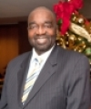
Stan’s Experience
Affirmative action?

Slide 13
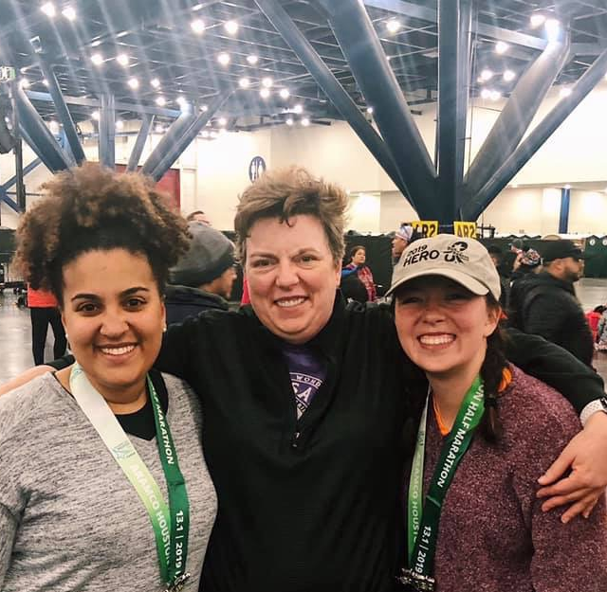
Brooke’s Experience

Slide 14
Interactive Discussion : Your Turn
Think of a word you’ve been called that you didn’t like or offended you.
How did it make you feel?

Slide 15
Examples of Microaggressions
Theme | Microaggression | Message
Ascription of Intelligence | “You are so articulate” | It’s unusual for someone of your race to be intelligent.
Color blindness | “When I look at you, I don’t see color.” | Denies a person of color’s racial/ethnic experiences.
Denial of individual racism | “My best friend is Black.” | I’m immune because I have friends of color.
Wing et al., 2007

Slide 16
Examples of Microaggressions, cont’d.
Theme | Microaggression | Message
Sexual Orientation | “So who’s the man in the relationship?” | Implies that a relationship must involve a man and a woman
Disability | Without being asked, a man helps a disabled person board the train. | You can’t function independently.
Class | “That’s ghetto.” | Being poor is associated with negative/undesirable characteristics.
Wing et al., 2007

Slide 17
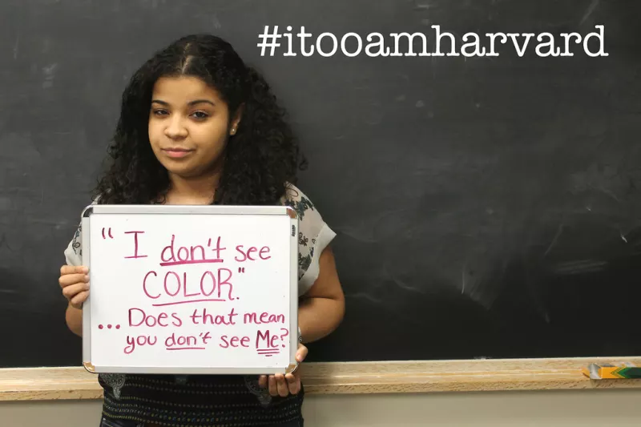
Example 1
Vingiano, A. (2014). 63 Black Harvard Students Share Their Experiences In A Powerful Photo Project. Retrieved from https://www.buzzfeednews.com/article/alisonvingiano/21-black-harvard-students-share-their-experiences-through-a

Slide 18
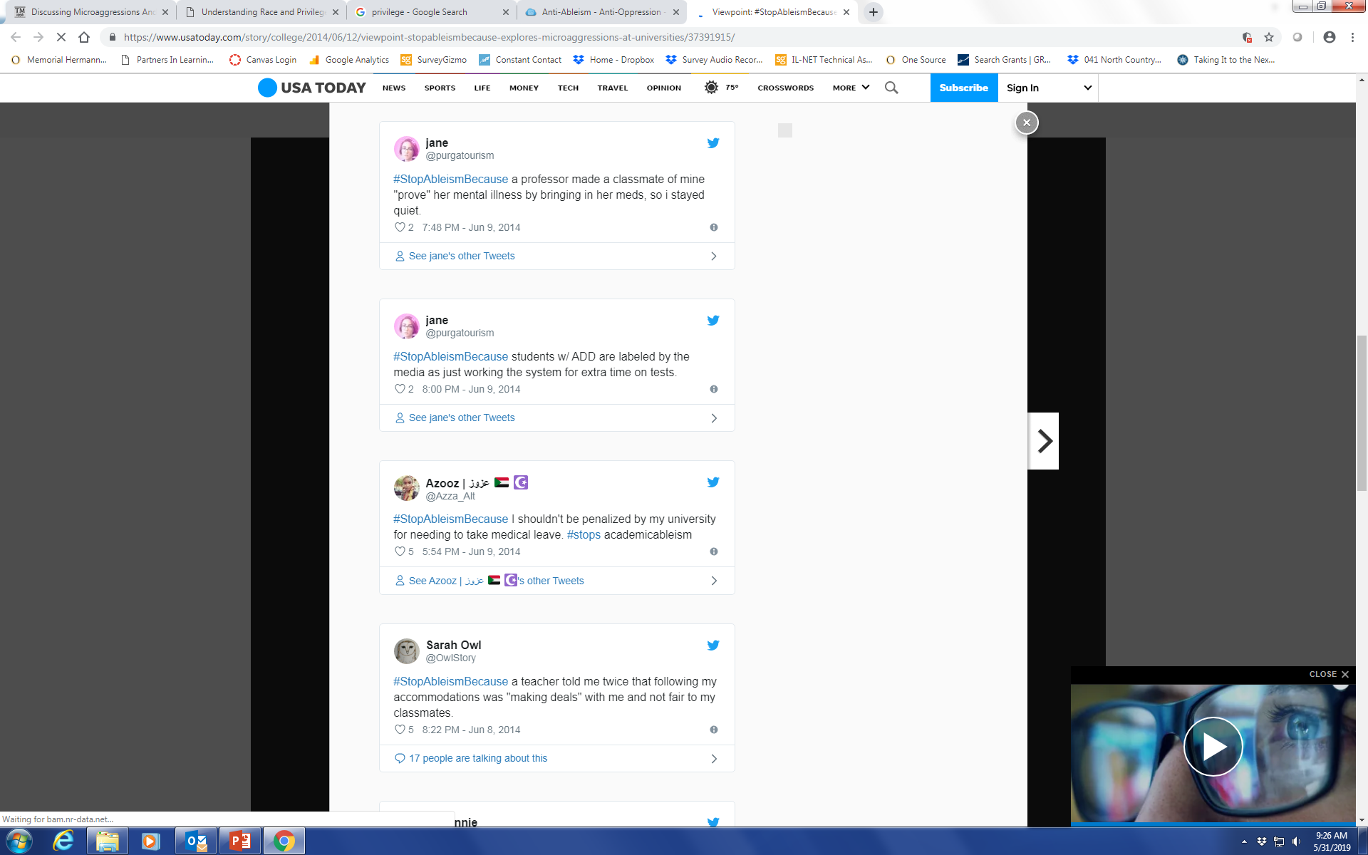
Example 2
Jones, J. (2014). Viewpoint: #StopAbleismBecause explores microaggressions at universities. Retrieved from https://www.usatoday.com/story/college/2014/06/12/viewpoint-stopableismbecause-explores-microaggressions-at-universities/37391915/

Slide 19
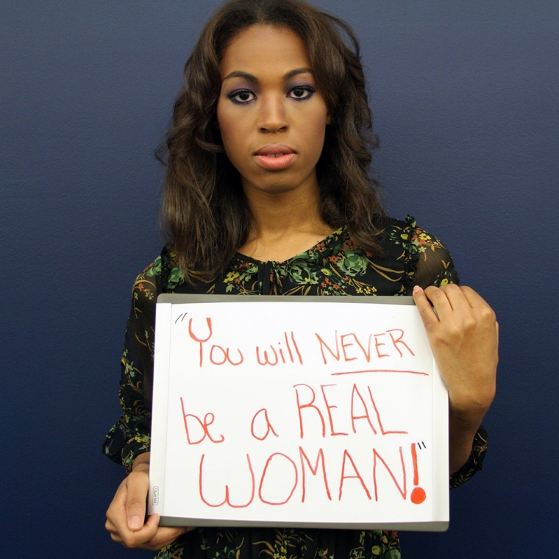
Example 3
GLADD. (2015). GLAAD launches trans microaggressions photo project #transwk. Retrieved from https://www.glaad.org/blog/glaad-launches-trans-microaggressions-photo-project-transwk

Slide 20
The Impact of Microaggressions
Internal dilemmas
  What did (s)he mean by that?
  Should I say something?
  Did I interpret that correctly?
  How should I respond?
  Will this affect our relationship?
  If I don’t respond, does it convey I accept their statement?
  Will I regret not saying something?

Slide 21
The Impact of Microaggressions, cont’d.
Psychological Consequences
  Anxiety
  Depression
  Helplessness
  Diminished confidence
Notes:
Anxiety - "an emotion characterized by feelings of tension, worried thoughts and physical changes like increased blood pressure.“ (https://www.medicalnewstoday.com/articles/323454.php)
Depression - “Depression is a mood disorder that causes a persistent feeling of sadness and loss of interest.” (https://www.mayoclinic.org/diseases-conditions/depression/symptoms-causes/syc-20356007)
Helplessness – “When people feel that they have no control over their situation” (https://www.verywellmind.com/what-is-learned-helplessness-2795326)
Diminished confidence

Slide 22
The Impact of Microaggressions, cont’d. 2
Health Consequences
  Minorities experienced elevated levels of trauma and depression.
  Depressive symptoms were the link in the relationship between racial microaggressions and thoughts of suicide in study of 405 undergraduate students.
  Creates lack of trust in service providers and caregivers.
(Torino, 2017)

Slide 23
How should microaggressions be addressed systematically?
Involves monitoring for inequities in exposures and opportunities, as well as for disparities in outcomes.
Involves examination of structures, policies, practices, norms, and values.
Requires intervention on societal structures and attention to systems of power.

Slide 24
How should CILs address microaggressions?
Starts with leadership and a welcoming organizational culture.
Foundation of accountability and personal responsibility.
Ask people how they want to be communicated with.
Avoid environmental microaggressions.
  Buildings named only after White, heterosexual, upper class males.
Formalized training.
Continue (or start) to have conversations.

Slide 25
How should individuals address microaggressions?
When you’re the target
  Attack the comment and not the person.
  Educate/inform.
  Speak up.
  The worst response, is no response!
  People who witness a microaggression can be affected by it even when the target isn't affected.

Slide 26
How should individuals address microaggressions? cont’d.
When you’re the micro aggressor
  Addressing microaggression is not only the responsibility of the target/marginalized group.
  Don’t dismiss the experience of the microaggression as an isolated incident.
  Apologize and reflect.

Slide 27
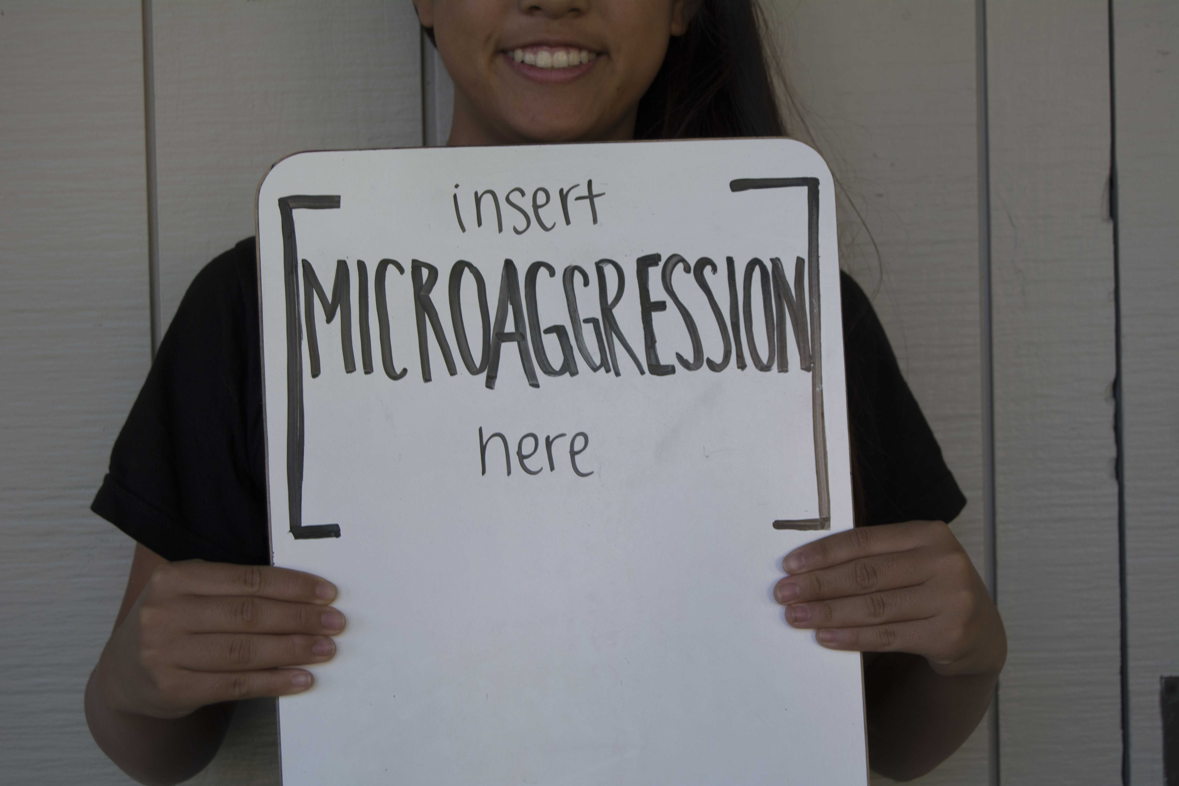
Interactive Discussion and Q&A
What will you do to avoid committing a microaggression or how will you address them?

Slide 28
References
Banks, B.M. The Impact of Microaggressions – An Introductory Training: Presentation prepared for the Nebraska Internship Consortium in Professional Psychology. Retrieved from https://cehs.unl.edu/images/EdPsych/nicpp/NICPP_microaggression_presentation_2015-06-02.pdf
Jones C.P. (2003). Confronting Institutionalized Racism. Phylon, 50(1-2):7-22.
CompassPoint. (2016). Conflict Resolution with Power and Privilege in Mind. Retrieved from https://www.compasspoint.org/sites/default/files/documents/Conflict%20Resolution%20with%20PP%20in%20Mind%202.08.17%20-%20FINAL.pdf
Nadal, K.L. (2014). A Guide to Responding to Microaggressions. CUNY Forum, 2(1), 71-76.
Power, Privilege, and Everyday Life. (n.d.). Retrieved from www.microaggressions.com
Racial Microaggressions in Everyday Life: Implications for Clinical Practice. American Psychologist, 62(4), 271-286.
Sue, D.W., Capodilupo, C.M., Torino, C.G., Bucceri, J.M., Holder, A., Nadal, K. & Esquilin, M. (2007). Racial microaggressions in everyday life: Implications for clinical practice. American Psychologist, 62(4), 271-286.
Sue, D.W. (2011). Microaggressions: More than Just Race. Retrieved from https://www.psychologytoday.com/us/blog/microaggressions-in-everyday-life/201011/microaggressions-more-just-race
Torino, G.C. (2017). How racism and microaggressions lead to worse health. Retrieved from https://www.centerforhealthjournalism.org/2017/11/08/how-racism-and-microaggressions-lead-worse-health
YW Boston. (2017). What is intersectionality, and what does it have to do with me? Retrieved from https://www.ywboston.org/2017/03/what-is-intersectionality-and-what-does-it-have-to-do-with-me/

Slide 29
Contact
Brooke Curtis
Brooke.Curtis@memorialhermann.org
Stan Holbrook
sholbrook4@verizon.net

Slide 30
CIL-NET Attribution
This project is supported by grant number 90ILTA0001 from the U.S. Administration for Community Living, Department of Health and Human Services, Washington, D.C. 20201. Grantees undertaking projects under government sponsorship are encouraged to express freely their findings and conclusions. Points of view or opinions do not, therefore, necessarily represent official Administration for Community Living policy.

