Slide 1
Independent Living Research Utilization

Slide 2
Data Mining and Community Mapping to Address Diversity Susan Dooha

Slide 3
Center for Independence of the Disabled, New York (CIDNY)
CIDNY was founded in 1978 and currently has 76 staff and a budget of $7.5 m;
In 2018 CIDNY served 52,310 individuals;
Offices in New York and Queens counties—serve people citywide;
75% of staff are Black, Latinx/Hispanic, Asian American.
58% are bilingual/bicultural and speak 26 languages.
Speak 10 of the top 12 languages in the City.

Slide 4
Why are disability statistics so important to our work?
It helps us intentionally change our leadership, staff, planning, outreach, recruitment, hiring, program selection, organizational policies and practices to support our goal to reflect the community.
Identify disparities in graduation rates, income, poverty, health coverage and outcomes, food access and set goals to address them.
Join in coalitions with other stakeholders to create systemic change.
Communicate with the public, policy makers and funders in a more effective way about the communities they serve by using both individual experiences and data.

Slide 5
Disability statistics and YOU!
Have you used statistics about your community to support advocacy?
What statistics did you use?
Did the statistics help you? Were there gaps?

Slide 6
There is no perfect database on disability.
Different definitions for different purposes, definitions include:
U.S. Census, American Community Survey (ACS)
Social Security
Workers’ Compensation
Americans with Disabilities Act
Survey of Income and Program Participation
Behavioral Risk Factor Surveillance System
Centers for Disease Control
Differences:
Some are medical model.
Others change as government legislation affects them.
Some are based on employment.
Some have local data—or don’t.
Some exclude portions of the population.
Notes:
This is showing the American Community Survey Questionnaire. the ACS covers rate of disability in each community by age, gender, race, ethnicity, specific disability and captures the status of people with disabilities for education, employment, income, poverty, food, housing, transportation, family status, health coverage and more. Makes it possible to compare the lives of people with disabilities -- for each disability, comparisons among races and ethnicities related to status on different topics, comparison between people with disabilities and those with no disability -- to show inequities.

Slide 7
CIDNY sought out a partnership with University of New Hampshire (UNH)
UNH is funded by HHS through the National Institute on Disability, Independent Living, and Rehabilitation.
They helped CIDNY for free!
CIDNY used UNH provided ACS data for outreach, service planning, advocacy, coalition building, systems change.
Shared goals:
Improve government policies re: education, employment, income, poverty, health, housing, food, transportation, family status, etc.
Advocates for improving the lives of people with disabilities.

Slide 8
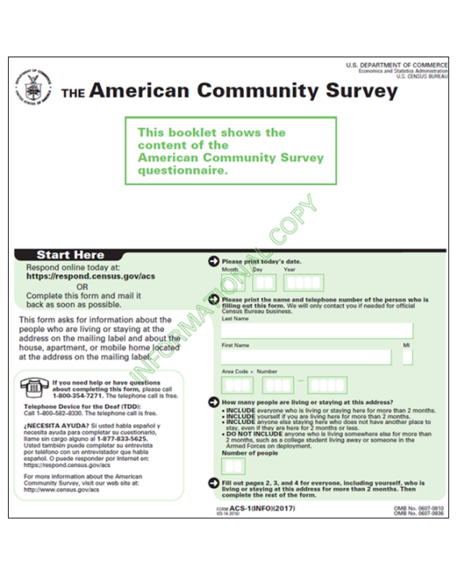
What kind of information does UNH provide? American Community Survey Questionnaire
ACS covers rate of disability in each community by age, gender, race, ethnicity, specific disability; and captures the status of people with disabilities for education, employment, income, poverty, food, housing, transportation, family status, health coverage and more.
Notes:
This is showing the American Community Survey Questionnaire. the ACS covers rate of disability in each community by age, gender, race, ethnicity, specific disability and captures the status of people with disabilities for education, employment, income, poverty, food, housing, transportation, family status, health coverage and more. Makes it possible to compare the lives of people with disabilities -- for each disability, comparisons among races and ethnicities related to status on different topics, comparison between people with disabilities and those with no disability -- to show inequities.

Slide 9
ACS Questionnaire
Makes it possible to compare the lives of people with disabilities – for each disability, comparisons among races and ethnicities related to status on different topics, comparison between people with disabilities and those with no disability – to show inequities.
Notes:
This is showing the American Community Survey Questionnaire. the ACS covers rate of disability in each community by age, gender, race, ethnicity, specific disability and captures the status of people with disabilities for education, employment, income, poverty, food, housing, transportation, family status, health coverage and more. Makes it possible to compare the lives of people with disabilities -- for each disability, comparisons among races and ethnicities related to status on different topics, comparison between people with disabilities and those with no disability -- to show inequities.

Slide 10
Measuring Disability: Functional Limitations
Six standardized questions to identify people with disabilities in national surveys
Vision: (all ages)
Are you blind or do you have serious difficulty seeing, even when wearing glasses?
Hearing: (all ages)
Are you deaf or do you have serious difficulty hearing?
Ambulatory: (ages 5+)
Do you have serious difficulty walking or climbing stairs?

Slide 11
Measuring Disability: Functional Limitations, cont’d.
Six standardized questions to identify people with disabilities in national surveys
Cognitive: (ages 5+)
Because of a physical, mental, or emotional condition, do you have serious difficulty concentrating, remembering, or making decisions?
Self-care: (ages 5+)
Do you have difficulty dressing or bathing?
Independent living: (ages 15+)
Because of a physical, mental, or emotional condition, do you have difficulty doing errands alone such as visiting a doctor's office or shopping?

Slide 12
American Community Survey (ACS)
1-year estimates
5-year estimates
12 months of data (Jan-Dec 2017 data available since Oct. 2018).
Data for large geographies (population of 65,000+).
Least precise; most current.
Use if you have a large geographic area and want only the most recent data.
Pool 60 months of data.
Data for smaller geographies (Block groups, Census Tracts, Zip Code Areas, State Legislative Districts).
Most precise; least current.
Use if you have a small geographic area.

Slide 13
What is the data that you most want to see for your community?
What do you want to do?
What do you need to know?
identifying key issues
targeting legislators
identifying coalition partners
teaching the public
engaging grassroots
diversity demographics
educational attainment
employment
median income
poverty
food access
health coverage
housing
transportation

Slide 14
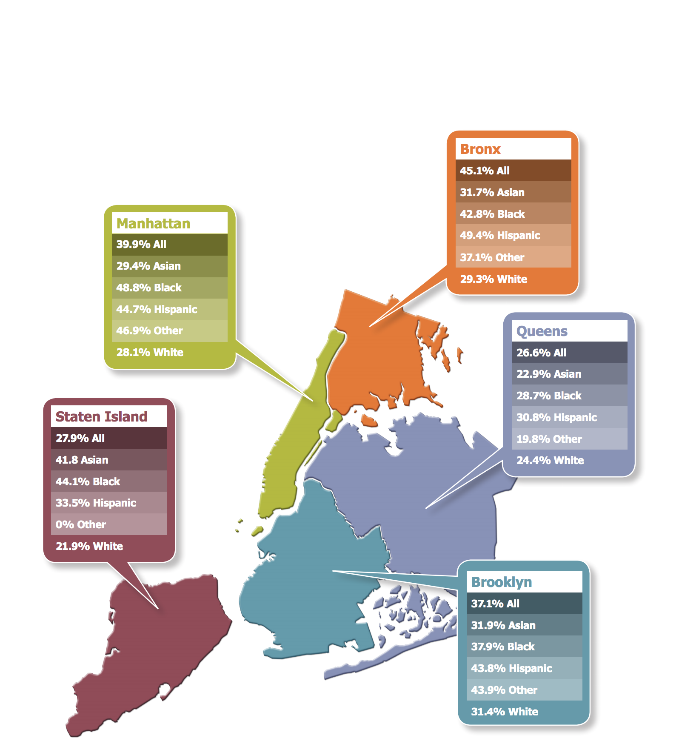
Statistics on disability, race and poverty helped us reach policymakers on health, housing, transportation and other topics.
In NYC, 35% of people with disabilities live below the federal poverty level. The poverty rate is higher among people in some racial/ethnic groups. In some counties, the poverty rate is significantly higher.
This data (broken out by county) helped us reach lawmakers about policy and resource needs of their communities.
Notes:
For an example of looking at issues facing New Yorkers in our communities by county and race/ethnicity we start here, looking at poverty. In New York City, 35 percent of people with disabilities are living below the federal poverty level. The poverty rate is higher among people in some racial/ethnic groups is higher. In some counties, the poverty rate is significantly higher. Poverty rates in NYC are higher than at State and federal level. We use this information to talk with local policymakers about key issues in their jurisdictions and help them understand who is most affected when we are talking about policy solutions.

Slide 15
Using data to affect policy
CIDNY uses research data in litigation, settlement talks and monitoring on issues that affect all people with disabilities, but particularly people with disabilities who are Black, Hispanic/Latinx, Asian American Communities.
Examples:
Subway accessibility litigation
Right to Counsel legislation helping low-income people with disabilities facing eviction
Targeting disaster relief to the needs of people with disabilities who speak a language other than English

Slide 16
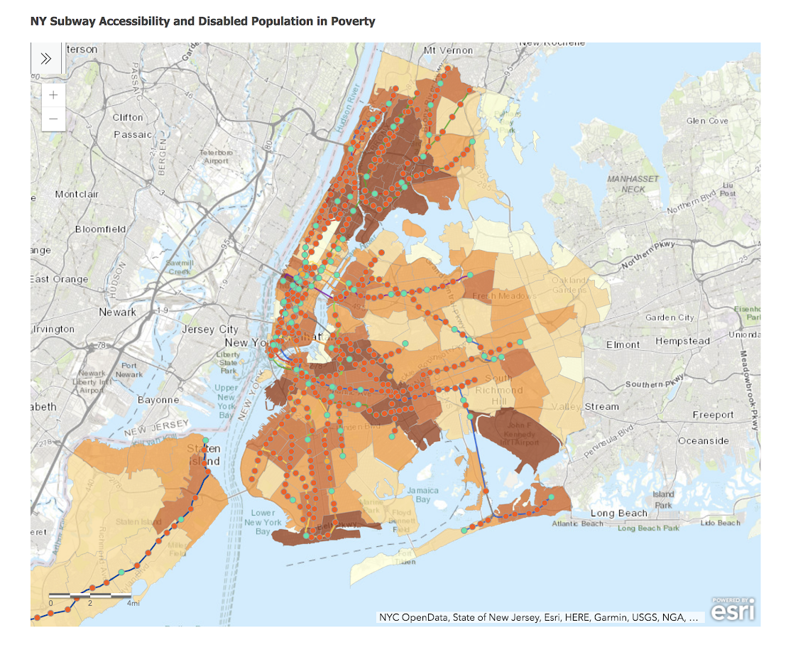
In litigation, we use mapping to see gaps in services that result in inequities.
Map shows subway lines with and without elevators in low income communities of color with high rates of disability.
Notes:
We advocate to remove transportation barriers, we sit on advisory groups, testify at hearings, meet with policymakers. We mapped where people with disabilities who are poor live in each community to show policy makers that there are few if any accessible subway stations in communities with the highest density of people with disabilities who need them and have few alternatives.

Slide 17
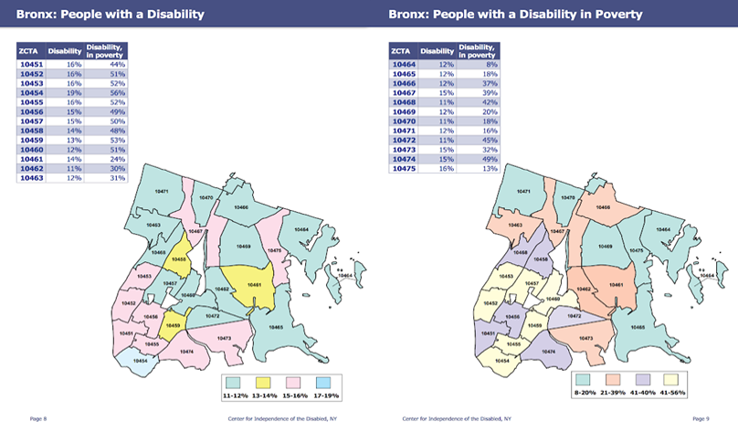
Creating a right to counsel for people facing eviction and targeting people with disabilities of color who are in greatest need.
Notes:
We take the data and drill down to zip code level data and visualize it so that outreach can be planned for the most affected neighborhoods with specific resources.
We use this information to target outreach for services, what community partners we might work with, what language staff need to participate in outreach, what language materials to bring.

Slide 18
Using data to target resources during disasters by changing federal agency practices.
After Hurricane Sandy hit NYC, data helped us talk to the USDA about directing disaster food resources to people with disabilities in hurricane zones in Queens.
People with SSI/SSDI were eligible.
We used zip codes, names of neighborhoods, SSA population in those neighborhoods,
We emphasized languages spoken to ensure translated materials were available.
We partnered with immigration and legal groups to get translated information about disaster food stamps to people that needed it.
Notes:
.

Slide 19
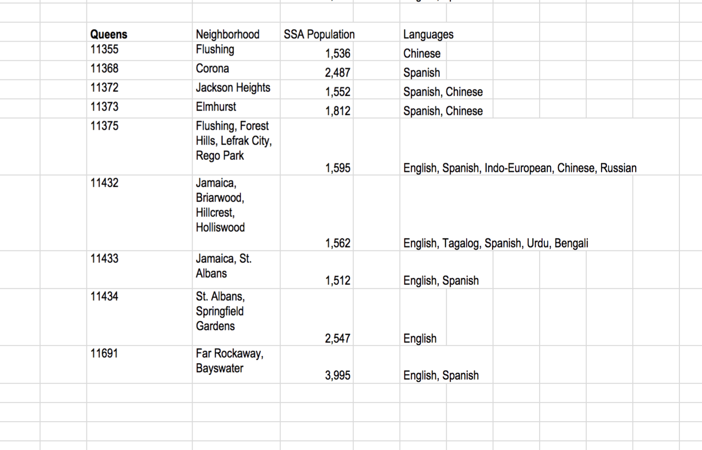
Breakdown of Queens by neighborhood, disability, and languages made our point to federal admins.
Notes:
Following Hurricane Sandy in New York, we worked with the other advocates, U.S. Department of Agriculture and New York City to look at where the highest need among poor elderly and disabled would be. They wanted our advice about where to target Disaster Food Stamp outreach and offices, etc.
We identified the languages spoken in each neighborhood so that offices set up in communities could be staffed by people who could communicate.

Slide 20
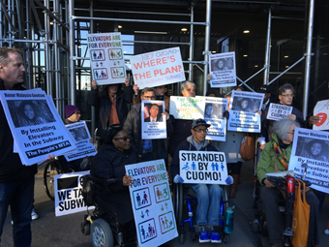
Knowing the community helps identify and join effective partners for change.
Coalition members and community advocates join together to fight for subway elevators in Court...stay tuned.
Notes:
We emphasize working with partners in each community and have been invited to bring resources on site in racially and ethnically diverse communities. We identify issues, such as health care, safety-net benefits, housing that bring us together in coalitions with other groups.

Slide 21
Do you have comments and questions?

Slide 22
Contact
Susan Dooha
sdooha@cidny.org

Slide 23
Disability, Diversity and Intersectionality for Centers for Independent Living Day 2 Wrap Up Facilitator: Stan Holbrook August 21, 2019 Atlanta, Georgia

Slide 24
CIL-NET Attribution
This project is supported by grant number 90ILTA0001 from the U.S. Administration for Community Living, Department of Health and Human Services, Washington, D.C. 20201. Grantees undertaking projects under government sponsorship are encouraged to express freely their findings and conclusions. Points of view or opinions do not, therefore, necessarily represent official Administration for Community Living policy.

