Slide 1

IL-NET National Training and Technical Assistance Center for Independent Living

Slide 2
Human Resources and Payroll Options – internal or external?
August 8, 2024
Financial Managers Peer Call

Slide 3
Facilitator:
Paula McElwee, Director of Technical Assistance, IL-Net

Slide 4




IL-NET Partners
Today’s presentation is brought to you by the Administration for Community Living at the US Department of Health and Human Services in conjunction with the IL-NET. The IL-NET is operated by ILRU and collaborates with NCIL, APRIL, the University of Montana, and a consultant network of subject-matter experts. The IL-NET T&TA Center provides training and technical assistance to centers for independent living, statewide independent living councils, and designated state entities.
Image Descriptions: Logos of Independent Living Research Utilization, Association of Programs for Rural Independent Living, National Council on Independent Living Logo: A multi-colored fingerprint, and University of Montana.

Slide 5
What You Will Discuss Today
Do you also have HR responsibilities? What do those look like?
How is payroll handled? Do you use a payroll service for some or all?
Do you use an HR firm?
How do you work with managers on the HR responsibilities? Do they do their part?

Slide 6
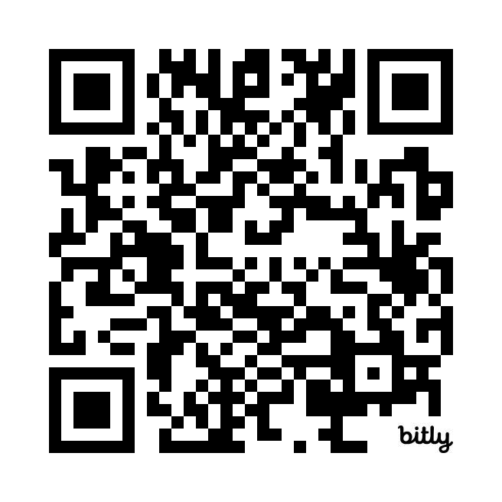
Save the Date!
IL Philosophy and Practice Summit – Reclaiming Our Movement
Join the IL-NET T&TA Center’s two-day learning intensive for conversation and action!
September 17 – 18, 2024
Register today at:
bit.ly/4fEThq8

Slide 7
Slide 7 Are you drawn into HR responsibilities?
Advertising for position openings?
Checking references?
Setting up interviews?
Conducting intake process, including filling out benefits forms, setting up new employee files, setting up payroll?
???

Slide 8
Who uses an external payroll firm?
How is that working?

Slide 9
Who uses an external HR firm?
Policies? Advice? Other?
How is that working?

Slide 10
Other HR or payroll responsibilities?
Questions before we turn off the recording?

Slide 11
Contact Information
Paula McElwee, Director of Technical Assistance at IL-NET Training &Technical Assistance Center for Independent Living at ILRU: paulamcelwee.ilru@gmail.com

Slide 12
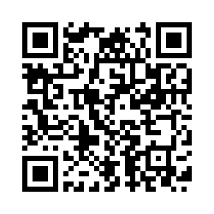
Evaluation Survey
Thank you for joining us today! We need your feedback so we can continue to provide you with peer calls that work for you. Please complete the brief evaluation at the following link: https://uthtmc.az1.qualtrics.com/jfe/form/SV_b8lwgiFTfl0p0uW
To view today’s presentation and previously recorded Financial Managers Training Peer Discussion presentations, please visit the following link: https://www.ilru.org/training/financial-managers-centers-for-independent-living

Slide 13
IL-NET Attribution
The IL-NET is supported by grant numbers 90ILTA0002 and 90ISTA0002 from the U.S. Administration for Community Living, Department of Health and Human Services, Washington, D.C. 20201. Grantees undertaking projects under government sponsorship are encouraged to express freely their findings and conclusions. Points of view or opinions do not, therefore, necessarily represent official Administration for Community Living policy.

