Slide 1
Participant-Direction in Health Payer Contracting for Centers for Independent Living
ILRU
Aging and Disability Business Institute

Slide 2



Webinar Instructions
Audio Options
Use your computer speakers, OR dial in using the phone number in your registration email.
All participants are muted.
Questions and Answers (Q&A)
You can submit questions for the panelists at any time during this presentation. On the Zoom module on the bottom of your screen, click the Q&A icon, type your question in the box and submit.
Chat Feature
The Chat feature allows webinar attendees, the host, co-hosts and panelists to communicate for the duration of the webinar.
Notes:
All attendees of this webinar are in listen only mode for the duration of the webinar. That means your microphone or phone will be muted. But there are still ways you can engage with our speakers today.
You can submit questions for the presenters or panelists at any time during this presentation by clicking the Zoom Question and Answer or “Q&A” button at the bottom of your screen. Type your question into the Q&A box and submit. There will be time at the end of the webinar to address attendees’ questions.
Please limit your use of the Chat Feature, another button at the bottom of your Zoom screen, for technical support. We have staff on the line to provide technical assistance at any time during the webinar. Click on the Chat button to submit a message to the host if you need technical support.
This webinar will be recorded, and we will share a link with you later this week.

Slide 3
Accessibility
Screen Reader Users: Reduce unwanted chatter
  Request speech on demand: Insert, Spacebar, “S”
To get our attention if you need tech assistance:
  Raise or Lower Hand: Alt + Y
Notes:
Screen Readers
To minimize unnecessary “chatter” for people using screen readers again, we are asking that all attendees use the Chat Box only for any technical issues that may arise, and if you have questions about webinar content, please use the Q&A feature.
For those who are using the JAWS screen reader and want to silence unwanted chatter in the chat and Q&A boxes, activate the “speed on demand” feature by pressing: Insert, Spacebar and then pressing the letter “S” on the keyboard
For those who are not able to use the chat feature:
Raise or lower hand: Press Alt + Y

Slide 4
Welcome to Participant-Direction in Health Payer Contracting for Centers for Independent Living
The Aging and Disability Institute values your perspectives on the effectiveness and usefulness of this webinar. At the end of the webinar, we will ask you to complete an evaluation survey. The survey link will appear on your screen after the webinar ends. Please complete and submit the form. This evaluation is important. We take your feedback seriously.

Slide 5
Participant-Direction in Health Payer Contracting for Centers for Independent Living
Molly Morris, Vice President, Applied Self-Direction
Suzanne Crisp, Senior Advisor, Public Partnerships Group, LLC
Amber O’Haver, Chief Revolutionary Officer/ Owner, Disability Revolution
Moderator Richard Petty, Director, IL NET Training and Technical Assistance Center for CILs and SILCs

Slide 6
Self-Direction Overview

Slide 7
What is Self-Direction?
Self-direction, sometimes called consumer direction, participant direction or self-determination.
Self-direction is a model of long-term care service delivery that helps people of all ages, with all types of disabilities, maintain their independence in their home and community
The person decides how, when, and from whom their services and supports will be delivered
As a model, self-direction prioritizes the person’s choice, control, and flexibility
7

Slide 8

What is Self-Direction?
Participant has choice and control
What
Who
How
When

Slide 9
Traditional Services
Self-Directed Services
Member
Workers recruited and report to agency
Agency specifies salary and benefits
Normal work hour schedule
Worker training required by agency
Program and agency set tasks
Case managers determine needs & services
Recruits and manages workers
Makes decisions about needs and services
Sets tasks
Member
Trains/ arranges worker training
Specifies salary and benefits (optional)
Assigns flexible work hour schedule

Slide 10
Self-Direction By State
WA
MT
ME
ND
VT
OR
MN
NH
ID
SD
WI
NY
MA
WY
MI
RI
IA
PA
CT
NV
NE
OH
NJ
UT
IL
IN
DE
CA
CO
WV
VA
MD
KS
MO
KY
NC
DC
TN
AZ
OK
SC
NM
AR
MS
AL
GA
TX
LA
AK
FL
HI
Less than 1,000 participants
5,000-9,999 participants
30,000-70,000 participants
Over 700,000 participants
1,000 – 4,999 participants
10,000-29,999 participants
Over 100,000 participants
Data source: 2023 Self-Direction National Inventory
10
Notes:
10

Slide 11
Continuum of Self-Direction
Individuals have EMPLOYER and BUDGET AUTHORITY to make flexible purchases of goods and services
Individuals have EMPLOYER AUTHORITY to hire, manage, and fire workers
Individuals share feedback and preferences with agency
11

Slide 12


Self-Direction Program Components
Person Self-Directing (Participant)
Manages and directs services
and supports, including being
the employer
Information & Assistance (I&A)
Provides guidance and resources on all aspects of self-direction, including support and encouragement
Financial Management Services (FMS) Entity
Supporting the regulatory and financial responsibilities of the self-directing participant
12

Slide 13
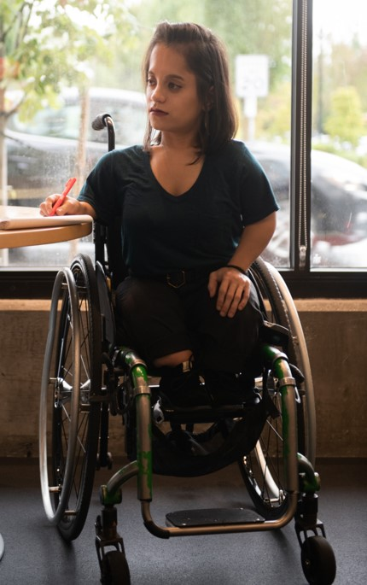
Participant's Role: Most Important
#1 priority
Self in self-direction
Ultimate decision maker
Other names include:
  Employer
  Client
  Consumer
Manages and directs services and supports
13

Slide 14

Participant’s Responsibilities
Understands and accepts the responsibilities of self-direction
Works within program guidelines
Works with case manager to create a person-centered plan
Follows spending plan
Hires staff: is the employer
Purchases goods and services if program allows
Openly communicate
Ask for assistance when needed
14

Slide 15

Information & Assistance Role
Provides information and assistance to the participant to ensure the participant can be successful when self-directing
Differs from the role of a traditional case manager
Differs from ‘Information & Referral’
Other names for this role used nationally include:
  Support Broker (IN will use this term)
  Support Coordinator
  Options Counselor
15

Slide 16

Information & Assistance Responsibilities
Provides guidance, resources, support and encouragement on all aspects of self-direction
Empowers vs. manages: “Important To” vs “Important For”
Works with the participant to create a person-centered plan
Informs the participant of self-directing responsibilities and independence
Provides tools for continued success
  Problem solving!
Cares about participant’s goals and personal outcomes
16

Slide 17

Financial Management Services (FMS) Entity Role
Supporting the regulatory and financial responsibilities of the self-directing participant, including fiscal, reporting, budget and employment responsibilities:
  Employer must be designated
  Taxes withheld and deposited
  Insurance must be paid
17

Slide 18

FMS Entity Responsibilities
Complete financial transactions based the spending plan of a participant
Ensure participants comply federal, state and program requirements, including those of an employer (hiring, training requirements, reporting)
Communicate about spending or payments with the participant and their team (case manager, broker, representative, employee etc.) as needed
Generate regular reports
18

Slide 19
Two Models of Financial Management Services
Fiscal/Employer Agent (F/EA) (Fiscal Intermediary) Vendor or Gov’t Model | Agency with Choice
Participant (or their representative) is the sole common law employer | Co-employment: Agency is the common law employer, and the participant (or their representative) is the managing employer
Participant usually assigns work, schedules, and supervises | Participant usually assigns work, schedules, and supervises, but agency have some say in the scheduling
The participant sets their own qualifications for the worker Minimum hiring and training standards from the state, usually related to safety of the participant. | Agency may have additional training requirements and standards for workers
FMS role is limited to payroll, regulatory functions and reporting
19

Slide 20
Self-Direction LTSS Funding Sources
Medicaid
  Offers self-directed services under a variety of federal authorities under the Social Security Act (e.g., §1915(c), §1915(i), §1915(k), and §1115 Demonstration and Evaluation)
Veterans Health Administration (VHA)
  Veteran Directed Care (VDC)
  4,400 Veterans in 42 states plus DC and Puerto Rico
State Revenues
  For example, Minnesota Consumer Support Grant
20
Notes:
Most of the funding comes from Medicaid which are waivers or state plan services. Out of the ones you see listed here, the 1915 c is the biggest, most common source of funding for self-directed services. These service have a federal and state combination of funding, federal dollars and state dollars.
VDC is trying to increase it’s share in the self-direction world. another source of funding for Veterans to self-direct. And what were seeing with VDC is that it’s growing in both people receiving VDC and states offering VDC
Some states have a state funded only program and you see one example here for the state of Illinois. This is where the state is funding the program as opposed to Medicaid where, as I mentioned before, programs are funded with state and federal dollars.

Slide 21
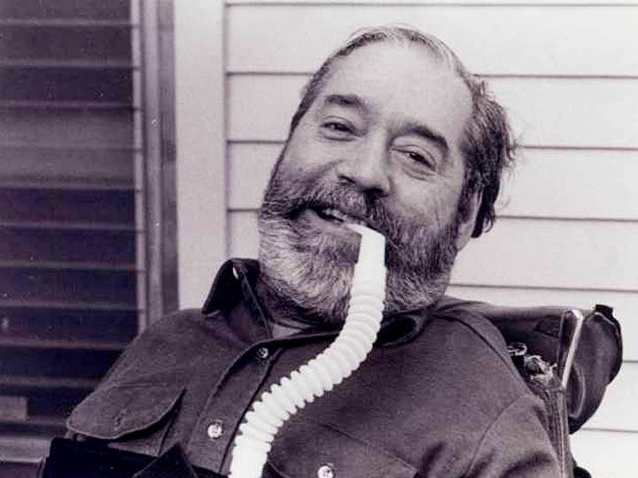
History of CILs and Self-Direction
Self-direction history is deeply rooted within the independent living movement
Early versions of self-direction were developed and advanced by independent living leaders
  Ed Roberts and other activists launched a self-direction attendant care program at the University of California at Berkeley in the late 1960s
  In 1972, self-direction was made available more broadly with the formation of the nation’s first Center for Independent Living (CIL)
Notes:
Richard to do

Slide 22
The Role of CILs in Self-Direction
The eventual adoption of self-direction more widely across the country was often seeded with the support of CILs
The degree of involvement of CILs in self-direction programs varies considerably from state to state
  Support for self-direction is well-aligned with the five core services of CILs, including:
    Peer Counseling
    Information & Referral
    Individual and Systems Advocacy
    Independent Living Skills Training
    Life Transition Assistance
  Some CILs contract with states to provide Financial Management Services (FMS) or to deploy Support Brokers
Notes:
Richard to do

Slide 23
Common Features of the ILM and Self-Direction
De-medicalization and de-professionalization culture
De-institutionalization goals
Consumer-driven practices and thinking
Community integration
Individual responsibility
Empowerment- self-help
Equality and equity
Choice, control, and quality services
Control of goods and services promoting independence/interdependence

Slide 24
Challenges to the ILM and Self-Direction
Workforce shortages
Unfounded perception that individuals will misuse funding if provided directly to them.
Apprehension about paying legally responsible individuals
Major state decision-makers are unfamiliar with the principles of ILM and self-direction.
Competition for funding between the elderly community, the disability community, and funding service individuals with developmental and intellectual disabilities.
Failure to conduct reliable cost studies.
The Electronic Visit Verification System has been difficult to implement.
Fair Labor Standards Act interpretations may be difficult to implement.

Slide 25
Collaboration Points - Advocacy
CILs can:
  Use their position to educate and inform state decision-makers, including legislatures, about the value of personal empowerment, choice, and control.
  Offer detailed information about self-direction – eligibility requirements and options to access services.
  Help with identifying underserved areas.
  Influence policy, laws, and budgets.
  Assist with ensuring quality services.
  Conduct personal experience surveys.
Self-directed advocates can:
  Identify instances to unite on common political topics.
  Serve on CIL and Self-Directed committees, advisory boards, and councils.
  Teach local CILs and health care payers about Self-Directed opportunities

Slide 26
Collaboration Points – Providing Direct Services
CILs might consider:
  Becoming an Agency with Choice or Fiscal Employer Agent vendor for self-directed services.
  Becoming the required information and assistance provider for self-directed services.
  Create training modules for self-directed direct care workers.
  Actively becoming a paid provider to offer service coordination with transitions.
  Develop a training curriculum for service coordinators.
  Train individuals self-directing to be an employer or co-employer, manage an individual budget, and purchase goods and services.
  Produce a direct care worker registry or system to “match” individuals with direct care workers.
  https://www.medicaid.gov/sites/default/files/2023-12/cib12122023_0.pdf
  Build a community procurement system to offer reasonably priced goods and services.
26

Slide 27
Participant-Direction in Health Payer Contracting for Centers for Independent Living Evaluation
The Aging and Disability Institute values your perspectives on the effectiveness and usefulness of this webinar. At the end of the webinar, we will ask you to complete an evaluation survey. The survey link will appear on your screen after the webinar ends. Please complete and submit the form. This evaluation is important. We take your feedback seriously.

Slide 28

Disability Led-Entities & Health Payer
Contracting Examples / Opportunities
January 30, 2024
Amber OHaver, Chief Revolutionary Officer
#DisruptingTheStatusQuo

Slide 29


FISCAL MANAGEMENT SERVICES (FMS)
Partnering and investing in Disability-Led / Owned / Directed Entities is key to furthering equity and opportunity
FMS start-up is hindersome, but Health Payers may have the unique ability to support and mentor CILs and Disability-Led Entities with new business ventures in the managed care space (like FMS)
Kansas CILs as FMS entities

Slide 30
INFORMATION & ASSISTANCE (I&A)
Typical I&A Providers in States
Area Agencies on Aging (AAAs) and Aging & Disability Resource Centers (ADRCs) are the largest provider of I&A in the country
FMS entities have also provided I&A
Potential Conflicts & Challenges with these entities doing I&A
Advantages of Disability-Lead Entities doing I&A
Leverages Existing Skill-Set
Support Brokerage
Peer to Peer – Trust & Similar Lived Experience
Pulse on local and state disability community
Virginia CILs (Service Facilitation) Health Payer Contracts

Slide 31
EDUCATION & TRAINING (including TA)
For Who (via Health Payers)?
Care & Service Coordinators
Vendors & Providers
Members & Beneficiaries with Disabilities
Member & Beneficiary Caregiver Support
About What?
Self-Direction 101
Self-Direction as a Solution to Workforce Shortage
Self-Direction as a Tool for Transition & Diversion
Self-Direction as a Mechanism to Foster Diverse Cultures & Communities
Self-Direction as a Road / Path to Empowerment
DSW Training for Peers with Disabilities (Emphasis on Self-Direction)
Notes:
Significant benefit of disability-led entities providing education and training
Automatic Peer to Peer Support

Slide 32
OUTREACH & STAKEHOLDER ENGAGEMENT
Community Listening Sessions for Members & Beneficiaries on Self-Direction
Focus Group Facilitation / Support of Members & Beneficiaries on Expansion & Enhancement of Self-Direction
Recruitment for Member & Beneficiary Advisory Sub-Committee on Self-Direction
Facilitation Support of Member & Beneficiary Advisory Sub-Committee on Self-Direction
Conduct Members & Beneficiaries Health Payer Satisfaction Interviews / Surveys on Self-Direction
Notes:
Significant benefit of disability-led entities providing education and training
Automatic Peer to Peer Support

Slide 33
EMPLOYMENT REFERRAL SOURCE
Partner with CILs / Other Disability-Lead / Driven Entities for employment referrals of consumers for open health payer positions
Recruitment and marketing pipeline for consumers / peers with disabilities seeking Direct Service Worker employment opportunities to provide Self-Directed Home and Community-Based Supports / Services for fellow peers with disabilities (Attendant Care, specifically) who are Health Payer members and beneficiaries

Slide 34
TRANSITION & DIVERSION
Health Payers can partner with Disability-Lead Entities to leverage self-direction as a tool / mechanism for deinstitutionalization and prevention efforts:
  Solution to address lack of Direct Support Workers
  Solution to address “care deserts”
  Solution to mitigate abuse and neglect
  Solution to better, more reliable quality care

Slide 35
THANKS / Q & A

Slide 36

CONTACT
700 N. Carr Rd. #1003
Plainfield, IN 46168
317.796.0537
disrupt@disability-revolution.com
www.disability-revolution.com
#DisruptingTheStatusQuo

Slide 37
Thank you for participating in this Aging and Disability Business Institute Training
The Aging and Disability Institute values your perspectives on the effectiveness and usefulness of this webinar. Please complete the evaluation survey form. The survey link will appear on your screen. Please complete and submit the form. This evaluation is important. We take your feedback seriously.

