Slide 1
New Community Opportunities Center
at ILRU Presents…
Best Practice Models to Enhance the Successful Transition to College and Careers
June 20, 2011
Presented by:
Margo Vreeburg Izzo, Ph.D.
Program Director
The Ohio State University
Nisonger Center
Izzo.1@osu.edu
614-292-9218

Slide 2
New Community Opportunities Center
at ILRU Presents…
Best Practice Models to Enhance the Successful Transition to College and Careers
June 20, 2011
Presented by:
Margo Vreeburg Izzo, Ph.D.
Program Director
The Ohio State University
Nisonger Center
Izzo.1@osu.edu
614-292-9218

Slide 3
Purpose of the Project
This presentation is part of a series of trainings and other activities provided to the IL field by the New Community Opportunities Center at ILRU. The project’s purpose is to assist CILs in developing self-sustaining programs that support community alternatives to institutionalization for individuals of any age, and youth transition from school to post-secondary education, employment, and community living.

Slide 4
Youth Transition Project Team
ILRU’s partners and collaborators in the youth transition activities include
Utah State University, Center for Persons with Disabilities
National Youth Leadership Network
Michele Martin, Social Media Consultant
Margo Vreeburg Izzo, Ohio State’s Nisonger Center
Association of Programs for Rural Independent Living

Slide 5
You will learn…
Part 1
The difference between services mandated
by IDEA of 2004 and Sec. 504
Evidence-based practices to prepare
youth with disabilities for college
Part 2
Essential college survival skills
Part 3
Examples of new models developed under the TPSID program

Slide 6
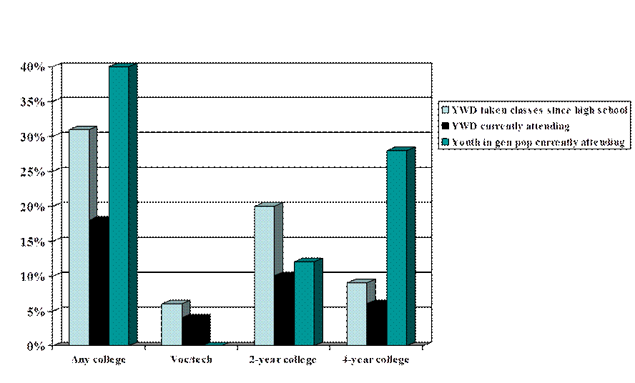
Table 1: Postsecondary School Attendance
(N = 12,000, NLTS2, 2004)

Slide 7
Requirements of Transition Legislation
(IDEA, 2004; P.L. 108-446)
Clarifies that the purpose of each student’s full, appropriate public education is to
“prepare them for further education, employment, and independent living.”

Slide 8
Postsecondary Goals
Generally understood to refer to goals that youth hope to achieve after leaving high school
  (IDEA 2004 Part B Regulations, §300.320(b), discussion of Final Rule p. 46,668)
    Employment
    Education/Training
    Independent Living

Slide 9
Legislation: IDEA, ADA, HEA & 504
  High Schools/LEAs
  Determine eligibility
  Deliver FAPE thru IEP
  Goals/objectives modify curricula – FAPE
  Access to general curricula w/ modifications
  Required to provide transition services, tutoring, accommodations, modifications
College Students
Self-identify
Provide documentation
No IEPs required
No modifications
Accommodations provided
Academic adjustments
  Priority registration
  Reducing course loads
  Course substitutions
  Extra time for tests
  Notetakers

Slide 10
High School and College
High School
Services delivered in general ed, special ed class, community
Receive age-appropriate transition assessment
Promotes movement to further education, employment, ILS
LEA must coordinate FAPE & transition services for students
College
Service provided by disability counselors
Not required to provide special classes
Increase in specialized programs designed specifically for youth w/ disabilities
Not required to provide FAPE; only academic adjustments required

Slide 11
Evidence Based Practices
Student Learning Communities (SLC)
  SLC for High School Students
  SLC for Advanced Students
Mentoring
  Peer and Professional mentoring
  Electronic and face-to-face
Assistive Technology
Work Based Experiences (i.e. Internships)

Slide 12
Student Learning Community
Weekly sessions totally ~ 20 hrs
Mixed mode
  Electronic, class trips, class meetings
Speakers who are near-peers, professionals, or disability/student services

Slide 13
Beginner Student Learning Communities
Designed for upper level high school students or first year college students
Matching Personality, Interests & Skills to Careers
Self-Advocacy, Disclosure & Transition Skills
Assistive Technology
Presentation of Self-Advocacy Plans
Leverage the benefits of work-based experiences (i.e. internships)
Increasing internal locus of control

Slide 14
Advanced Student Learning Communities
Designed for college students and graduate students
Transition assessments to promote awareness of skills, aptitudes and learning styles
Self-Advocacy & Disclosure
Finding internships and addressing issues of accessibility
Student responsibilities
Employability Skills (résumé development, personal statements)

Slide 15

Mentoring
“Mentoring relationships increase academic achievement, self-confidence and social skills, and decrease behavioral problems”*
Students participate through:
    listserv
    email
    face-to-face
*(Campbell-Whatley, 2001; Cartledge & Kourea, 2008; Leake, Burgstahler &Izzo, in press)

Slide 16
Assistive Technology (AT)
AT provided by secondary programs is often owned by the school district
AT owned by school district does not transition to college setting
Rehabilitation Services can purchase needed AT so students can learn to use AT
Recommendation: purchase AT for students while in High School so they become proficient AT users prior to attending college.
Notes:
15

Slide 17
Clarify Career Goals Work-Based Experiences
Career Exploration
Job Shadowing
Volunteer Work
Service Learning
Internships (unpaid and paid)
Apprenticeships
Paid Employment

Slide 18
Questions and Answers

Slide 19
Part 2: College Success Strategies
Know your GOALS for going to college
  Career
  Education/Lifelong Learning
  Social
  Employability Development
Balance education and employment goals

Slide 20
Use Disability Services
Use quality of disability services to make college choice
  Colleges are required to provide disability services but quality of services vary
  Some programs have expertise in specific disability categories: e.g.
    Gallaudet and Rochester Institute of Technology–Deaf/HoH
    Landmark College, VT: SLD, ADHD, ASD

Slide 21
Use Disability Services, cont’d.
Other programs cannot serve some disability categories as well as others: e.g.
    Colleges located in rural areas may have difficulty finding interpreters for Deaf/HoH students

Slide 22
Disability Documentation
Determine the types of documentation acceptable to IHE’s office of disability services
Gold Standard: WAIS within 3 years; Woodcock Johnson Achievement Battery
Summary of Performance – May be acceptable

Slide 23
Disability Documentation, cont’d.
Latest Evaluation Team Report (ETR) – more likely to be acceptable if adult versions of psychometric tests (mental measurements) completed within last 3 years
Request updated ETR in last 2 years of HS
  Use this ETR to gain accommodations on SAT/ACT

Slide 24
Ability Advising
Students have academic advisors and disability counselors:
  Academic Advisors have expertise on requirements of major & supports (i.e. tutoring)
  Disability Advisors have expertise on accommodations and self-advocacy
  Student must initiate meetings with above advisors.
  Ability Advisors are modeled after the NCAA support for athletes. They require students to meet on a pre-determined schedule.

Slide 25
Self-Advocacy
Develop a self-advocacy plan - Youth need to:
Understand their disability and how it affects their ability to learn and participate in college
Know academic strengths and weaknesses and what accommodations/supports are needed
Practice disclosing until they are comfortable talking about their disability and accommodations
National Collaborative on Workforce and Disability/Youth: www.ncwd-youth.info/
The 411 on Disability Disclosure: A Workbook

Slide 26
Plan for Managing Stress
Exams, papers, disclosure, scheduling classes:
  May lead to STRESS
Assist youth to develop a plan for managing stress
  Time management
  Organizational skills
  Gaining support services before stress damages academic standing
Daily Balance PLEASES: PLAN, LAUGH, EAT, ATTITUDE, STUDY, EXERCISE, SLEEP

Slide 27
Study and Time Management Skills
For every hour spent in class, encourage youth to schedule 2 – 3 hours for review, reading texts, study groups, writing papers, etc.
Take courses in HS and college on study strategies
Sponsor panels of successful college students to review study strategies specific to majors of interest (Arts/Humanities and STEM majors)

Slide 28
Benefits of Paid Internships
Real-world experience valued by employers
Career exploration – clarification of interests
Development of new skills
Improved self-esteem & ability to make decisions
Improved grades – academics linked to practice
Practice job seeking
Extra spending money
Opportunity to gain employment upon graduation

Slide 29
Practice Survival Skills in HS
While in High School, youth can:
Use accommodations likely to be approved in college settings (no modifications; only accommodations)
Develop self-advocacy plan
Advocate for accommodations independent of Special Ed Intervention Specialist
Gain time and stress management skills
Practice, Practice, Practice

Slide 30
FAME: Faculty and Administrator Modules
This online curricula for faculty and administrators
provides information on five interrelated modules:
Rights and Responsibilities of faculty, students, and disability service providers (R&R)
Universal Design for Learning (UDL)
Web Accessibility and assistive technology (WEB)

Slide 31
FAME: Faculty and Administrator Modules, cont’d.
College Writing strategies for all students (CW)
Climate Assessment strategies to develop a welcoming climate for students with disabilities (CA)
For More Info: http://fame.oln.org/

Slide 32
Questions and Answers

Slide 33
Higher Ed Opportunities Act of 2008
Authorized Model Demo Program for college opportunities for Students with ID
Congress appropriated $11M to fund 27 model demos and one Coordinating Center
Potential Pipeline of Students with ID:
Ages 12 – 17: 268,821
Ages 18 – 21: 72,679
341,500
Source: U.S. Department of Education, Office of Special Education Programs, Data Analysis System (DANS), OMB $18200043: Children with Disabilities Receiving Special Education Under Part B of the IDEA,” 2007.

Slide 34
College-Based Transition Programs
Students with ID who participated in dual enrollment programs in postsecondary settings had a high rate of paid employment.
From 2005-09, 96 students with ID received services from IDEA/LEA within college setting:
    89 were employed in paid employment
    Average wage was $8.00
For more info:
www.thinkcollege.net
INSIGHT, Issue No. 3, Oct. 2010

Slide 35
TOPS: Student Experiences
Individualized Supports
Peer Support | Mentoring | Family Support | Educational/Job Coaching
Inclusive Postsecondary Campus Experience
Enroll/Audit
College Courses
Project SEARCH Internships
Self-Determination
Health, Wellness
Independent Living skills
Residential
Campus Experiences
E-Portfolio
Each student exits the program with an e-portfolio that documents academic employment and independent living skills through digital pictures, video and documents.

Slide 36

Project SEARCH
Provides work experiences for youth with disabilities
Engages employers, community partners, employment service providers to meet workforce needs of businesses and job seekers
Youth learn job tasks at no expense to employer
Goal is EMPLOYMENT!
For more information: http://www.projectsearch.us/

Slide 37
Project SEARCH Activities
Education: Student recruitment, Instructor at each business site, Program Management (curriculum, billing, documentation and evaluation)
Vocational Rehabilitation: VR counselor participates in student evaluations and job development, funds Job Coaches provided by CRP who is CARF Accredited
Employer (Program Sites) – Participate in program evaluation, Overhead (space, phone, etc.), Classroom space with basic furnishings, Employer Liaison, Job sites (for worksite rotations)

Slide 38
Value of Internships
Improves employment outcomes
  (Luecking & Fabian, 2001)
Young people with disabilities more likely to obtain/retain employment as adults
  (Wagner, Newman, Cameto, Garza & Levine, 2005)
Significantly more successful in adult employment for up to 20 years after leaving school
  (Brown, Shiraga, & Kessler, 2006)

Slide 39
Participants Exit with an E-Portfolio
Flexible digital photo/video & print documents
Updated quarterly with new skills/experiences
Reformatted for different audiences
  Parents
  Employers
  Faculty
  Administrators
Formats range from PowerPoint – Digital Stories

Slide 40
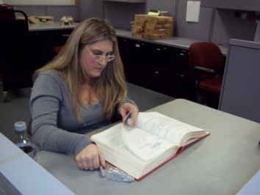
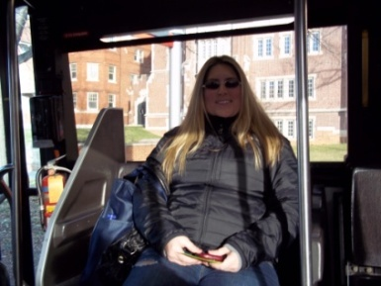
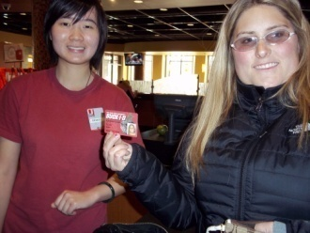
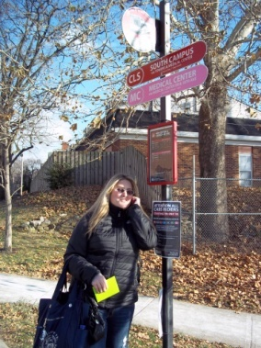
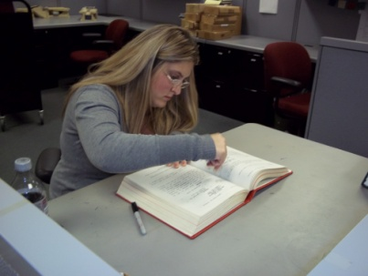
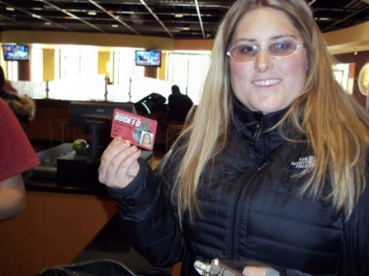
My Accomplishments
Used my Buck ID to purchase food
Used RPAC pass to workout
Completed my internship successfully
  Student Assistant at Moritz College of Law Library
Completed University Survey 100
Completed English 277
Independently navigates from internship to classes, meetings, and the RPAC.
RPAC- Met Robin to setup workout schedule routine
Friends made on campus
Questions

Slide 41
How Can CILs Assist Youth?
Advocate for work-based learning in IEP
Utilize assessments to assist youth transition to
college/careers
Make academics relevant by noting employment
applications (connect school and work skills)
Invite VR counselors to speak to staff, youth &
parents
Discuss student’s strengths and needs
Align accommodations provided in school with
those provided in college and work settings

Slide 42
Encourage Youth to:
Be assertive, but don’t be too strong or demanding
in telling others what you want.
Clearly state what you want and defend your right
to get it.
Ask for advice, but all final decisions are up to you.
Evaluate the progress you are making towards
your goals.
Make changes if necessary.

Slide 43
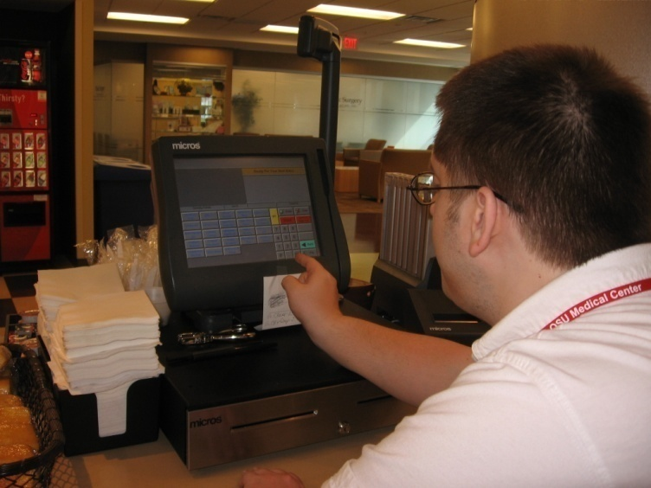
Benefits for Youth and Employers
Youth:
Identify career interests
Build self-confidence
Improve employment outcomes
Employers:
Display good corporate citizenship
Expand business outreach to under-represented populations
Reduce costs associated with hiring of new employees
Employers benefit from enhanced
diversity in their organization.

Slide 44
National Resources
1. Think College – www.thinkcollege.net
2. National Secondary Transition Technical Assistance Center: www.nsttac.org
3. National Collaborative on Workforce and Disability/Youth: www.ncwd-youth.info/
The 411 on Disability Disclosure: A Workbook
4. National Center for Secondary Education and Transition: www.ncset.org See Youthhood
5. Association of Higher Ed and Disability: www.ahead.org
6. Fast Facts for Faculty: Fact sheets on 12 different topics:
http://ada.osu.edu/resources/fastfacts/index.htm
7. FAME: http://fame.oln.org/

Slide 45
Questions and Answers

Slide 46
Wrap Up and Evaluation
Please complete the evaluation of this program by clicking here:
https://vovici.com/wsb.dll/s/12291g4a93e

Slide 47
New Resource for CILs
Your participation is invited in the new blog for CILs where you can read about and share tips and strategies for developing and providing youth transition services and programs.
Click here for CIL Youth Transition Blog

Slide 48
New Community Opportunities
Attribution
This webinar is presented by the New Community Opportunities Center, a national training and technical assistance project of ILRU, Independent Living Research Utilization. Support for development of this presentation was provided by the U.S. Department of Education, Rehabilitation Services Administration under grant number H400B100003. No official endorsement of the Department of Education should be inferred. Permission is granted for duplication of any portion of this slide presentation, providing that the following credit is given to the project: Developed as part of the New Community Opportunities Center at ILRU.

