Slide 1



CULTURAL AND LINGUISTIC COMPETENCE:
IMPLICATIONS FOR
STATEWIDE INDEPENDENT LIVING COUNCILS
Tawara D. Goode
August 9, 2011
National Center
for Cultural Competence

Slide 2
CULTURAL AND LINGUISTIC COMPETENCE:
IMPLICATIONS FOR
STATEWIDE INDEPENDENT LIVING COUNCILS
Tawara D. Goode
August 9, 2011
National Center
for Cultural Competence

Slide 3



Rationale for Cultural and Linguistic Competence
in Independent Living
Diversity of world views and beliefs about disability
Laws & Federal and State Mandates
Demographic changes in the U.S., its territories, and tribal communities
Address racial, ethnic, socio-economic, and geographic disparities
Improve quality, effectiveness, and satisfaction with services and supports
Slide Source:© 2011 - National Center for Cultural Competence

Slide 4
Why should SILCs address cultural and linguistic competence?
Access
Effectiveness
Acceptability
Satisfaction
improvement
Services
Supports
Outcomes
Slide Source:© 2011 - National Center for Cultural Competence

Slide 5
Culture is the learned and shared knowledge that specific groups use to generate their behavior and interpret their experience of the world. It includes but is not limited to:
roles
values
rituals
communication
languages
relationships
courtesies
thought
beliefs
practices
customs
manners of
interacting
expected
behaviors
Culture applies to racial, ethnic, religious, political, professional, and other social
groups. It is transmitted through social and institutional traditions and norms to
succeeding generations. Culture is a paradox, while many aspects remain the same,
it is also dynamic, constantly changing.
Slide Source:© 2011 - National Center for Cultural Competence
Data Source: Gilbert, J. Goode, T., & Dunne, C., 2007.

Slide 6
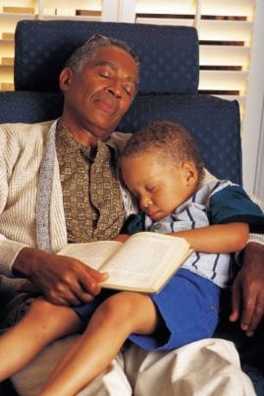
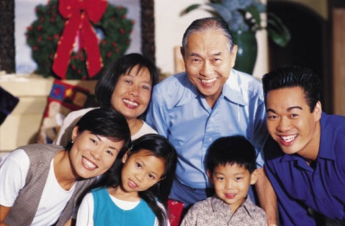

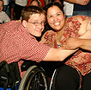


Cultural Diversity
The term cultural diversity is used to describe differences in ethnic or racial classification & self-identification, tribal or clan affiliation, nationality, language, age, gender, sexual orientation, gender identity or expression, socioeconomic status, education, religion, spirituality, physical and intellectual abilities, personal appearance, and other factors that distinguish one group or individual from another.
Goode & Jackson, 2009
Slide Source: © 2011 - National Center for Cultural Competence

Slide 7
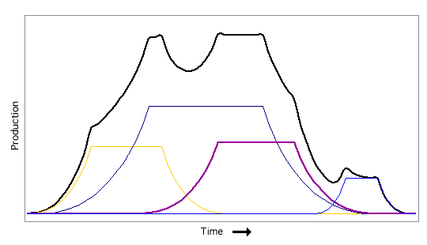
Multiple Cultural Identities
IMPORTANCE
POINT IN TIME & CONTEXT
Slide Source: 2011 - National Center for Cultural Competence

Slide 8
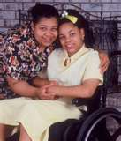
VIEWS ON DISABILITY IDENTITY
The population of people who
experience disability is extraordinarily
diverse and, therefore, the idea of a
common disability identity isolates
disability artificially from intersecting
identities related to race, gender, sexuality,
class, age, and other axes of social significance. (p.43).
SOURCE: Gill, C. & Cross, W. (2010). Disability Identity and Racial-Cultural Identity Development: Points of Convergence, Divergence and Interplay. In F. Balcazar, Y. Suarez-Balcazar, T. Taylor-Ritzler, & C. Keys (Eds.), Race, Culture, and Disability: Rehabilitation Science and Practice. Sudbury, MA: Jones and Bartlett Publishers
Slide Source: 2011 - National Center for Cultural Competence

Slide 9

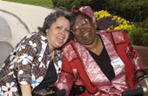
RACIAL IDENTITY vs. DISABILITY IDENTITY S ABOUT DISABILITY IDENTITY
There is no simple relationship between
race and disability.
Some people of color with disabilities have
prioritized their identification and affiliation
with persons who share their cultural/racial
heritage and have had little contact with
disability groups.
They tend to see disability in terms of
limitation rather than identity.(p.46)
SOURCE: Gill, C. & Cross, W. (2010). Disability Identity and Racial-Cultural Identity Development: Points of Convergence, Divergence and Interplay. In F. Balcazar, Y. Suarez-Balcazar, T. Taylor-Ritzler, & C. Keys (Eds.), Race, Culture, and Disability: Rehabilitation Science and Practice. Sudbury, MA: Jones and Bartlett Publishers
Slide Source: 2011 - National Center for Cultural Competence

Slide 10

RACIAL IDENTITY vs. DISABILITY IDENTITY
Some people of color have substantial
contact with disability groups.
They are more likely to identify as being
“disabled” and to reference parallels
between race and disability.
Some say that their experiences of
race-based oppression have prepared
them to understand disability as a social
minority experience. This suggests intersectional
expressions of identify. (p.46)
SOURCE: Gill, C. & Cross, W. (2010). Disability Identity and Racial-Cultural Identity Development: Points of Convergence, Divergence and Interplay. In F. Balcazar, Y. Suarez-Balcazar, T. Taylor-Ritzler, & C. Keys (Eds.), Race, Culture, and Disability: Rehabilitation Science and Practice. Sudbury, MA: Jones and Bartlett Publishers
Slide Source: 2011 - National Center for Cultural Competence

Slide 11

Cultural Competence
Definition & Framework

Slide 12
Are we on the same page?
Culturally aware
Cultural
humility
Culturally
relevant
Cultural
sensitivity
Culturally competent
Culturally & linguistically competent
Multicultural Competence
Culturally appropriate
Linguistically
competent
Culturally effective
Cultural
Proficiency
T.D. Goode
Slide Source:© 2011 - National Center for Cultural Competence

Slide 13
Cultural Competence
behaviors
practices
policies
attitudes
structures
requires that organizations have a clearly defined, congruent set of values and principles, and demonstrate behaviors, attitudes, policies, structures, and practices that enable them to work effectively cross-culturally
(adapted from from Cross, Bazron, Dennis and Isaacs, 1989)
Slide Source:© 2011 - National Center for Cultural Competence

Slide 14
Five Elements of Cultural Competence
Organizational Level
value diversity
conduct cultural self-assessment
manage the dynamics of difference
institutionalize cultural knowledge
adapt to diversity
        - policies - structures
        - values - services
(Cross, Bazron, Dennis and Isaacs, 1989)
Slide Source:© 2011 - National Center for Cultural Competence

Slide 15
Five Elements of Cultural Competence
Individual Level
acknowledge cultural differences
understand your own culture
engage in self-assessment
acquire cultural knowledge & skills
view behavior within a cultural context
(Cross, Bazron, Dennis and Isaacs, 1989)
Slide Source:© 2011 - National Center for Cultural Competence

Slide 16
ESSENTIAL ELEMENTS IN A
CULTURALLY COMPETENT SYSTEM
  These five elements must be manifested at every level of an organization including:
    policy makers
    administration
    practice & service delivery
    consumer/patient/family
    community
  and reflected in its attitudes, structures, policies, practices, and services.
Adapted from Cross, Bazron, Dennis, & Isaacs, 1989
Slide Source:© 2011 - National Center for Cultural Competence

Slide 17
Cultural Competence Continuum
(Cross, Bazron, Dennis and Isaacs, 1989)
Cultural
Proficiency
Cultural
Competence
Cultural
Pre-Competence
Cultural
Blindness
Cultural
Incapacity
Cultural
Destructiveness
Slide Source:© 2011 - National Center for Cultural Competence

Slide 18

Linguistic Competence
Definition & Framework

Slide 19
Languages Other Than English Spoken at Home in the U.S.
Total Population 5 years and over 285,797,349*
Speak Spanish or Spanish Creole 35,468,501
Speak Indo European languages 10,495,295
[French (Patois, Cajun), French Creole, Italian, Portuguese, Portuguese Creole, German, Yiddish, Other West Germanic languages, Scandinavian languages, Greek, Russian, Polish, Serbo-Croatian, Other Slavic languages, Armenian, Persian, Gujarathi, Hindi, Urdu, Other Indic languages]
Speak Asian and Pacific Island languages 8,698,825
[Chinese, Japanese, Korean, Mon-Kymer, Cambodian, Miao, Hmong, Thai, Laotian, Vietnamese, Tagalog, other
Pacific Island languages]
Other Languages 2,435,383
[Navajo, Other Native American languages, Hungarian, Arabic, Hebrew, African languages, other unspecified languages]
* Total estimated U.S. population including those who speak English
Data Source: S1601. Languages Spoken at Home, 2009 American Community Survey Year 1 Estimates, U.S. Census Bureau
Slide Source: National Center for Cultural Competence, 2011

Slide 20
What is Linguistic Isolation?
Linguistic isolation refers to households in which no person over the age of 14 speaks English at least very well
Linguistically Isolated Households in the U.S. in 2009
All households 4.7%
Households speaking--
Spanish 25.9%
Other Indo-European languages 16.6%
Asian and Pacific Island languages 27.5%
Other languages 17.2%
Data Source: U.S. Census Bureau
2009 American Community Survey – 1 Year Estimates
Slide Source: National Center for Cultural Competence, 2011

Slide 21
LINGUISTIC COMPETENCE FRAMEWORK
POLICY
DEDICATED
FISCAL
RESOURCES
PRACTICES
LINGUISTIC
COMPETENCE
DEDICATED
PERSONNEL
RESOURCES
STRUCTURES
PROCEDURES
Goode & Jones, Revised 2009, National Center for Cultural Competence
Slide Source:© 2011 - National Center for Cultural Competence

Slide 22

Linguistic Competence:
Legal Mandates, Guidance, and Standards

Slide 23
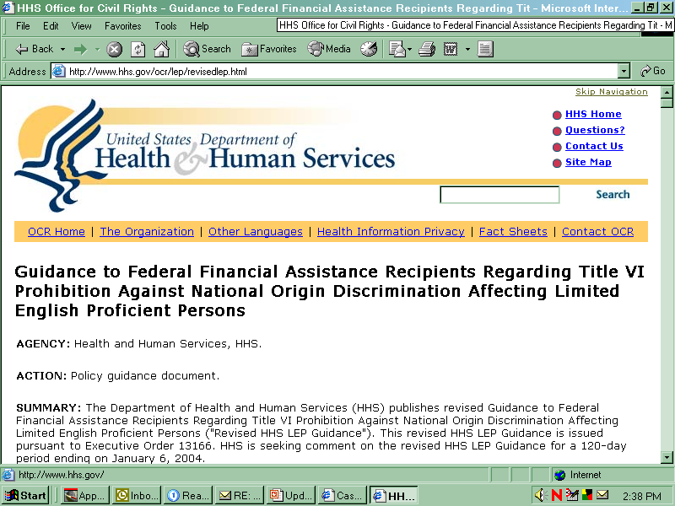
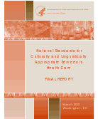
Linguistic Competence:
Legal Mandates, Regulations, Guidance, and Standards
Title VI of the Civil Rights Act of 1964,
Section 601 Non-Discrimination in
Federally-Assisted Programs
National Standards on Culturally
and Linguistically Appropriate Services
(CLAS)
Slide Source: National Center for Cultural Competence, 2011

Slide 24
Title VI - Civil Rights Act of 1964
SEC. 601 TITLE VI--NONDISCRIMINATION IN FEDERALLY ASSISTED PROGRAMS
Provisions related to language access:
Service providers should implement policies and procedures to provide access to services and information in appropriate languages other than English to ensure that persons with limited English proficiency are effectively informed and effectively participate in any benefit.
http://usinfo.state.gov/usa/infousa/laws/majorlaw/civilr19.htm
Data Source: Civil Rights Act of 1964, P.L. 88-62
Slide Source: National Center for Cultural Competence, 2011
Notes:
Civil Rights Act
The CRA of 1964 states that “No person in the US shall, on the ground of race, color, or national orgin, be excluded from participation in, be denied the benefits of, or be subjected to discrimination under any program or activity receiving Federal financial assistance” This includes programs designed to provide healthcare. Federal funding can be terminated if this is not followed. Although we will not discuss this at length, this also includes written materials, sign language interpreters and braille.
The entire document can be found at the following link.

Slide 25



Linguistic Competence:
Legal Mandates, Regulations, Guidance, and Standards
Non- Discrimination based on Race, Color, National Origin, Age, Disability, Sex
Title VI, Section 601, Civil Rights Act of 1964
Title IX, Education Amendments of 1972
Rehabilitation Act of 1973,
Section 504
Age Discrimination Act of 1975
Title II, Americans with Disabilities Act of 1990
Slide Source: National Center for Cultural Competence, 2011

Slide 26

Linguistic Competence:
The Roles of Health and Mental Health Literacy

Slide 27
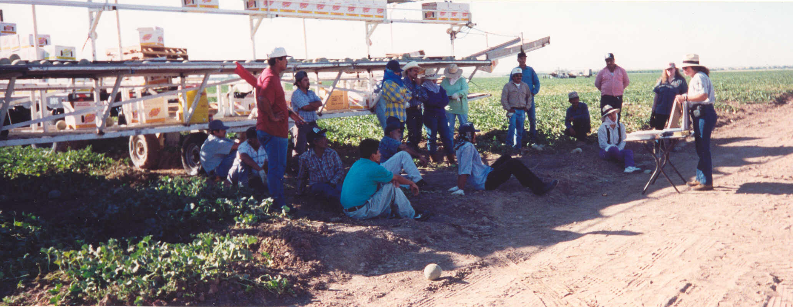
Definition of Health Literacy
The degree to which individuals have the capacity to obtain, process, and understand basic health information and services needed to make appropriate health decisions.
HP 2010: Health Communicationhttp://www.hrsa.gov/quality/healthlit.htm
DATA SOURCE: National Libraries of Medicine, 2000
Slide Source: National Center for Cultural Competence, 2011
Notes:
Who and what is a LEP? LEP is defined as individuals that do not speak English as their primary language and who have a limited ability to read, write, speak, or understand English may be limited English proficient, or “LEP”, and may be eligible to receive language assistance with respect to a particular type of service, benefit, or encounter (CRA guidance).

Slide 28



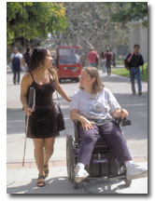
Definition of Mental Health Literacy
“Mental health literacy is the knowledge, beliefs, and abilities that enable the recognition, management, or prevention of mental health problems.”
Data Source: Canadian Alliance on Mental Illness and Mental Health
Slide Source: National Center for Cultural Competence, 2011
Notes:
Who and what is a LEP? LEP is defined as individuals that do not speak English as their primary language and who have a limited ability to read, write, speak, or understand English may be limited English proficient, or “LEP”, and may be eligible to receive language assistance with respect to a particular type of service, benefit, or encounter (CRA guidance).

Slide 29

Characteristics of Culturally & Linguistically Competent Organizations

Slide 30
Characteristics of Culturally & Linguistically Competent Organizations
philosophy
mission statement
policy, structures, procedures, practices
diverse, knowledgeable & skilled workforce
dedicated resources & incentives
community engagement & partnerships
publish & disseminate
advocacy
Slide Source:© 2011 - National Center for Cultural Competence

Slide 31

CLC: What are the implications for SILCs
INDEPENDENT LIVING SERVICES
acquire knowledge of cultural beliefs and practices
about the concept of “independent”
identify best and evidence-based practices on
increasing and enhancing independent living
services within culturally and linguistically diverse
communities
ensure that the state plan addresses the role of
cultural and linguistic competence in independent
living (i.e. philosophy, policy, and practice, evaluation)
Slide Source:© 2011 - National Center for Cultural Competence

Slide 32
CLC: What are the implications for SILCs
DATA GATHERING & ANALYSIS
TO INFORM PUBLIC POLICY
ensure the collection of racial, ethnic, and primary
language data for all independent living services
identify the nature and scope of disparities (i.e. race,
ethnicity, gender, primary language, geographic
locale)
develop reports that include policy implications of
addressing disparities within the state
conduct studies on preferences, needs, and
satisfaction with independent living services for
culturally and linguistically diverse groups
Slide Source:© 2011 - National Center for Cultural Competence

Slide 33
CLC: What are the implications for SILCs
ENGAGING COMMUNITIES IN SPIL DEVELOPMENT & EVALUATION
ensure that community engagement activities
incorporate cultural beliefs and practices
ensure that community engagement activities are
conducted in a culturally and linguistically
competent manner, including but not limited to:
- provision of language access services (interpretation and
translation)
- scheduling avoids cultural, religious, spiritual observances
- racial, ethnic, language and gender concordance (when
requested)
Slide Source:© 2011 - National Center for Cultural Competence

Slide 34
CLC: What are the implications for SILCs
ENGAGING COMMUNITIES IN SPIL DEVELOPMENT & EVALUATION
(cont’d)
ensure that community engagement activities are
conducted in a culturally and linguistically
competent manner, including but not limited to:
- recognizes and acknowledges culturally-defined approaches
to advocacy
- convene at times and settings in keeping with individual and
community norms
  - evaluation includes the extent to which culture and language
  are addressed
Slide Source:© 2011 - National Center for Cultural Competence

Slide 35
CLC: What are the implications for SILCs
ENGAGING COMMUNITIES IN SPIL
DEVELOPMENT & EVALUATION
conduct information dissemination and public awareness efforts about the SPIL within diverse communities including:
  urban, suburban, frontier
  tribal communities
  U.S. territories
ensure information dissemination in languages other than English
collaborate with cultural brokers and key community
informants to conduct community engagement activities
provide guidance on developing policy and practices that
support culturally and linguistically competent community
outreach and engagement
Slide Source:© 2011 - National Center for Cultural Competence

Slide 36
CLC: What are the implications for SILCs
STATE PLAN
Do goals, objectives, and/or strategies include a focus on:
- needs and preferences of underserved or inappropriately served
racial and ethnic groups?
- disparities by race, ethnicity, primary language, gender, geographic
locale?
- cultural and linguistic competence in the planning, delivering, and
evaluating independent living services?
- outreach and engaging diverse communities?
Does the budget allocate fiscal resources to address the needs and preferences of culturally and linguistically diverse populations?
Do strategies address compliance with Title VI, Section 601, Non-Discrimination in Federally-Assisted Programs?
Slide Source:© 2011 - National Center for Cultural Competence

Slide 37
CLC: What are the implications for SILCs
STATE PLAN
Does the plan:
report services provided in the state by race, ethnicity, primary language?
describe the capacity of the network of CILs to provide culturally and linguistically competent services?
describe how providers in the state’s independent living network collaborate to address disparities (i.e. race, ethnicity, primary language, geographic locale)? enhance cultural and linguistic competence?
include evaluation criteria that assesses cultural and linguistic competence?
specify budget line items to support state efforts to address underserved communities?
Slide Source:© 2011 - National Center for Cultural Competence

Slide 38



Applying the Principles and Practices of Cultural and Linguistic Competence to How the SILCs do their Work
Ensure that the SILC membership is reflective of the cultural and linguistic diversity within the state. Attend to gaps in representation when recruiting new SILC members.
Provide training to all members on the SILC's philosophy, policy, and practices on ensuring cultural and linguistic competence.
Slide Source:© 2011 - National Center for Cultural Competence

Slide 39
Applying the Principles and Practices of Cultural and Linguistic Competence to How the SILCs do their Work, cont’d.
Ensure the provision of interpretation and translation services to members who prefer and need language assistance.
Recognize and respond to cultural differences in conducting meetings, group decision-making, and information sharing in Council activities.
Slide Source:© 2011 - National Center for Cultural Competence

Slide 40
Cultural competence
and linguistic competence
are a life’s journey …
not a destination
Safe travels!
T.D. Goode
Slide Source: National Center for Cultural Competence, 2011

Slide 41

National Center for Cultural Competence
The content of and this PowerPoint presentation are copyrighted and are protected by Georgetown University's copyright policies.
Permission is required to use or modify this PowerPoint presentation:
  in its entirety, individual slides, or excerpts.
  for broad or multiple dissemination.
  for commercial purposes.
To request permission and for more information, contact cultural@georgetown.edu.
Please visit our website at http://nccc.georgetown.edu
Slide Source:© 2011 - National Center for Cultural Competence

Slide 42
Wrap Up and Evaluation
Please complete the evaluation of this program by clicking here:
https://vovici.com/wsb.dll/s/12291g4bb34

Slide 43
SILC-NET Attribution
This webinar/teleconference was presented by the SILC-NET, a project of the IL NET, an ILRU/NCIL/APRIL National Training and Technical Assistance Program. Support for this presentation was provided by the U.S. Department of Education, Rehabilitation Services Administration under grant number H132B070003-10. No official endorsement of the Department of Education should be inferred

