Slide 1


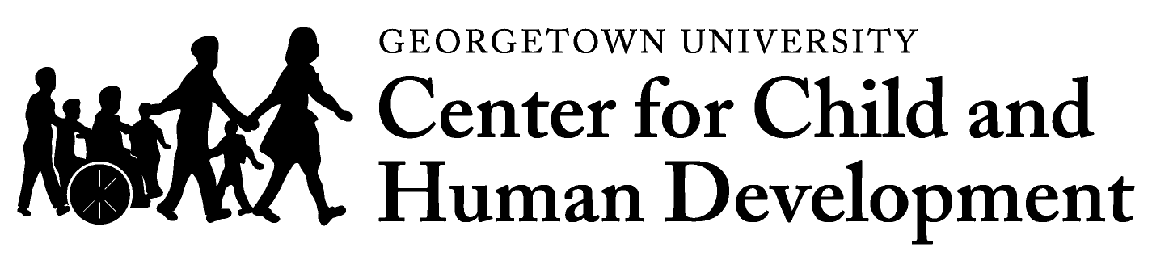
Cultural and Linguistic Competence in
Centers for Independent Living:
what will it take?
Tawara D. Goode
September 7, 2011
National Center
for Cultural Competence

Slide 2
Cultural and Linguistic Competence in
Centers for Independent Living:
what will it take?
Tawara D. Goode
September 7, 2011
National Center
for Cultural Competence

Slide 3



Some Reasons to Address Cultural and Linguistic Competence
Diversity of world views and beliefs about disability
Laws & Federal and State Mandates
Demographic changes in the U.S., its territories, and tribal communities
Address racial, ethnic, socio-economic, and geographic disparities
Improve quality, effectiveness, and satisfaction with services and supports
Slide Source:© 2011 - National Center for Cultural Competence

Slide 4
Exploring the Multiple Dimensions of Culture
and How They Intersect with Disability

Slide 5
Culture is the learned and shared knowledge that specific groups use to generate their behavior and interpret their experience of the world. It includes but is not limited to:
roles
values
rituals
communication
languages
relationships
courtesies
thought
beliefs
practices
customs
manners of
interacting
expected
behaviors
Culture applies to racial, ethnic, religious, political, professional, and other social
groups. It is transmitted through social and institutional traditions and norms to
succeeding generations. Culture is a paradox, while many aspects remain the same,
it is also dynamic, constantly changing.
Slide Source:© 2011 - National Center for Cultural Competence
Data Source: Gilbert, J. Goode, T., & Dunne, C., 2007.

Slide 6


Culture …
is applicable to all peoples
is active & dynamic
is multi-layered
is viewed as thick, thin, or compartmentalized
structures perceptions & shapes behaviors
is a total way of life –
tells group members how to behave,
and provides their identity
Culture is …
Adapted from Vivian Jackson, NCCC, 2003
Slide Source:© 2011 - National Center for Cultural Competence

Slide 7
Culture
Culture is akin to being the person
observed through a one-way mirror;
everything we see is from our own
perspective.
It is only when we join the observed
on the other side that it is possible to see ourselves and others clearly – but getting to the other side of the glass presents many challenges.
(Lynch & Hanson 1992 Developing Cross Cultural Competence)
Slide Source: 2011 - National Center for Cultural Competence

Slide 8
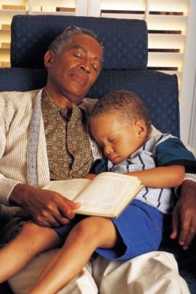
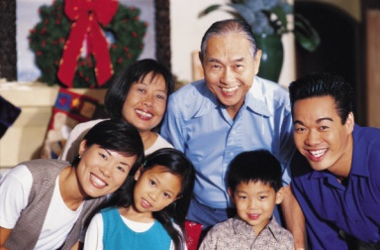

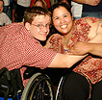


Cultural Diversity
The term cultural diversity is used to describe differences in ethnic or racial classification & self-identification, tribal or clan affiliation, nationality, language, age, gender, sexual orientation, gender identity or expression, socioeconomic status, education, religion, spirituality, physical and intellectual abilities, personal appearance, and other factors that distinguish one group or individual from another.
Goode & Jackson, 2009
Slide Source: © 2011 - National Center for Cultural Competence

Slide 9
Cultural Factors That Influence Diversity Among Individuals and Groups
Internal Factors
Cultural/Racial/Ethnic Identity
Tribal Affiliation/Clan
Nationality
Acculturation/Assimilation
Socioeconomic Status/Class
Education
Language
Literacy
Family Constellation
Social History
Perception of Time
Health Beliefs & Practices
Literacy
Health & Mental Health Literacy
Beliefs about Disability or Mental Health
Lived Experience of Disability or Mental Illness
Age & Life Cycle Issues
Gender, Gender Identity & Expression
Sexual Orientation
Religion & Spiritual Views
Spatial & Regional Patterns
Political Orientation/Affiliation
Adapted with permission from James Mason, Ph.D., NCCC Senior Consultant
Slide Source:© 2011 - National Center for Cultural Competence

Slide 10

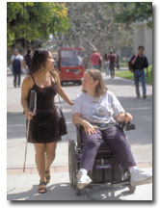
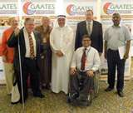
Cultural Beliefs about Disability
Superstition
Fate or Destiny
Karma
Malevolent Forces
Religiosity & Spirituality
Cultural & Familial Folklore
Natural Life Occurrence
Slide Source: © 2011 - National Center for Cultural Competence

Slide 11
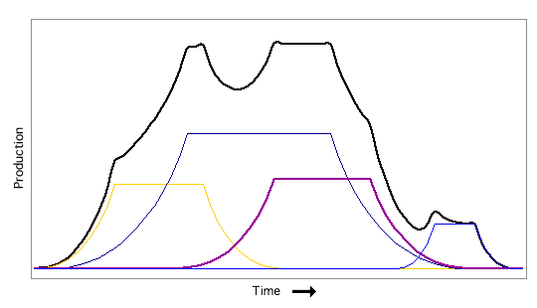
Multiple Cultural Identities
IMPORTANCE
POINT IN TIME & CONTEXT
Slide Source: 2011 - National Center for Cultural Competence

Slide 12
VIEWS ON DISABILITY IDENTITY
The population of people who
experience disability is extraordinarily
diverse and, therefore, the idea of a
common disability identity isolates
disability artificially from intersecting
identities related to race, gender, sexuality, class, age, and other axes of social significance. (p.43).
SOURCE: Gill, C. & Cross, W. (2010). Disability Identity and Racial-Cultural Identity Development: Points of Convergence, Divergence and Interplay. In F. Balcazar, Y. Suarez-Balcazar, T. Taylor-Ritzler, & C. Keys (Eds.), Race, Culture, and Disability: Rehabilitation Science and Practice. Sudbury, MA: Jones and Bartlett Publishers
Slide Source: 2011 - National Center for Cultural Competence

Slide 13
RACIAL IDENTITY vs. DISABILITY IDENTITY S ABOUT DISABILITY IDENTITY
There is no simple relationship between
race and disability.
Some people of color with disabilities have
prioritized their identification and affiliation
with persons who share their cultural/racial
heritage and have had little contact with
disability groups.
They tend to see disability in terms of
limitation rather than identity.(p.46)
SOURCE: Gill, C. & Cross, W. (2010). Disability Identity and Racial-Cultural Identity Development: Points of Convergence, Divergence and Interplay. In F. Balcazar, Y. Suarez-Balcazar, T. Taylor-Ritzler, & C. Keys (Eds.), Race, Culture, and Disability: Rehabilitation Science and Practice. Sudbury, MA: Jones and Bartlett Publishers
Slide Source: 2011 - National Center for Cultural Competence

Slide 14
RACIAL IDENTITY vs. DISABILITY IDENTITY
Some people of color have substantial
contact with disability groups.
They are more likely to identify as being
“disabled” and to reference parallels
between race and disability.
Some say that their experiences of
race-based oppression have prepared
them to understand disability as a social
minority experience. This suggests intersectional
expressions of identify. (p.46)
SOURCE: Gill, C. & Cross, W. (2010). Disability Identity and Racial-Cultural Identity Development: Points of Convergence, Divergence and Interplay. In F. Balcazar, Y. Suarez-Balcazar, T. Taylor-Ritzler, & C. Keys (Eds.), Race, Culture, and Disability: Rehabilitation Science and Practice. Sudbury, MA: Jones and Bartlett Publishers
Slide Source: 2011 - National Center for Cultural Competence

Slide 15

VIGNETTE
Paul, a CIL staff complained to his supervisor that he did not understand why Alberto would never make a decision on his own. Alberto always stated he wanted to talk it over with his family. Paul felt that Alberto did not understand the “independent” in independent living.
What are the cultural factors presented by this situation?
What guidance would you give as Paul’s supervisor?
Slide Source: © 2011 - National Center for Cultural Competence

Slide 16

Cultural Competence
Definition & Framework

Slide 17
Are we on the same page?
Culturally aware
Cultural
humility
Culturally
relevant
Cultural
sensitivity
Culturally competent
Culturally & linguistically competent
Multicultural Competence
Culturally appropriate
Linguistically
competent
Culturally effective
Cultural
Proficiency
T.D. Goode
Slide Source:© 2011 - National Center for Cultural Competence

Slide 18
Cultural Competence
behaviors
practices
policies
attitudes
structures
requires that organizations have a clearly defined, congruent set of values and principles, and demonstrate behaviors, attitudes, policies, structures, and practices that enable them to work effectively cross-culturally
(adapted from from Cross, Bazron, Dennis and Isaacs, 1989)
Slide Source:© 2011 - National Center for Cultural Competence

Slide 19
Five Elements of Cultural Competence
Organizational Level
value diversity
conduct cultural self-assessment
manage the dynamics of difference
institutionalize cultural knowledge
adapt to diversity
        - policies - structures
        - values - services
(Cross, Bazron, Dennis and Isaacs, 1989)
Slide Source:© 2011 - National Center for Cultural Competence

Slide 20
Five Elements of Cultural Competence
Individual Level
acknowledge cultural differences
understand your own culture
engage in self-assessment
acquire cultural knowledge & skills
view behavior within a cultural context
(Cross, Bazron, Dennis and Isaacs, 1989)
Slide Source:© 2011 - National Center for Cultural Competence

Slide 21
ESSENTIAL ELEMENTS IN A
CULTURALLY COMPETENT SYSTEM
  These five elements must be manifested at every level of an organization including:
    policy makers
    administration
    practice & service delivery
    consumer/patient/family
    community
  and reflected in its attitudes, structures, policies, practices, and services.
Adapted from Cross, Bazron, Dennis, & Isaacs, 1989
Slide Source:© 2011 - National Center for Cultural Competence

Slide 22
Cultural Competence Continuum
(Cross, Bazron, Dennis and Isaacs, 1989)
Cultural
Proficiency
Cultural
Competence
Cultural
Pre-Competence
Cultural
Blindness
Cultural
Incapacity
Cultural
Destructiveness
Slide Source:© 2011 - National Center for Cultural Competence

Slide 23

Linguistic Competence
Definition & Framework

Slide 24
Languages Other Than English Spoken at Home in the U.S.
Total Population 5 years and over 285,797,349*
Speak Spanish or Spanish Creole 35,468,501
Speak Indo European languages 10,495,295
[French (Patois, Cajun), French Creole, Italian, Portuguese, Portuguese Creole, German, Yiddish, Other West Germanic languages, Scandinavian languages, Greek, Russian, Polish, Serbo-Croatian, Other Slavic languages, Armenian, Persian, Gujarathi, Hindi, Urdu, Other Indic languages]
Speak Asian and Pacific Island languages 8,698,825
[Chinese, Japanese, Korean, Mon-Kymer, Cambodian, Miao, Hmong, Thai, Laotian, Vietnamese, Tagalog, other
Pacific Island languages]
Other Languages 2,435,383
[Navajo, Other Native American languages, Hungarian, Arabic, Hebrew, African languages, other unspecified languages]
* Total estimated U.S. population including those who speak English
Data Source: S1601. Languages Spoken at Home, 2009 American Community Survey Year 1 Estimates, U.S. Census Bureau
Slide Source: National Center for Cultural Competence, 2011

Slide 25
What is Linguistic Isolation?
Linguistic isolation refers to households in which no person over the age of 14 speaks English at least very well
Linguistically Isolated Households in the U.S. in 2009
All households 4.7%
Households speaking--
Spanish 25.9%
Other Indo-European languages 16.6%
Asian and Pacific Island languages 27.5%
Other languages 17.2%
Data Source: U.S. Census Bureau
2009 American Community Survey – 1 Year Estimates
Slide Source: National Center for Cultural Competence, 2011

Slide 26
Linguistic Competence
is the capacity of an organization and its personnel to
communicate effectively, and convey information in a
manner that is easily understood by diverse groups
including persons of limited English proficiency, those
who have low literacy skills or are not literate, individuals
with disabilities, and those who are deaf or hard of
hearing.
requires organizational and provider capacity to
respond effectively to the health literacy needs of
populations served
ensures policy, structures, practices, procedures
and dedicated resources to support this capacity
Goode & Jones, Revised 2009
Slide Source:© 2011 - National Center for Cultural Competence

Slide 27
LINGUISTIC COMPETENCE FRAMEWORK
POLICY
DEDICATED
FISCAL
RESOURCES
PRACTICES
LINGUISTIC
COMPETENCE
DEDICATED
PERSONNEL
RESOURCES
STRUCTURES
PROCEDURES
Goode & Jones, Revised 2009, National Center for Cultural Competence
Slide Source:© 2011 - National Center for Cultural Competence

Slide 28

Linguistic Competence:
Legal Mandates, Guidance, and Standards

Slide 29
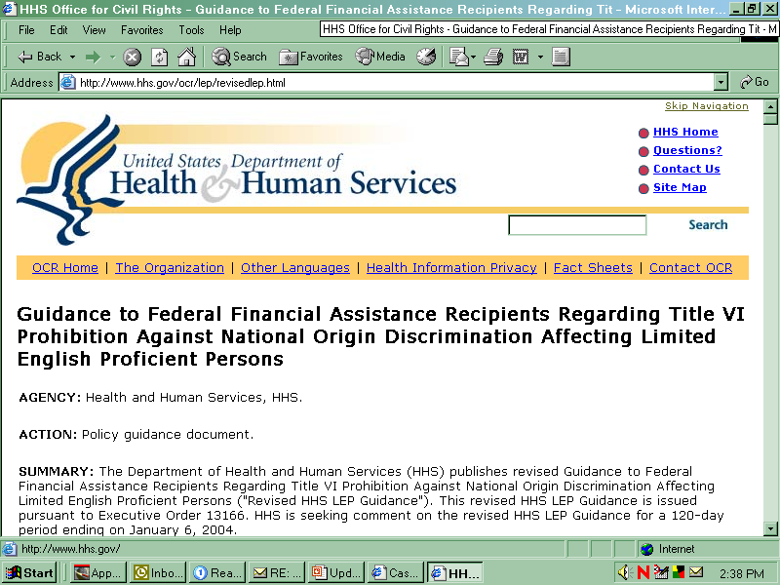
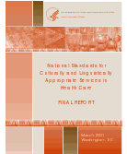
Linguistic Competence:
Legal Mandates, Regulations, Guidance, and Standards
Title VI of the Civil Rights Act of 1964,
Section 601 Non-Discrimination in
Federally-Assisted Programs
National Standards on Culturally
and Linguistically Appropriate Services
(CLAS)
Slide Source: National Center for Cultural Competence, 2011

Slide 30
Title VI - Civil Rights Act of 1964
SEC. 601 TITLE VI--NONDISCRIMINATION IN FEDERALLY ASSISTED PROGRAMS
Provisions related to language access:
Service providers should implement policies and procedures to provide access to services and information in appropriate languages other than English to ensure that persons with limited English proficiency are effectively informed and effectively participate in any benefit.
http://usinfo.state.gov/usa/infousa/laws/majorlaw/civilr19.htm
Data Source: Civil Rights Act of 1964, P.L. 88-62
Slide Source: National Center for Cultural Competence, 2011
Notes:
Civil Rights Act
The CRA of 1964 states that “No person in the US shall, on the ground of race, color, or national orgin, be excluded from participation in, be denied the benefits of, or be subjected to discrimination under any program or activity receiving Federal financial assistance” This includes programs designed to provide healthcare. Federal funding can be terminated if this is not followed. Although we will not discuss this at length, this also includes written materials, sign language interpreters and braille.
The entire document can be found at the following link.

Slide 31



Linguistic Competence:
Legal Mandates, Regulations, Guidance, and Standards
Non- Discrimination based on Race, Color, National Origin, Age, Disability, Sex
Title VI, Section 601, Civil Rights Act of 1964
Title IX, Education Amendments of 1972
Rehabilitation Act of 1973,
Section 504
Age Discrimination Act of 1975
Title II, Americans with Disabilities Act of 1990
Slide Source: National Center for Cultural Competence, 2011

Slide 32
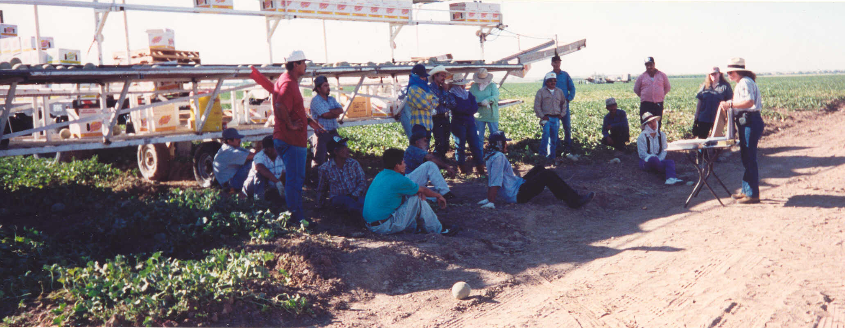
Definition of Health Literacy
The degree to which individuals have the capacity to obtain, process, and understand basic health information and services needed to make appropriate health decisions.
HP 2010: Health Communicationhttp://www.hrsa.gov/quality/healthlit.htm
DATA SOURCE: National Libraries of Medicine, 2000
Slide Source: National Center for Cultural Competence, 2011
Notes:
Who and what is a LEP? LEP is defined as individuals that do not speak English as their primary language and who have a limited ability to read, write, speak, or understand English may be limited English proficient, or “LEP”, and may be eligible to receive language assistance with respect to a particular type of service, benefit, or encounter (CRA guidance).

Slide 33
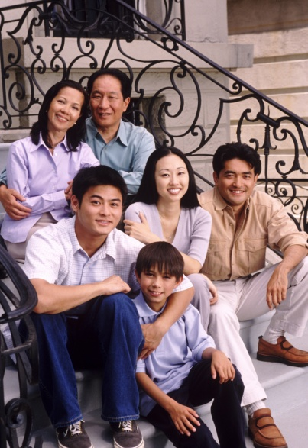
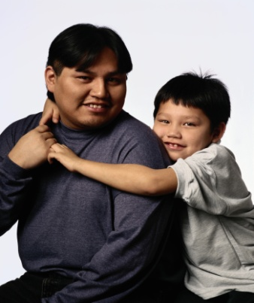
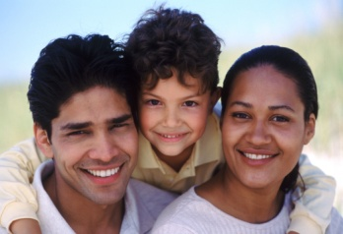
Definition of Mental Health Literacy
“Mental health literacy is the knowledge, beliefs, and abilities that enable the recognition, management, or prevention of mental health problems.”
Data Source: Canadian Alliance on Mental Illness and Mental Health
Slide Source: National Center for Cultural Competence, 2010
Notes:
Who and what is a LEP? LEP is defined as individuals that do not speak English as their primary language and who have a limited ability to read, write, speak, or understand English may be limited English proficient, or “LEP”, and may be eligible to receive language assistance with respect to a particular type of service, benefit, or encounter (CRA guidance).

Slide 34
Characteristics of Culturally & Linguistically Competent Organizations

Slide 35
Characteristics of Culturally & Linguistically Competent Organizations
philosophy
mission statement
policy, structures, procedures, practices
diverse, knowledgeable & skilled workforce
dedicated resources & incentives
community engagement & partnerships
publish & disseminate
advocacy
Slide Source:© 2011 - National Center for Cultural Competence

Slide 36

CLC: What are the implications for CILs
Individual and Systems Advocacy
Do the CIL’s disability awareness training activities
address cultural and linguistic differences?
Does the CIL conduct training in languages other
than English?
Are CIL staff knowledgeable of culturally-defined
beliefs and practices related to advocacy?
Does the CIL collaborate with ethnic and/or community-based organizations concerned with social justice for culturally and linguistically diverse groups?
Does the CIL advocate for reducing disparities in
services and supports among the population of
people who experience disability (e.g. race,
ethnicity, primary language spoken, geographic
locale)?
Slide Source:© 2011 - National Center for Cultural Competence

Slide 37
CLC: What are the implications for CILs
Information and Referral
Does the CIL have the capacity to:
(a) respond to phone call and e-mail inquiries in
languages other than English?
(b) disseminate information in multiple languages?
Is the CIL aware of and have relationship with community-based organizations that provide culturally and linguistically competent services and supports?
Does the CIL conduct follow-up to determine the extent to which referrals and information met the cultural and linguistic needs of individuals who experience disabilities? Is this information provided to organizations providing services and supports?
Does the CIL screen printed information for literacy levels
and cultural appropriateness?
Slide Source:© 2011 - National Center for Cultural Competence

Slide 38
CLC: What are the implications for CILs
Peer Support
Does the CIL offer peer support that recognizes preference for racial, ethnic, language, gender and age concordance?
Are “peers” provided training and/or coaching to recognize and respond to differing world views about disability?
Does the CIL have peers who speak languages other than English?
Are peers knowledgeable of how to work with foreign language interpreters?
Slide Source:© 2011 - National Center for Cultural Competence

Slide 39
CLC: What are the implications for CILs
Independent Living Skills Training
Does the CIL’s independent living skills training address culturally defined beliefs about independence?
Do CIL staff collaborate with natural, helping networks of
supports within diverse communities to conduct training?
Does the CIL use cultural brokers to assist with
curriculum development that provides a cultural context
for independent living in diverse communities?
Does the CIL conduct independent living skills training in languages other than English?
Slide Source:© 2011 - National Center for Cultural Competence

Slide 40
A Consumer Definition
of Cultural and Linguistic Competence
The services I need,
from a perspective I can relate to,
in a language I am comfortable with,
at a location I can get to.
Slide Source:© 2011 - National Center for Cultural Competence

Slide 41
Cultural competence
and linguistic competence
are a life’s journey …
not a destination
Safe travels!
T.D. Goode
Slide Source: National Center for Cultural Competence, 2010

Slide 42

National Center for Cultural Competence
The content of and this PowerPoint presentation are copyrighted and are protected by Georgetown University's copyright policies.
Permission is required to use or modify this PowerPoint presentation:
  in its entirety, individual slides, or excerpts.
  for broad or multiple dissemination.
  for commercial purposes.
To request permission and for more information, contact cultural@georgetown.edu.
Please visit our website at http://nccc.georgetown.edu
Slide Source:© 2011 - National Center for Cultural Competence

Slide 43
Wrap Up and Evaluation
Please complete the evaluation of this program by clicking here:
https://vovici.com/wsb.dll/s/12291g4be7c

Slide 44
New Community Opportunities
Attribution
This webinar is presented by the New Community Opportunities Center, a national training and technical assistance project of ILRU, Independent Living Research Utilization. Support for development of this presentation was provided by the U.S. Department of Education, Rehabilitation Services Administration under grant number H400B100003. No official endorsement of the Department of Education should be inferred. Permission is granted for duplication of any portion of this slide presentation, providing that the following credit is given to the project: Developed as part of the New Community Opportunities Center at ILRU.
43

