Slide 1
New Community Opportunities Center
Presents…
Effecting Policy Change in Medicaid
and Community Services
February 13, 2013
3:00P.M. – 4:30P.M. EST
Presenters:
Suzanne Crisp
Bruce Darling
0
Notes:
0

Slide 2
New Community Opportunities Center
Presents…
Effecting Policy Change in Medicaid
and Community Services
February 13, 2013
3:00P.M. – 4:30P.M. EST
Presenters:
Suzanne Crisp
Bruce Darling

Slide 3
Public Input and Government
A requirement of the Federal Administrative Procedures Act
Reduces conflict and litigation
Impacts outcome of legislation
Distributes expertise
Improves the product

Slide 4
Federal Regulations
Notice of Proposed Rule Making (NPRM)
Interim Federal Rule with Comments
Final Rule

Slide 5
Federal Policy Guidance
State Medicaid Directors Letter
Letters to State Officials
Information Bulletins

Slide 6
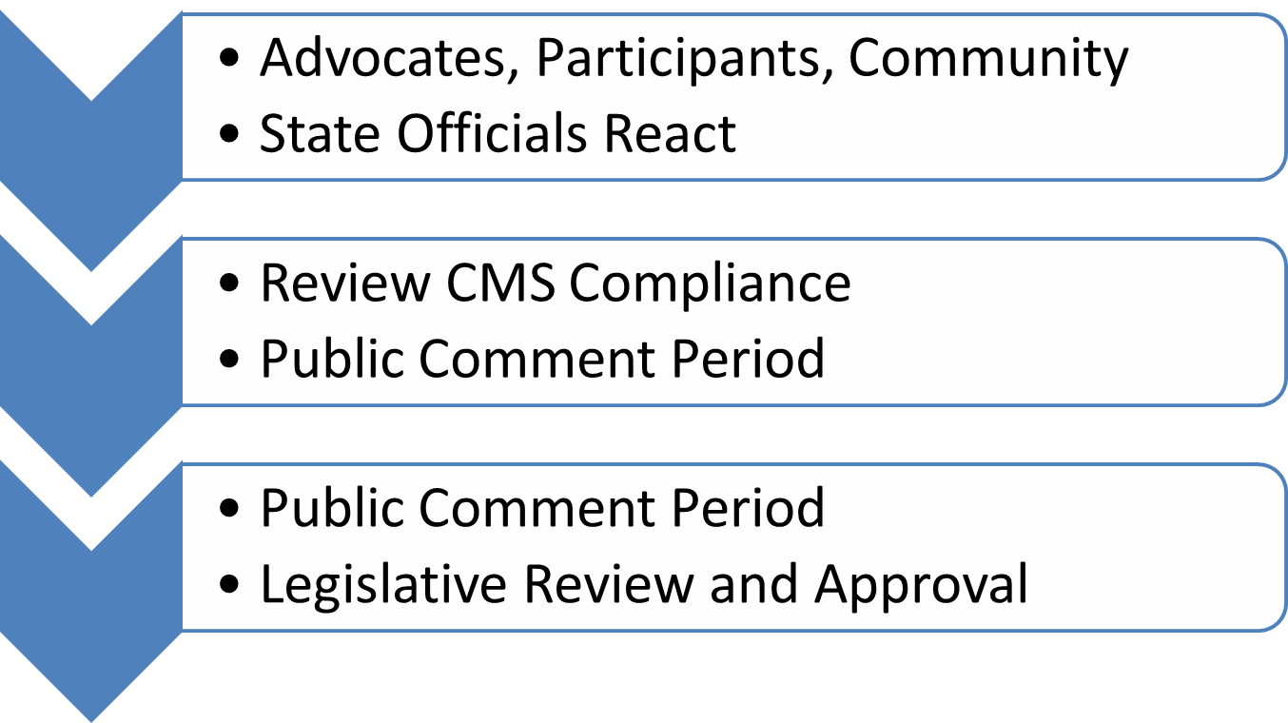
State Process
5

Slide 7
See DEHPG Organizational Chart
6

Slide 8
Questions??
Use the chat window on your screen to type in your questions.
Or press the number 7 on your telephone keypad to signal the operator.

Slide 9
Federal Authorities
Medicaid State Plan Services
Medicaid Home & Community Based Services (Waivers) 1915(c)
Medicaid HCBS 1915(i)
Medicaid HCBS (Self-Directed Option) 1915(j)
Community First Option 1915(k)
Section 1115 Demonstrations
Medicaid Managed Care Authorities
  Section 1915(a)
  Section 1915(b)
8

Slide 10
State Plan Services
Some HCBS services are available in the regular State plan:
  Personal Care
  Home Health (nursing, medical supplies, appliances, home health aid, etc.)
  Rehabilitative Services
  Targeted Case Management
  Self-Directed Personal Care
9

Slide 11
To Receive State Plan Services
Must be eligible for medical assistance under the State Plan
States must provide needs-based criteria to establish who can receive the benefit
Must reside in the community
Must have income that does not exceed 150% of the Federal Poverty Level
Affordable Care Act – states have the option to include individuals with incomes up to 300% of SSI and eligible for a waiver
10

Slide 12
Section 1915(c)
Provides an alternative to institutions
Currently the primary vehicle to offer non-institutional services to individuals with significant disabilities
Allows for consumer-directed options
States may set geographical locations
Offer different services to particular groups
11

Slide 13
Section 1915(c), cont’d.
Serves individuals in a home or “home-like” setting (but the definition of “home-like” may vary)
Income – may use the higher income ceiling (300% of SSI) and spousal impoverishment rules
Must be budget neutral but can use different approaches to this
  Individual budgeting
  Aggregate budgeting
  Mixed approach

Slide 14
Section 1915(i) State Plan HCBS
Established in 2007
Allows states to offer HCBS as a state plan benefit
Breaks the “eligibility link” between HCBS and institutional care
Most states use this option to cover behavioral health services
Consumer/self-direction may be an option
13

Slide 15
Section 1915(j)
Effective 2007
Allows states the option to provide consumer/self-directed personal assistance services (PAS) in the Medicaid State plan
May include permissible purchases
Participants set their own provider qualifications and train their providers of PAS
Must provide employer and budget authority
States may target and limit

Slide 16
Section 1915(k)
Community First Choice Option
Affordable Care Act added new option in 2010
Allows states to provide a “person-centered” home and community-based attendant services and supports
Individuals must meet institutional level of care (Nursing Facility, ICF-MR, IMD)
States will receive 6% in federal financial participation

Slide 17
Section 1915(k), cont’d.
Provides assistance with accomplishing
  Activities of daily living
  Instrumental activities of daily living
  Health related functions
Assistance provided through hands-on support, safety monitoring, and cueing
All services and supports must be consumer-controlled
  Agency-provider model
  Self-directed with budget model
  Other

Slide 18
Section 1915(b)/(c)
Combines two authorities
Section 1915(c) – typical Home and Community-Based Services offerings
Allows state to overlay voluntary or involuntary managed care practices
Michigan operates largest B/C
Trend has been to use the Section 1115 authority
17

Slide 19
1115 Demonstration Projects
Used when states seek to demonstrate whether a new service or intervention would lead to a change in Medicaid policy
The Secretary may waive compliance with any requirement under 1902 of the Social Security Act
Many states are using this authority to manage their entire Medicaid program

Slide 20
Dual Eligible Demos
State Demonstrations to Integrate Services for Dual Eligible Individuals (Medicaid/Medicare)
Person-centered models that coordinate primary, acute, behavioral and long-term supports and services
15 states selected: California, Colorado, Connecticut, Massachusetts, Michigan, Minnesota, New York, North Carolina, Oklahoma, Oregon, South Carolina, Tennessee, Vermont, Washington and Wisconsin
Get more info at: http://ly.adapt.org/duals

Slide 21
Where do I start?
Find out about the waivers in your state.
CMS has a webpage where you can see:
Section 1115 Research & Demonstration Projects
Section 1915(b) Managed Care Waivers
Section 1915(c) Home and Community-Based Services Waivers
Concurrent Section 1915(b) and 1915(c) Waivers
http://www.medicaid.gov/Medicaid-CHIP-Program-Information/By-Topics/Waivers/Waivers.html

Slide 22
Questions??
Use the chat window on your screen to type in your questions.
Or press the number 7 on your telephone keypad to signal the operator.
21

Slide 23
What is CMS telling the states?
READ IT FOR YOURSELF!
CMS issues guidance in the form of letters to State Medicaid Directors, letters to State Health Officials, and Informational Bulletins to communicate with states and other stakeholders regarding operational issues related to Medicaid.
(Tip: Search “Olmstead”)
http://www.medicaid.gov/Federal-Policy-Guidance/Federal-Policy-Guidance.html
22

Slide 24
You can’t fight City Hall!
So changing CMS must be impossible…
That’s WRONG!
We CAN change CMS!
23

Slide 25
Example 1: Changing the MDS
The Minimum Data Set (MDS) tracked the number of
people in nursing facilities that expressed an interest in
returning to the community…
but NOTHING was done with that information!
ADAPT changed that!
Now when an individual expresses an interest in
returning to the community they are supposed to be
referred for assistance.
24

Slide 26
Examples of MDS Change
CMS created a brochure for NF residents about returning to the community. It explains to the resident why they are being asked by facility staff whether they want more information about the possibility of returning to the community.
http://www.medicare.gov/publications/pubs/pdf/11477.pdf
25

Slide 27
Is the MDS change working?
If you aren’t sure what the process is in your
state, ask the State Point of Contact!
Here’s a link you can use to find that person.
http://www.ltcombudsman.org/sites/default/files/issues/LCA-Point-of-Contact%20List-Final2-Portrait.pdf
26

Slide 28
Example 2: Public Comment
States were making massive changes in their Medicaid
programs without advocates even knowing about it.
There were no public comment requirements for 1115
demonstration programs.
ADAPT changed that!
A final rule, effective on April 27, 2012, establishes a
process for ensuring public input into the development
and approval of new section 1115 demonstrations as
well as extensions of existing demonstrations.
27

Slide 29
Is the MDS change working?
If you aren’t sure what the process is in your state, ask the State Point of Contact!
Here’s a link you can use to find that person.
http://www.ltcombudsman.org/sites/default/files/issues/LCA-Point-of-Contact%20List-Final2-Portrait.pdf
28

Slide 30
Example 2: Public Comment
States were making massive changes in their Medicaid
programs without advocates even knowing about it.
There were no public comment requirements for 1115
demonstration programs.
ADAPT changed that!
A final rule, effective on April 27, 2012, establishes a
process for ensuring public input into the development
and approval of new section 1115 demonstrations as
well as extensions of existing demonstrations.
29

Slide 31
How can I make comments?
CMS has a web page for that!
Seriously.
Here’s yet another really long link you can use.
http://www.medicaid.gov/Medicaid-CHIP-Program-Information/By-Topics/Waivers/1115/public-comments.html
30

Slide 32
I don’t have 500 people willing to storm the HHS building in Washington.
What can I do?
Even without 500 activists, you
can make a difference.
31

Slide 33
Bring the national work home.
Nationally, we have fought to get the Aging and Disability Resource Centers to include the Centers for Independent Living.
In New York, we have scuttled the state’s application for ADRC funding and raised concerns regarding an 1115 waiver application because CILs were not adequately involved.
New York just applied for the Balancing Incentive Payment Program and described incorporating the CILs in its “No Wrong Door” system. Twice!
32

Slide 34
Five things advocates can do…
Participate in the public comment process.
Question state policy changes that promote institutionalization or undercut self-direction.
Ask the state how it is proactively supporting people in returning to the community from institutions.
Learn what other states are doing and ask why those best practices aren’t being done in your state. Use the State Medicaid Director letters!
Demand that managed care have consumer protections and use contract language/rates that promote community living.
33

Slide 35
Ask questions of CMS
When your state tells you…
“CMS told us we had to do it this way.”
Ask CMS.
Then close the loop with your state.
In New York, by doing this, we were able to be on
the call where CMS was giving guidance to the state
about implementing the Community First Choice
Option!
34

Slide 36
You don’t need to do it alone…
Find and work with experienced Medicaid “wonks” in your state.
Join (or START) a My Medicaid Matters Coalition! You can get ideas here: http://www.mmmtx.org
and http://www.adapt.org/main/medicaid_rally
Get involved in ADAPT. http://www.adapt.org/main.training
Learn from other CIL and ADAPT advocates. Many of us are happy to help. You can reach me by email at BDarling@cdrnys.org
35

Slide 37
Finally, a homework assignment
If your state has NOT selected the Community First Choice Option*, ask the state to do a formal analysis to determine whether it should. Insist they “show their work”.
Need help?
With just three links, you are a CFC expert!
http://ly.adapt.org/cfcoverview
http://cdrnys.org/files/CFC-FAQ-122211.pdf
http://adapt.org/main/cfcletter
*Arkansas, California, Louisiana, Maryland, Minnesota, New York, Rhode Island, and
Washington have either selected or announced they are selecting CFC.
36

Slide 38
Questions??
Use the chat window on your screen to type in your questions.
Or press the number 7 on your telephone keypad to signal the operator.

Slide 39
Wrap Up and Evaluation Survey
Your opinion counts! Click the link below to provide your evaluation of today’s webinar:
https://vovici.com/wsb.dll/s/12291g52608

Slide 40
For more information
Bruce Darling, President/CEO, Center for Disability Rights and ADAPT Organizer
bdarling@rochestercdr.org
Suzanne Crisp, Director of Program Design and Implementation for the National Resource Center for Participant-Directed Services at Boston College
suzanne.crisp@bc.edu

Slide 41
New Community Opportunities Center at ILRU
This program is part of a series of trainings and other activities provided to the IL field by the New Community Opportunities Center at ILRU. The project’s purpose is to assist CILs in developing self-sustaining programs that support community alternatives to institutionalization for individuals of any age, and youth transition from school to post-secondary education, employment, and community living. ILRU’s partners and collaborators in the project include:
  Utah State University, Center for Persons with Disabilities
  National Council on Independent Living
  Suzanne Crisp, national community alternatives expert
  Association of Programs for Rural Independent Living
  Michele Martin, Social Media Consultant

Slide 42
New Community Opportunities Center Attribution
This training is presented by the New Community Opportunities Center, a national training and technical assistance project of ILRU, Independent Living Research Utilization. Support for development of this presentation was provided by the U.S. Department of Education, Rehabilitation Services Administration under grant number H400B100003. No official endorsement of the Department of Education should be inferred. Permission is granted for duplication of any portion of this slide presentation, providing that the following credit is given to the project: Developed as part of the New Community Opportunities Center at ILRU.

