Slide 1
Get to the Core of It:
Information & Referral
December 11, 2013
Presenters:
Darrel Christenson
Roger Howard

Slide 2
Slide 2 Why is I&R a Core Service?
A primary means to promoting consumer empowerment
Supports an individual’s capacity for self-reliance and self determination
“Education, affirmation, collaborative planning, and problem solving”—AIRS
Provides a road map for navigating complex and confusing systems

Slide 3
Slide 3 I&R Core Service: The Human Approach –The First Point of Entry
Consumers contact I&R Specialist for:
Programs and services offered by their CIL
Independent Living Skills
Advocacy
Peer Support

Slide 4
Slide 4 The First Point of Entry, cont’d.
Consumers contact I&R Specialist for:
Resources offered within the community
Housing
Employment
Financial Assistance
Healthcare

Slide 5
Slide 5 Customer Service
For an I&R Specialist to succeed at providing relevant information, they must possess not only knowledge, but customer services skills as well
Know what you can and cannot do for the consumer
Know your boundaries/parameters—it’s ok
Let them down easy

Slide 6
Slide 6 Listening Skills
Listen and understand the consumer’s issues
Let the consumer speak without interruptions
Be nonbiased with your suggestions

Slide 7
Slide 7 Communication Skills
Relay information clearly and concisely to consumers over the phone
Have good written skills for consumers who choose to communicate by email or TTY
When face-to-face with consumer, show proper body language that is consistent with the matter at hand

Slide 8
Slide 8 De-escalation / Crisis Management
Do not take matters personally
Let consumer vent without interruptions
Make sure consumer knows that you are there to help
Utilize other resources around you
Offer to follow-up at a later date

Slide 9
Slide 9 Time Management & Prioritizing Responses
Establish routines and stick to them as much as possible
Get in the habit of setting time limits
Utilize a day planner or Outlook Calendar to schedule events and follow-up calls
Keep resources close at hand so you don’t waste time searching

Slide 10
Slide 10 Prioritizing Responses
Consider consumer’s needs
Look at their deadlines
What resources are available at that moment?
Is there another team member who can assist?
Keep your day planner/calendar close by to avoid overlapping of tasks
Don’t forget your other consumers

Slide 11
Slide 11 Follow Up and Consumer Relationships
Timely follow-up and call backs are simple ways to show you care and value them as a consumer
Follow-up can earn you additional open consumers, which means additional agency revenue
How do you feel when a business you solicited from follows-up with you?

Slide 12
Slide 12 Questions and Answers

Slide 13
Slide 13 The Art and Science of I & R: Connecting People & Resources
The Nuts and Bolts of I&R Include…
Record Keeping and Data Management
Information Resource Management
Policies and Procedures
Shared Responsibility among Staff versus Dedicated Staff Position
Community Collaborations

Slide 14
Slide 14 Record Keeping and Data Management
Helps assure accountability
Facilitates long-term planning and resource allocation
Identifies possible systems advocacy issues
AND
Can provide verifiable data for funding requests, grant proposals, and policy initiatives

Slide 15
Slide 15 Examples
23 referrals to Energy Assistance but only 6 received assistance (accountability)
Increased contacts for transportation resources after the only accessible taxi in town is gone (planning & resource allocation)
10 calls regarding lack of effective communication for medical appointments (systems advocacy!)

Slide 16
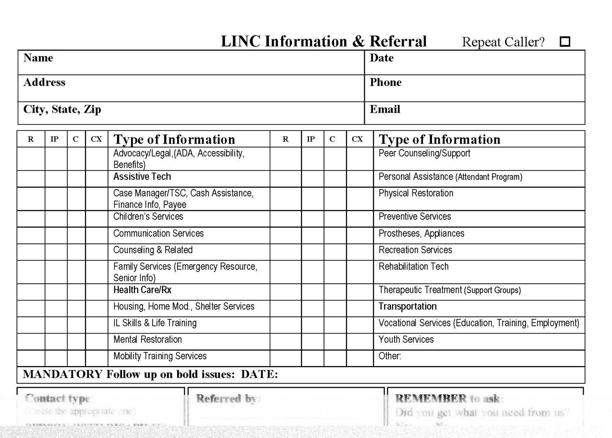
Slide 16 LINC I&R Form

Slide 17
Slide 17 Information Resource Management
Develop and maintain accurate resource lists
Catalog documents, publications, DVDs, etc.
Web-based resources—consumer desk with accessible work station and assistance available
Accessible formats

Slide 18
Slide 18 Catalog Example
ADA Title III
ADA Accessibility Guidelines
Common Problems in New Construction (Hotels, for example)
Databases searchable alphabetically, type of service, geographic area, eligibility, etc. Cross-Referenced!

Slide 19
Slide 19 Another Catalog Example: Accessibility
ADAAG
Fair Housing Standards
Visitability
ANSI Standards
Building Codes
Universal Design

Slide 20
Slide 20 Policies and Procedures
Information Provision
Referral Provision
Crisis Intervention
Cooperative Relationships
Promotion and Outreach
Follow-up
Disaster Preparedness

Slide 21
Slide 21 Shared versus Dedicated Staff Responsibility
Shared Approach
Can be more flexible
Empowers staff
Can lead to inconsistent customer service
Individual Approach
Can be more Specialized
Can free up and support other staff
When is an I&R more than an I&R?

Slide 22
Slide 22 Community Collaborations
211
General I&R versus I&R specific to disability issues
ADRCs
Information and assistance on long-term support options
Other I&R Providers
Other resources and databases

Slide 23
Slide 23 Questions & Answers
Notes:
23

Slide 24
Slide 24 I&R Resources
www.airs.org – Standards for I&R
www.wnyil.org/compendium – Forms, Policies, Procedures
Local and regional Alliances, 211

Slide 25
Slide 25 Contact Information
Darrel Christenson—Director of Community Integration, ABIL
(602) 296-0530 or darrelc@abil.org
Roger Howard—Executive Director, LINC
www.lincidaho.org
(208) 336-3335 or rhoward@lincidaho.org

Slide 26
Slide 26 Wrap Up and Evaluation
Please click the link below to complete your evaluation
of this program:
https://vovici.com/wsb.dll/s/12291g54cc7

Slide 27
Slide 27 CIL-NET Attribution
Support for development of this training was provided by the U.S. Department of Education, Rehabilitation Services Administration under grant number H132B070001. No official endorsement of the Department of Education should be inferred. Permission is granted for duplication of any portion of this PowerPoint presentation, providing that the following credit is given to the project: Developed as part of the CIL-NET, a project of the IL-NET, an ILRU/NCIL/APRIL National Training and Technical Assistance Program.

