Slide 1
New Community Opportunities Center at
ILRU Presents…
Centers for Independent Living as
Financial Management Service (FMS) Providers
Part 1: Basics
June 11, 2014
3:00 P.M.- 4:30 P.M. EDT
Presenters:
Lucia Cucu
Mollie Murphy
1

Slide 2
Financial Management Services (FMS)
Why does FMS exist?
Employer Authority and Budget Authority
Why might a CIL be an FMS provider?
Who is our competition?
What states have opportunities for FMS?

Slide 3
Self Direction Programs
Medicaid
  Managed Care
Veterans
Older Americans Act
Behavioral Health
Private Pay

Slide 4
Financial Management Services
Medicaid
  Requires FMS
Veterans
  Requires FMS
Older Americans Act
  Usually requires FMS
Behavioral Health
  Expect to require FMS in the future
Private Pay
  Optional, but useful for families

Slide 5
Solving Liability Concerns and
Administrative Burden
97%
of consumer direction programs use a third party Financial Management Services provider to handle payroll, taxes, insurances & budget management on consumer behalves
75%
use a Fiscal/Employer Agent model of Financial Management Services. In this model, the consumer is the common law employer (employer of record) and the Fiscal/Employer Agent performs all payroll, tax and insurance responsibilities. The Fiscal/Employer Agent takes on joint liability for the federal taxes under a special section of the Internal Revenue Code.
-From Inventory of Participant Direction, National Resource Center for Participant-Directed Services, 2011

Slide 6
Hallmarks of Self-Directed Services
Participant directly hires, trains, supervises and discharges workers
Workers may be consumer’s friends, neighbors, family members or be identified from some other source (e.g. placing an ad in a newspaper)
Participant manages allocation of his/her program resources
Participant determines the mix of goods and services that meet his/her individual needs (ideally)

Slide 7
Questions?

Slide 8
Complexity in Managing Services and Supports
Directly hiring non-agency workers means serving as an employer of those workers
Employers have important responsibilities including:
  Hiring, managing, scheduling, training, and discharging
  Withholding, calculating, depositing and filing required taxes
  Managing required insurance
  Paying workers in accordance with federal, state and local laws
Notes:
This slide needs to talk about the employer responsibilities that consumer employers in these programs come under almost all of the same rules as other employers.

Slide 9
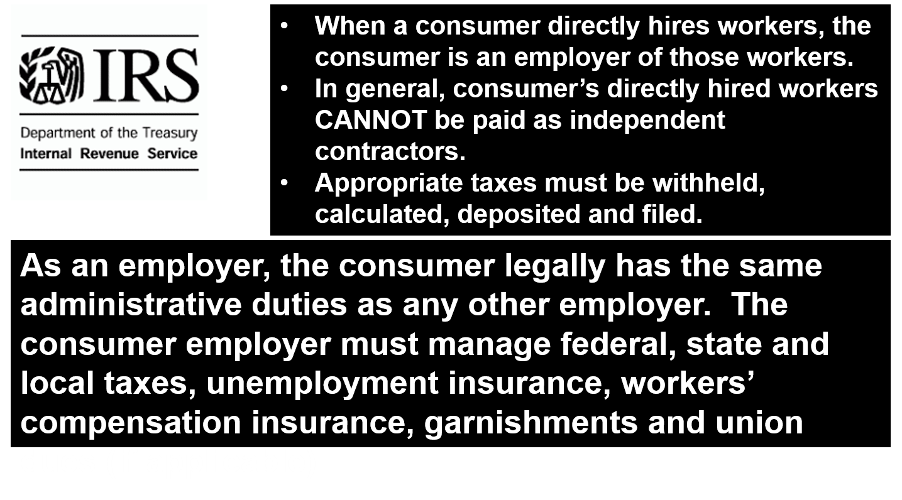
Why Financial Management Services?

Slide 10
When Employers Pay Employees They Generally Must…
Withhold federal income tax from employee pay (optional for household employees)
Withhold Social Security & Medicare taxes from employee pay
File and deposit with the IRS withheld employee federal income, Social Security and Medicare taxes and the employer portions of Social Security and Medicare taxes
File and deposit federal unemployment taxes
File and deposit state unemployment taxes
Maintain compliance with any employee state or local income or disability tax rules, including withholding from employee pay as well as filing and depositing with state and local tax agencies, as applicable
Notes:
When consumers have workers in consumer direction programs, all of this has to be done by someone.

Slide 11
When Employers Pay Employees They Generally Must…cont’d.
Provide employees with year-end information returns, such as Forms W-2
Maintain compliance with state workers’ compensation statutes
Verify that employees are authorized to work in the United States
Maintain compliance with other state rules, such as state pay day requirements
Maintain compliance with the Federal Fair Labor Standards Act
Notes:
When consumers have workers in consumer direction programs, all of this has to be done by someone.

Slide 12
FMS is a Participant Support
FMS providers perform administrative responsibilities so that:
  Consumers can focus on managing their services and supports
  Tax, employment and insurance regulation compliance is maintained
  Payments to consumer’s providers are made in accordance with budget
  Additional controls are in place to detect and prevent fraud and abuse

Slide 13
FMS Duties
FMS provider:
  supports the consumer through the administrative process of being an employer
  supports the consumer to ensure workers are legally hired
  can conduct criminal background checks on workers
  ensures that workers and other providers are paid in compliance with applicable rules and regulations
  makes payments in accordance with spending plans, authorizations and program rules
    This includes paying workers, agencies, or other goods and services vendors

Slide 14
FMS Duties, cont’d.
FMS provider:
  has controls in place to detect and prevent fraud and abuse
  helps protect the consumer by getting workers’ compensation policies in place
  generates reports for consumers and program administrative agencies showing expenditures and individual budget information
  maintains fiscal accountability and oversight in a flexible program

Slide 15
What Determines the FMS’ Duties?
A lot, but an important determinant of an FMS provider’s duties is the type of authority offered for consumers within the program
These include:
Budget Authority
  Employer Authority
The original “Cash & Counseling” program had both budget authority and employer authority
In the Veteran-Directed HCBS program, both budget authority and employer authority are required
Notes:
The two types of authority in consumer direction programs are budget authority and employer authority. At Boston College we say that having either of these makes a program consumer directed. Programs could have one or both of these authorities. How these authorities are implemented and exercised will impact the consumer direction a program offers. They’ll of course influence FMS services, too.

Slide 16
Budget Authority
Budget Authority means that a consumer has choice and control over what goods and services to purchase within their spending plan and how to allocate their money within their spending plan
The FMS entity’s role is to:
  Maintain separate accounting for each consumer-directed budget
  Process invoices (vendors) & timesheets (workers) in accordance with each consumer’s budget
  Only pay those invoices and timesheets that are approved in the budget and meet other program requirements
  Prepare reports showing budget amounts, spending and amounts remaining
Notes:
Read the slide.

Slide 17
Employer Authority
Employer Authority means that a consumer can directly hire workers of his/her choice and will train, manage, schedule and dismiss workers.
The FMS entity’s role is to:
  facilitate employment of workers by the consumer or representative by performing certain employer responsibilities as an agent of the consumer employer
  process payroll
  withhold and deposit applicable employee Federal, State and Local income taxes
Notes:
Again, employer authority and budget authority can exist simultaneously in a program or indepentently

Slide 18
Employer Authority, cont’d.
The FMS Entity’s role is to:
  file and deposit applicable employer Federal, State and Local employment taxes, including unemployment, Social Security and Medicare taxes
  file employer tax returns and issue year-end wage and earnings statements (e.g. IRS Forms W-2, IRS Forms 1099, State Forms W-2, 1099 or equivalent)
  support the consumer to maintain compliance with applicable workers’ compensation regulations
  support the consumer to review worker authorization information and collect applicable employment forms from workers

Slide 19
Questions?

Slide 20
Why consider FMS?
This is a tough business
  Steep learning curve
  Significant investment required
  Financial risk often involved
  Legal risk
FMS offers another opportunity to be involved in self direction in a deep and meaningful way
  FMS is critical to self direction program operations
  CILs are uniquely positioned to support participants to self direct through FMS
  Opportunity to diversify revenue

Slide 21
Who is our competition?
For-profit companies with deep FMS expertise
Non-profit entities with deep FMS expertise
For-profit and non-profit home health agencies who also provide FMS in self direction
Sometimes, other CILs

Slide 22
How do programs choose FMS providers?
Medicaid
  FMS as a Medicaid service
    Consumers must have the choice of any qualified provider
    Result = multiple to many FMS providers
  FMS as an Administrative function
    Program procurement process, usually guided by state procurement rules
    Request for Proposal
    Request for Bid
    Request for Qualifications
    Contract
    Result = One to a few FMS providers

Slide 23
Medicaid Managed Care
When self direction is offered through Medicaid Managed Care, often (but not always) the Managed Care Organization (MCO) determines how FMS is delivered
  The MCO often purchases it from an FMS provider that they select
  Working with an MCO can be a good way to get FMS experience without a state procurement process

Slide 24
How do programs choose FMS providers?
Veteran-Directed HCBS
  Aging Network Entities (ADRCs, AAAs, ASAPs, SUAs) decide how FMS will be provided
    They provide it in-house (not often)
    They purchase it from an FMS provider without experience with VD-HCBS (sometimes)
    They purchase it from an FMS provider with experience with VD-HCBS (most often)
  Sometimes state procurement rules govern the process, but most often the private Aging Network Entities decide how to provide/purchase FMS

Slide 25
How do programs choose FMS providers?
Older Americans Act
  Aging network entities tend to decide how FMS will be provided or purchased
Behavioral Health
  To be seen
Private Pay
  Not required, but can be helpful to families.

Slide 26
Program Procurement Process
Most programs procure with a structured, scored process, such as a Request for Proposal
  Proposals may be 50 – 150+ pages in length. Great effort expended to respond to detailed, technical proposals
  Usually, experience with FMS is required, often of the same size and scope of the opportunity in question
  Competing against established, experienced providers
To qualify to provide as Medicaid service:
  must exhibit proof of meeting qualifications
  made available for consumers to choose you

Slide 27
How long might the work last?
FMS provider contracts secured by a procurement process like an RFP usually last for around 3 years, often with options for extensions
Switching costs are high
  Programs want to make a good selection so they can keep the same FMS provider for as long as their procurement rules allow them

Slide 28
How long might the work last?
Work secured by qualified provider lasts as long as the provider is selected by consumers and continues to meet qualifications
Contracts without a formal RFP process usually last as long as specified by contract

Slide 29
Information on States
California Regional Centers for ID/DD population consider less established providers
DC is expected to pursue self direction and FMS but will likely require FMS provider with experience
Kansas currently takes any qualified provider for one of their self direction programs
Missouri PCA CDS program takes any qualified provider
North Carolina just delayed an RFP; looking for a single provider with experience

Slide 30
Information on States, cont’d.
Texas takes any qualified provider for their CDSA program
Wisconsin counties have contracts for provision of Family Care FMS providers and sometimes work with providers with less experience
Watch states moving to Medicaid Managed Care
  Develop relationships with MCOs

Slide 31
Questions?
Many free resources at www.participantdirection.org
I’m happy to help: mollie.murphy@annkissam.com
Cell: 617-953-3914

Slide 32
Wrap Up and Evaluation
Please click the link below to complete your evaluation of this program:
https://vovici.com/wsb.dll/s/12291g5667b
33

Slide 33
New Community Opportunities
Attribution
This training is presented by the New Community Opportunities Center, a national training and technical assistance project of ILRU, Independent Living Research Utilization. Support for development of this presentation was provided by the U.S. Department of Education, Rehabilitation Services Administration under grant number H400B100003. No official endorsement of the Department of Education should be inferred. Permission is granted for duplication of any portion of this slide presentation, providing that the following credit is given to the project: Developed as part of the New Community Opportunities Center at ILRU.

