Slide 1
New Community Opportunities Center at
ILRU Presents…
Centers for Independent Living as
Financial Management Service (FMS) Providers Part 2: Models of FMS
June 18, 2014
3:00 P.M.- 4:30 P.M. EDT
Presenters:
Lucia Cucu
Mollie Murphy
1

Slide 2
Today’s Agenda
Models of FMS
Difference between FMS and “payroll”
CIL staff skills, expertise needed
Investment considerations
“Upside” of FMS

Slide 3
Models of FMS
Two primary models of FMS used in most consumer direction programs
  Fiscal/Employer Agent
  Agency with Choice
Both models can have:
  Employer Authority &
  Budget Authority

Slide 4
Models of FMS: Fiscal/Employer Agent
Two types of Fiscal/Employer Agent (F/EA):
  Government F/EA
  Vendor F/EA
Consumer (or representative) is the common law employer of home-based workers who are employees. Consumer hires, fires, trains and manages workers.
The F/EA supports the consumer to complete and file appropriate tax forms to become an employer, manages payroll duties on behalf of the employer and withholds, deposits and files applicable taxes on the employer’s behalf. The F/EA may manage applicable workers’ compensation duties.

Slide 5
Models of FMS: Fiscal/Employer Agent, cont’d.
The consumer can also work with agencies, vendors and other independent contractors. The consumer is NOT the employer of agencies, vendors or other independent contractors. Payments to these entities can be made by the F/EA or another source.

Slide 6



Models of FMS: Fiscal/Employer Agent, cont’d. 2
Consumer
Employer
Employee
FMS Provider

Slide 7
Fiscal/Employer Agent: Benefits
Provides consumers with significant control, while providing ample support and fiscal accountability
Allows contracting entities to contract with one or many F/EA providers
Can have tax cost reductions if consumer hires certain family members
Because workers are the consumers’ employees, the contracting entity is not beholden to the provider to allow consumers to keep workers they know and like
Affordable Care Act

Slide 8
Fiscal/Employer Agent: Challenges
The F/EA industry is less mature than the traditional provider industry. Contracting entities need to take a major role in monitoring the quality of service and compliance with regulations.
State and Federal tax and insurance regulations can be a challenge for inexperienced F/EA providers.
It can be difficult for a consumer to have a seamless transition from getting at least partial publicly-funded services to fully privately funded services with the F/EA model.
Since the F/EA is not the employer of workers, the F/EA is limited in how much direct oversight of workers it can provide. In general, the F/EA can provide employer skills training to the consumer, but cannot provide worker oversight or control itself.

Slide 9
Questions?

Slide 10
Models of FMS: Agency with Choice
Agency and consumer have a co-employment relationship for workers that provide services to the consumer.
The agency is the primary employer.
The consumer is the managing employer.
The agency hires the worker and manages all duties related to tax, labor, and workers’ compensation rules and regulations.
The consumer may refer a worker to the agency for hire, participate in training the worker, and have some control over scheduling and dismissing the worker.
Notes:
Agency with Choice is one type of FMS. While it can be argued that this type of FMS does not offer the consumer as much choice and control as the F/EA model, AwC can be an especially good model if consumer budgets are small. The fixed costs associated with AwC are not as high as that for F/EA.

Slide 11

Models of FMS: Agency with Choice, cont’d.
Consumer
FMS Provider
Employee

Slide 12
Agency with Choice: Benefits
A good option for consumers who want to choose and schedule their workers, but do not want other employer responsibilities, like hiring, disciplining, or discharging workers.
Since the agency is the employer of workers, agency can provide ample worker-related assistance to consumers.
This is a good option for consumers who will switch from being at least partially publicly funded to fully privately funded.

Slide 13
Agency with Choice: Challenges
Unlike the F/EA model, consumer choice and control is not inherent in the AwC model. Standards and monitoring must be in place to ensure that this model is consumer-directed.
Agencies may have liability concerns about the joint employer relationship. The agency is the primary employer, but with the consumer as managing employer, the agency cannot always effectively manage the agency’s risk without infringing on consumer choice and control.
Conflicts of interest can arise for Agencies with Choice who both manage budget funds and provide services that consumers could choose to purchase with budget funds.

Slide 14
Models of Financial Management Services
Responsibility | Fiscal/Employer Agent | Agency with Choice
Employer of Workers | Participant | Agency (but participant has input on certain employment duties)
Payroll Duties Performed By | Fiscal/Employer Agent | Agency
Compliance with Employment Rules Maintained By | Fiscal/Employer Agent | Agency
Sets Worker Rate of Pay | Participant | Agency (participant may have input)
Sets Worker Schedule | Participant | Agency (participant may have input)
Pays Nonemployee Goods/Services Providers | Fiscal/Employer Agent | Agency

Slide 15
Questions?

Slide 16
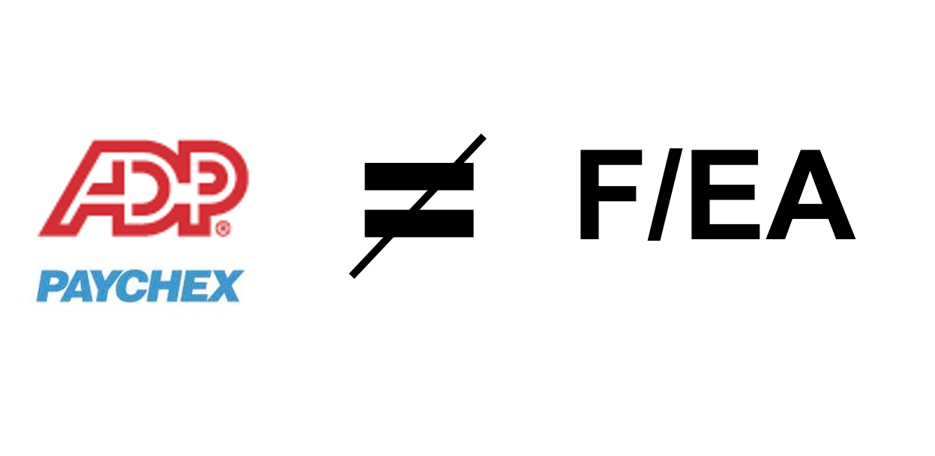
FMS is NOT just “Payroll”
F/EA takes on liability under special section of Internal Revenue Code that payroll companies do not take on.
F/EA performs a variety of services that a payroll company cannot or will not.
Consumers are household employers and have different tax rules than regular employers; payroll companies rarely have processes to deal with household employer rules.

Slide 17
FMS is NOT “Payroll,” cont’d.
AwC is a joint employer. Payroll company would never take that on.
AwC performs a variety of services that a payroll company cannot or will not.
Issues in paying in consumer direction are quite different than in “normal payroll.”

Slide 18
Tax and Labor Rules and Regulations are Different for Household Employees
Employers of household employees must comply with tax and labor rules and regulations that are different in some areas than those utilized for businesses, non-profits or government entities.
For certain aspects of payroll and tax withholding, depositing and filing, different procedures are required to withhold and remit taxes for household employees than for “regular” employees.
For this reason, some payroll companies will not manage payroll for household employers, but this is changing as consumer direction grows.
Notes:
The IRS has responded to this by developing specific revenue procedures for public programs with consumer direction and household employees. While there are some inherent benefits of classifying workers as household (higher threshholds for paying unemployment, and FICA; exemption from Workers’ Compensation requirements in many states), this classification complicates payroll in that payroll for such workers is not “business as usual.” Different procedures are used to pay workers of consumer directing employers, so paying this workers is not a simple as integrating them into an organizations payroll process for office or other employees.

Slide 19
Directly Hired Workers are Employees
The IRS has determined, in general, that most workers in consumer-directed programs are employees, not independent contractors (See IRS Notice 2003-70).
This is IMPORTANT.
The funding entity, consumer and the FMS can be held liable for paying workers as independent contractors when they should be paid as employees.
Be very careful before paying any worker as an independent contractor.
Notes:
19

Slide 20
Questions?

Slide 21
Considering FMS – Staff Expertise
If performing F/EA:
  Staff expertise in:
    Payroll & accounts payable
    Household employer tax and labor rules
    Workers’ compensation rules
    Rules for operating as an IRS Section 3504 Agent, under Rev. Proc. 2013-39
    Program rules
    Consumer individual budget/allocations rules
    Medicaid billing (if Medicaid program)
    FLSA rules & regulations
    Contract review
    Self direction

Slide 22
Considering FMS – Staff Expertise, cont’d.
If performing Agency with Choice:
  Staff expertise in:
    Payroll & accounts payable
    Joint employment rules and liability
    Program rules
    Consumer individual budget/allocations rules
    Medicaid billing (if Medicaid program)
    FLSA rules & regulations
    Contract review

Slide 23
Considering FMS: Infrastructure
You need systems and processes in place to:
  Manage enrollment of consumers (including setting consumers/representatives up as employers with you as an agent, if F/EA model)
  Manage enrollment of workers as employees
  Manage enrollment of vendors who provide service to consumers
  If F/EA, manage individual payroll and tax accounts
  Process timesheets and invoices, while enforcing complex program rules

Slide 24
Considering FMS: Infrastructure, cont’d.
You need systems and processes in place to:
  Manage large volume of phone calls and other inquiries
  Manage Medicaid claiming and remittances (if Medicaid program)
  Track consumers’ individual budgets, providing up to the minute reports

Slide 25
Considering FMS: Capital
Often in FMS, payments must be made by the FMS provider before services can be reimbursed by the program
  In some cases, there are delays in reimbursement
  State payday rules require prompt payment of employees
  You may require access to hundreds of thousand to tens of millions of dollars of capital, depending on the size of the program
    This can be a serious barrier to entry

Slide 26
The Major Barriers to Entry
Capital
  cash required to pay for services with sometimes long delays before reimbursement
Software
  managing the complexity of budget rules, payroll and enrolling participants in these programs means demand for complex software
Getting Experience – Chicken & Egg
  Buyers of FMS require experience. Difficult to get experience without already having experience.

Slide 27
Other considerations
Legal risk
Large upfront investments required; not guaranteed revenue

Slide 28
Upside: Revenue
Usually, FMS is paid for in the following way:
  FMS providers reimbursed directly for consumers’ services
    e.g. Pay employee $150 and have $25 in tax costs and $4 in workers’ comp costs. FMS provider reimbursed for $179.
  FMS paid for own services with a Per Member Per Month (PMPM) mechanism
    Average PMPM is about $90 a month for both F/EA and AwC
  Usually, no other revenue sources, such as start-up lump sum payments etc.

Slide 29
Upside: Revenue, cont’d.
Imagine you serve a program that has:
  Year 1: average of 50 consumers/month
  Year 2: average of 100 consumers/month
  Year 3: average of 200 consumers/month
Your revenue:
  Year 1: $54,000
  Year 2: $108,000
  Year 3: $216,000
  Total Revenue from 3-Year Contract: $378,000

Slide 30
Upside: Revenue, cont’d. 2
The PMPM can vary program to program
The volume of consumers served can vary program to program
What you do as an FMS provider can vary program to program
Catch – 22: you want to start with a small volume while you determine how to perform FMS. But, hard to have funds for investment with a small volume of consumers served.

Slide 31
Upside: Other Benefits
Opportunity to weave independent living philosophy and benefits into self direction
Programs benefit from CIL expertise on consumers directing their lives and services
Other benefits? Ideas from the audience?

Slide 32
Next Steps if Considering FMS
Talk to some CILs who do it
Explore www.participantdirection.org and read up on Financial Management Services
Consider a service like FMS Turbo, to learn more about FMS
Comb sites like governmentbids.com to identify RFPs and other bid opportunities, to read up on what is required even before you decide to bid
Consider the possible capital requirements

Slide 33
Next steps if Considering FMS, cont’d.
Talk to your leadership about managing FMS operations. Do they have the interest & skills?
As you learn more about FMS operations, consider how you’d perform them within your organization. Review software packages.
Keep an eye on opportunities; develop relationships
  Managed Care Organizations seeking FMS providers
  Veteran-Directed HCBS in your area
  RFPs, RFQs etc

Slide 34
Questions?
Many free resources at www.participantdirection.org
I’m happy to help: mollie.murphy@annkissam.com
Cell: 617-953-3914

Slide 35
Wrap Up and Evaluation
Please click the link below to complete your evaluation of this program:
https://vovici.com/wsb.dll/s/12291g5667c
33

Slide 36
New Community Opportunities
Attribution
This training is presented by the New Community Opportunities Center, a national training and technical assistance project of ILRU, Independent Living Research Utilization. Support for development of this presentation was provided by the U.S. Department of Education, Rehabilitation Services Administration under grant number H400B100003. No official endorsement of the Department of Education should be inferred. Permission is granted for duplication of any portion of this slide presentation, providing that the following credit is given to the project: Developed as part of the New Community Opportunities Center at ILRU.

