Slide 1

Recognizing and Responding to
Caregiver Abuse
July 9, 2014
Presenters:
Jan Derry
Erin Fontaine
Leslie Myers

Slide 2
Objectives
Upon completion of this webinar, participants will have knowledge and resources which will enable them to―
Recognize and understand signs of different types of caregiver abuse
Describe the importance of abuse education and policies and procedures for CIL staff
Explain the essentials of trauma-based interviewing
Recognize the importance of awareness of and collaboration with victim service programs

Slide 3
Have you or your CIL been involved with work around violence/abuse of people with disabilities?

Slide 4
How many people work for a CIL that provides caregiver / personal assistant services?

Slide 5
How many people work with individuals with disabilities who receive caregiver / personal assistant services?

Slide 6
Incidence of Caregiver Abuse
More than half of all abuse of people with disabilities is estimated to be perpetrated by family members and peers with disabilities. Disability professionals (i.e., paid or unpaid caregivers, doctors, and nurses) are generally believed responsible for the other half.
In addition, approximately 67 percent of perpetrators who abused individuals with severe cognitive disabilities accessed them through their work in disability services.
(Sobsey, D. and T. Doe. 1991. “Patterns of sexual abuse and assault.” Journal of Sexuality and Disability, 9(3): 243259.)

Slide 7
Caregiver Abuse
The misuse of power in a caregiving relationship, where persons who have disabilities may depend upon caregiver(s) in order to function independently.

Slide 8
Types of Caregiver Abuse
Physical
Sexual
Emotional/Verbal
Financial
Neglect

Slide 9
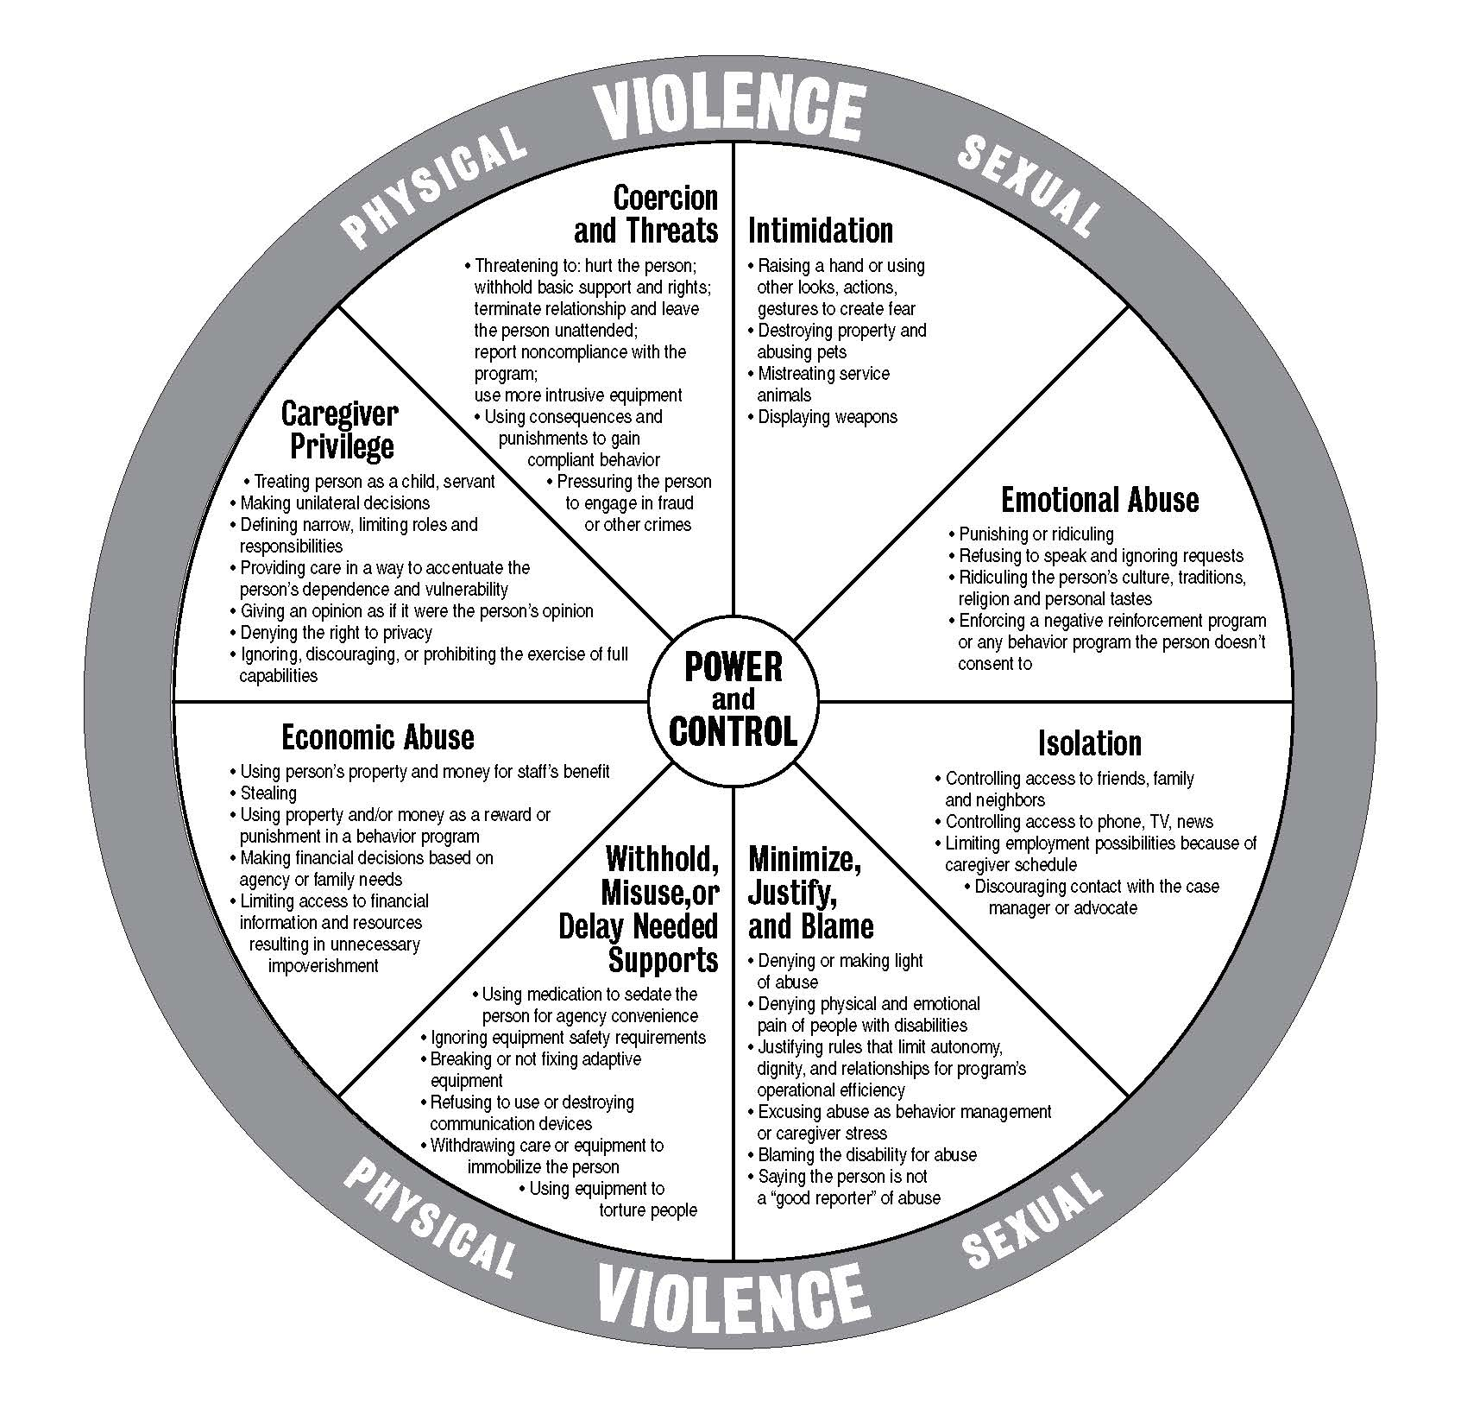
Power and Control Dynamics―Abuse of People with Developmental Disabilities by a Caregiver
Developed by: Wisconsin Coalition Against Domestic Violence
307 S. Paterson St., Suite 2, Madison, WI 53703
608-255-0539
Based on the model by the Domestic Violence
Intervention Project, Duluth, MN.

Slide 10
Overprotection
Advocate and Educator David Hinsburger calls overprotection of people with disabilities “the Other Abuse.”
Family members and/or service providers may deny access to information and experience in attempt to protect the person.
Notes:
People with disabilities should have the right to take risks and experience a life full of meaning. Being allowed to try and fail is more empowering than being denied the opportunity to try at all. By integration into the community, we can decrease isolation and vulnerability. Look at ways to educate on personal safety rather than hold a person back in isolation.

Slide 11
Risk Factors for People with Disabilities
Negative public attitudes about disability
Reliance upon others for care
Lack of support services for caregivers
Social isolation
Lack of opportunities to develop social skills through typical social interaction
Nature and severity of disability
Low income and limited opportunities for employment
Lack of control or choice over their personal affairs
Lack of credibility or people with disabilities when they report or disclose abuse
Socialization of people with disabilities to be compliant
Notes:
Look at additional notes from Jan and fewer bullets on screen

Slide 12
Barriers to Reporting an Abusive Caregiver
Agency assumption that caregiver "problems" are improper management by people with disabilities
Labeled as "difficult client"
Abuse may be hard to document and prosecute
So intimidated people with disabilities will not reveal real reason for dismissal
No emergency PCA provider; could end up with no caregiver
Possibility of retaliation
DV shelter services may not "fit" unless caregiver is a relative
Notes:
Reliance on caregivers,

Slide 13
Questions & Answers
13
Notes:
13

Slide 14
CIL Staff
Education and Procedures

Slide 15
Organizational Foundation for Consumer Safety
New Staff Training/Ongoing Staff Training
Signs of Abuse/What to look for
Questions to ask
Agency policies around abuse
Procedures around disclosures of abuse
State laws around abuse
Self-care/stress management

Slide 16
Staff/Caregiver Hiring:
What is your process for hiring staff?
Do you run background checks for caregivers hired through CIL?
Do you run background checks for other positions? What about volunteers?

Slide 17
Types of Background Screening Mechanisms:
Basic Screening Practices
Employment reference checks
Personal reference checks
Personal interviews
Confirmation of education
Written application
On-the-job observation

Slide 18
Types of Background Screening Mechanisms: Frequently Used Practices
Local criminal record check
State criminal record check
FBI criminal record check
State central child/dependent adult abuse registry check
State sex offender registry check
Nurse’s aide registry record check
Motor vehicle record check
Professional disciplinary board background check

Slide 19
Types of Background Screening Mechanisms: Infrequently Used Practices
Alcohol/drug testing
Psychological testing
Mental illness/psychiatric history check
Home visits
(Guidelines for the Screening of Persons Working With Children, the Elderly, and Individuals With Disabilities in Need of Support by Office of Juvenile Justice and Delinquency Prevention (1998))

Slide 20
Policies and Procedures
CILs should have clear policies and procedures that address:
  Staff responsibilities following disclosure of abuse
  Staff responsibilities after observing abusive actions by other staff
  Agency responsibilities following reports of staff members who are abusive
    Investigation
    Legal remedies—contacting police, assisting with making formal charges
    Terminating employment
    Reporting abusive caregivers to existing registries
  Employee Assistance Programs for caregivers who are staff to address stress and personal issues

Slide 21
Procedural Changes
What is your practice when overseeing caregivers who are staff members?
Do the supervising staff meet with the consumers alone?
Best practice dictates that we offer a safe place, without the caregiver present, so that:
  Problems can be freely discussed
  Any possible abuse can be disclosed
  Safety/well-being can be ensured

Slide 22
Workplace Safety for Staff with Caregivers
Do you have anything in place that addresses the possibility that staff who use caregivers can be safe? Things to think about:
  Guidelines for caregiver/staff interactions within the workplace
  Allowing staff a safe place to disclose any problems
  Offering Employee Assistance Programs for staff

Slide 23
Zero Tolerance
Promote a work culture of zero tolerance for abuse, neglect, and exploitation by having clear abuse/neglect policies and procedures, including:
Required reporting of all incidents of suspected abuse and neglect
Consistent enforcement of reporting policies
Protection for staff and clients who report
Sanctions for those who do not report observed or suspected abuse, neglect, and exploitation

Slide 24
Questions & Answers
24
Notes:
24

Slide 25
Trauma Based Interviewing

Slide 26
Emotional Trauma
Trauma can exacerbate mental health symptoms
Trauma can impact memory
Re-experiencing the trauma
Emotional numbing and avoidance
Hyper-vigilance, jumpiness, being “on guard”

Slide 27
What to do
Perspective of context
Affirmation of healing
Encourage use of supports and community resources
Watch for vicarious trauma
Ensure confidentiality

Slide 28
Crisis Intervention
Listen and Believe
Management not resolution
Be clear about your role
Discuss reporting requirements
Provide safe environment
Do not judge
Disabilities may impact thought process in crisis
Knowledge is power

Slide 29
Safety Planning
A thoughtful deliberate process to create a plan to enhance safety, keeping in mind that each person’s circumstances, safety needs, and concerns are unique
Based on individual need
What to ask in a crisis
Provide time and space to prepare
Incorporate unique needs of the individual
At home, work, community
Checklist of what to take
Include resources available if needed

Slide 30
Reducing Risk of Abuse
Education on abuse, safety and sexuality
Practices in place for hiring caregivers
Raising public awareness
Reporting Abuse
Advocating for Community Inclusion
Train Staff
Guidelines within your agencies

Slide 31
Questions & Answers
31
Notes:
31

Slide 32
Community Collaboration
Where do we start?!
Examples of Local Collaboratives with CILs

Slide 33
The Key!
We all do what we do best ….and we do it together…this means that no one person has to do it all!

Slide 34
West Virginia

Slide 35
West Virginia
Began in 05 with a statewide study of disability service providers, funded by the WV Developmental Disabilities Council
Key Findings

Slide 36
West Virginia Key Findings
2006 Developed partnership under the Accessing Safety Initiative of the Office on Violence against Women, US DOJ
Partners: WV Foundation for Rape Information and Services, WV Department of Health and Human Services, WV University Center for Excellence in Disability and the Northern West Virginia Center for Independent Living
Vision of the Partnership
Outcomes and ongoing efforts

Slide 37
Milwaukee, Wisconsin

Slide 38
Milwaukee
When I started working at IndependenceFirst in 1998, I also started working on violence against people with disabilities.
In 2004 a lot of things changed as a result of one particular case in which despite 6 years of working intensely with the local agencies everything fell apart.

Slide 39
West Virginia

Slide 40
The Case of “Janet”
Janet
Employer
Domestic Violence Programs
Adult Protective Services
Others
Independence
First

Slide 41
Developing a Collaboration
2010 DART representation is now 41 Agencies
Intervention by State Funder
Development of DART (17 Agencies)
DART continues to add partners as needed
DART becomes a subcommittee of the Milwaukee Commission on Domestic Violence and Sexual Abuse

Slide 42
Funded and Unfunded
41 agencies met regularly without funding
MMDI: Access funded in 2007 by OVW
  Partners, IndependenceFirst, Sojourner Family Peace Center, City of Milwaukee Health Department, and Milwaukee County Disability Services Division.
DART Transitional Housing Program funded twice by OVW

Slide 43
Duluth, Minnesota

Slide 44
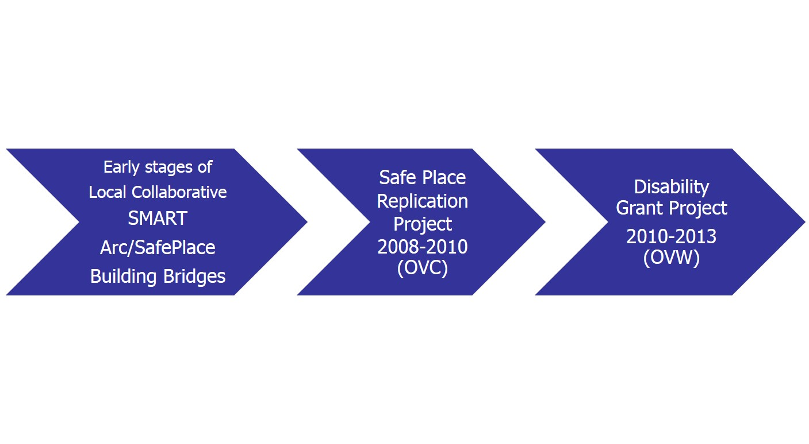
Duluth

Slide 45
Barriers to reporting―
Duluth Focus Groups 2009
Fear they won’t be believed
You feel like giving up on the system, takes so much energy, with so little in return
Embarrassment due to stigma of disabilities
Fear of retaliation
People might not realize they are crime victim
Fear of threats
Fear of not being heard

Slide 46
Needs Assessment Key Findings
Lack of Organizational Resources
Need for Increased Awareness and Cross Training
Gaps in Polices, Procedures, and Practices
Need for Increased Organizational Relationships
Vision for Sustainability
Barriers to Safety, Accessibility, and Welcoming Environments

Slide 47

http://www.connectionsduluth.org

Slide 48
NCIL Task Force on Violence and Abuse
Started in 2006 following a resolution passed by NCIL Membership at the 2006 Annual Conference
Since its inception, the Task Force has:
  Presented at workshops and conferences
  Written articles for the WHAM
  Encouraged NCIL to take a national stand on current trends on issues of violence and abuse
  Writing NCIL resolutions on topics related to violence and abuse of persons with disabilities
  Created talking points on legislative actions that relate to violence and abuse

Slide 49
Joining the Task Force
The NCIL Violence and Abuse Task Force generally meets via teleconference on the first Thursday of each month at 2:00 Eastern. For more information, please contact
  Jan Derry: jderry@nwvcil.org
  or
  Roberta Sick: sick@uark.edu.

Slide 50
Questions & Answers
50
Notes:
50

Slide 51
Additional Resources

Slide 52
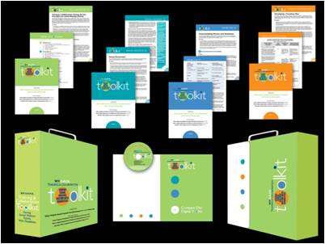
Resources
WV S.A.F.E. Training and Collaboration Toolkit
Serving Sexual Violence Victims with Disabilities
Guidance for service providers on working collaboratively to integrate accessible services for sexual violence victims with disabilities into the existing social service delivery system.

Slide 53
Toolkit: Serving Sexual Violence Victims with Disabilities
Facilitates collaboration among partnering agencies to improve the accessibility and appropriateness of services.
Builds individual providers' knowledge related to providing accessible and responsive services to sexual violence victims with disabilities.
Provides tools to facilitate assessment and planning by individual agencies to improve the accessibility of their services for sexual violence victims with disabilities.
Available for download at: http://www.fris.org.

Slide 54
Other Resources
Training and Collaboration Toolkit -
Serving Sexual Violence Victims with Disabilities
  http://www.fris.org/Resources/ToolkitDisabilities.html
Vera Website
  http://www.accessingsafety.org/
Brochure examples:
  http://www.fris.org/Resources/PDFs/Brochures/Bro-SexualViolenceDisabilities.pdf
  http://www.fris.org/Resources/PDFs/Brochures/Bro-SexualViolenceDisabilities.pdf

Slide 55
Contact Information
  Jan Derry - jderry@nwvcil.org
  Erin Fontaine - erint@accessnorth.net
  Leslie Myers - myoone58@gmail.com
55

Slide 56
Wrap Up and Evaluation
Please click the link below to complete your evaluation of this program:
https://vovici.com/wsb.dll/s/12291g55ede
56
Notes:
56

Slide 57
CIL-NET Attribution
Support for development of this training was provided by the U.S. Department of Education, Rehabilitation Services Administration under grant number H132B120001. No official endorsement of the Department of Education should be inferred. Permission is granted for duplication of any portion of this PowerPoint presentation, providing that the following credit is given to the project: Developed as part of the CIL-NET, a project of the IL NET, an ILRU/NCIL/APRIL National Training and Technical Assistance Program.

