Slide 1
Introduction to Housing Discrimination Laws for Independent Living Center Staff August 20, 2014 3:00 p.m. – 4:30 p.m. EDT Presenters: Claire Chantler Susan Crawford
1

Slide 2
Fair Housing Laws—Fair Housing Act
Title VIII prohibits discrimination in the sale, rental, and financing of dwellings, and in other housing-related transactions, based on race, color, national origin, religion, sex, familial status and disability.

Slide 3
Section 504 of the Rehabilitation Act of 1973
Section 504 prohibits discrimination based on
disability in any program or activity receiving
federal financial assistance.

Slide 4
Title II of the Americans with Disabilities Act
Title II prohibits discrimination based on
disability in programs, services, and activities
of public entities.
HUD enforces Title II as it relates to state
and local public housing, housing assistance
and housing referrals.

Slide 5
Design & Construction Requirements—What is Covered?
Multifamily housing designed and constructed for first occupancy after March 13, 1991
Buildings containing four or more units
If elevator, all dwelling units
If no elevator, all ground floor units

Slide 6
Design & Construction Requirements—What is Not Covered?
Buildings occupied before March 13, 1991
Detached single family houses
Duplexes or triplexes
Multistory townhomes
Buildings used previously for a nonresidential purpose, such as a warehouse, office building, or school, and is being converted to a multifamily dwelling

Slide 7
Design & Construction Requirements
Accessible building entrance on an accessible route
Accessible and usable public and common use areas
Usable doors
Accessible routes into and through covered unit
Light switches, electrical outlets, thermostats, and other environmental controls in accessible locations
Reinforced walls in bathrooms for later installation of grab bars
Usable kitchens and bathrooms

Slide 8
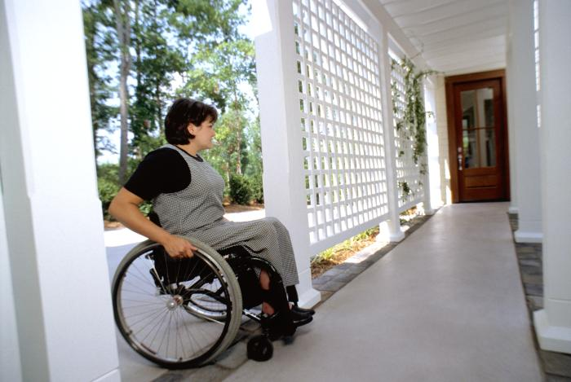
Design and Construction Requirements—Requirement 1
Accessible building entrance on an accessible route

Slide 9
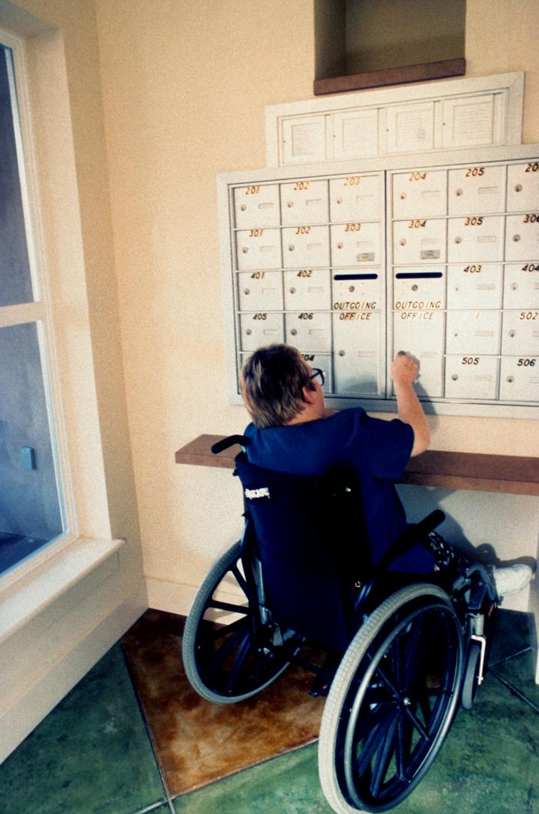
Design and Construction Requirements—Requirement 2
Accessible and usable public and common use areas

Slide 10
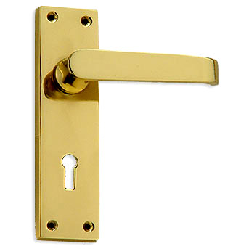
Design and Construction Requirements—Requirement 3
Usable doors

Slide 11
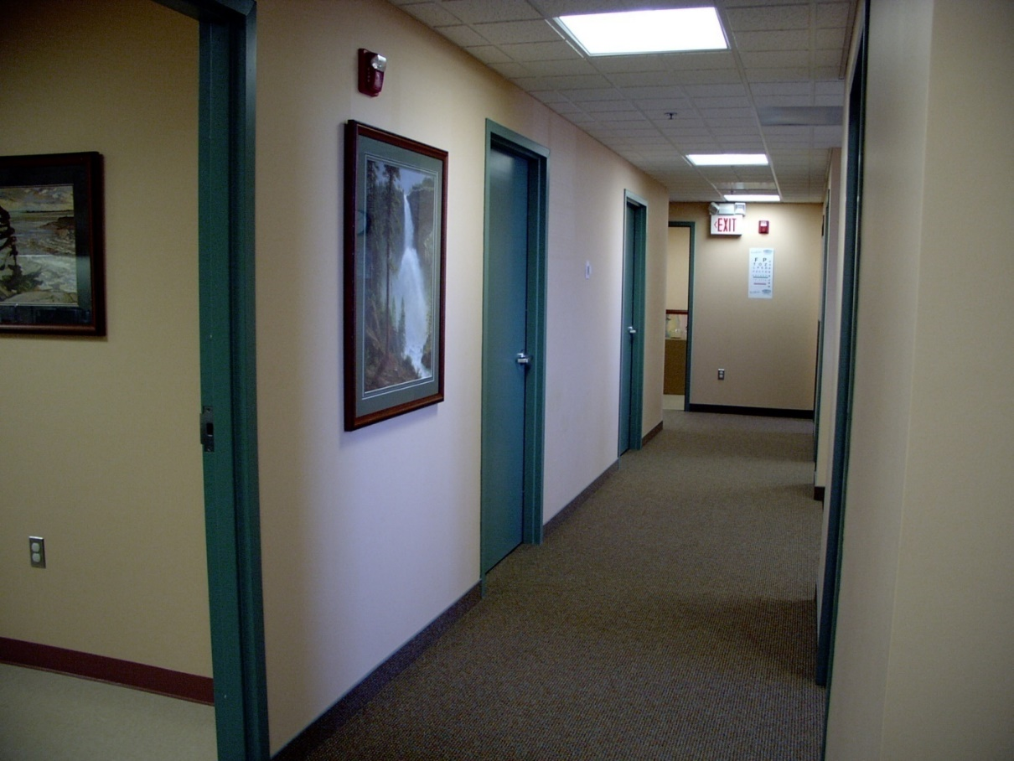
Design and Construction Requirements—Requirement 4
Accessible routes into and through covered unit

Slide 12
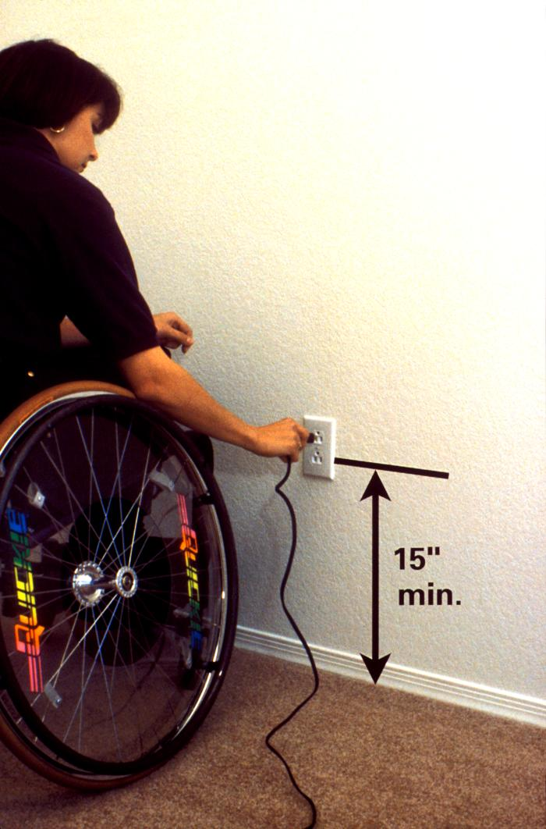
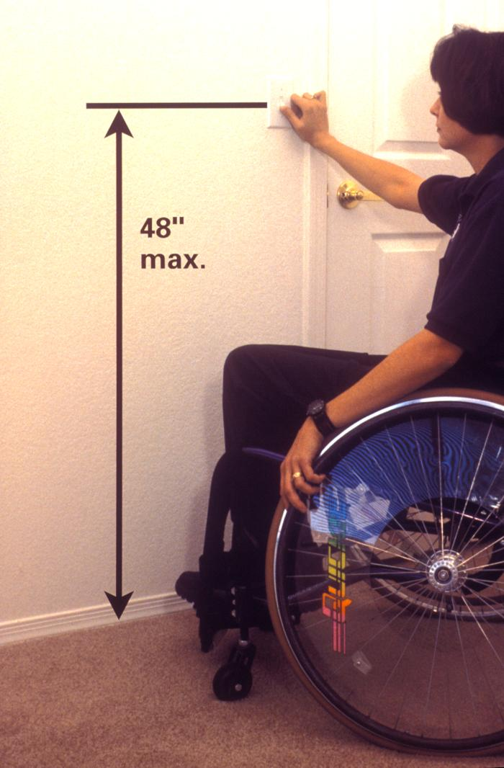
Design and Construction Requirements—Requirement 5
Light switches, electrical outlets, thermostats, and other environmental controls in accessible locations

Slide 13
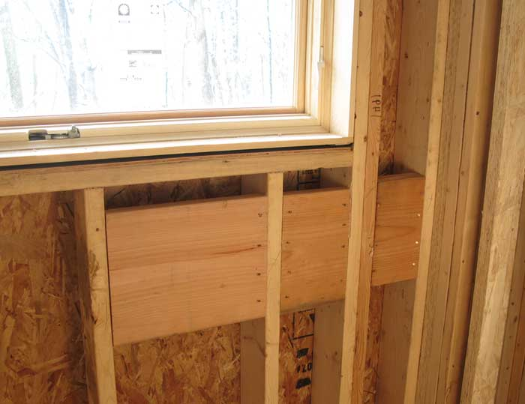
Design and Construction Requirements—Bathrooms
Reinforced walls in bathrooms for later installation of grab bars

Slide 14
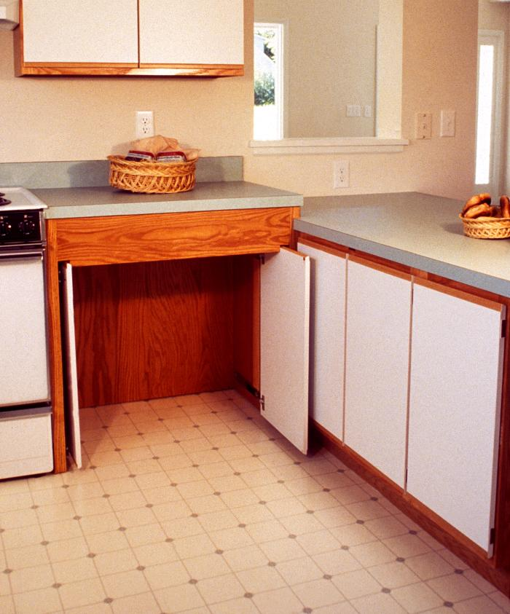
Design and Construction Requirements—Usable Kitchens and Bathrooms
Usable kitchens and bathrooms

Slide 15
Fair Housing Accessibility FIRST
Fair Housing Accessibility FIRST promotes compliance with the Fair Housing Act Design and Construction requirements. The program offers comprehensive and detailed instruction programs, useful web resources, and a toll-free information line for technical guidance and support.
Call our toll-free Design and Construct Resource Center: 1(888) 341-7781 (V/TTY)
Online: http://www.fairhousingfirst.org/index.asp

Slide 16
Questions?

Slide 17
Definition of Disability
A physical or mental impairment which
substantially limits one or more of a person‘s
major life activities, a record of having such an
impairment, or being regarded as having such
an impairment.

Slide 18
Reasonable Modification (RM)
The Act requires that landlords permit, at the
expense of the disabled person, reasonable
modifications of existing premises when
necessary to afford such person full
enjoyment of the premises.

Slide 19
Reasonable Accommodation (RA)
The Act requires landlords make reasonable
accommodations in rules, policies, practices,
or services, when necessary to afford the person equal opportunity to use and enjoy a dwelling.

Slide 20
The Difference between Reasonable Accommodation and Reasonable Modification
A reasonable modification is a structural change
made to the premises usually paid for by the tenant.
A reasonable accommodation is a change,
exception, or adjustment to a rule, policy,
practice, or service. The housing provider is
responsible for the costs associated with a
reasonable accommodation.

Slide 21
Reasonable Modifications — Who Pays to Make the Modification?
Tenants generally pay the cost of making the modification.
Housing providers pay for requested structural changes when the accessible features should have already existed in the building pursuant to the design and construct requirements of the Act.

Slide 22
What about removing modifications at the end of tenancy?
The tenant is obligated to restore those portions of the interior of the dwelling to their previous condition only where “it is reasonable to do so” and where the housing provider has requested the restoration, reasonable wear and tear excepted.

Slide 23
What about removing modifications at the end of tenancy?, cont’d.
If the modifications do not affect the housing provider’s or subsequent tenant’s use or enjoyment of the dwelling interior, the tenant cannot be required to restore the modifications to their prior state.
Reasonable modifications such as ramps to the front door of the dwelling or modifications made to laundry rooms or building entrances are not required to be restored.

Slide 24
Reasonable Modification Examples
Grab bars
Ramps, Lifts
Lowering cabinets and counters
Removing lower cabinets
Widening doorways
Changing door hardware, light bulbs
Sound proofing room
Flashing smoke alarms, doorbells

Slide 25
Parking Spaces— Reasonable Accommodation
Courts have required housing provider to provide accessible parking as a reasonable accommodation.
Housing providers may not require persons with disabilities to pay extra fees as a condition of receiving accessible parking spaces.

Slide 26
Reasonable Accommodation—The Fair Housing Act and Section 504 Do NOT Allow
Special liability insurance, fees, or deposits as a condition of receiving a reasonable accommodation.

Slide 27
Reasonable Accommodation Examples
Rental Properties
Parking spaces
Payment of rent
Housing Authorities
Live-in aides
Extensions or increases in voucher amount
Prior evictions
Homeless Shelters
ADLs, Medication prompting
Bans for previous behavior
Assisted Living or Rehab facilities

Slide 28
Questions?

Slide 29
Verification of Disability
Housing provider may request information regarding the disability only if it―
Is necessary to verify that the person meets the Act’s definition of disability
Describes the needed accommodation or modification
Shows the relationship between the person’s disability and the requested accommodation or modification
http://www.hud.gov/offices/fheo/library/huddojstatement.pdf
http://www.hud.gov/offices/fheo/disabilities/reasonable_modifications_mar08.pdf

Slide 30
Verification of Disability, cont’d.
If disability is not obvious, supporting documents may include―
Statement by the individual with a disability
Statement by a doctor
Statement from a peer support group
Statement by a social service agency or counselor
Proof of receipt of disability benefits
Statement by a reliable third party

Slide 31
Assistance Animal
An animal that works, provides assistance, or performs tasks for the benefit of a person with a disability, or
provides emotional support that alleviates one or more identified symptoms or effects of a person's disability.
An assistance animal is not a pet.

Slide 32
Denials of Request to Use Assistance Animals
Financial and administrative burdens.
Direct threat of harm or substantial physical damage to the property that cannot be mitigated by a reasonable accommodation.

Slide 33
Assistance Animals
Requires individualized assessment that relies on objective evidence about the specific animal’s actual conduct—not on mere speculation or fear about the types of harm or damage an animal may cause and not on evidence about harm or damage that other animals have caused.
Breed, size, and weight limitations may not be applied.
Conditions and restrictions that housing providers apply to pets may not be applied to assistance animals.

Slide 34
Resources on the FHEO Home page
Joint Statement of HUD & DOJ on Reasonable Modifications under the FHA
Joint Statement of HUD & DOJ on Reasonable Accommodations under the FHA
Service Animals and Assistance Animals for People with Disabilities in Housing and HUD funded programs

Slide 35
Denials of RAs and RMs
Review circumstances
Make request again in writing
Educate housing provider on Act
Contact Fair Housing organization or
File complaint with HUD

Slide 36
Filing A Complaint
The HUD toll-free number and link to file a complaint:
1(800) 669-9777
https://portal.hud.gov/FHEO903/Form903/Form903Start.action

Slide 37
Slide 26 Wrap Up and Evaluation
Please click the link below to complete your evaluation of this program:
https://vovici.com/wsb.dll/s/12291g56c85

Slide 38
For more information
Contact:
Claire Chantler - cchantler@nwvcil.org
Susan Crawford - susan.h.crawford@hud.gov

Slide 39
CIL-NET Attribution
Support for development of this training was provided by the U.S. Department of Education, Rehabilitation Services Administration under grant number H132B120001. No official endorsement of the Department of Education should be inferred. Permission is granted for duplication of any portion of this PowerPoint presentation, providing that the following credit is given to the project: Developed as part of the CIL-NET, a project of the IL NET, an ILRU/NCIL/APRIL National Training and Technical Assistance Program.

