Slide 1
New Community Opportunities Center at
ILRU Presents…
Funding and Delivering Youth Transition Programs: One CIL’s Experience with Sexuality Education
September 10, 2014
3:00 P.M.- 4:30 P.M. EDT
Presenter:
Alie Kriofske
IndependenceFirst
1

Slide 2
Learning Objectives
Develop awareness of the tools and resources that are available to a CIL to incorporate sexuality/relationship for consumers as an IL Skill
Describe one CIL’s best practices and consumer population for demonstrated effectiveness and sustainability
Describe the value of empowering youth, adolescents and adults with disabilities to negotiate their way through choices and concerns related to sexuality and relationships
Identify opportunities for funding and collaboration with other organizations to make such a program possible.

Slide 3
Independent Living Centers teach…
CILS teach people skills of independent living so that people with disabilities may
  Live where they choose to live
  Work in a meaningful job or career
  Have opportunities to participate in their communities fully through…
    Recreation
    Employment
    Relationships
CILs believe that people with disabilities have the right to be fully included in their communities

Slide 4
CILs don’t teach
We know relationships and sexuality are an integral part of human life
Yet we do not teach relationships and sexuality as a rule
Centers for Independent Living Certainly don’t teach sexuality and relationships skills very often or as an integral part of their IL skills curricula.

Slide 5
How IndependenceFirst (IF) began teaching sex ed
IF has a curriculum for IL skills.
  Everything you wanted to know about being an adult but were afraid to ask
This curriculum is taught to high school students and middle school students with disabilities
One session in the curriculum:
  Go ahead make my day: Boundaries and personal space

Slide 6
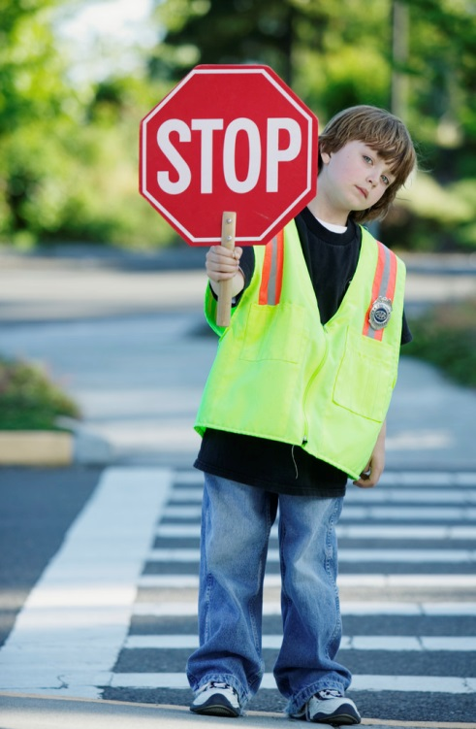
Boundaries and Relationships
Youth Leadership Specialist began teaching this session
  Boundaries and personal space
  Healthy and unhealthy relationships
  Community safety

Slide 7
A great need for more
It became clear that the need for this session was more than the session itself provided
5 week class for middle/high school students and adults with disabilities created
Safe Relationships Safe Places
  Boundaries and Personal Space
  Healthy vs Unhealthy Relationships
  Dating and Romance
  Sexual harassment and abuse prevention
  Relationships and Community safety

Slide 8
Funding
IF already receiving funding at this point from several small foundations for the Youth Program and from the Department of Health and Family Services (DHFS ) for programs serving people with disabilities who are victims of abuse.
2008—IF applies for a three-year cycle of the DHFS grant

Slide 9
DHFS Funding
Covered the program from 2009-2012
Staff salary and benefits for Youth specialist, 2 other staff
Covered Activities of Disability Abuse Response Team (DART), other abuse prevention
Included in Youth Program
  Safe Relationships Safe Places
  GirlsFirst support groups
  Boundaries and personal space sessions
  Healthy relationships day of the Youth Leadership Summit

Slide 10
Program growth & other funding streams
Sex ed class begins as a three-part workshop
More in-depth discussion on sexuality in SRSP classes
Parents Matter begins with United Way funding
Youth Specialist begins process of sexuality educator certification through the American Association of Sexuality Educators, Counselors and Therapists (AASECT )
Funding
  DHFS Grant (2008-2011)
  Jane Bradley Petit (2007-2011)
  United Way (2013-Present)
    Left one underfunded year (2012 $23,000 total)

Slide 11
Questions?

Slide 12
Sex ed and people with disabilities
Sexuality Education
Sexuality is often seen as “bad”
Sexuality is mistaken for simply the act of having sex
Sexuality is a natural part of life and is all-encompassing
There are issues of morality surrounding sex
People with disabilities
Often seen as asexual or not interested in sex
Also seen as oversexed
Because of these two narrow views, are often denied access to sexuality education or information about their bodies.

Slide 13
Sexuality
Privacy awareness
The body
Exploitation prevention
Social skills
Relationships

Slide 14
Sexuality and Disability:
The body and privacy
Care for the body
Body changes
Body image
Societal rules for bodies
Personal care and the body
Access to privacy
Names and anatomy for private body parts
Functions of body parts, including private body parts
Body changes (either in puberty or disability related)

Slide 15
Sexuality and Disability:
Exploitation Prevention
Boundaries in relationships
Relationships and Body rights
Personal Care and Body rights
Children with disabilities are three times more likely to be victims of sexual abuse (children with developmental and mental health disabilities even higher)
Adults with disabilities are also more likely to be victims of sexual abuse
People with disabilities are systematically denied access to basic information about sexual health and relationships
Dependency on others for long term care, social isolation and attitudes can make people more vulnerable to abuse

Slide 16
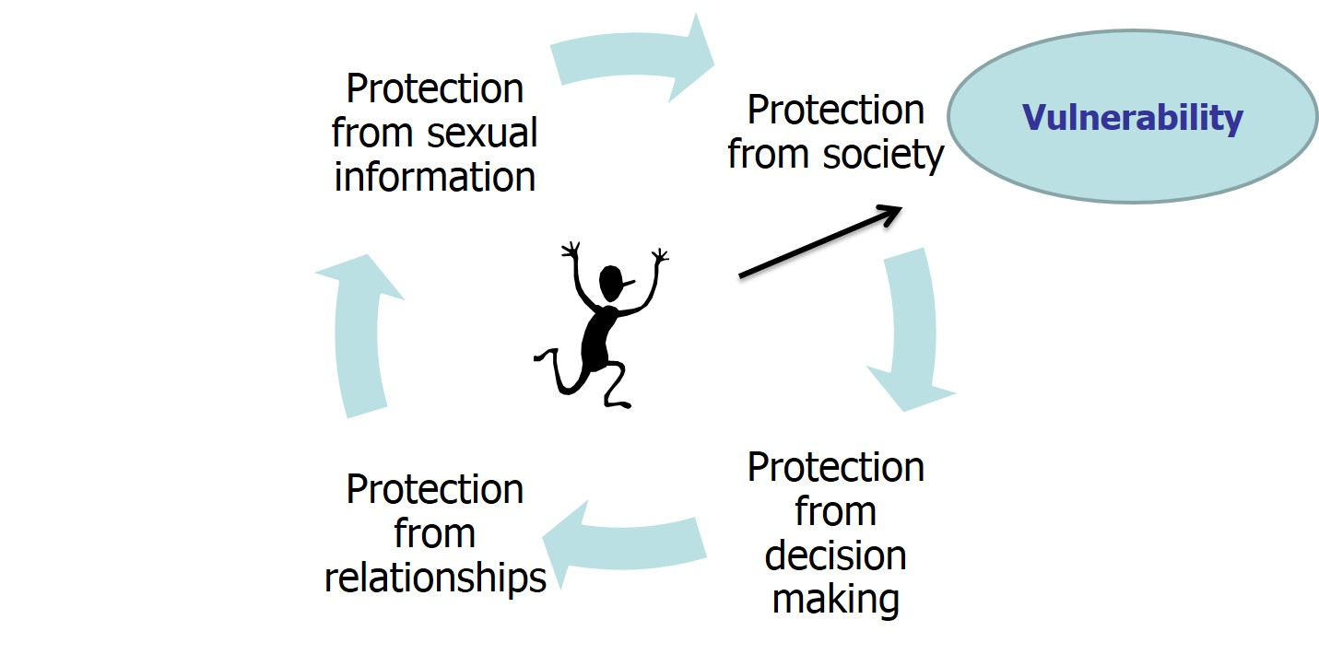
Exploitation Prevention:
Prison of protection

Slide 17
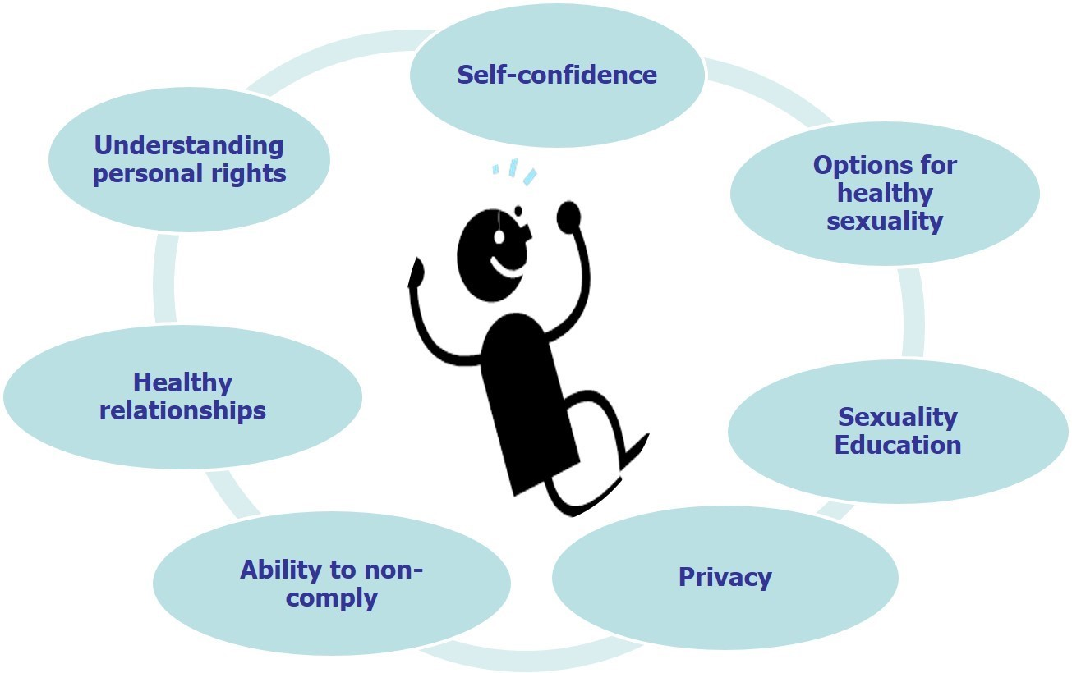
Exploitation Prevention: Ring of safety

Slide 18
Sexuality and disability: relationships and social skills
Types of relationships and boundaries in the various different relationships
Learning assertiveness
Identifying and expressing emotions
Dating and attraction to others
Self-esteem
Opportunity to seek, obtain and keep relationships

Slide 19
Sexuality education and IDEA
Policy regarding sexuality education varies throughout the states but includes such things as:
  Puberty
  Reproduction
  Pregnancy Prevention
  STD prevention
  HIV/AIDS awareness
  Healthy Relationships
Policy regarding Individuals with Disabilities and education does not include access to sexuality education
  Less than half of students with emotional or cognitive disabilities are included in regular education 80% of time. Meaning, if sex ed IS taking place, they may not even be in the room.

Slide 20
The question of guardianship
Just having a guardian does not mean that a person cannot consent to sexual activity
If a person is deemed incapable of consent to sexual contact, or are a high risk of abuse, relationships & what happens within will be decided on a case by case basis.
There is no place in a court guardianship order that deals with this
A person who has capacity to consent has a constitutionally protected right to consent to engage in knowing and voluntary sexual behavior.
However, sexual contact with a person who lacks capacity to consent is abuse.

Slide 21
Sexuality education: Addressing fears
Parents are the best sexuality educators for their children (We, as CILs, can encourage parents to talk about this)
Information about sex and sexuality is EVERYWHERE. If people are not receiving a sexuality education either through their families, faith-based communities, CILs or school, they are receiving it from their peers and the media.
Talking about sex and sexuality does not increase the likelihood that it will occur. ACTUALLY, young people who receive comprehensive sexuality education are more likely to abstain or delay sexual experiences

Slide 22
Questions?

Slide 23
IndependenceFirst’s Sexuality Education Program
Funding—United Way Healthy Girls Initiative, Making Proud Choices Curriculum (and F.L.A.S.H.)
  $40,000 July 1 2013-June 30-2014
  $49,000 July 1 2014-June 30 2015
Funding-United Way Parents Matter
  $2,000 Summer 2012
  $2,000 Winter/Spring 2012/2013
  Funding covers the Making Proud Choices classes, Safe Relationships Safe Places classes, 1 day of the summer camp dedicated to healthy relationships, Youth Leadership Specialist salary and opportunities for training/learning

Slide 24
Demographics: What and how
In the 2013 United Way grant proposal, IF claimed we would teach 5 classes to a total of 100 students.
2013-2014 Making Proud Choices classes
  17 classes
  210 students
2013 Parents Matter classes
  4 classes
  32 students
2013-2014 Safe Relationships classes
  4 classes
  65 students

Slide 25
Demographics: Where
In the 2013/2014 grant cycle, Making Proud Choices Sexuality education curriculum was taught at
  9 schools
  3 community-based organization
MPC was taught to
  Eighty-eight (88) 11-14 year olds (middle school)
  Seventy-four (74) 15-18 year olds (high school)
  Forty-eight (48) adults aged 18 and older
    18-21 year olds in transition programs in their high schools
    22 year olds and older in community-based organizations

Slide 26
Demographics: Who
48 Adults ages 18 and up with Cognitive disabilities*
31 High school students with Cognitive disabilities*
20 High school students with emotional/behavioral disabilities
26 High school students with learning disabilities*
13 High school and middle school students with mental health disabilities
52 Middle school students with cognitive disabilities*
20 Middle school students with learning disabilities*
  *Individuals with Autism

Slide 27
Outreach
Developing relationships with schools
Developing relationships with community service providers
Cold calls to transition specialists in schools
Attending meetings of school social workers, school special education teachers, transition advisory councils or boards and other collaborative groups
Reaching out to non-disability based non-profits who might have people with disabilities involved or need to learn how to involve people with disabilities

Slide 28
Funding opportunities
Youth programs are “sexy” for funders right now
Look for calls for proposals from national funders with local branches
  United Way
  Department of health and family services
  Department of education
  Council on developmental disability (or other disability specific councils or organizations)
Search for local foundations giving grants to non-profits specializing in youth work or underserved populations

Slide 29
Collaboration opportunities
Other disability organizations
  United Cerebral Palsy
  Parent centers (Wisconsin FACETS)
  Goodwill
  Organizations based in specific disabilities (autism, council for the blind, etc.)
Non-profits dedicated to anti-violence or healthy relationships
  Task force on family violence/Peace centers
  Homeless shelters or youth groups
  Other youth organizations
School districts/schools

Slide 30
Other topics
Puberty
Hygiene
Assertiveness
Conflict Resolution
Anger management
Boundaries and Personal Space
Dating
Internet safety
Bullying

Slide 31
Resources
Making Proud Choices and Parents Matter
Sexuality Education for adults with developmental disabilities
S.A.F.E. (Safety awareness for empowerment)
Teaching children with down syndrome about their bodies, boundaries and sexuality
Getting to the HEART of intimacy
The Ultimate Guide to Sex and disability
Making Sense of Sex
The Rules of Sex
Circles
FLASH

Slide 32
Accessibility
Captioning in videos
Large print
Suction cups on bottoms of models if using
Using a lot of pictures and hands-on activities
Repeat, repeat, repeat
Biologically and age appropriate information in a cognitively appropriate way
Assistive technology for learning (condom demonstration models; latex and scent free equipment)

Slide 33
Modifications and accommodations
Aprons
Video
Role play
Putting info like the menstrual cycle, steps for using a condom etc.. on large paper and have students line up for more visual understanding
Use of slang
Use pictures
  When showing public v private
  Types of relationships
  Social skills cues

Slide 34
Final thoughts on sexuality
People with disabilities are sexual
Sexuality is a natural part of being human
Sexuality is all encompassing
  The body, privacy awareness, Social Skills, Relationships, Exploitation prevention
Teaching sexual health can help individuals with independent living in general
Even if you don’t teach classes, being approachable and ask-able with this topic is a great step

Slide 35
Questions?

Slide 36
Contact
Alie Kriofske Mainella
Youth Leadership Specialist
IndependenceFirst
414-226-8112 (Direct/Voice) akriofske@independencefirst.org

Slide 37
Wrap Up and Evaluation
Please click the link below to complete your evaluation of this program:
https://vovici.com/wsb.dll/s/12291g56a96
33

Slide 38
New Community Opportunities
Attribution
This training is presented by the New Community Opportunities Center, a national training and technical assistance project of ILRU, Independent Living Research Utilization. Support for development of this presentation was provided by the U.S. Department of Education, Rehabilitation Services Administration under grant number H400B100003. No official endorsement of the Department of Education should be inferred. Permission is granted for duplication of any portion of this slide presentation, providing that the following credit is given to the project: Developed as part of the New Community Opportunities Center at ILRU.

