Slide 1
New Community Opportunities Center at
ILRU Presents…
Funding and Delivering Youth Transition Programs: One CIL’s Experience with Multiple Funding Sources
September 30, 2014
3:00 P.M.- 4:30 P.M. EDT
Presenter:
Alie Kriofske
IndependenceFirst
1

Slide 2
Learning Objectives
Describe funding sources used by one CIL to establish and maintain a youth transition program.
Identify individual youth services and activities that may lend themselves to alternate funding streams.
Identify the timeline of the addition of new programs and services to an existing center to successfully grow a new program.
Describe youth services and activities successfully designed and operated by one CIL.

Slide 3
IndependenceFirst
Metro-Milwaukee area CIL serving four counties
Non-profit agency directed by and for the benefit of people with disabilities
Mission: To effectively facilitate empowerment of individuals with disabilities through Education, Advocacy, Independent living Services and Coalition Building
$35,051,223 budget
Served 9,968 people in 2013

Slide 4
Once upon a time in 2004
IndependenceFirst took on a graduate school fellow from Marquette University
In the true form of an Independent Living center, she was allowed to make the position what she wanted it to be
Thus the Youth Leadership Program was born
Program initially funded by the Trinity Fellows Program/Marquette University and IF
  IndependenceFirst contributed $1400 per month and receives a fellow to work 18 hours per week during the school year and 40 hours per week during the summer.

Slide 5
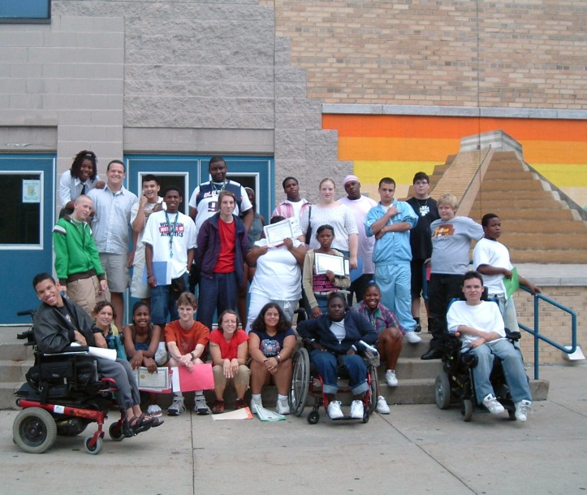
2005
Youth program begins a collaboration with Wisconsin FACETS (a statewide family assistance center based in Milwaukee)
Youth Leadership Summit program begins
  1 week summer program for high school students with disabilities to learn Independent Living and Transition skills.
  Program funded by IF’s federal
  funding and WI FACETS

Slide 6
2006
Trinity fellow running youth programs graduates with a master’s degree in Public Service, specializing in disability
Second Youth Leadership Summit is held at IndependenceFirst and it is approved for the Trinity Fellow to stay on for the summer and run it.
The first group of youth mentors are hired (alumni from 2005) to run group activities at the youth summit.
Trinity fellow proposes new position of Youth Leadership Specialist to run a youth program at IF (approved by board and executive director)

Slide 7
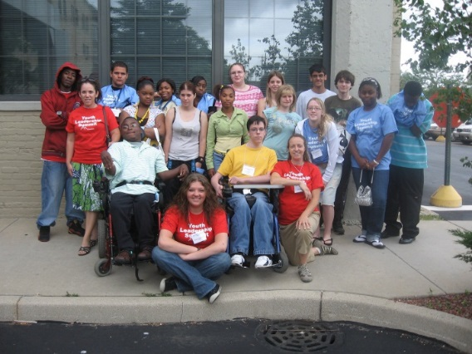
2007
Youth Programming
  3rd Youth Leadership Summit with youth mentors
  Disability Mentoring Day (50 youth served)
  IL classes for youth with cognitive disabilities
Funding
  New Youth Leadership Specialist position incorporated into budget (Federal/State funding)
  $10,000 secured from Jane Bradley Petit Foundation for youth program

Slide 8
2008
Youth Programming
  Youth Leadership Summit (second week added)
  Disability Mentoring Day (75 youth served)
  GirlsFirst program begins
  Boundaries and personal space classes
  IL Classes for youth with cognitive disabilities
Funding
  $40,000 Department of health and family services
  $10,000 Jane Bradley Petit Foundation
  $54,888 Miracle on Canal Street
    YOUTH LEADERSHP PROGRAM IS NOW FULLY FUNDED

Slide 9
2009
Youth Programming
  Two Youth Leadership Summits
  GirlsFirst (held 3 times per year)
  Disability Mentoring Day (100 youth served)
  Person Centered Planning
  Transition Series
  Boundaries and personal space Classes
Funding
  $10,000 Jane Bradley Petit Foundation
  Department of Health and Family Services $40,000
  $20,000 Youth Information, Training and Resource Center (YITRC) through WI FACETS

Slide 10
2010
Youth Programming
  Two Youth Leadership Summits
  GirlsFirst (held 3 times per year)
  Disability Mentoring Day (150 youth served)
  Person Centered Planning & Transition Series
  Boundaries and personal space Classes
  Safe Relationships Safe Places classes begin
Funding
  $10,000 Jane Bradley Petit Foundation
  Department of Health and Family Services $40,000
  $20,000 Youth Information, Training and Resource Center (YITRC) through WI FACETS
  $10,000 Ziemann Foundation & $3,000 Sensient Foundation

Slide 11
2011
Youth Programming
  Two Youth Leadership Summits & 5 year anniversary event
  GirlsFirst (held 3 times per year)
  Disability Mentoring Day (150 youth served)
  Person Centered Planning & Transition Series
  Boundaries and personal space Classes
  Safe Relationships Safe Places classes
Funding
  $10,000 Jane Bradley Petit Foundation
  $20,000 Youth Information, Training and Resource Center (YITRC) through WI FACETS
  $20,000 Northwestern Mutual Foundation

Slide 12
2012
Youth Programming
  Two Youth Leadership Summits
  GirlsFirst (held 3 times per year)
  Disability Mentoring Day (160 youth served)
  Boundaries and personal space Classes
  Safe Relationships Safe Places classes
  Sexuality education classes
Funding
  $3000 Sensient Foundation & $1,000 Ortgeisen Foundation
  $20,000 Northwestern Mutual Foundation
    FUNDING IS AT THE LOWEST POINT FOR THE YOUTH PROGRAM SINCE ITS INCEPTION

Slide 13
2013
Youth Programming
  Two Youth Leadership Summits
  Making Proud Choices (sexuality education)
  GirlsFirst
  Safe Relationships Safe Places
  Parents Matter
Funding
  $5,000 Steigleder Charitable Trust
  $2,633 Miracle on Canal Street
  $15,00 Morgan Stanley
  $35,000 Luedke Smith Fund
  $44,000 United Way

Slide 14
Questions?

Slide 15
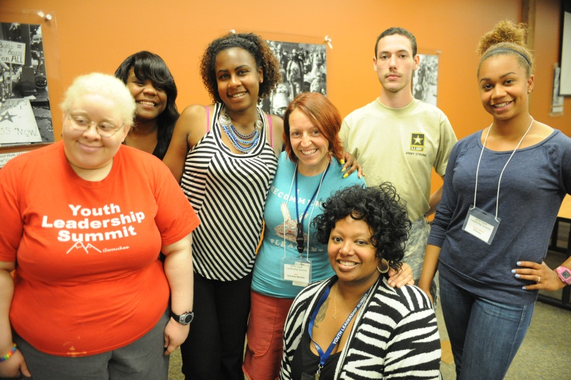
Current Youth Leadership Program
Youth Programming
  Two youth leadership summits
  GirlsFirst (four times per year)
  Making Proud Choices (sexuality education)
  Parents Matter
  Safe Relationships Safe Places
Funding
  $48,000 United Way
  $2500 Doerr Charitable Trust

Slide 16
The proof is in the numbers
Between 2004 and 2013, the number of consumers under 19 years old grew from less than 10% to 25%
Between 2004 and 2013, the number of consumers with cognitive disabilities grew from less than 5% to 20%
The Youth Leadership Specialist has served a total of 500 + consumers during a work year
Programs such as GirlsFirst and sexuality education classes have held waiting lists as long as 2 years

Slide 17
Growing a program piece by piece
Youth Leadership Summit
Disability Mentoring Day
GirlsFirst support groups
Person Centered Planning
Transition Series
Healthy Relationships and Sexuality
  Boundaries and Personal space
  Safe Relationships Safe Places
  Sexuality Education
  Parents Matter
  Making Proud Choices

Slide 18
Youth Leadership Summit
60 applicants the first year, 40 youth turned away
After 2 years IF added the second youth summit and accepted all applicants into the program
Added a musical component with the Figureheads
10 year collaboration with WI FACETS for the program
2-4 Volunteers, 20-25 youth & 2-4 staff in each Summit
Summit includes: Bus tickets, breakfast & lunch, $100 stipend, Learning: IL skills, disability awareness, healthy relationships, college & employment, conflict resolution, money management, self-advocacy

Slide 19
GirlsFirst
Youth Specialist attended 2 trainings to facilitate
  Access Living Chicago-Empowered FeFes
  Girls Circle Association
2-3 groups held throughout school year in elementary, middle and high schools
1 group held in the summer at IF for girls 8-18
Boyz2Men added as a boys support group in 2013
Girls meet once weekly, pick topics for discussion and create something (craft, writing, music, artwork) each session
Heart of the Matter added as a mother/daughter support group

Slide 20
Disability Mentoring Day
International event held on the 3rd Wednesday in October
Sponsored by the AAPD (American Association of Persons with Disabilities)
  Provide technical support and training opportunities
Youth learn skills and information about careers/jobs in their interest area
Employers learn the opportunities involved in hiring a person with a disability
Youth spend 1 hour to a full day job shadowing someone in their field of interest

Slide 21
Person Centered Planning and Transition Series
Person Centered Planning
  ½ day event based on the IEP experience
  Youth does the inviting and youth is asked each planning question first
  Asks youth to think about their dreams without boundaries and then imagine a positive, possible future
Transition Series
  Held three nights in fall and spring to cover specific transition topics
  2 hour event with guest speakers
  Youth, families and service providers invited
  Snacks and beverages served

Slide 22
Healthy Relationships/Sexuality
Boundaries and personal space saw a need for more information
Safe Relationships Safe places filled that need
Sexuality content of SRSP classes showed that youth did not have this background information (about puberty, dating or sex)
Sexuality education classes per request
Parents Matter!
Making Proud Choices

Slide 23
Questions?

Slide 24
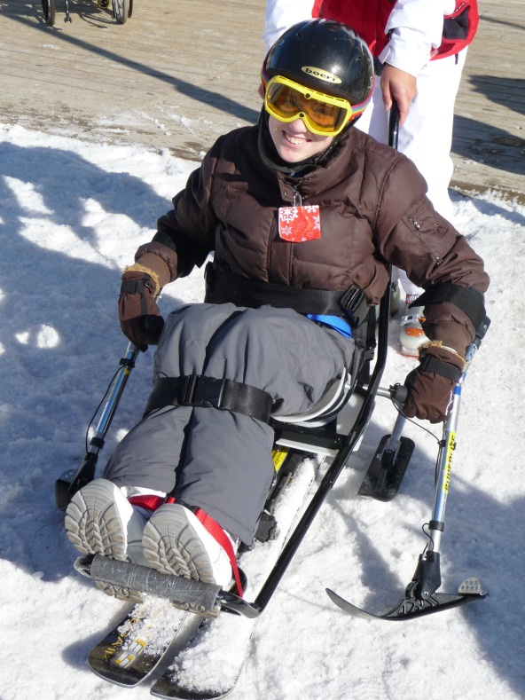
Other programs serving youth
Sports and Recreation Program
  Adaptive skiing
  Wheelchair soccer, hockey, basketball
  and rugby
  Biking Buddies
Peer Support Program
  Peer Power
Independent Living Skills Training
Benefits and Employment Program
Accessibility Consultations
  AT Demos and Loans

Slide 25
Other Funding
Sports and Recreation program
  Christopher Reeve Foundation
    Equipment
  Greater Milwaukee Foundation-Luedke Smith Fund
    Biking Buddies
    Other Independent Living Programs
  Milwaukee Public Schools
    Basketball
      Competitive Team
      Prep team
  CRV Pharmacy
Peer Support
  Peer Power (Independent Living Council of Wisconsin)

Slide 26
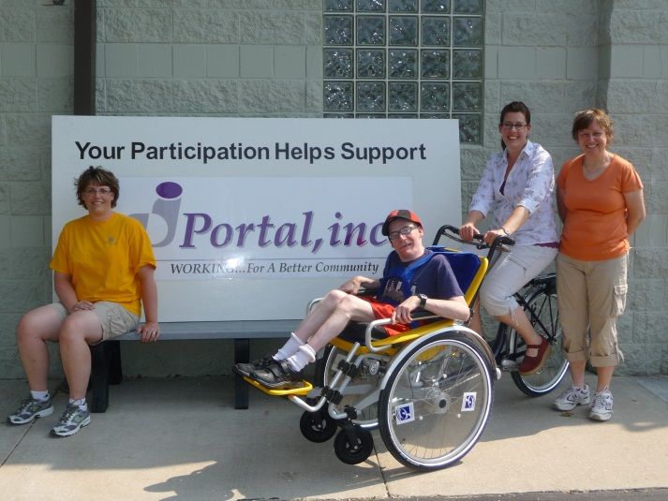
Funding and growing a program
Where to look for funding
  City and County Block Grants
  State Departments
    Children and Family Services
    Health and Family Services
    Department of Education
  Giving Campaigns (i.e. United Way)
  Local corporations and foundations
  Individual Giving

Slide 27
Making Yourself Fundable
Finding funding opportunities for specific programs/populations
Willingness to make your own investment
Having a replicable program
Demonstration that your work will continue after the grant period has ended
Working in coalitions
  Shows collaborations between two (or more) organizations
  Proves that you are not duplicating services
  Organizations sharing the wealth and working together

Slide 28
Outreach: Getting people to your program
Attending meetings of disability organizations
  Specific disability org, coalitions and groups like People First, The ARC, etc…
Attending meetings at school systems
  Social workers or special ed staff meetings
Offering to speak at schools
  Call the special ed supervisor or transition coordinator
  Go into classrooms and talk about programs/give a sample workshop
When funding is available, offering incentives
  Raffle prizes for attendees
  Stipends for travel or time
  Food!!!!!

Slide 29
Keeping people at your program
Consumer driven
  Hold planning sessions involving the consumers
  Give out surveys and LISTEN to the results
Leadership Roles
  Offering leadership roles to people who are repeating attendance
Make it fun
  Games, interactive activities, breaks, snacks, prizes
Involve families
Repeat performers
  Ask people to a panel of experts

Slide 30
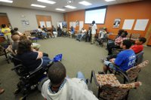
Another way to connect: Social Media
Facebook page for your program
Twitter Account
Instagram account
YouTube channel
Pinterest account
Linked in
Keeping a blog

Slide 31
Utilizing Volunteers
Volunteers love to help out with specific tasks, especially when they feel they’re making a difference
Even with a small staff-base volunteers can help make a program work
Reward volunteers with recognition awards, invites to agency events and just verbal thanks
Volunteers can
  Help with reading and writing
  Facilitate games
  Be a chaperone on an outing
  Present their own session at a workshop
  Assist with accommodation needs

Slide 32
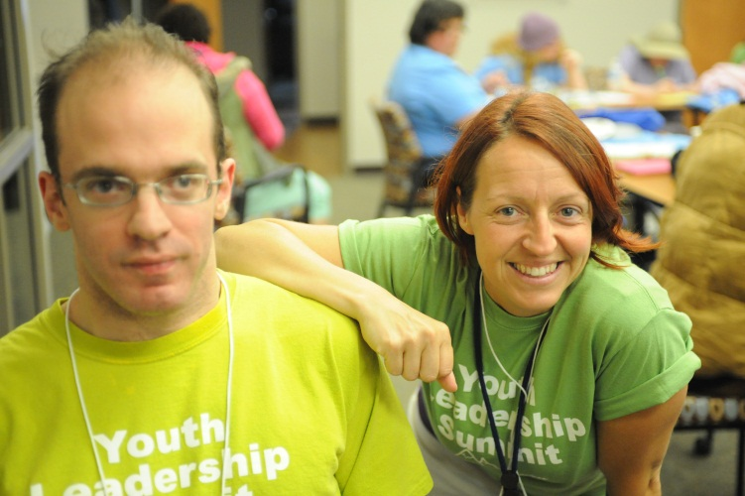
Collaboration
Collaborations are attractive to funders but also can help you make your program more accessible
You can take your expertise to another organization and they can bring theirs to you in kind!
Allows for more than one person running a program
  More adults in the room with youth
  Dividing work duties
  Dividing funding opportunities

Slide 33
Wrap up
Youth programming, opportunities for youth leadership and events for young people are attractive to both consumers and funders
Even in a small CIL without a grant writer or a PR team, you can grow a program, look for funding and write reports
IL is about people doing the things they want to do with their own lives—hold that philosophy close even with staff
Have faith!

Slide 34
Questions?

Slide 35
Contact
Alie Kriofske Mainella
Youth Leadership Specialist
IndependenceFirst
414-226-8112 (Direct/Voice)
akriofske@independencefirst.org

Slide 36
Wrap Up and Evaluation
Please click the link below to complete your evaluation of this program:
https://vovici.com/wsb.dll/s/12291g56a9b
33

Slide 37
New Community Opportunities
Attribution
This training is presented by the New Community Opportunities Center, a national training and technical assistance project of ILRU, Independent Living Research Utilization. Support for development of this presentation was provided by the U.S. Department of Education, Rehabilitation Services Administration under grant number H400B100003. No official endorsement of the Department of Education should be inferred. Permission is granted for duplication of any portion of this slide presentation, providing that the following credit is given to the project: Developed as part of the New Community Opportunities Center at ILRU.

