Slide 1
Practical Measures: Telling Your Story through Outcome Measures
November 12, 2014
Presenters:
Dan Kessler
Pat Puckett
Paul Spooner

Slide 2
Objectives
Upon completion of this webinar, participants will have knowledge and resources which will enable them to―
Describe the Outcome Measures Task Force tool that can be used by Centers to measure and understand outcome findings
Describe reporting and marketing opportunities that come from outcomes measurement
List examples that illustrate the value of outcome measures beyond Federal and/or funder requirements

Slide 3
Why Might Your CIL be Interested in Outcome Measures?
Your findings will help you share your success story with your constituents, your community, funders and others
Outcome measures are a tool that can help you improve your own effectiveness
Help you know if you’re really helping
Help you focus on what’s important
Help you know if your advocacy is effective

Slide 4
Why Centers Began to Work on Outcomes
Centers were calling for a better way to capture their accomplishments—to tell our own story—in a consistent manner.
The Rehabilitation Services Administration had begun an increased focus on outcomes.
2003—PART concluded “Results Not Demonstrated.”
Funders increased emphasis on outcomes and accountability.
Notes:
RSA required CIL’s to report on:
Improved access to healthcare, transportation, housing, and assistive technology.

Slide 5
Background―NCIL Task Force on Outcome Measures
Extensive work between 2006 and 2011
Bob Michaels Chaired the Task Force
Joint project of NCIL, ILRU, Univ. Kansas
Involved over 40 Centers
Final Report – http://www.ilru.org/sites/default/files/resources/outcome_measures/Focusing_on_Outcomes_in_the_CIL_Program.pdf

Slide 6
What Centers Learned
First, and very importantly, it is possible to measure the outcomes of Center programs, and the benefits are worth the effort.
The Centers’ second message, however, was that focusing on Center outcomes is not simple. Not all Centers were ready.
Notes:
74% of Year 2 respondents said that participating in the field test had been valuable or very valuable
72% were interested or very interested in participating in another field test.
Not all CILs were ready:
10 Centers dropped out before information-gathering began, and one additional Center failed to gather all the information needed.
Only 21 of 32 Centers (66%) volunteering for the field test were able to provide a full set of outcome information.

Slide 7
What Centers Learned, cont’d. 2
Seventy-eight percent (78%) of CILs needed 10 or fewer hours to gather information about their own CIL’s outcomes
93% needed 10 or fewer hours to enter all the outcome information into Survey Monkey.
Sixty-seven percent (67%) of CILs thought it was easy or very easy to ask questions of consumers.
70% thought it was easy or very easy to ask questions of I&R callers.

Slide 8
Indicators Define What We Mean by Outcomes
An indicator is a specific item of information that defines what we mean by the outcome
Sometimes we want to achieve things
Sometimes we want to prevent things
Notes:
Examples:
Achieve something:

Slide 9
Questions & Answers
Notes:
9

Slide 10
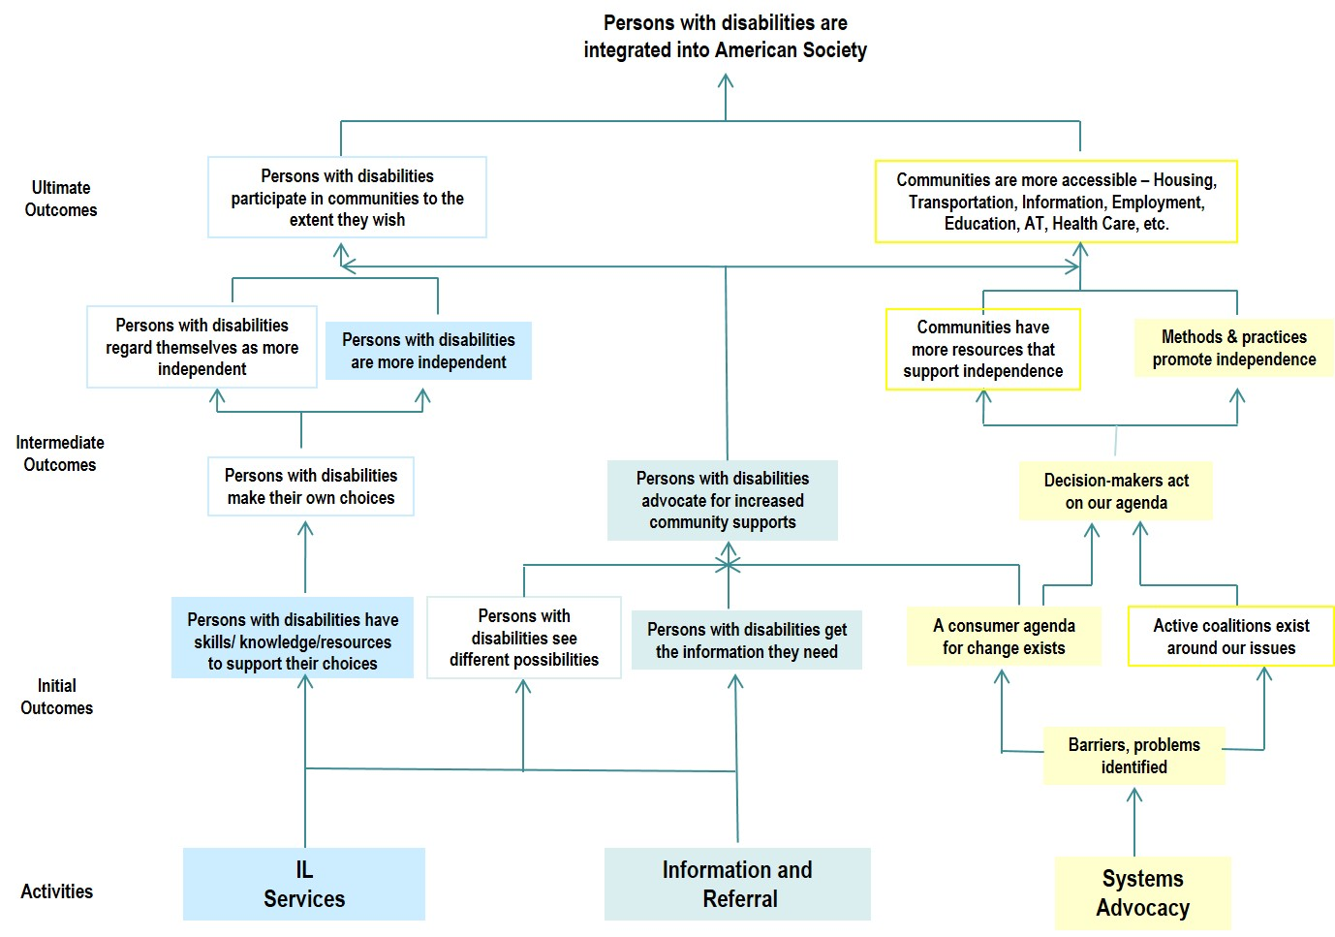
Logic Model for the CIL Program

Slide 11
Desired Outcomes
PWD have skills/knowledge/resources to support their choices.
PWD are more independent.
PWD get the information they need.
PWD advocate for increased community supports.
Barriers and problems are identified.
A consumer agenda for change exists.
Decision Makers act on our agenda.
Methods and practices promote independence.

Slide 12
Information and Referral Stream
Outcome: Persons with disabilities get the information they need
Indicator: “Persons contacting the CIL report they have the information they requested.”
Indicator: “Persons contacting the CIL report they used a new resource they learned about from the CIL.”

Slide 13
IL Services Stream
Outcome: Persons with disabilities have skills/knowledge/resources to support their choices
Indicator: “People served by the CIL can list at least one (1) specific skill, type of knowledge, or resource they have now that they didn’t have before approaching the CIL.”

Slide 14
Systems Advocacy Stream
Outcome: Barriers, problems identified
Indicator: “Activities, such as surveys, public meetings, focus groups, polls, are conducted to identify or confirm the primary barriers/problems in the community that prevent persons with disabilities from leading more independent lives.”

Slide 15
Systems Advocacy Stream, cont’d.
Outcome: A consumer agenda for change exists
Indicator: “Presence within the CIL’s annual plan of a separate section containing an explicit systems advocacy work plan.”

Slide 16
Systems Advocacy Stream, cont’d. 2
Outcome: Decision-makers act on our agenda
Indicator: “The number of positive changes achieved or negative changes prevented in legislation, policies, practices, or services at the local, state, or federal level that address the barriers/problems identified by the center’s consumers.”

Slide 17
Systems Advocacy Stream, cont’d. 3
Outcome: Methods and practices promote independence
Indicator: “# and % of consumers served by the CIL within the past calendar year who moved out of an institution and into a self-directed, community-based setting.”
Indicator: “# and % of consumers served by the CIL within the past calendar year who remained in a self-directed, community-based setting on December 31 despite having been at risk of moving into an institution.”

Slide 18
Resources
http://www.ilru.org/resources-outcome-measures
Interview Guides (Consumers, I&R)
Outcomes Management Worksheet
http://www.ilru.org/training/outcome-measures-for-centers-for-independent-living
2 ½ day training with Power Point, on-demand videos, handouts.
Notes:
2 Day Training
What an outcome is
What a logic model is and how a logic model is useful
Lessons learned from NCIL’s outcome measures field test
What challenges remain in measuring CIL outcomes
How to develop measurable indicators for these outcomes
How to identify sources, methods, and procedures to measure outcomes
Two main ways to use outcome information
Why it’s wise to focus on improvement, not reporting
Tools to help understand outcome findings
Steps to improve your CIL’s outcomes in the future

Slide 19
Questions & Answers
19
Notes:
19

Slide 20
The Process
CILs that beta tested the process, did so using three questionnaires.
I & R callers were told “our CIL wants to make sure that people are getting the information they need. May we call you back in a couple of weeks to check?”
CIL consumers were randomly selected until a statistically significant number of consumers were identified.
Overall CIL questionnaire.

Slide 21
I & R Questionnaire
WHEN YOU HAVE THE I&R CALLER ON THE PHONE, READ:
“Hi, my name is ____(your name)________________ with ___(name of your CIL)___. On ___(date of the initial I&R call)___, you called our agency for information and referral assistance. In order to improve our services, we are calling back to some people like you who contacted us during this past year. I’d like to ask you two short questions about the service you got from our Center when you contacted us. All answers will be kept confidential. Do you have a moment to answer two short questions?”
If answer is no, try to re-schedule FOR aNOTHER time.
IF ANSWER IS STILL NO, DOCUMENT YOUR ATTEMPT AND THANK THE CONSUMER FOR HER/HIS TIME.

Slide 22
I&R Questionnaire, cont’d.
If answer is yes, continue:
“Thank you. For each question, please be as honest as possible. There are no right or wrong answers, just whatever you feel is true. We want to know how you feel, so we can do the best possible job. Let’s begin:
“Sometimes we’re able to help people get the information they need from us, and sometimes we’re not. For you personally, did you receive the information you needed from us?”
I Don’t Remember __________
No __________
Yes __________

Slide 23
I & R Questionnaire, cont’d. 2
“Sometimes people use a new resource they learned about from us, and sometimes they don’t. By the word “resource,” I mean someplace you can call or visit to get more help or more information. For you personally, did you use a new resource you learned about from us?”
I Don’t Remember __________
No ____________
Yes ____________
THANK YOU SCRIPT: “Those are my two questions. Thank you for your help. Your input will be useful to us and other Centers like us as we improve services for persons who contact us. And as I mentioned before, your answers will be kept completely confidential within our Center.”

Slide 24
Examples from Report from the Outcomes Task Force
Desired Outcome: PWD get the information they need
72% of I&R callers received the information they needed; 15% did not and 13% could not remember.
52% used the information they got, 32 % did not and 17% could not remember.
Desired Outcome: PWD have skills/knowledge/resources to support their choices.
70 % of CIL consumers reported that they learned new skills/knowledge or resources and were able to list one or more examples.

Slide 25
Two Ways to Use Outcome Information
Outside our CIL – for PR value
Easily understood by many different audiences
A tool to enhance the fund-raising capacity of the CIL
Recruit talented staff and volunteers
Promote our CIL to potential clients and referral sources
Encourage other agencies to collaborate

Slide 26
Two Ways to Use Outcome Information, cont’d.
Inside our CIL – for program improvement
Know how effective we’re being
Find ways to be even more effective
Help staff to focus on what’s important
Identify training needs
Support both short- and long-range planning

Slide 27
Possible Next Steps
Review the training materials on ILRU website
Put “outcomes” on the agenda for the next staff and/or board meeting
Include a section on outcomes in your next annual report or on your website
Review your satisfaction survey, including whether it captures outcomes
Select several indicators to measure

Slide 28
Questions & Answers
Notes:
28

Slide 29
Contact Information
Dan Kessler - dan.kessler@drradvocates.org
Patricia Puckett - PPuckett@silcga.org
Paul Spooner – pspooner@mwcil.org

Slide 30
Wrap Up and Evaluation
Please click the link below to complete your evaluation of this program:
https://vovici.com/wsb.dll/s/12291g5712f
Notes:
30

Slide 31
CIL-NET Attribution
Support for development of this training was provided by the U.S. Department of Education, Rehabilitation Services Administration under grant number H132B120001. No official endorsement of the Department of Education should be inferred. Permission is granted for duplication of any portion of this PowerPoint presentation, providing that the following credit is given to the project: Developed as part of the CIL-NET, a project of the IL NET, an ILRU/NCIL/APRIL National Training and Technical Assistance Program.

