Slide 1
Future of Medicaid
Presenters:
Lex Frieden
Connie Garner
Jean Hall
December 13, 2017

Slide 2
Lex Frieden
Professor of Biomedical Informatics and Professor of Rehabilitation at the University of Texas Health Science Center at Houston, Director of ILRU at TIRR Memorial Hermann, and Professor of Rehabilitation at Baylor College of Medicine

Slide 3
Collaborative on Health Reform and Independent Living (CHRIL) Project Objective and Purpose
To provide disability stakeholders with accurate, current and actionable information on how recent changes in health policy directly or indirectly impact the community living and participation of working-age adults with disabilities.
Systematically investigate and disseminate essential findings about how health reforms affect working-age adults with disabilities.

Slide 4
CHRIL Institutional Members
Washington State University (WSU)
University of Kansas (KU)
George Mason University (GMU)
Independent Living Research Utilization (ILRU) at TIRR Memorial Hermann

Slide 5
CHRIL Strategic Partners
National Council on Independent Living (NCIL)
American Association on Health and Disability (AAHD)
Association of Programs for Rural Independent Living (APRIL)
Disability Research Interest Group (DRIG) of AcademyHealth
Urban Institute

Slide 6
Medicaid Managed Care
Jean Hall, PhD
Director, Institute for Health and Disability Policy Studies at the University of Kansas and Professor, University of Kansas Medical Center, Department of Health Policy and Management

Slide 7
Medicaid Managed Care is Growing
Currently, 39 states have at least some Medicaid enrollees in managed care programs
The majority of Medicaid enrollees nationally receive all or part of their Medicaid services through a managed care program
Use of managed care continues to grow and states are increasingly moving people with disabilities into managed care arrangements
States use managed care to decrease costs and also to add more predictability to costs

Slide 8
Which Medicaid enrollees are most expensive?

Slide 9
Where is the money spent?

Slide 10
Where are the services provided?

Slide 11
Surveys of Kansas Medicaid Enrollees with Disabilities
First study administered via telephone and in-person 4-8 months after transition to KanCare, April-August 2013, n=105
  Adult Medicaid beneficiaries (18+) in physical disability, traumatic brain injury or intellectual disability home and community based services (HCBS) waiver or enrolled in the Kansas Medicaid Buy-In
Second study administered via telephone and in-person October 2016-February 2017, n=189
  Adult Medicaid beneficiaries (18+) with serious mental illnesses (SMI) using services at one of six Community Mental Health Centers across the state

Slide 12
Problem areas
Provider Networks*
  “None of the providers I have seen for years in Jackson County Missouri takes KanCare [KS Medicaid managed care].”
  “Speech therapy is a two and a half month wait because there’s only one provider for my MCO.”
Benefits/Coverage
  “Can’t get [medication name], so I am just not taking it. I need it though.”
  “I had to pay $700 to get a joystick on my new wheelchair; they [MCO] won’t cover it even though I’m a quad[riplegic].”
  Step Therapy and Preauthorization for prescriptions are especially problematic for people with mental health conditions—32% reported not taking at least one prescribed medication
*In 2017, CMS noted the state does not provide sufficient data on adequacy of networks

Slide 13
Problem areas, continued
Transportation
  “The transportation people don’t transfer me correctly and I’ve gotten hurt.”
  “My PCA [personal care attendant] can’t get paid to go along with me.”
  “My doctor’s office changed my appointment time, but the MCO won’t change the pickup time because it is not 3 days notice.”

Slide 14
Problem areas, continued 2
Communication*
  “The 800 number tells you to go online, but they don’t realize that not everyone has internet access.”
  “I am completely confused about KanCare, I get things in the mail and I don't understand them.”
  “The information book they send is so thick plus I can't read it with my vision issues, even with my glasses and magnifier it is difficult.”
*In 2017, CMS found the state to be out of compliance regarding information for consumers

Slide 15
Problem areas, continued 3
Care Coordination
  All HCBS waiver participants are assigned a Care Manager/Coordinator with their MCO; 50% of survey respondents did not know who their coordinator was.
  “I had more direct contact with my case manager before [managed care]. Now, I have to call a number, leave a message – which doesn’t always get to the care coordinator – and then wait. There is no way to directly contact them.”

Slide 16
Problem areas, continued 4
  “You have one [coordinator] for medical, but I don’t have someone for everything else, like problems with my wheelchair or housing.”
  Less than 20% of respondents with SMI reported working with a care coordinator, despite the fact that 73% had co-occurring physical illnesses or conditions, including diabetes and heart disease.

Slide 17
Conclusions
Medicaid managed care organizations (MCOs) may not be fully prepared to meet the unique needs of people with significant disabilities
Medical issues include lack of broad provider networks, coverage limits
Non-medical issues include transportation and communication
LTSS, including care coordination, are essential to maintaining the health and function of people with disabilities
General lack of disability cultural competence and awareness of accessibility issues

Slide 18
Implications for Policy & Practice
Gaps in care due to difficulties obtaining services and supports can quickly lead to adverse outcomes for people with disabilities and increased costs for Medicaid programs
With the nationwide trend in moving people with disabilities to managed care, MCOs must have the capacity to best serve these individuals
Utilization of disability-related measures of access and quality of care are needed
Outcomes for Medicaid beneficiaries with disabilities must be monitored closely and separately

Slide 19
Questions and
Discussion

Slide 20
Medicaid Waiver Options in the Context of Health Care Reform:
Implications for Individuals with Disabilities
Connie Garner, M.S.
Vice President for Disability Policy & Education Policy
ML Strategies

Slide 21

2017: Where are we going … and why are we in this conundrum?

Slide 22
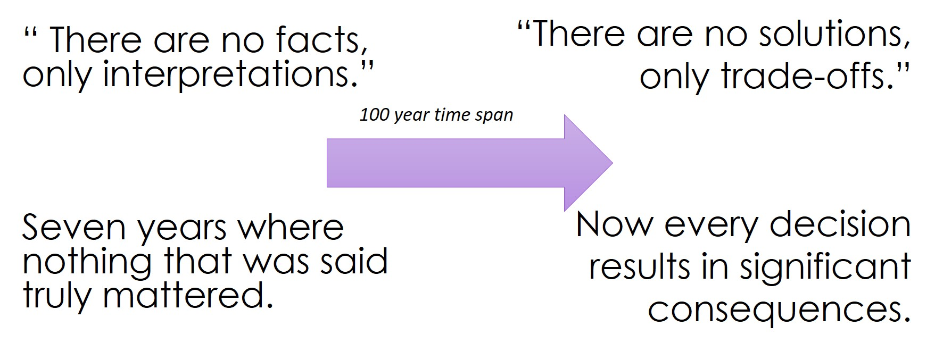
Significant Consequences

Slide 23
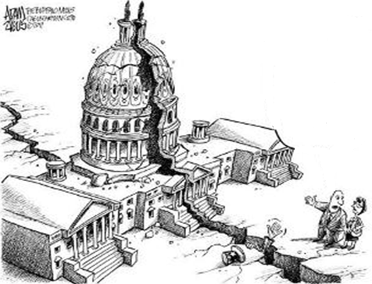
The Health Care Fight in 2017
The American Health Care Act v1.0
The American Health Care Act v2.0
The Better Care Reconciliation Act
Skinny Repeal
Graham-Cassidy

Slide 24
Congressional Budget Office Score
The CBO score estimated that the AHCA would:
  Reduce the federal deficit by $150 billion over ten years 2017-2026
  Result in 24 million people losing health insurance coverage by 2026
  Result in 14 million Medicaid beneficiaries losing Medicaid coverage by 2026
  Reduce federal funding to the Medicaid program by $839 billion from 2017-2026

Slide 25
Where do we go from here, and how will it affect individuals with disabilities and their families?

Slide 26

Disability Policy
Disability policy is not a single issue, but focuses on equity, fairness, and opportunity for our most vulnerable citizens.

Slide 27
Where Does the Definition of Community Begin?
Societal expectations
Family values
System infrastructures
    Laws
    Schools
    Neighborhoods

Slide 28

Tools of the “Trained”

Slide 29
New World of Medicaid HCBS Options
Started in 1983 under 1915 (c), as a waiver alternative to institutional care
In 2005, 1915 (i) →no waiver necessary
1915 (j) is self-directed care option
1915 (k) is Community First Choice

Slide 30
Common Elements of Interest
Home and Community Based Services
Defined as the nature and quality of participant experiences
Not “what they are not”
Based on outcomes, NOT places

Slide 31
Common Elements of Interest, continued
Person-Centered Planning
A planning process that addresses health and LTSS reflecting individual preferences/goals
Includes chosen representatives
Includes paid and unpaid services related to: community participation, employment, income/savings, and healthcare/wellness

Slide 32

If families and advocates don’t act, what will happen?
????? 1115 Waivers ?????

Slide 33
What is the Intended Purpose of These Waiver Demos?
Provide flexibility to states to implement projects that “are likely to assist in promoting the objectives of Medicaid.”
Allow “waiving” of certain current Medicaid requirements in order to implement the demo/test ideas.
Goals:
  ↑ coverage
  ↑ access
  ↑ health outcomes
  ↑ efficiency and quality of care

Slide 34
What is the Unintended Use of These Waivers?
Imposed work requirements
↑ premiums on low income people
↑ limit on enrollment
Coverage lockout

Slide 35
Dueling Agendas at Play
Political
Issues around expanded government role in healthcare.
Financial
↓ Medicaid enrollment, but ↑ Medicaid spending.

Slide 36
Non-Approved Requested Restrictions
Eligibility to 100% of FPL
≠ presumptive eligibility
Drug screening and testing
Time limits on coverage
Non-payment lockout

Slide 37
New CMS Guidance on 1115 Waivers
CMS released new guidance on 1115 Waivers.
CMS’ goal is to reduce burden for states throughout the approval process.
CMS will also work with each state to develop a timeline for the approval process.
CMS will work to expedite the approval process of 1115 Waivers by developing parameters for expedited approval of certain waiver authorities.
CMS may also approve the extension of successful waivers in a state for a period up to 10 years.

Slide 38

Change for the Future
“If you don't like something change it; if you can't change it, change the way you think about it.”

Slide 39
Questions and
Discussion

Slide 40
Evaluation Survey and Contact Information
Directly following the webinar, you will see an evaluation survey to complete on your screen. We appreciate your feedback!
http://www.surveygizmo.com/s3/3985341/Webinar-Evaluation-December-13-2017-Future-of-Medicaid
Lex Frieden – lfrieden@bcm.edu
Connie Garner - cmgarner@mlstrategies.com
Jean Hall – jhall@ku.edu

Slide 41
CHRIL Attribution
The CHRIL is funded by a 5-year Disability and Rehabilitation Research Program (DRRP) grant from the National Institute on Disability, Independent Living, and Rehabilitation Research (NIDILRR grant number 90DP0075-01-00). The CHRIL brings together disability advocates and researchers from 4 institutions (Washington State University, the University of Kansas, George Mason University, and Independent Living Research Utilization (ILRU) at TIRR Memorial Hermann) to systematically investigate and disseminate essential findings about how the Affordable Care Act's implementation affects working age adults with disabilities. The CHRIL website is at CHRIL.ORG.

