Slide 1
Collaborative on Health Reform and Independent Living (CHRIL) presents…
Health Reform and People with Disabilities:
Lessons to Date from the CHRIL
Presenters:
Jae Kennedy, Washington State University
Lex Frieden, ILRU
Jean Hall, University of Kansas
January 31, 2019

Slide 2
Today’s Agenda
Brief overview of the CHRIL
Health insurance coverage, health services usage, and access problems before and after implementation of the ACA in 2014
Information and training needs of CILs
Using the Health Reform Monitoring Survey (HRMS) to assess effects of the ACA for people with disabilities
Lessons learned from the CHRIL: the challenges and rewards of disability policy research

Slide 3
The Collaborative on Health Reform and Independent Living (CHRIL)
Project Objective: To discover and share essential information about how health reforms affect working-age adults with disabilities
Institutional Members: Washington State University (WSU), Independent Living Research Utilization (ILRU) at TIRR Memorial Hermann, University of Kansas (KU), and George Mason University (GMU)
Strategic Partners: American Association on Health and Disability (AAHD), National Council on Independent Living (NCIL), Association of Programs for Rural Independent Living (APRIL), Disability Research Interest Group (DRIG) of AcademyHealth, and Urban Institute

Slide 4
Jae Kennedy
Washington State University jjkennedy@wsu.edu
Health insurance coverage, health services usage, and access problems before and after implementation of the ACA in 2014

Slide 5
Why focus on “working age” adults with disabilities?
Work and private health insurance
Disability benefits and public health insurance
Notes:
For one thing, the great majority of adults over age 65 already participate in a single payer system – Medicare.
Working-age adults with disabilities are also interesting from a policy perspective because they usually have high health care needs and associated costs, so insurance is particularly important, but they also face barriers to coverage.
Some working-age adults with disabilities apply for SSI or SSDI mainly for health insurance coverage rather than transfer income, a phenomenon we describe as Health Insurance Motivated Disability Enrollment (Kennedy & Blodgett, 2014).
The Affordable Care Act eliminated pre-existing coverage exclusions for private insurance, and created new Medicaid coverage options for the states. The impact of those changes on working-age adults with disabilities had not been studied.

Slide 6
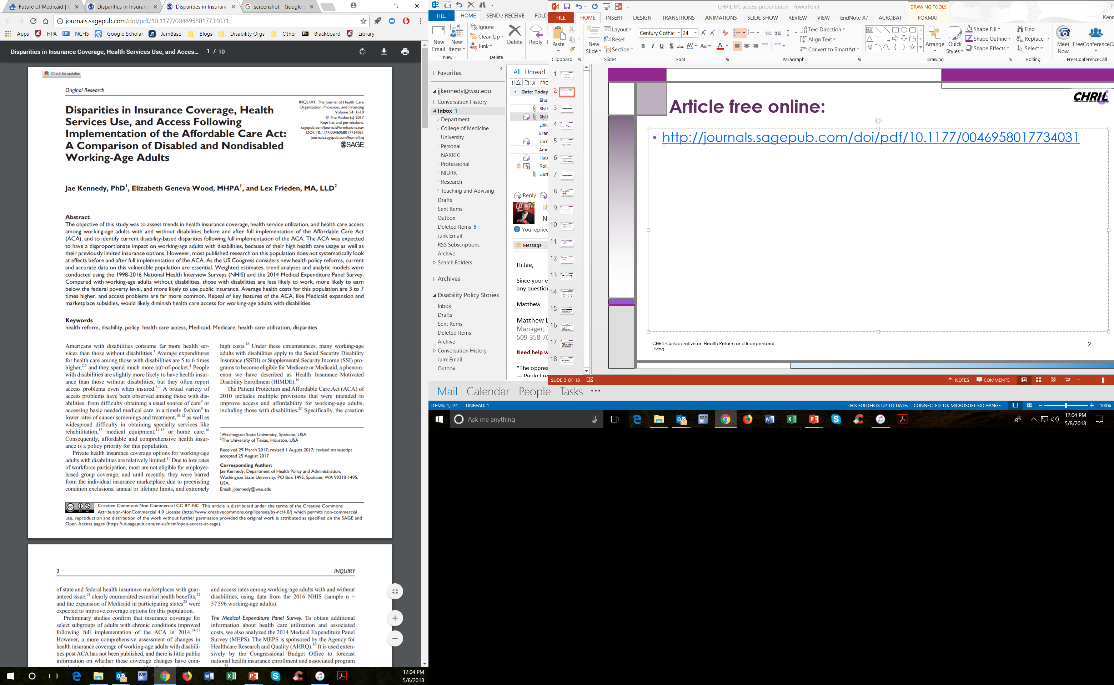
Disparities in Insurance Coverage, Health Services Use, and Access Following Implementation of the Affordable Care Act
Jae Kennedy, Liz Wood & Lex Frieden (2017) Inquiry, 54(10), pp. 1-10.
http://journals.sagepub.com/doi/pdf/10.1177/0046958017734031
Notes:
The trend figures presented here are updated from this publicly available journal article.

Slide 7
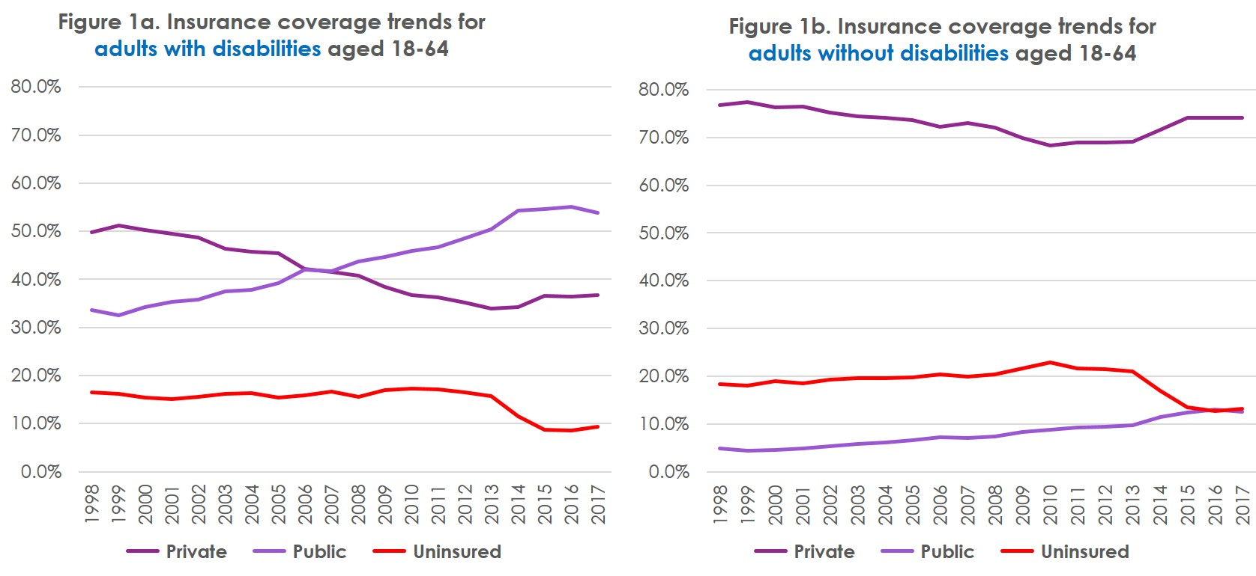
Insurance coverage trends
ACA
ACA
Notes:
The proportion of adults without insurance declined after ACA implementation

Slide 8
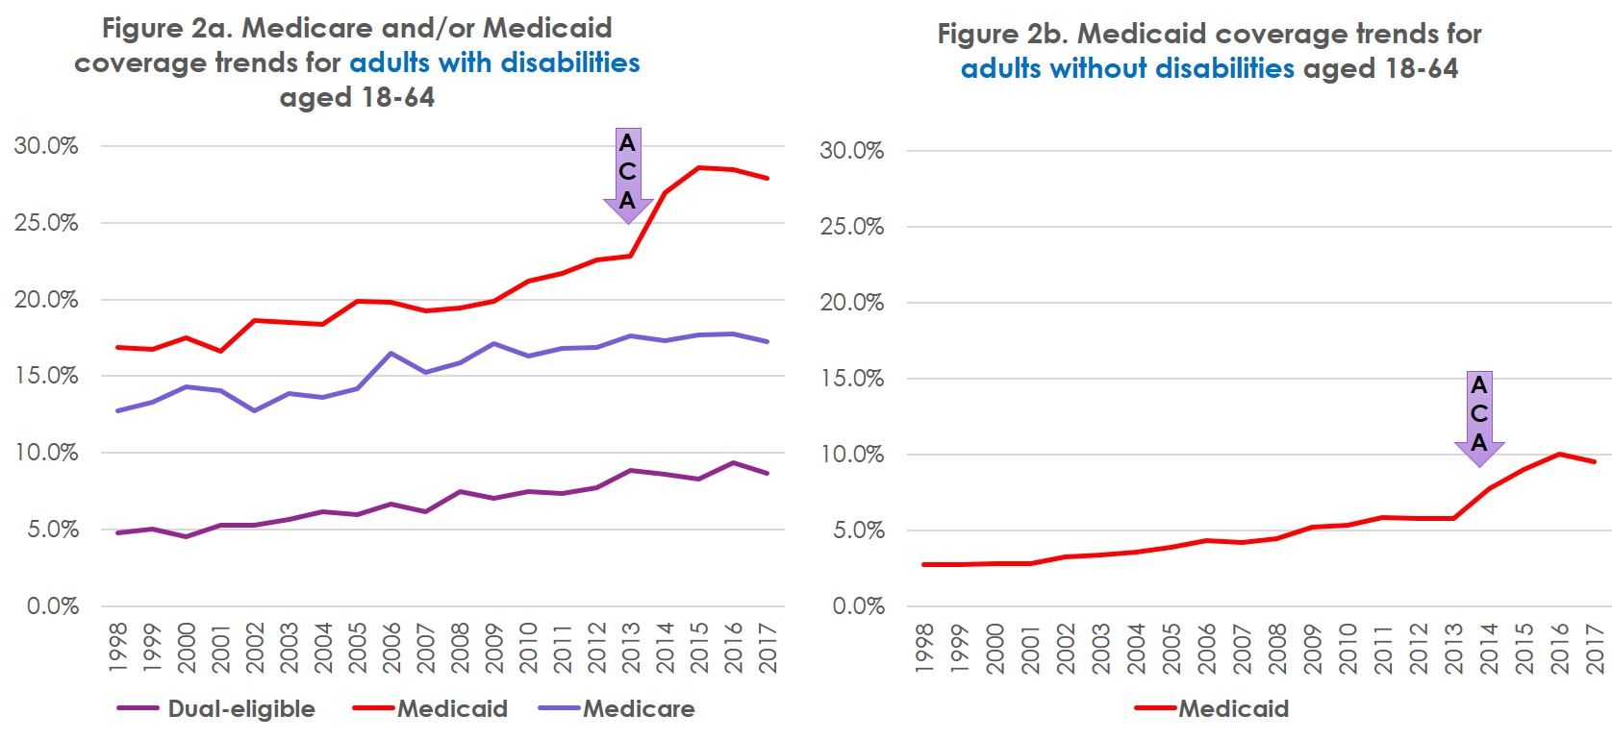
Public insurance coverage trends
Notes:
The proportion of adults enrolled in Medicaid increased after ACA implementaton

Slide 9
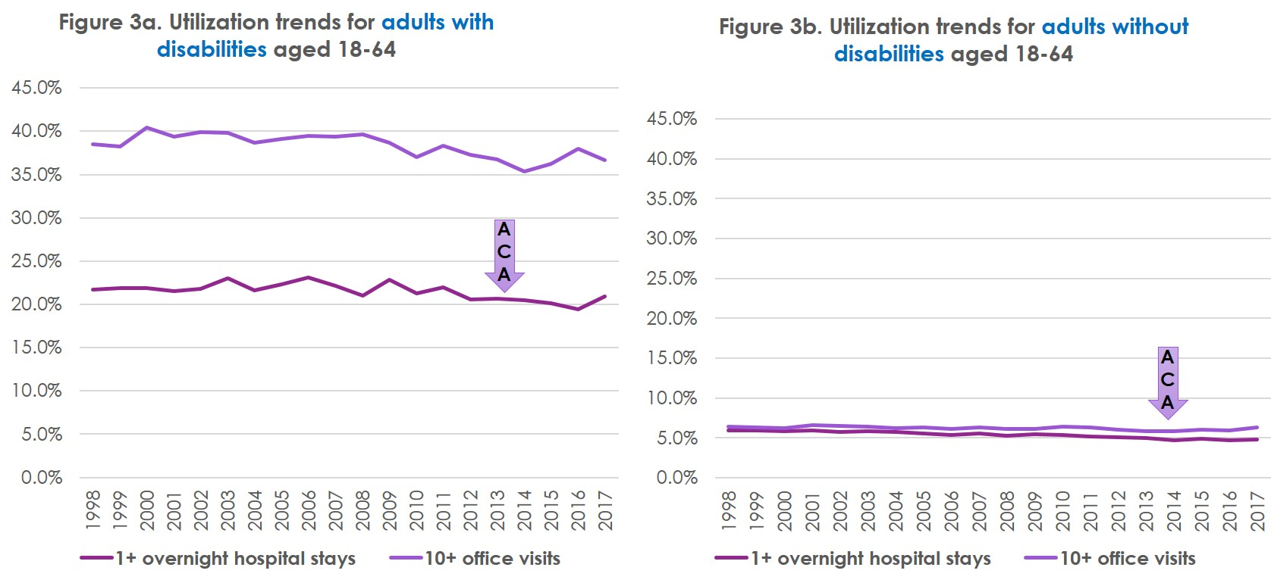
Hospital and physician utilization trends
Notes:
Better insurance coverage didn’t increase heavy use of hospital or physician services. This is important, because economists are perennially concerned that reducing costs by improving insurance leads to higher use rates.

Slide 10
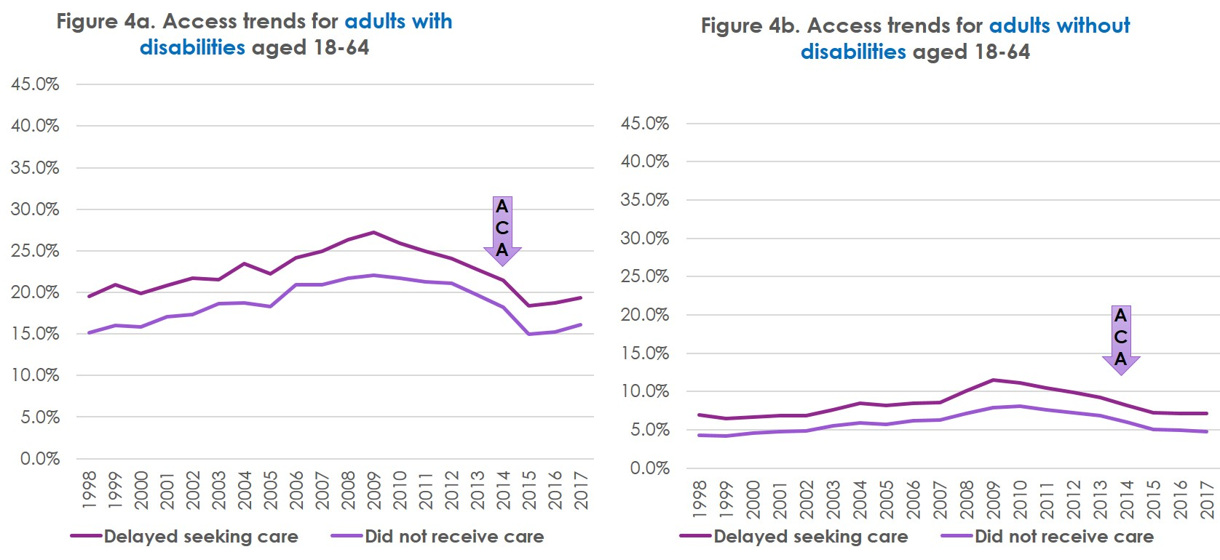
Access trends
Notes:
Affordability problems peaked at the height of the Great Recession, and declined afterwards. But there was a steeper drop after ACA implementation.
Access problems for adults with disabilities seem to be increasing recently (2016 and 2017) – it’s something to keep an eye on.

Slide 11
Take-away points from trend analysis
Working-age Americans with disabilities use a lot more health services than those without disabilities, but also have more difficulty obtaining and paying for these services.
Working-age Americans with disabilities rely a lot more on public health insurance (Medicaid and Medicare) than those without disabilities. Consequently, they are relatively vulnerable to changes in Medicaid policy.
For both working age adults with disabilities and those without disabilities, the implementation of the ACA in 2014 coincided with an increase in health insurance coverage and a decline in health care access problems.
Notes:
The ACA seemed to improve coverage and access for adults with and without disabilities, but the huge disparities between people with and without disabilities remain.

Slide 12
Lex Frieden
ILRU lfrieden@bcm.edu

Slide 13
Health Insurance Information and Training Needs of Centers for Independent Living (CILs)
Central hypothesis:
Centers for Independent Living throughout the US will require new research, training, and technical assistance products to meet the needs of consumers with disabilities.
Research questions:
  Are CILs currently providing benefits counseling and health insurance enrollment assistance to clients with disabilities?
  What are the information, training, and technical assistance needs of the CIL staff and clients?
  What are the major health policy concerns of CIL staff and clients?
Notes:
Lex pass to Alexander when finished with this slide

Slide 14
Needs Assessment of
Centers for Independent Living (CILs)
Goal
Conduct a survey to determine the information, training, and technical assistance needs of Centers for Independent Living (CILs) as they help consumers access healthcare and obtain or maintain health insurance coverage.
Central question: Do CILs provide these services?
If yes, how?
If no, how can we help you to do so?

Slide 15
Needs Assessment of CILs ― Main Findings
75.7% of the CILs responded that they provided health insurance counseling and enrollment assistance for consumers. (Only 8.7% of these CILs stated they were doing well in offering this service).
Individual, face-to-face, or telephone was the most reported method of providing this assistance. CIL websites were reported as the major means for providing awareness that these services were offered.
91% of CILs indicated a need for more information and training.

Slide 16
Needs Assessment of CILs ― Information/Training Needs
  More detailed information on how to decipher coverage and compare coverage between plans.
  Training on how to identify major areas of concern for consumers.
  More up-to-date, easily accessible information regarding health insurance rules.
  Training to be better able to advocate for specific consumers based on their disability and budget.
  Training on how to play a more active role in persuasion of legislators and encourage consumers to do the same.

Slide 17
CILs Executive Director Follow-up Interviews
― Findings
Differences in how CIL staff obtains information on health insurance rules
  Inability to efficiently find information, lack of regular updates from federal organizations
Lack of knowledge of specific staff training and technical assistance needs
  No specific specialists for heath insurance enrollment/coverage inquires
Uncertainties in addressing consumer concerns
  Medicaid eligibility, loss of coverage, unpredictable recent healthcare legislation changes

Slide 18
Implications of Findings
Essential need to improve the availability and accessibility of information on updated health insurance rules
  Enhance how CILs disseminate this information to their consumers.
Impact of findings on people with disabilities
Importance of education for CILs staff in identifying and addressing consumer’s concerns
  Translate to effective health insurance counseling and enrollment assistance.

Slide 19
Conclusions
There is critical need to improve the education and quality of information available for CIL staff to keep their consumers updated on health legislation and health insurance rules.
The findings from the survey along with the follow up interviews will help guide the CHRIL team in developing relevant and up-to-date training to CILs.
Notes:
Alexander pass to Lex when done with slide

Slide 20
CHRIL Training to Date
Webinars (6) – now on-demand:
  What CILs Need to Know about Health Insurance Open Enrollment
  Introduction to the Affordable Care Act
  Early Findings from the CHRIL
  CILs Survey and Executive Director Follow-Up Findings
  Future of Medicaid
  Health Insurance Coverage and Health Care Access Disparities
RapidCourses – Self-Paced Tutorials; Fully Accessible & Available 24/7 (3):
  Disability and Health Insurance
  Medicaid 101
  Medicare 101

Slide 21
Questions & Discussion

Slide 22
Jean Hall
University of Kansas jhall@ku.edu

Slide 23
Using the Health Reform Monitoring Survey (HRMS) to assess effects of the ACA for people with disabilities
The Health Reform Monitoring Survey (HRMS), a national web-based survey started in 2013, assessed pre- and post-ACA experiences of people with disabilities.
Two analytical groups: 1) people with disabilities overall, and 2) people with psychiatric disabilities.
For people with psychiatric disabilities, we found:
  Post-ACA reforms, people with mental health conditions were less likely to be uninsured and have unmet need due to the cost of care
  They were more likely to have a usual source of care
  These effects were experienced in both expansion and non-expansion states
Thomas, K. C., Shartzer, A., Kurth, N. K., & Hall, J. P. (2017). Impact of ACA health reforms for people with mental health conditions. Psychiatric Services, 69(2), 231-234.

Slide 24
Medicaid Expansion vs. Non-Expansion States
Based on the HRMS data, the broader population of people with disabilities was also more likely to be insured post-ACA, with significantly fewer uninsured in Medicaid expansion states.
In Medicaid expansion states, people with disabilities were also more likely to be employed:
  Employment increased from 41.3 to 47.0% in expansion states, while in non-expansion states, employment decreased from 43.5 to 41.4%.
Hall, J. P., Shartzer, A., Kurth, N. K., & Thomas, K. C. (2018). Medicaid expansion as an employment incentive program for people with disabilities. American Journal of Public Health, 108(9), 1235-1237.

Slide 25
Coverage features also have an effect on employment
Two plan features were associated with an increase in employment:
    Living in a state with Marketplace habilitative services without limits
    Living in a state with Medicaid physical therapy without limits

Slide 26
National interviews: five themes
While coverage and access have improved, problem areas remain for disability researchers and advocates to address:
Information and Understanding of Coverage
Out-of-pocket costs
Prescription medications
Provider networks
Transportation
Hall, J. P., Kurth N.K., Gimm, G. & Smith, S (2018). Perspectives of adults with disabilities on access to health insurance and health care. Presented at the American Public Health Association Annual Meeting, San Diego, CA; November 12, 2018.

Slide 27
National Survey on Health Reform and Disability
First fielded in 2018; web-based, national cross-disability survey to learn about experiences with insurance post-ACA, N=1246.
Many research groups are exploring the data and developing manuscripts on topics such as:
  Rural vs urban experiences
  Network adequacy and employment
  Sub-group experiences (e.g., LGBTQ+ and IDD)
  Stability of coverage
  Relationship between health insurance, employment and disability program participation
  Sources of personal assistance services

Slide 28
Plans moving forward
Currently conducting our second round of national interviews
Second administration of the National Survey on Health Reform and Disability will begin in fall 2019
Will continue to explore all of the primary data collected and develop manuscripts, policy briefs, other publications and presentations to share the findings

Slide 29
Jae Kennedy
Lessons Learned: The Challenges and Rewards of Disability Policy Research

Slide 30
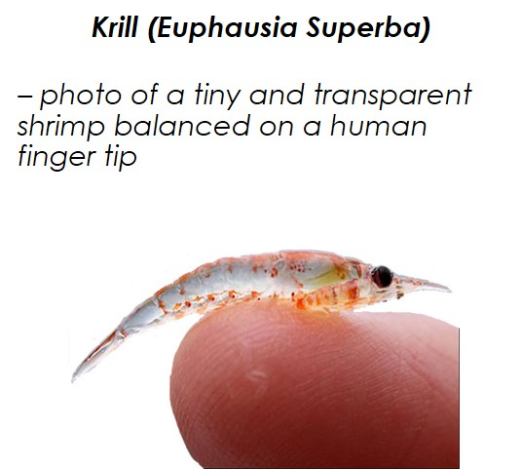
A small team of disability advocates tackles a very big policy question
The ARC described the ACA as “the most significant law for people with disabilities since the enactment of the Americans with Disabilities Act.”
However, the disability community was not a significant player in development of the ACA, and the impact on people with disabilities was not fully considered.
Effective disability advocacy requires precise and rapid assessment of the impact of public policies and regulation on the disabled population.
The Collaborative on Health Reform and Independent Living (CHRIL) attempted to meet “this urgent need for accurate, accessible and timely information.”
Notes:
We knew the ACA was going to be very important to the disability community, but there wasn’t a lot of policy research that focused on this population.
We also knew that this was a really big and difficult issue to tackle, and that a lot of people had very strong opinions about reform.

Slide 31
“Nobody knew health care could be so complicated” (Donald Trump, 2/27/17)
Washington State University and the University of Kansas began submitting grant proposals to study the impact of the ACA on people with disabilities in 2011, but got a lot of pushback from NIDILRR reviewers regarding:
  The volatility of the political context
  The complexity of both the study population and the health insurance system
  The methodological challenges in measuring coverage, access and costs
  The disconnect between research and policy, e.g., “existing reports on the disparity to healthcare haven’t impacted the rate of access, and the applicant has not provided sufficient justification of how this project will have a beneficial impact on the target population beyond the producing of yet one more federal report on the unequal access to healthcare” (reviewer 3, 2012)
Notes:
The CHRIL team submitted about 4 grant proposals before we finally received our DRRP award in 2015.
NIDILRR reviewers were pretty skeptical about our proposals

Slide 32
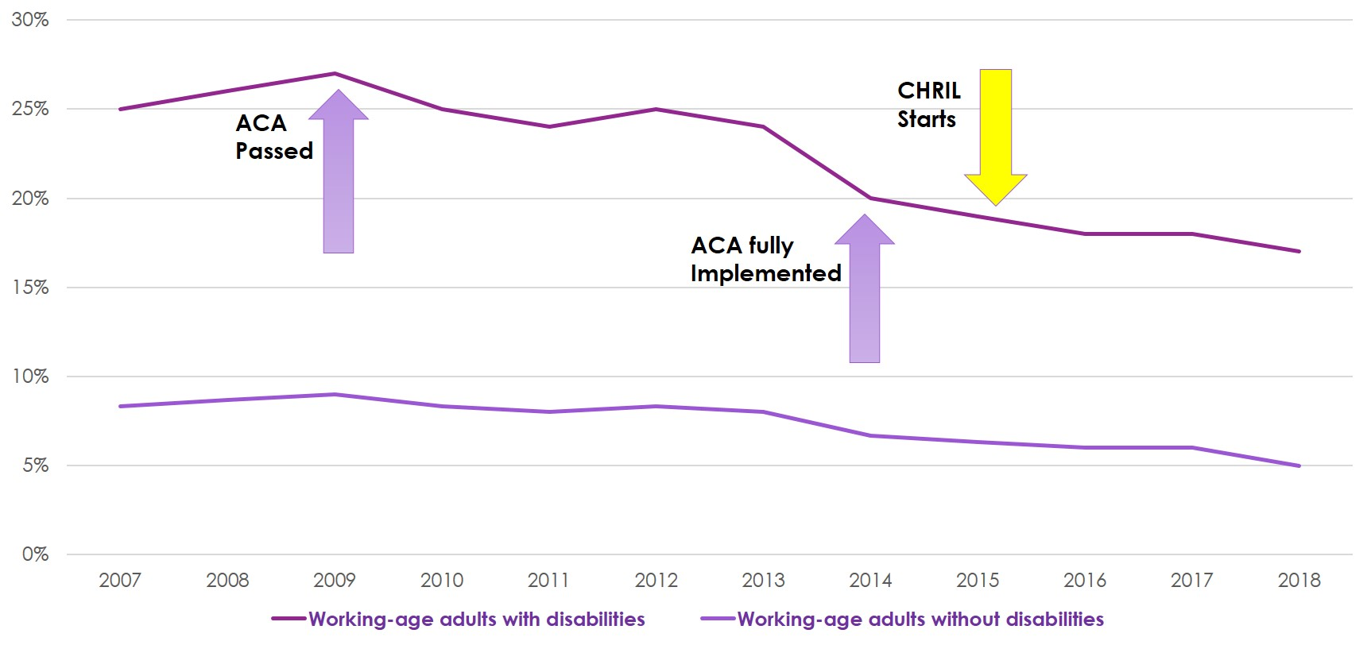
A simplified model of ACA evaluation
Notes:
In the CHRIL proposal, we describe a standard type of quasi-experimental design called interrupted time-series. Basically, researchers observe changes in one or more groups over time, and see if the slope of the trend line changes after an important interruption or intervention.
In this figure, we are looking at changes in the proportion of adults with and without disabilities who report difficulty paying for needed medical care. We knew that a growing number of Americans were having difficulty paying for care, and that those with disabilities were about 3 times more likely than those without disabilities to have difficulty.
A main goal of the Affordable Care Act was to reduce health care costs, so we hypothesized that rates of difficulty would decline after the ACA was fully implemented in 2014. When we started the CHIL project in 2015, we could look back to see how these rates changed.
But a lot of other things were happening during this period, and these might also have affected the affordability of health care…

Slide 33
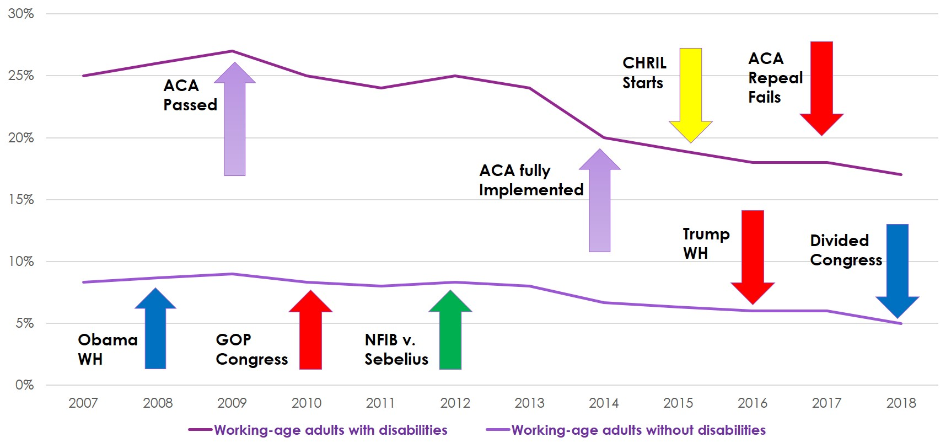
What actually happened…
The Great Recession
Notes:
After the Supreme Court decided that the ACA was mostly constitutional, and we addressed other reviewer comments, we got the CHRIL grant.
But we didn’t fully anticipate the continued resistance to implementation of Medicaid expansion, or the big push to repeal the ACA after the 2016 election. As the political environment changed, so did the research questions.
This is a big problem for anyone who does policy research, not just the CHRIL team. Funders like NIDILRR have to take a risk when they fund research like this, because of the uncertainty of the intervention and political controversy of the policy issue.
I would argue that the success of the CHRIL shows that, for important policy questions, the benefit is worth the risk.

Slide 34
Getting beyond “the producing of yet one more federal report”

Slide 35
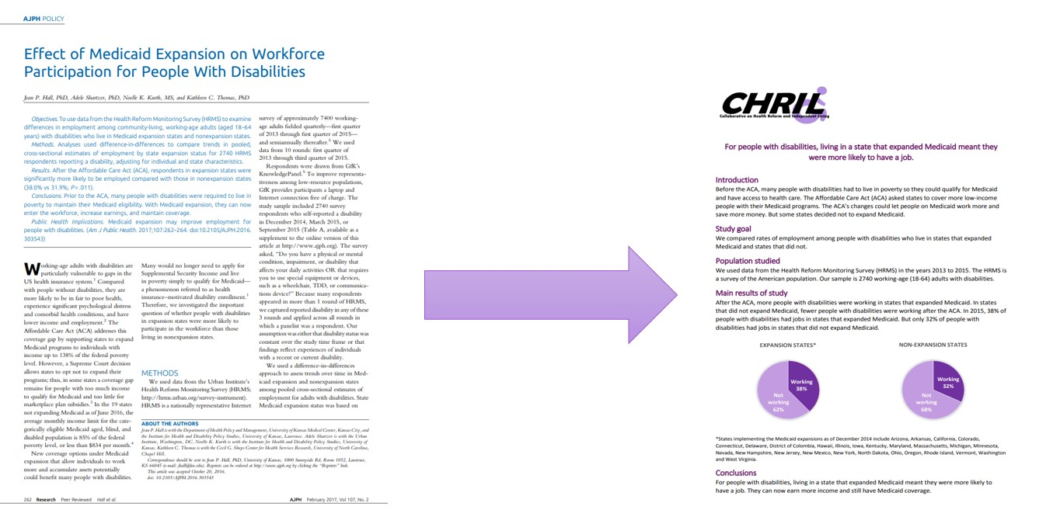
Making journal articles accessible
CHRIL articles are accompanied on our website by a 1-2 page report that summarizes our research question, methods, and findings in non-technical language. This ensures that our findings are available to people who do not have graduate educations and/or institutional access to research journals.

Slide 36
Going beyond journal articles
  Sharing early findings and policy insights through webinars (like this one) that are available with transcripts on our website
  Bypassing the journal process by offering free, timely, non-technical reports on topical issues and findings from our research:
    “Just Because Our Diseases Are Rare Doesn’t Mean We Don’t Count:” Perspectives Of Americans With Disabilities On Access To Health Care
    Centers For Independent Living Report That Their Consumers Are Concerned About The Uncertain Climate Of Health Reform.
    The Prevalence And Treatment Of Opioid Misuse Among Working-Age Adults With Disabilities, 2016
    People With Disabilities And Health Insurance Marketplaces
Notes:
We really are committed to working with the disability community and providing resources and training other than journal articles and reports.

Slide 37
Turning disability advocates into policy experts
  In-person trainings at independent living conferences (Denver, DC, Spokane, next stop Grand Rapids…), presented with CART transcribers, ASL interpreters, alternate formats of handouts, etc.
  Online, fully-accessible self-paced courses on topics of interest like Medicaid and Medicare
  A summer internship for undergraduate and graduate students with personal and/or professional interests in disability issues (ten so far!)
  A post-doctoral training program for scholars with disabilities.
Notes:
We really are committed to working with the disability community and providing resources and training other than journal articles and reports.

Slide 38
Working with disability organizations
Abandoned our planned “town hall” meetings at NCIL and APRIL, because the original format was too unstructured
Now offering “Health Policy 101” and “Health Policy 102” workshops at NCIL and APRIL: attendance doubled between the 2nd and 3rd year
Initiated the “disability policy stories” project, with semi-structured interviews of disability advocates about health insurance and health care – video and audio clips to be added to the CHRIL webpages – participant experts referred to journalists and policymakers
Notes:
For many disability advocates, health policy is a matter of life or death.
People are passionate, and frequently quite angry. That’s good!
But we need to give them information and strategies for channeling that energy. “Call your Congressional Representative” is not enough.

Slide 39
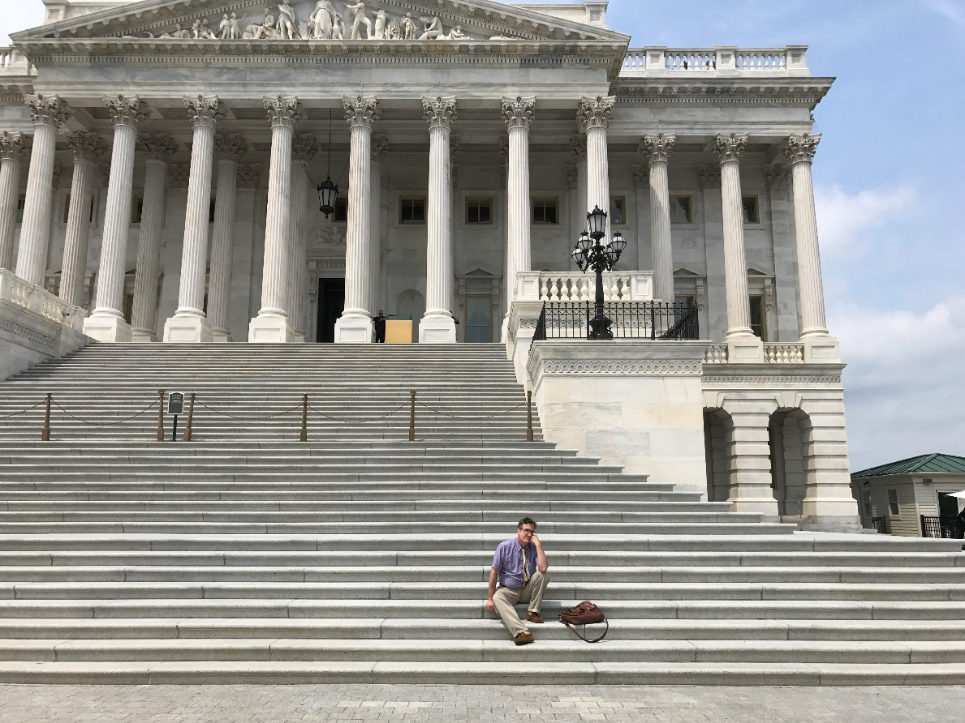
Dealing with the politics
Accept change
Tolerate ambiguity
Embrace emotion
Listen carefully
Explain patiently
Encourage critical thinking
Notes:
Research projects like the CHRIL are inherently difficult to manage, but the plus side is that people really care about the work.
The CHRIL team strongly believes that better evidence leads to better policy. This objective stance helps defuse partisan passions.

Slide 40
Emerging Issues
It’s safe to say we didn’t fully anticipate the complexity and volatility of Medicaid policy, particularly after the 2016 election
Managed care organizations now provide the bulk of Medicaid coverage throughout the country, and high-need populations, including working-age adults with disabilities, are no longer excluded
More states are participating in Medicaid expansion, but many are also seeking waivers to modify the structure, eligibility and financing of their programs
The Trump administration is trying to revive plans for Medicaid block grants, despite the concerns of analysts and advocates
Notes:
At least for the next few years, it looks like the main arena for policy change will be state and federal Medicaid policy.
It is imperative to focus on specific states and territories and talk with local disability communities – employing qualitative techniques and particularly case studies

Slide 41
What’s next?
The CHRIL will be seeking supplemental funding to study how the changing nature of Medicaid may affect people with disabilities, including:
  State variations in eligibility
  Work requirements
  Block grants
  Medicaid Buy-In programs
  CILs partnerships with Managed Care Organizations
Notes:
Stay tuned!

Slide 42
Final Questions / Wrap Up / Evaluation
CHRIL Website: www.chril.org
After the webinar ends, you will see an evaluation survey. Please fill this out – your feedback is important and appreciated!
https://www.surveygizmo.com/s3/4718075/Webinar-Evaluation-January-31-2019-Health-Reform-and-People-with-Disabilities-Lessons-To-Date-from-the-CHRIL

Slide 43
Acknowledgements
The Collaborative on Health Reform and Independent Living (CHRIL) is funded by a grant from the National Institute on Disability, Independent Living, and Rehabilitation Research (NIDILRR), US Department of Health and Human Services.
The contents of these presentations do not represent the policy of NIDILRR, ACL, HHS, or the US Government.

