Slide 1

Independent Living Research Utilization

Slide 2

High-Performance Measurement Framework
Webinar Series for SILCs
Webinar 2:
How to Select and Capture the Best Measures to Quantify your Impact and Value
Presenters:
Sheri Chaney Jones
Jeremy Morris
August 7, 2019

Slide 3
Evaluation Survey & Presenter Contact Information
Your feedback on this webinar is important to us. At the end of the presentation you will have the opportunity to complete a brief evaluation survey.
Sheri Chaney Jones – scjones@measurementresourcesco.com
Jeremy Morris - jmorris@ohiosilc.org
Paula McElwee – paulamcelwee.ilru@gmail.com

Slide 4
What You Will Learn…
How to create a high-performance measurement culture.
The importance of a SILC logic model for success.
How to attract funders with data.
How to create the perfect customized statewide measurement framework.
Impactful data-driven communication strategies using data.

Slide 5
Five Strategies for Turning Data into Dollars
Culture
Capture
Communicate
Change/ Celebrate
Clarify

Slide 6

2. Clarify your Vision

Slide 7

Clarifying Tool: Five Whys Exercise
Why do you do what you do?
  Why, so that…
  Why, so that…
  Why, so that…
  Why, so that…
  Why, so that…
Why do your funders/ partners want to partner with you?
Why do your participants/consumers participate? What do they hope to accomplish?

Slide 8
Client Example
Before
After
We are a public agency that blah, blah, through blah, blah, blah aims to improve blah, blah, blah, for Ohio’s blah, blah, blah…….
“Promoting choice, independence, and quality of life for all Aging Ohioans.”

Slide 9
Clarify Tool: Logic Models – Refer to Workbook Pages 5-6

Slide 10


Stop Counting Hamburgers, Start Measuring Your True Profit (i.e. Outcomes)
33,000,000 burgers daily
350,000 burgers daily

Slide 11
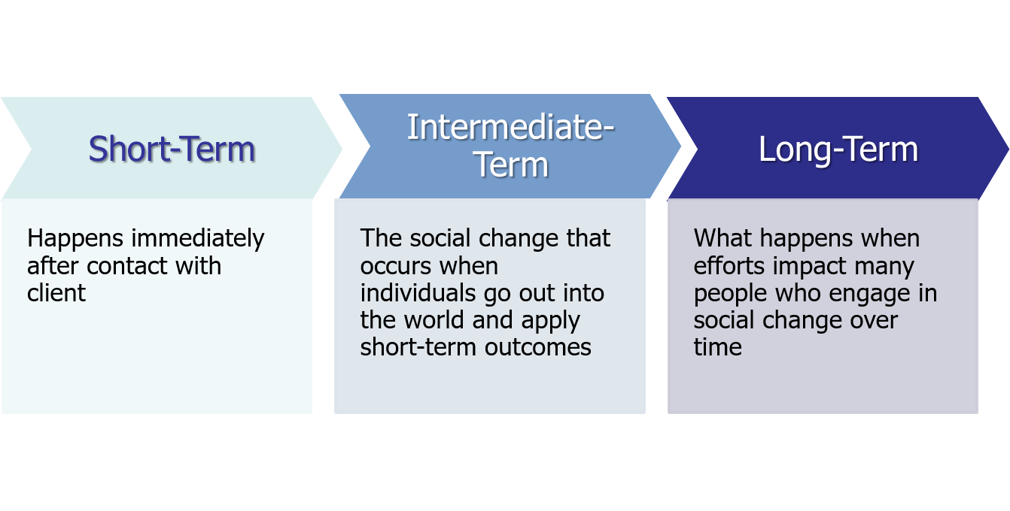
What is the Difference Between Short, Intermediate, and Long-Term Outcomes?

Slide 12


Learning from Leaders
Jeremy Morris: Executive Director, Ohio Statewide Independent Living Council

Slide 13
High-Performance Measurement Clarify Questions
How did/does having a logic model help the OSILC in terms of its clarity?

Slide 14
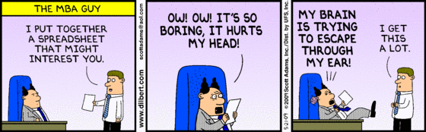

3. Capture Your Results

Slide 15

Defining the Best Success Measures

Slide 16
Reflect on both the stakeholders, as well as your own needs
Your Whys
Your Participant’s Whys
Your Funder’s Whys

Slide 17
OSILC Global Measures
Desired Performance Measure | Description
Improve quality and effectiveness of services | Effectiveness of services reflects the extent the IL Network is improving the capacity of service providers and meeting the needs of the consumers. It includes the percent of consumers meeting their goals as well as how long it takes a consumer to achieve goals. This measure also examines perception of quality and cost per successful outcomes.
Increase elements of a meaningful quality of life | Elements of a meaningful quality of life include constructs that allow an individual to fully live the life they desire with the needed supports that allows them to life this life. This includes achieving personal health and wellbeing, overcoming barriers to self-fulfillment, exercising control over decisions and making choices based on personal preferences.
Increase community participation | Community participation is defined as a consumer successfully participating in meaningful adult life. Activities can include participation in recreation activities, volunteering, civic engagement, and employment.
Increase diversion/transition from more restrictive settings | This measures the extent the IL Network are successful at keeping people out of and/or transitioning consumers from nursing homes.
Increase awareness of independent living and independent living services/alignment of public perception | This measure monitors the level of awareness in the general public about independent living and services. It also monitors how well the general perception of independent living and services align with the IL Network.
Advance policies and practices for independent living and equity | This long-term measuring is defined as the number of practices and policies at the organizational and public policy level that move forward because of IL Network efforts.

Slide 18

What to Capture
Demographic data on participants
Activities/ Services received
  Start and end date
Costs/ Revenues
Participant and stakeholder feedback (satisfaction data)
OUTCOMES (your true profit)

Slide 19
Rules for Selecting Good Measures
Provides an agreed upon basis for decision making.
Are understandable.
Applies broadly.
May be interpreted uniformly.
A way to measure it exists.
Has face validity.
Economical to apply.

Slide 20
12 Outcome Measures
Increased knowledge and learning
Changed attitudes
Increased readiness
Reduction of undesirable behavior
Increased desirable behavior
Maintenance of new behavior
Increased social status
Increased economic conditions
Increased health conditions
Reduction in administrative costs
Increased economic development
Participant, employee, and/ or stakeholder satisfaction

Slide 21
Measures Test
Are these measures related to important policy and practice issues?
Are these measures relevant and apply to practitioners?
Can these measures be communicated in a way that will influence outcomes?
Are incentives built into the system for collecting and acting on these data?
Are the measures linked to the stakeholders interests?

Slide 22
Developing Objective Measures
“Garbage in, garbage out”
Stay neutral, avoid leading questions
Ask one item at a time
Test survey questions first
Keep it short – only ask the most important questions

Slide 23
Success Measures: How to Capture
Existing data sources/ Literature review
Use the tools you have
Use free/ Low cost tools
Seek qualified vendors, but not until you have defined success

Slide 24
OSILC Measurement Framework
What was done by the IL Network? | How well was it done? | How are people better off?
# of capacity building meetings convened # of information, advocacy/policy activities # of community engagement efforts # of people served/engaged # of contact hours/units of service provided # of referrals made | % of target population reached % of consumers/partners who report positive experience and satisfaction with services % of partners who report increased capacity % of consumers who completed goals on the Independent Living Plans % increase in awareness and alignment of IL and IL services Cost per success | % of eligible consumers successfully transitioned/diverted to appropriately less restrictive environments % of consumers participating in meaningful adult life # of policy changes at the state, local and organizational levels % of consumers who report increase in independence % of consumers who report improved quality of life

Slide 25
Learning from Leaders
Jeremy Morris: Executive Director, Ohio Statewide Independent Living Council

Slide 26
High-Performance Measurement Capture Questions
Where is Ohio’s IL Network in the implementation of your measurement framework?
What obstacles have you had to overcome?
How has having this measurement framework helped you?

Slide 27
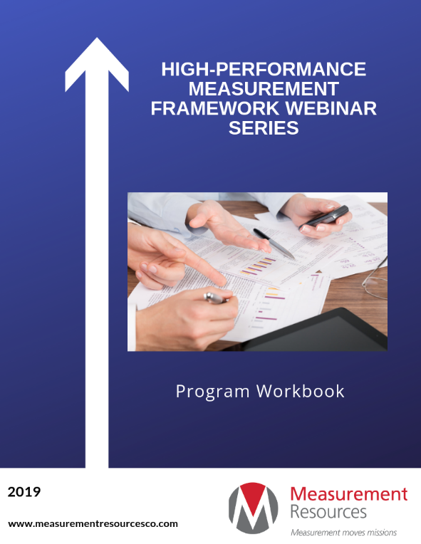
Webinar 2: Action Items
Activity 4: Five Whys
Activity 5: Logic Model
Activity 6: Measurement Selection

Slide 28
Final Questions and Evaluation Survey
Any final questions?
Directly following the webinar, you will see a short evaluation survey to complete on your screen. We appreciate your feedback!
https://usu.co1.qualtrics.com/jfe/form/SV_6rQkTJFOfPyaY2V

Slide 29
SILC-NET Attribution
This project is supported by grant number 90ISTA0001 from the U.S. Administration for Community Living, Department of Health and Human Services, Washington, D.C. 20201. Grantees undertaking projects under government sponsorship are encouraged to express freely their findings and conclusions. Points of view or opinions do not, therefore, necessarily represent official Administration for Community Living policy.

