Slide 1

>>Slide 1
Independent Living Research Utilization

Slide 2
>>Slide 2
How CIL’s Can (and Should!) Support Consumers Experiencing Homelessness
Presenters:
Georgina Alvarez
Robbie Roppolo
June 30, 2021

Slide 3
>>Slide 3
Welcome and Housekeeping
CART Captioning & ASL Interpreters are available.
We are screen sharing, so please ensure you are in side-by-side mode.
We will have audience Q&A today. You may submit a question through:
  Zoom Q&A Tab
  Email tim@ncil.org
  Phone callers only may press *9 on their keypad
Submit questions anytime, but we will wait for our Q&A break to address them.
Please fill out the evaluation after today’s event.

Slide 4
>>Slide 4
Meet the Presenters
Georgina Alvarez – galvarez@cccil.org
Robbie Roppolo – robbie@atlantiscommunity.org

Slide 5
>>Slide 5
What You Will Learn
Creative approaches that educate communities to advocate against barriers for securing safe, accessible housing.
Outreach strategies that inform and foster an atmosphere for collaboration among providers, governmental entities, the business community, and other stakeholders about available homeless prevention resources and services inclusive of consumers who are black, indigenous, and people of color (BIPOC) and who are multiply marginalized.
Funding streams for homelessness prevention activities, including leveraging COVID-19 funding to support consumers without places to live.

Slide 6

>>Slide 6
CENTRAL COAST CENTER FOR INDEPENDENT LIVING (CCCIL)
Rapid Re-Housing, Homeless prevention and
IL Services
Presented by:
Georgina Alvarez, Director of Programs

Slide 7
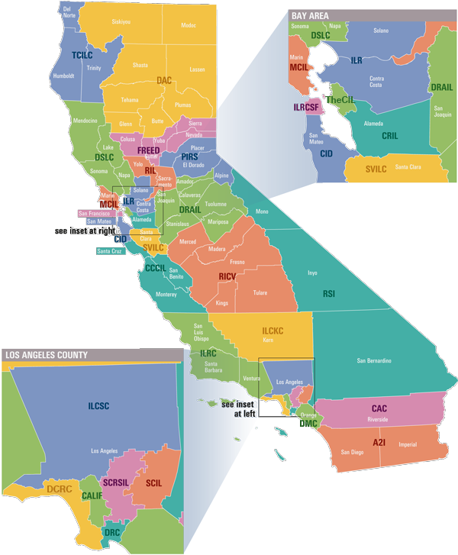
>>Slide 7
Who we are and what do we do?
One of the 28 CILs in CA
IL Services
Rapid-Rehousing Services
Homeless Prevention Services

Slide 8
>>Slide 8
CCCIL Rapid Re-Housing (RRH) and Homeless Prevention (HP) Background
2014- Supported Services for Veterans Families (SSVF)
2016 Emergency Solutions Grants (ESG) City of Salinas
2018 Housing and Disability Advocacy Program (HDAP)-Monterey and Santa Cruz County
2018 Whole Person Care – Health Department Monterey County
RRH and HP Programs expanded to city, Continuum of Care and County

Slide 9
>>Slide 9
RRH and HP Program Design, Challenges, and Sustainability
Program Design
  Staffing
    Hire of new staff
    Trainings
    Certifications
  Redesign CIL Services/Programs to meet needs of our community
    IL Philosophy
    Housing First Model
  Partnerships/Collaborations
    Continuum of Care
    Homeless Providers
    County and City Leaders
    Local Housing Authorities

Slide 10
>>Slide 10
RRH and HP Program Design, challenges, and sustainability, cont’d.
Challenges
  Lack of affordable and accessible housing
  Lack of transitional housing
  Housing barriers
Sustainability
  City, County, State, Foundations, and Continuum of Care funding

Slide 11
>>Slide 11
Next Steps…..What is next?
Continue establishing partnerships with local leaders to address the needs of our community
On going participation in community meetings
Leverage of local funding and resources to continue programs

Slide 12
      >>Slide 12
      Questions & Discussion

Slide 13

>>Slide 13
Atlantis Community, Inc.
Your Life
Your Independence
Your Community

Slide 14
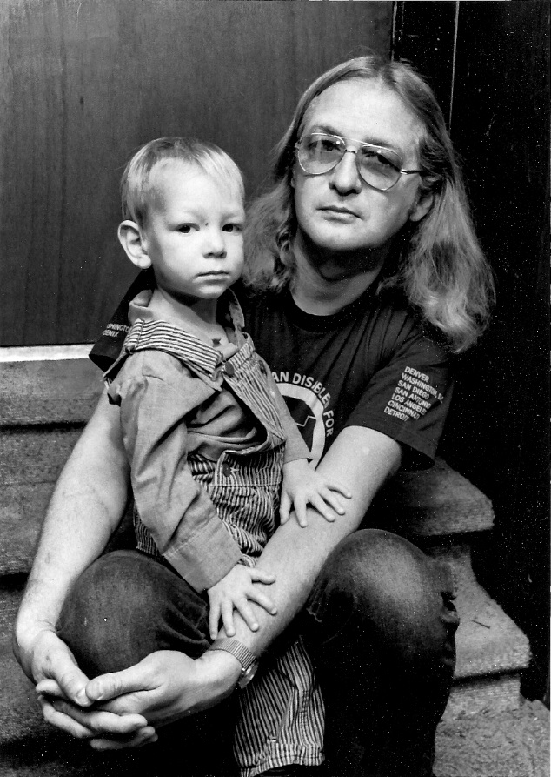
>>Slide 14
History of Atlantis Community Inc.
Founded by Wade Blank
Established in 1975
2nd Center for Independent Living
Notes:
Worked in a nursing home where there were children as young as 12. He started to take them out on activities but was fired as a result
He along with an attorney, John Holland sued the nursing home to start moving people with disabilities out of the nursing home
He worked with City and County of Denver to set up assisted living apartments
42 years of advocating for rights of the disability community

Slide 15
>>Slide 15
Advocate for all people
Our mission is to advocate for all people with disabilities to be a meaningful part of an integrated community of their choice

Slide 16
>>Slide 16
Independent Living Philosophy
Consumer Control
Self-Help
Peer Support
Equal Access
Self-Advocacy
Integration
Full Inclusion

Slide 17
>>Slide17
IL Process
Develop Goal
IL Plan
Meet with IL Specialist
Reach Goal
Develop new goal or Discontinue
Intake
Notes:
Goals are person driven.
Once the person requesting help has become a consumer we get to work on setting goals.
A comprehensive plan can be developed between I.L. staff and consumer but it is not mandatory.

Slide 18
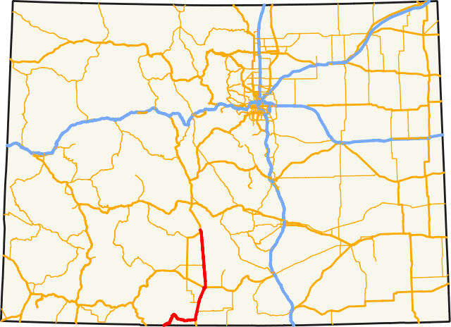

>>Slide 18
Mobile CIL

Slide 19
>>Slide 19
Obtaining Our Mobile Unit
In 2015, the other CIL in Denver closed leaving the Atlantis Community as the sole CIL in the larger Denver metropolitan area. The Mobile CIL supports the Atlantis Community with the delivery of our core services to underserved consumers who cannot access Atlantis’s physical location due to their disabilities. It also allows us to address barriers that exist when experiencing homelessness or living in a rural part of our 7-county catchment area.
Focus on un and underserved populations
  People with significant disabilities who cannot access transportation
  People with significant disabilities experiencing homelessness

Slide 20
>>Slide 20
Obtaining Our Mobile Unit, cont’d.
The grant proposal that Atlantis submitted aligned with the 2016 Colorado State Plan for Independent Living
The federal grant was not enough to purchase the vehicle. We worked closely with our DSE for the additional funding
The design of the ramp allows it to fold down into the floor allowing for more space inside the vehicle, thus allowing more than one consumer who uses a wheelchair to be in the van at one time
Notes:
We made the decision to purchase the vehicle because we couldn’t lease one and make the modifications we wanted.
This particular vehicle was chosen in part because:
1.Low carriage so there is one small step up for people who don’t need to use the ramp, but cannot do the tall step(s) you see in a lot of accessible vehicles.
2. Climate control even when vehicle is turned off
ACI conducted research on the various means to implement a Mobile CIL
The vehicle was a floor model (had about 600 miles) so we were able to get a bit of a discount.
. Older vehicles, even recent vehicles, often had very high mileage, which increases the cost of maintenance, decreased gas mileage, and lessens the life of the vehicle, while also potentially putting staff at risk if the vehicle breaks down. Additionally, longer and more comprehensive warranties are available on new vehicles. Due to the geographic area that ACI serves, it is necessary to have a consistently reliable vehicle.

Slide 21
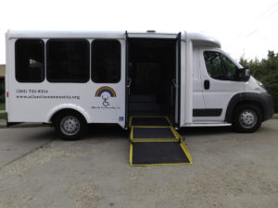
>>Slide 21
Spirit of Independence
Equal Access for Everyone
Notes:
13 passenger bus, 12 seats and 1 wheelchair securement area.

Slide 22
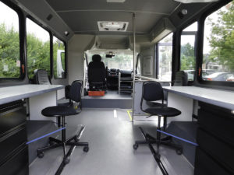
>>Slide 22
Spirit of Independence
Equal Access for Everyone, cont’d.
Notes:
We removed the 12 seats and customized the interior. The wheelchair securement area is still intact which gives us the ability to hire a Mobile I.L. Specialist who uses a wheelchair. We do not provide transportation for our consumers, it allows us to meet consumers where they are. In order for a consumer to be eligible for services through the Mobile Unit, there must be barriers related to the persons disability that is keeping them from reaching our main CIL.

Slide 23
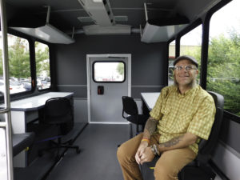
>>Slide 23
Spirit of Independence
Equal Access for Everyone, cont’d. 2
Notes:
Overhead storage and an overhead auxiliary air conditioner & heater. The auxiliary air/heat allows us to work with consumers whose bodies may not regulate temperature very well. We also installed a power inverter with 2 outlets which power our printer and allows us to recharge our laptops/mobile phones/wireless hotspot etc.

Slide 24
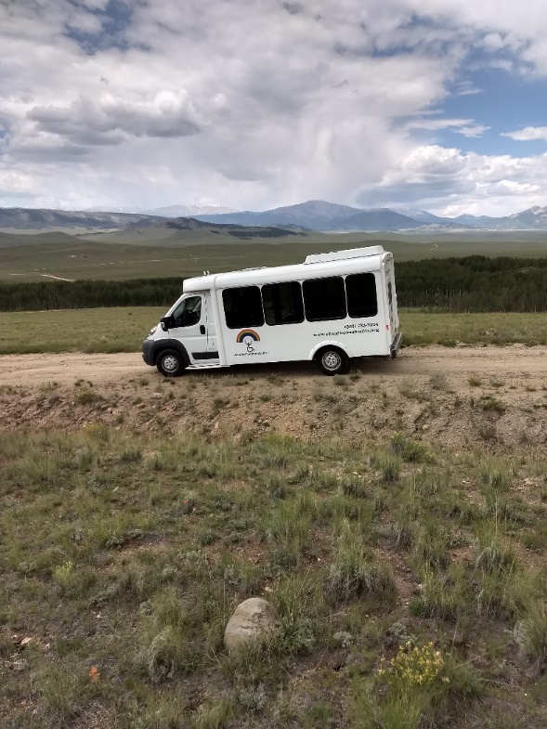
>>Slide 24
Spirit of Independence
Equal Access for Everyone, cont’d. 3
Notes:
We have 2 sources of internet. The 1st is called Internet in Motion which consists of a router and modem. We also have a wireless hotspot through our cellular provider.

Slide 25
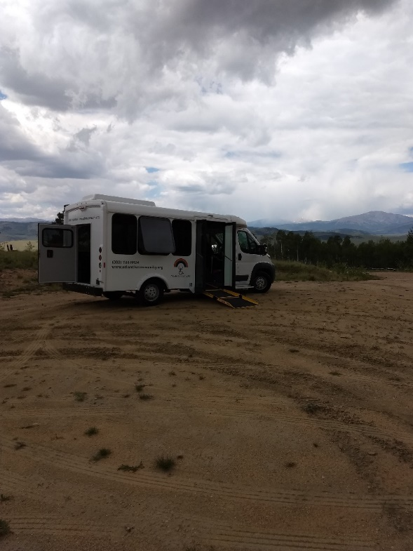
>>Slide 25
Spirit of Independence
Equal Access for Everyone, cont’d. 4
Notes:
Currently our Mobile Independent Living Unit is a 2 person team made up of myself and 1 Mobile I.L. Specialist. We did just post a job opening for our 2nd Mobile I.L. Specialist which will complete our team giving us 1 Mobile Unit manager and 2 Mobile Independent Living Specialists. Our day to day operations include conducting intakes, follow-up appointments with consumers so they can work on their Independent Living Plans and outreach days. Additionally, we attend resource fairs and other planned community events such as Project Homeless Connect and Denver Day of Dignity which offer on the spot services and resources for people experiencing homelessness.

Slide 26
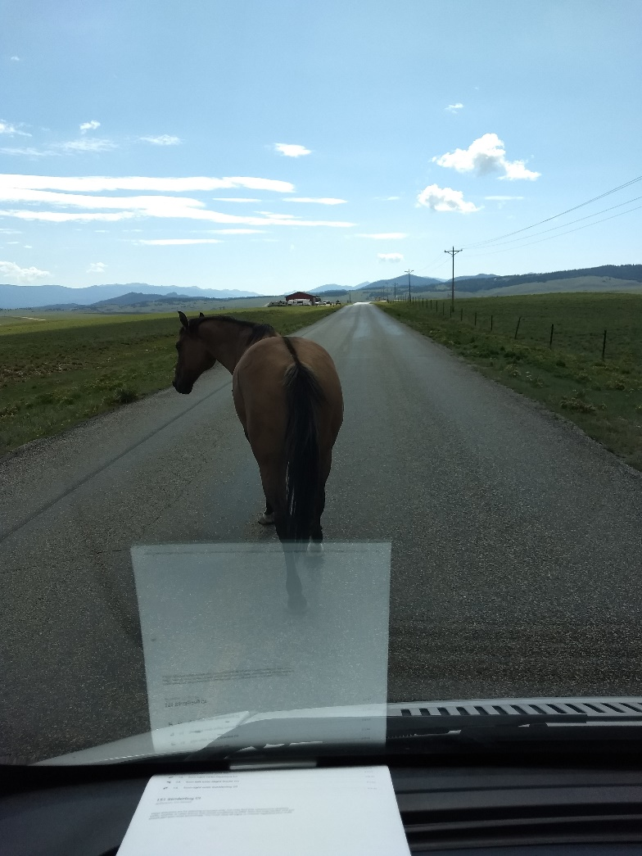
>>Slide 26
Lessons Learned:
Rush hour in Como Colorado
Notes:
As far as we know, we are the 1st Center For Independent Living with a Mobile office, with that comes a steep learning curve. Don’t underestimate the value of your community partners and the power of nurturing those relationships. Early on, there were delays in taking possession of our Mobile Office. Fortunately our relationships with the individual county Arc offices, within our 7 county catchment area allowed us to use their conference rooms if necessary to conduct intakes and follow up appointments as those were locations that some of our early consumers could get to.
When it comes to powering equipment, there can be issues. The auxiliary ac/heat, internet in motion, and the power inverter only work when the engine is running. This is where the wireless hotspot really comes in handy since it has an internal battery. This allows us to shut the engine off even when we’re parked doing outreach unless we have to print, use the auxiliary ac/heat or recharge any of our battery powered equipment.

Slide 27
      >>Slide 27
      Questions & Discussion

Slide 28
      >>Slide 28
      How did you begin working with people experiencing homelessness at your CIL?

Slide 29
      >>Slide 29
      You both live in areas that have experienced rapid growth and rising expenses. How do you deal with the shortage of affordable, accessible housing?

Slide 30
      >>Slide 30
      What local or state partners have been critical in doing this work?
      Were any of those partnerships in place before you did this work or did they build because you were doing work in the homeless community?

Slide 31
      >>Slide 31
      How do you staff and fund this work?
      Have you been able to leverage COVID funding to support this work for unhoused consumers?

Slide 32
      >>Slide 32
      How have you all connected and engaged with people who are without housing?

Slide 33
      >>Slide 33
      What kind of supports have you all included for people who are Black, Indigenous, People of Color (BIPOC) and multiply marginalized?

Slide 34
      >>Slide 34
      Questions & Discussion

Slide 35
>>Slide 35
Final Questions and Evaluation Survey
Any final questions?
Directly following the webinar, you will see a short evaluation survey to complete on your screen. We appreciate your feedback!
https://uthtmc.az1.qualtrics.com/jfe/form/SV_8IET3cmb2Rv1qXc

Slide 36
>> Slide 36
IL-NET Attribution
The IL-NET is supported by grant numbers 90ILTA0002 and 90ISTA0002 from the U.S. Administration for Community Living, Department of Health and Human Services, Washington, D.C. 20201. Grantees undertaking projects under government sponsorship are encouraged to express freely their findings and conclusions. Points of view or opinions do not, therefore, necessarily represent official Administration for Community Living policy.

