Slide 1
>>Slide 1
IL-NET National Training and Technical Assistance Center for Independent Living
ILRU T&TA Center

Slide 2
>> Slide 2 Know Your Resources — Orientation to the IL-NET National T&TA Center for Independent Living Presenters: Sandra Breitengross Bitter Carol Eubanks Paula McElwee Richard Petty Sierra Royster Jenny Sichel November 10, 2022

Slide 3
>> Slide 3 Evaluation Survey & Presenter Contact Information
Your feedback on this webinar is important to us. At the end of the presentation, you will have the opportunity to complete a brief evaluation survey.
Sandra Breitengross Bitter –sbb.ilru@gmail.com
Carol Eubanks – eubanks@bcm.edu
Paula McElwee – paulamcelwee.ilru@gmail.com
Richard Petty – rpetty@bcm.edu
Sierra Royster – sroyster@april-rural.org
Jenny Sichel – jenny@ncil.org

Slide 4
>>Slide 4 What You Will Learn Today
Overview of the IL-NET T&TA Center for CILs and SILCs — history, funding, and roles.
Overview of the website layout and the best method to search for resources on the ILRU website.
The wide array of training, resources, programs, and services available to CILs, SILCs, DSEs, consumers, and other stakeholders.

Slide 5
Slide 5 Overview of IL-NET Richard Petty, ILRU IL-NET Project Director Sandra Breitengross-Bitter, ILRU IL-NET Director of Training

Slide 6
>> Slide 6 How the IL-NET is Funded
Authorized by the Rehabilitation Act, the IL-NET National Training and Technical Assistance Center for Independent Living is funded by the Administration for Community Living (ACL).
IL training and TA is available for centers for independent living (CILs) and statewide independent living councils (SILCs). Designated State Entities (DSEs) may also receive TA.
IL-NET previously conducted the additional ACL-funded Disability, Diversity, and Intersectionality project to identify and share information about CILs making progress in this area. On-demand trainings available at https://www.ilru.org/projects/cil-diversity.

Slide 7
>> Slide 7 IL-NET T&TA Center
The Center is operated by Independent Living Research Utilization (ILRU) – https://www.ilru.org
ILRU is assisted in operating the IL-NET by:
National Council on Independent Living (NCIL) – https://www.ncil.org
Association of Programs for Rural Independent Living (APRIL) – https://www.april-rural.org
The University of Montana Rural Institute and RTC: Rural – https://rtc.ruralinstitute.umt.edu/

Slide 8
>> Slide 8 A Little IL-NET History & Scope
The Training and Technical Assistance Center for CILs and SILCs has been in operation (in one form or another) for over 28 years.
The IL-NET has evolved and grown to better meet needs of the field.
Each partner organization brings different strengths.
The resulting synergy increases effectiveness of the IL-NET.
The IL-NET has the national perspective needed as well as depth of understanding and commitment to IL philosophy.
IL-NET offers a cafeteria-style range of services so that CILs and SILCs can choose what works best for their educational needs and interests, staff and boards’ schedules, and organization budgets.

Slide 9
>> Slide 9 What We Offer CILs and SILCs
Virtual/On-location training
Online courses
Webinars
Self-study Web-based tutorials (RapidCourses)
Training manuals, factsheets, sample CIL/SILC policies/procedures/forms, and other resource materials
On-demand video from recordings of past on-location trainings and webinars/teleconferences
CIL-to-CIL and SILC-to-SILC peer mentoring
Technical Assistance (individualized or statewide IL network training/TA)
Intensive Support to help with compliance review findings
Peer technical assistance group calls/web-meetings
Electronic newsletters, blogs, and social media postings
Learning collaboratives – cohorts of CILs working together over time on a specific objective

Slide 10
>>Slide 10 What’s New with the IL-NET
Fast News weekly newsletter for CILs and SILCs. A compilation of all that is new on the ILRU website, ensuring you are up-to-date on what's new in independent living. Sign up at https://www.ilru.org/fast-news-sign-form
Biennial T&TA Institutes
Peer call for Leaders Under 40
Link to Training Calendar: Yearly Training Calendar | Independent Living Research Utilization (ilru.org)

Slide 11
Slide 11 ILRU’s IL-NET National Training and Technical Assistance Center for Independent Living
ILRU's IL-NET National Training and Technical Assistance Center for Independent Living
ILRU
-T/TA Center Oversight - Training and Technical Assistance - Intensive Support - Operates Website - T&TA Evaluations
National Council on Independent Living (NCIL)
- Logistics for Institutes, On-Location & Webinars - Coordinate Learning Collaboratives
The University of Montana Rural Institute and RTC: Rural
- Employs TA Coordinator
- Key organization in the multi-stakeholder group
Association for Rural Independent Living (APRIL)
- Coordinate Peer Mentoring
- Coordinate Rural Conversation Community calls

Slide 12
>> Slide 12 Independent Living Research Utilization (ILRU) Overview
A program of TIRR Memorial Hermann in Houston, ILRU was founded in 1977 as a national program of research, training, and technical assistance to support self-direction and community living for people with disabilities. (ILRU is housed with its companion program, the National Center for Aging and Disability).
The IL-NET (for CILs and SILCs) is a principal project of ILRU.
ILRU is involved in other programs and projects, including:
Southwest ADA Center
ADA Participation Action Research Consortium (ADA-PARC)
Aging and Disability Business Institute (with the National Association of Area Agencies on Aging)
Various research projects

Slide 13
>> Slide 13 ILRU’s Role in the IL-NET
ILRU:
Is the federal grantee and oversees the center.
Conducts or oversees the instructional design (learning objectives and content) of all training.
Conducts intensive support for CILs and SILCs.
Develops and publishes training manuals, PowerPoint presentations, handouts, and other training materials.
Provides individualized, group, and statewide IL network technical assistance.
Develops and manages the RapidCourses tutorials.
Operates the center website at ILRU.org.

Slide 14
>> Slide 14 Overview of ILRU.org Carol Eubanks, ILRU IL-NET Instructional Designer

Slide 15
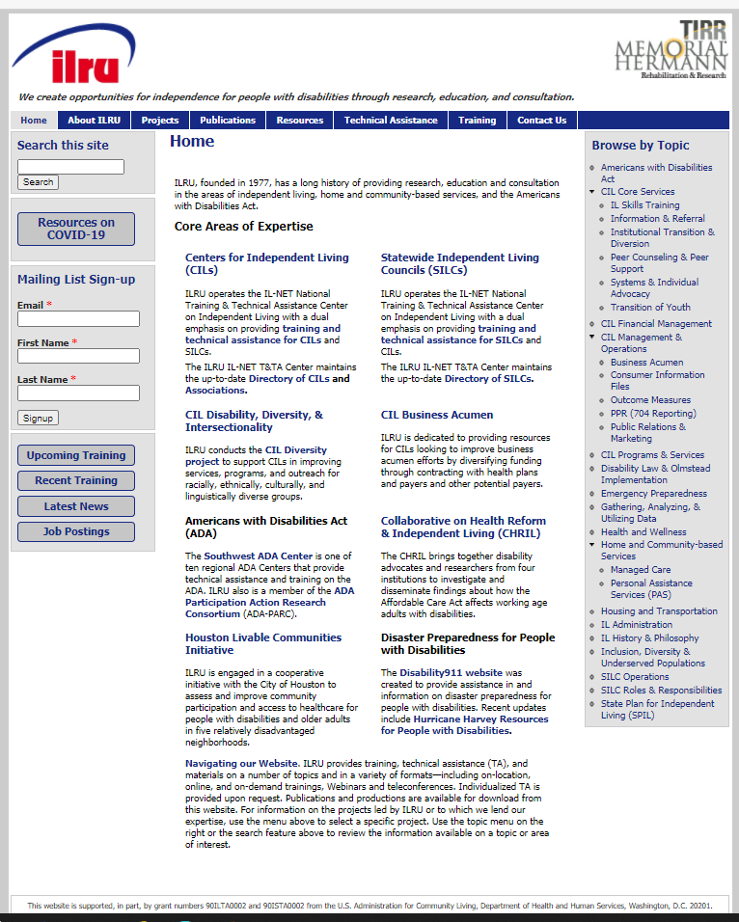
>> Slide 15 Homepage – ILRU.ORG
ILRU’s IL-NET National Training and Technical Assistance Center for Independent Living

Slide 16
>> Slide 16 Centers for Independent Living (CILs) and Statewide Independent Living Council (SILCs)
Training for CILs and SILCs
Biennial Institutes and On-location workshops
Online courses
National webinars
Web-based tutorials – RapidCourses
Publications for CILs and SILCs
ILRU Directory of CILs and associations / SILCs
Important to notify ilru@ilru.org with updates such as address/phone number, name of director
Training manuals and fact sheets, examples: Management 101 Tool Kit for new Executive Directors, and Promising Practices in Creating Welcoming, Culturally Inclusive CILs that Promote Equity

Slide 17
>> Slide 17 Training: On-Demand and RapidCourses
On-Demand Training – Offers many previous on-location trainings that can be viewed as video recordings. Can receive email verification for viewing trainings by completing survey at https://www.surveygizmo.com/s3/5520229/On-Demand-Training-Registration.
RapidCourses are self-paced, web-based tutorials, fully accessible, and available 24/7. Free of charge and require registration. Course catalogs include Foundations of Independent Living, State Plan for Independent Living, Consumer Information Files, CIL Boards of Directors, CIL Core Services, Designated State Entity, and Statewide Independent Living Councils.

Slide 18
>>Slide 18 Online Courses
Online courses include access to instructor, weekly assignments, discussion area to engage with peers, checkpoint quiz questions, and instructor-led discussions. Past topics have included:
Orientation to Independent Living for New CIL Personnel
Management 101 for CIL Executive Directors
The Action of Leading: SILC Leadership for Chairpersons, Members, and Staff

Slide 19
>> Slide 19 Questions & Discussion

Slide 20
Slide 20 Overview of On-Location Trainings, Webinars, and Learning Collaboratives Jenny Sichel, NCIL IL-NET Training Logistics Coordinator

Slide 21
>> Slide 21 National Council on Independent Living (NCIL) Overview
Founded in 1982, NCIL is the longest-running national cross-disability, grassroots organization run by and for people with disabilities.
National Association of CILs and SILCs located in Washington, DC.
Involved since 1994.
NCIL provides training & technical assistance activities for all CILs and SILCs through its work with the IL-NET National Training and Technical Assistance Center for Independent Living. Visit us online at www.ncil.org.
IL-NET events posted at https://www.ncil.org/annual-conference/training/ in addition to the ILRU website.

Slide 22
>> Slide 22 NCIL’s Role in the IL-NET Project
Coordinate Biennial Institute and On-Location Training Workshops
Coordinate and Host Webinars
Coordinate Learning Collaboratives
Provide Technical Assistance

Slide 23
>> Slide 23 Biennial Institute and On-Location Training Workshops
ILRU offered the first biennial institute in September 2022 which is now available on-demand.
ILRU will continue to offer on-location workshops and other presentations at IL conferences, like NCIL, APRIL, and SILC Congress.
ILRU does record our on-location trainings whenever possible. Presentation materials, including captioned videos, manuals, and handouts are posted at ILRU.org.

Slide 24
>> Slide 24 Webinars
The IL-NET will offer seven to eight IL-NET webinars each year.
These are 90-minute presentations designed to introduce you to a topic or delve into a specific aspect of CIL or SILC programs or operations.
All webinars are archived online, including training materials. https://www.ilru.org/training-on-demand

Slide 25
>> Slide 25 Webinar Topics
IL-NET has offered hundreds of webinars over the years. The topics cover a staggering variety of issues related to CILs and SILCs.
Tentative FY 2023 topics include:
Transition
Serving Cross- Disability Populations
Professional Development & Leadership Training for Staff – Organizational Health
Lessons Learned in Serving Tribal Members or Native Populations with Disabilities

Slide 26
Slide 26 Overview of the Peer Mentoring Program and Rural Conversation Community Calls Sierra Royster, APRIL IL-NET Peer Mentoring Coordinator

Slide 27
>> Slide 27 Association of Programs for Rural Independent Living (APRIL) Overview
A national grass roots, consumer controlled, nonprofit membership organization.
Founded in 1986.
Focusing on rural independent living.
Simple rural definition is lack of access to resources.
All CILs and SILCs can access the services APRIL administers for ILRU’s IL-NET National Training and Technical Assistance Center for Independent Living.

Slide 28
>> Slide 28 APRIL’s Role in the IL-NET
Provides Peer Mentoring Services
Hosts the Rural Conversation Community calls/web-meetings
Provides Technical Assistance

Slide 29
>> Slide 29 Peer Mentoring Services
Built upon the IL building block of Peer Support.
All CILs and SILCs are eligible who are not currently accessing Intensive Support services with Paula.
Six-month contract period to complete goals set by the mentee with mentor.
Full scholarships available
CILs and SILCs can access Peer Mentoring more than once for new goals.
Mentors can be chosen to fit mentee’s needs.
Some peer relationships continue beyond the Mentoring.

Slide 30
>> Slide 30 Peer Mentoring, cont’d.
Electronic/Virtual: Most mentoring can be carried out online, depending on the goal if it is better suited for a site mentoring, there are limited travel slots available for onsite or offsite options. (at your site or going to your mentor’s site). Travel permitting.

Slide 31
>> Slide 31 Peer Mentoring Application and Process
Applications are available by contacting Molson.april@gmail.com or the APRIL website www.april-rural.org, or ILRU, NCIL, or University of Montana.
Mentee sets a few achievable goals to work on with their mentor.
Mentee will interview potential mentors from at least two candidates until someone who matches their goal needs, learning style, or other important qualities to the mentee are met.
Once a mentor is selected, the mentor and mentee will begin working on their goal.
Monthly progress reports and an evaluation must be completed along with a final follow-up at the end of the fiscal year.

Slide 32
>> Slide 32 Rural Conversation Community
A one hour Zoom Meeting building a community of peer support for centers serving rural areas.
There are no designated presenters and listeners for these calls.
Everyone on this call is the presenter of information, everyone is there to learn from one another and offer peer support.
This group is free-of-charge, and held on the third Wednesday of the month.
Targeted to EDs, Program Managers, and Direct Service Staff at Centers for IL.

Slide 33
Slide 33 Overview of Technical Assistance, Intensive Support, TA Office Hours and Peer Support TA Calls Paula McElwee, ILRU IL-NET Director of TA

Slide 34
>> Slide 34 Specific Technical Assistance
Is available to CILs, SILCs, and DSEs, and to staff, board and leadership.
Can be requested by phone or email.
Paula McElwee paulamcelwee.ilru@gmail.com
559-250-3082 (Pacific time)
Because this is grant supported, there is no charge.
Focus: understanding and applying the Rehabilitation Act, regulations, indicators of compliance, guidance and other specific written material related to what is required of CILs, SILCs, and DSEs.
Can provide training or information and answer questions for individuals, board, or other groups via Zoom or conference call.

Slide 35
>> Slide 35 Intensive Support is also Available
When a CIL or SILC is found out of compliance, and is developing a Corrective Action Plan, they are provided with intensive support.
This can be provided by phone, ZOOM or email. Assistance and training may be provided for your CIL or SILC in the identified areas.
Referrals are typically made by the DSE or the ACL/OILP Program Officer* for your state. Self-referrals are also possible.
On occasion (as time allows) we provide on-site training for a state’s IL Network to review requirements for all of the partners together – the CILs, DSE, and SILC. These are more typically provided virtually due to travel costs.
*Your state’s ACL PO can be found at https://acl.gov/programs/aging-and-disability-networks/centers-independent-living, the first + at the bottom of the page.

Slide 36
>> Slide 36 Peer Support TA Calls
SILCs (staff and/or council chairs) are invited to the SILCSpeak call on the first Thursday of the month.
CIL executive directors participate on a call, typically the second Monday each month, but sometimes adjusted for holidays.
CIL associate directors/program managers participate on a call, typically the second Tuesday of the month.
IL Leaders Under 40 is a new group, meeting the first Tuesday of the month, beginning in December.
Calls for DSEs are quarterly.
Calls for CIL Financial Managers are quarterly.
All calls are at 3:00 p.m. Eastern time
TA Office hours, the last Thursday of the month from 12:00-1:00 pm Eastern time.
Contact us to be added to the reminder list for any of these calls.

Slide 37
>> Slide 37 A TA Refresher...and individualized support
Many technical assistance requests are by email and include a written response.
Pertinent TA topics and answers to frequently asked questions are posted on the IL-NET TA blog. Subscribe at http://ilnet-ta.org/wp/ to be notified of new posts via email.
Brand new directors of both CILs and SILCs can set up periodic one-to-one phone calls on a weekly, bi-weekly or monthly basis as they get oriented to the new job.

Slide 38
>> Slide 38 Questions & Discussion

Slide 39
>> Slide 39 Upcoming IL-NET Training & TA Activities
Upcoming webinar:
Transition – January 2023
Upcoming TA Peer Discussions (3:00 Eastern unless otherwise indicated):
Office Hours – November 17, 2022, noon Eastern
SILCSpeak – Thursday, December 1, 2022
Designated State Entities (DSEs) – December 5, 2022
IL Leaders under 40 – Tuesday, December 6, 2022
CIL EDs – Monday, December 12, 2022
CIL Program Managers – Tuesday, December 13, 2022
CIL Financial Managers – February 6, 2023
IL-NET Yearly Training Calendar available at https://www.ilru.org/yearly-training-calendar

Slide 40
>> Slide 40 Final Questions and Evaluation Survey
Any final questions?
Directly following the webinar, you will see a short evaluation survey to complete on your screen. We appreciate your feedback!
https://uthtmc.az1.qualtrics.com/jfe/form/SV_9Rg9XEfLH8ddIR8

Slide 41
>> Slide 41 IL-NET Attribution
The IL-NET is supported by grant numbers 90ILTA0002 and 90ISTA0002 from the U.S. Administration for Community Living, Department of Health and Human Services, Washington, D.C. 20201. Grantees undertaking projects under government sponsorship are encouraged to express freely their findings and conclusions. Points of view or opinions do not, therefore, necessarily represent official Administration for Community Living policy.

