Slide 1
>> Slide 1 Being Invited in: Understanding and Respecting Native Disability Culture November 29, 2022

Slide 2
>>Slide 2 What You Will Learn Today
Key issues tribal communities are facing around disability
Barriers and best practices to collaboration
Impacts to community-led efforts
How to partner to strengthen work with tribal communities

Slide 3
>> Slide 3 Evaluation Survey
Your feedback on this webinar is important to us. At the end of the presentation, you will have the opportunity to complete a brief evaluation survey.
https://uthtmc.az1.qualtrics.com/jfe/form/SV_cC52xZKba53oGA6

Slide 4
>> Slide 4 Our Panelists
Hoskie Benally, Community and Government Liaison, Native American Disability Law Center; Member, National Council on Disability
Adam Brown, Executive Director, Disability Services and Legal Center
Joan O’Keefe, Executive Director, Southeast Alaska Independent Living, Inc.
Janelle Friday, Village Independent Living Coordinator
Julie Shaw, Executive Director, Superior Alliance for Independent Living
Jillian Nyberg, Executive Director, indigo
Kimball Gray, Program Analyst, Administration for Community Living, U.S. Department of Health & Human Services

Slide 5
>>Slide 5 Joan O’Keefe, Executive Director Southeast Alaska Independent Living, Inc. Janelle Friday, Village Independent Living Coordinator

Slide 6
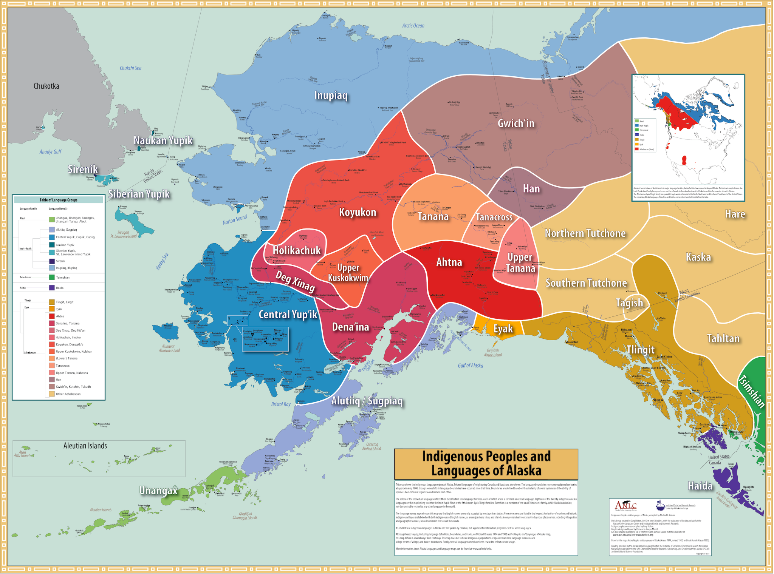
>>Slide 6 Indigenous Peoples and Languages of Alaska

Slide 7
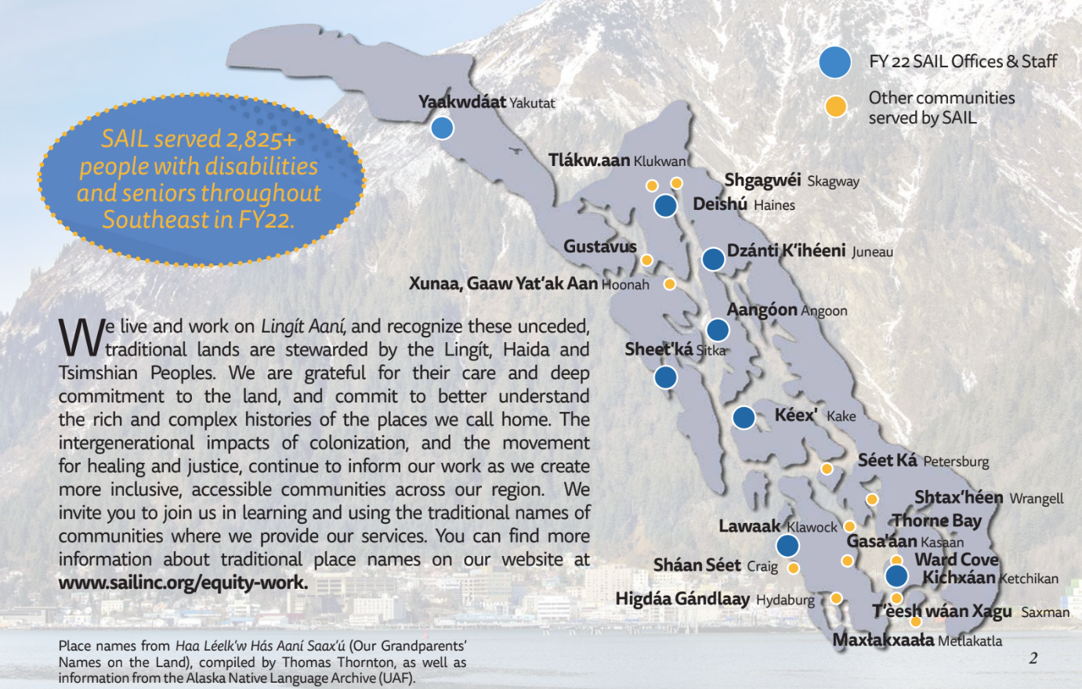
>>Slide 7 SAIL Offices & Staff

Slide 8
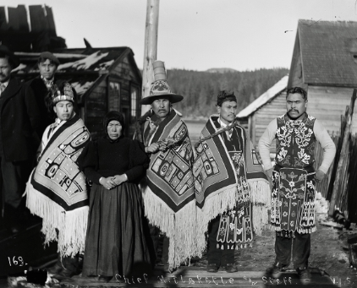
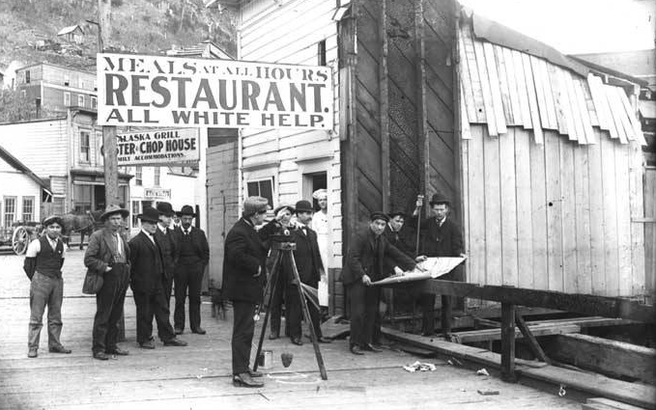
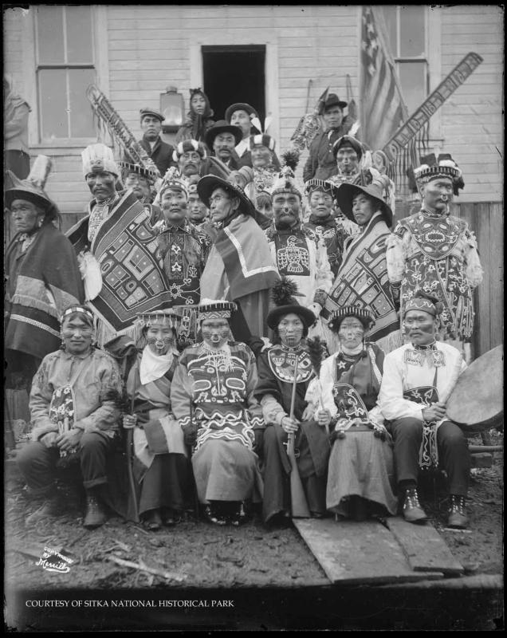
>>Slide 8 Images of Alaska Life

Slide 9
>> Slide 10 Questions & Discussion

Slide 10
>>Slide 11 Contact Information
Hoskie Benally, Native American Disability Law Center; Member, National Council on Disability, hbenally@nativedisabilitylaw.org
Adam Brown, Disability Services and Legal Center, ASBrown@mydslc.org
Joan O’Keefe, Southeast Alaska Independent Living, Inc., jokeefe@sailinc.org
Janelle Friday, Village Independent Living Coordinator, jfriday@sailinc.org
Julie Shaw, Superior Alliance for Independent Living, julies@upsail.org
Jillian Nyberg, indigo, jnd@indigowi.org
Kimball Gray, Program Analyst, Administration for Community Living, U.S. Department of Health & Human Services, Kimball.Gray@acl.hhs.gov
Paula McElwee, Director Training & Technical Assistance, paulamcelwee.irlu@gmail.com

Slide 11
>>Slide 12 Final Questions and Evaluation Survey
Any final questions?
Directly following the webinar, you will see a short evaluation survey to complete on your screen. We appreciate your feedback!
https://uthtmc.az1.qualtrics.com/jfe/form/SV_cC52xZKba53oGA6

