Slide 1

>>Slide 1
Independent Living Research Utilization

Slide 2
>>Slide 2
IL-NET Biennial IL Virtual Institute
Developing Leaders through Diverse and Inclusive Consumer-Directed Youth Leadership Opportunities
Presenters:
Aaron Baier
Kimberly Tissot
Panelists:
Wednesday Jones
Alexis Rivers
Jack Symonette
September 8, 2022

Slide 3
>>Slide 3
Welcome and Housekeeping
CART Captioning & ASL Interpreters are available.
We will have audience Q&A today. You may submit a question through:
  Zoom Q&A Tab
  Phone callers only may press *9 on their keypad
Submit questions anytime, but we will wait for our Q&A break to address them.
Please fill out the evaluation after today’s event.

Slide 4
>>Slide 4
Meet the Presenters
Aaron Baier
Kimberly Tissot
Panelists:
Wednesday Jones
Alexis Rivers
Jack Symonette

Slide 5
>>Slide 5
What You Will Learn
Examples from the IL network of how leaders can emerge and grow when they are supported and given opportunities from their youth
Examples of successful youth programming
Trends among youth with disabilities
Strategies to empowering youth leadership
Strategies that don’t work for youth that you should stop immediately

Slide 6
>>Slide 6
Introductions & Background
Hard conversations will occur during this session.
Leaders develop from their personal and shared experiences.
As peers, we can share our stories and support the next generation of leaders.
People with disabilities are critical to leading the IL movement as this is our movement.
Why do people stay in IL.

Slide 7
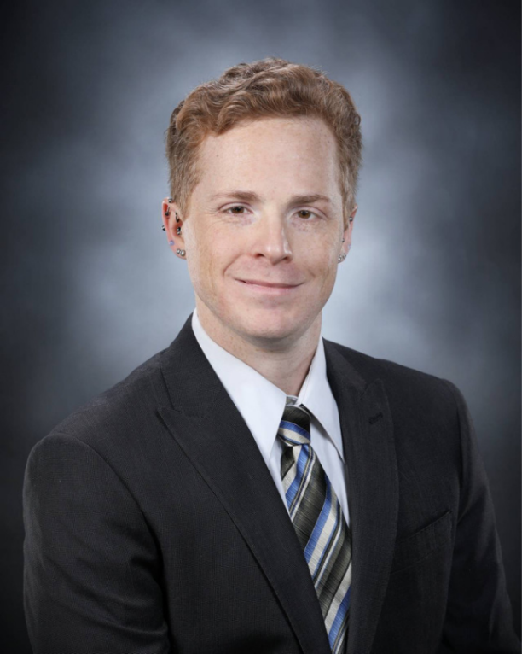
>>Slide 7
Aaron’s Journey
Declared legally blind at age 16 as a result of Retinitis Pigmentosa
Started the first youth group at age 17
Began work in IL at age 21
Served on a variety of IL and Youth movement Governing Boards
Served as Executive Director for Access to Independence in Cortland, NY, and served the agency in various roles over 15 years
Currently serves as Director of Administration for Independent Living Center of the Hudson Valley in Troy, NY

Slide 8
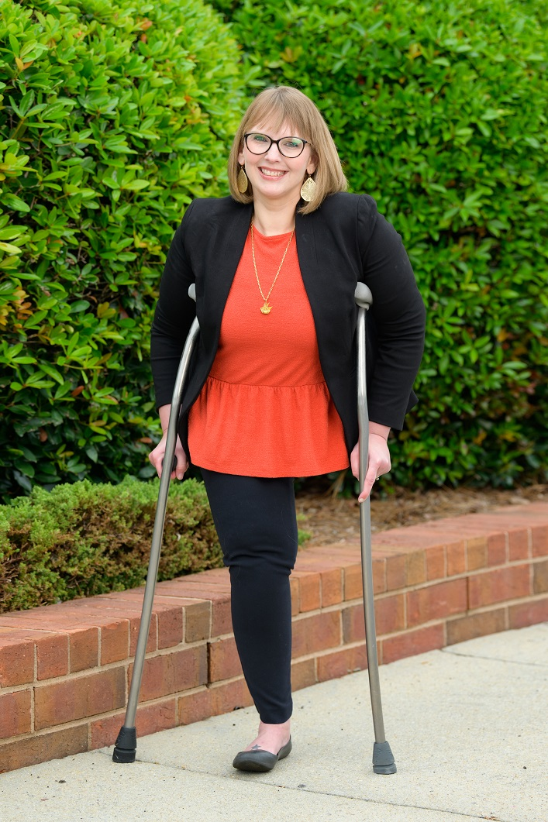
>>Slide 8
Kimberly’s Journey
Serves as the President & CEO of Able SC; Board President of APRIL
Disabled since the age of two
Past experience working with children with disabilities in the medical setting to help prepare/cope and disability rights via P&A
Started in the independent living movement at 28 years old
Built programs from the needs of people with all disabilities; driven and compared by the passion from my own experience
Led the efforts of passing groundbreaking legislation by being disability-led
Dedicated to strengthening the IL philosophy as disability-led organizations are critical

Slide 9
>>Slide 9
Nothing About Us, Without Us!
Consumer Control is at all levels, within all programs
The same is true for successful youth leadership development
Youth-run, Youth-Led Programs: Past, Present, Future
  National Youth Leadership Network
  Pat Figueroa Youth Sponsorship
  Youth Leadership Advocacy Network
  APRIL
  Equip
  SC Youth Leadership Forum
  Pre-Employment Transition Services

Slide 10
>>Slide 10
Youth Program Examples

Slide 11

>>Slide 11
National Youth Leadership Network
The National Youth Leadership Network was a nonprofit organization dedicated to the development of young leaders with disabilities in the United States.
Governed by youth with disabilities
Collaborated with youth movements across the country
Provided support and consultory services to help the movement grow and for services to be accessible to young people.
Notes:
Lex

Slide 12

>>Slide 12
Pat Figueroa Youth Sponsorship
The Pat Figueroa Youth Sponsorship is an initiative to provide financial support to young people to achieve their leadership and advocacy goals.
Funded by CILs in New York State and coordinated by the New York SILC and Youth Committee
Offers a modest path to overcome financial barriers to leadership.
Notes:
Lex

Slide 13
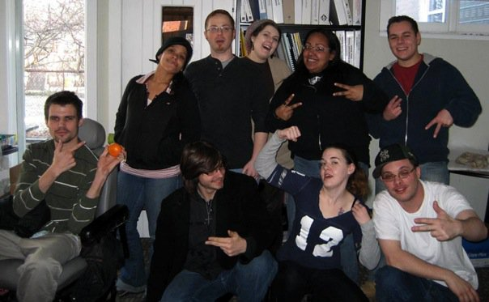
>>Slide 13
Youth Leadership Advocacy Network
The Youth Leadership Advocacy Network is a new initiative to bring youth-led advocacy back to New York.
Born from supporting young people with social and emotional challenges, quickly grew and evolved to a cross-disability initiative.
Teaches, mentors and puts into action, the skills that young people can use to become effective leaders and advocates.
Notes:
Lex

Slide 14
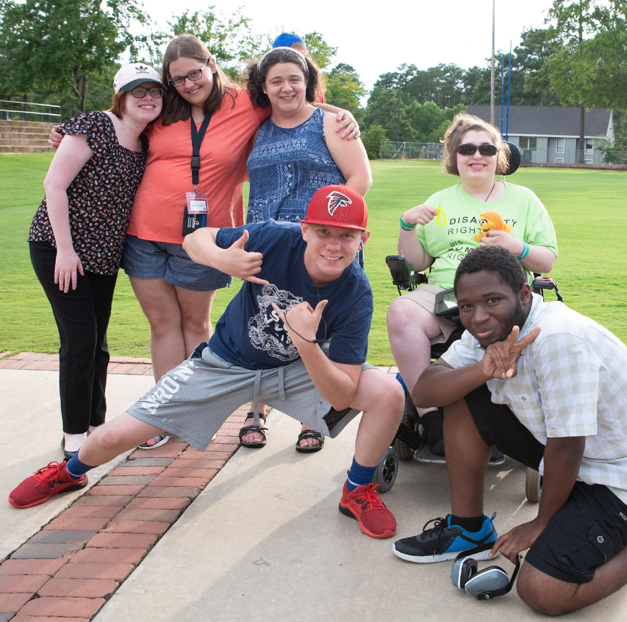
>>Slide 14
Equip Leadership Program
Equip is a peer-to-peer young adult leadership group focused on empowerment, support, and camaraderie for youth ages 13-28 with disabilities. Our young adult leaders guide youth with every type of disability in finding their a-ha moment—when they take charge of their lives, find their unique voice to self-advocate, and engage with their community of peers more fully.
Notes:
Lex

Slide 15
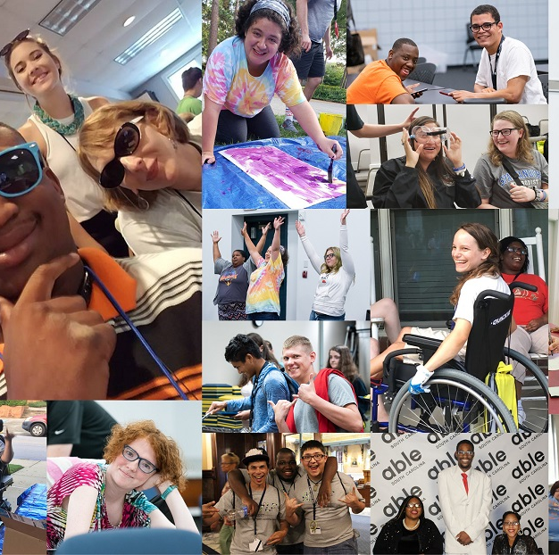
>>Slide 15
Equip Leadership Program―
Led by Youth for Youth
Equip Hangouts
Social Skills Groups
One-on-One Peer Mentoring
Able SC Youth Discord
The Equip Summer Series
T

Slide 16
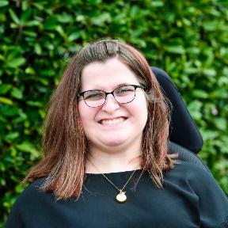
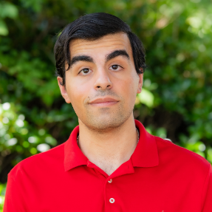

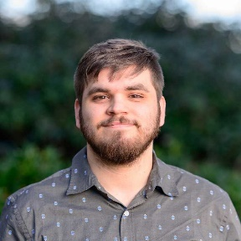
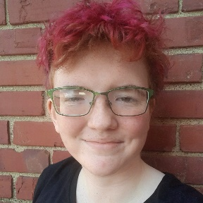
>>Slide 16
Equip Leaders and Mentors
Paid youth leaders on staff!
Youth lead for youth
Ownership of the program
Build work skills
Develops their leadership skills
Successful outcomes
Carrie McWhorter
Eden Alon
Holden Roberts
Lex Hathaway

Slide 17
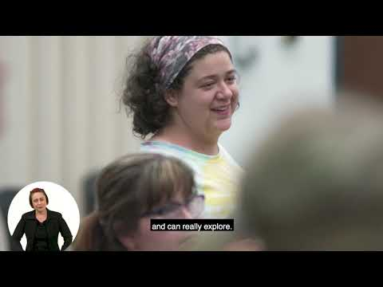
>>Slide 17
Youth Leadership Forum―
Equip Leaders and Mentors

Slide 18
>>Slide 18
Overview of Pre-Employment Transition Services: Pre-ETS
Skills that students need to have to get competitive integrated jobs, maintain those jobs, and reach their desired level of independence as they transition out of high school. Vocational Rehabilitation Departments are responsible to ensure 15% of their funding is going toward Pre-ETS.
Services Include:
1. Instruction in self-advocacy
2. Workplace readiness training to develop social skills and independent living
3. Counseling on opportunities for postsecondary educational and training programs
4. Job exploration counseling
5. Work-based learning experiences

Slide 19
>>Slide 19
Transition Services
IDEA and the Rehabilitation Act, as amended by WIOA, the definition of ‘transition services’ means: a coordinated set of activities that are designed within a results- or outcome-oriented process that promotes movement from school to post-school activities including:
  Postsecondary Education
  Vocational education
  Competitive integrated employment
  Supported employment
  Continuing and adult education
  Adult services
  Independent living
  Community participation

Slide 20
>>Slide 20
Intersection and Coordination
Services should be based on the individual student’s needs, taking into account their strengths, preferences, and interests:
  Instruction should be tailored.
  Related services should be relevant.
  Community experiences should be accessible and relevant.
  Development of employment and other post-school adult living objectives should be personalized.
  Daily living skills training and functional vocational evaluation should be used when appropriate.

Slide 21
>>Slide 21
CILs Play a Critical Role
Department of Education Office of Special Education: Provides guidance to school districts and oversea and enforces special education law. They are also aware of the education gaps.
Vocational Rehabilitation Departments: VR counselors and staff provide rehabilitation services, vocational guidance and counseling, and job placement.
Centers for Independent Living: Are the experts in disability rights legislation, disability justice, disability culture, peer-to-peer services, advocacy and self-advocacy, accessibility, and independent living.

Slide 22
>>Slide 22
Youth Trends & the Need for CILs
Youth with disabilities are often viewed through a parental, medicalized, anti-disability, anti-disability justice lens. This leads to:
  Poor Self-Esteem/Lack of disability pride
  No knowledge of their rights and success of people with disabilities
  Inability to identify needs/accommodations
  Learned helplessness
  Inability to advocate for themselves
  Controlled by others
  Unaware they have a community
  Othering themselves
  Lack of expectations for themselves
  Discrimination

Slide 23
>>Slide 23
The Strategies that Engage & Empower
Youth leading the programs, including content and subject matter
Include youth in your CIL's strategic plan.
Meet youth where they are and build/invest.
Listen & Learn – mentoring is mutual
Step Up, Step Back
Hire our target audience—youth with disabilities.
Design your marketing and outreach strategy with youth leading.

Slide 24
>>Slide 24
What doesn’t work, so stop!
Non-disabled staff leading the services (i.e., parents, teachers, etc.).
Not including different perspectives of youth
Presenting without youth
Not teaching disability rights, disability justice, history, IL leaders, and the importance of representation
Adults coming up with content or program implementation strategies
Using the wrong social media platform
Not holding youth to expectations
Adults providing peer mentoring
Not teaching advocacy and activism
Exclusion of food in your programs

Slide 25
>>Slide 25
Impact of Youth Leadership in IL
Creating leaders with disabilities to lead the movement
Progressive and trending changes to IL practice
More education occurring in schools and among peers
Professionals learning directly from youth with disabilities
Leadership is not age-specific
Historically informed leaders with new ideas
Diverse people and perspectives
A continuum of focus and growth
A culture of mentorship and cooperation

Slide 26
>>Slide 26
Questions for Aaron and Kimberly?

Slide 27
      >>Slide 27
      Break
      Return in 1 hour

Slide 28
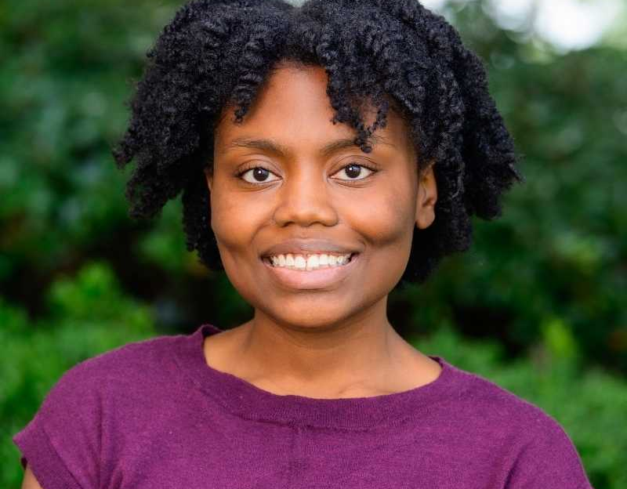

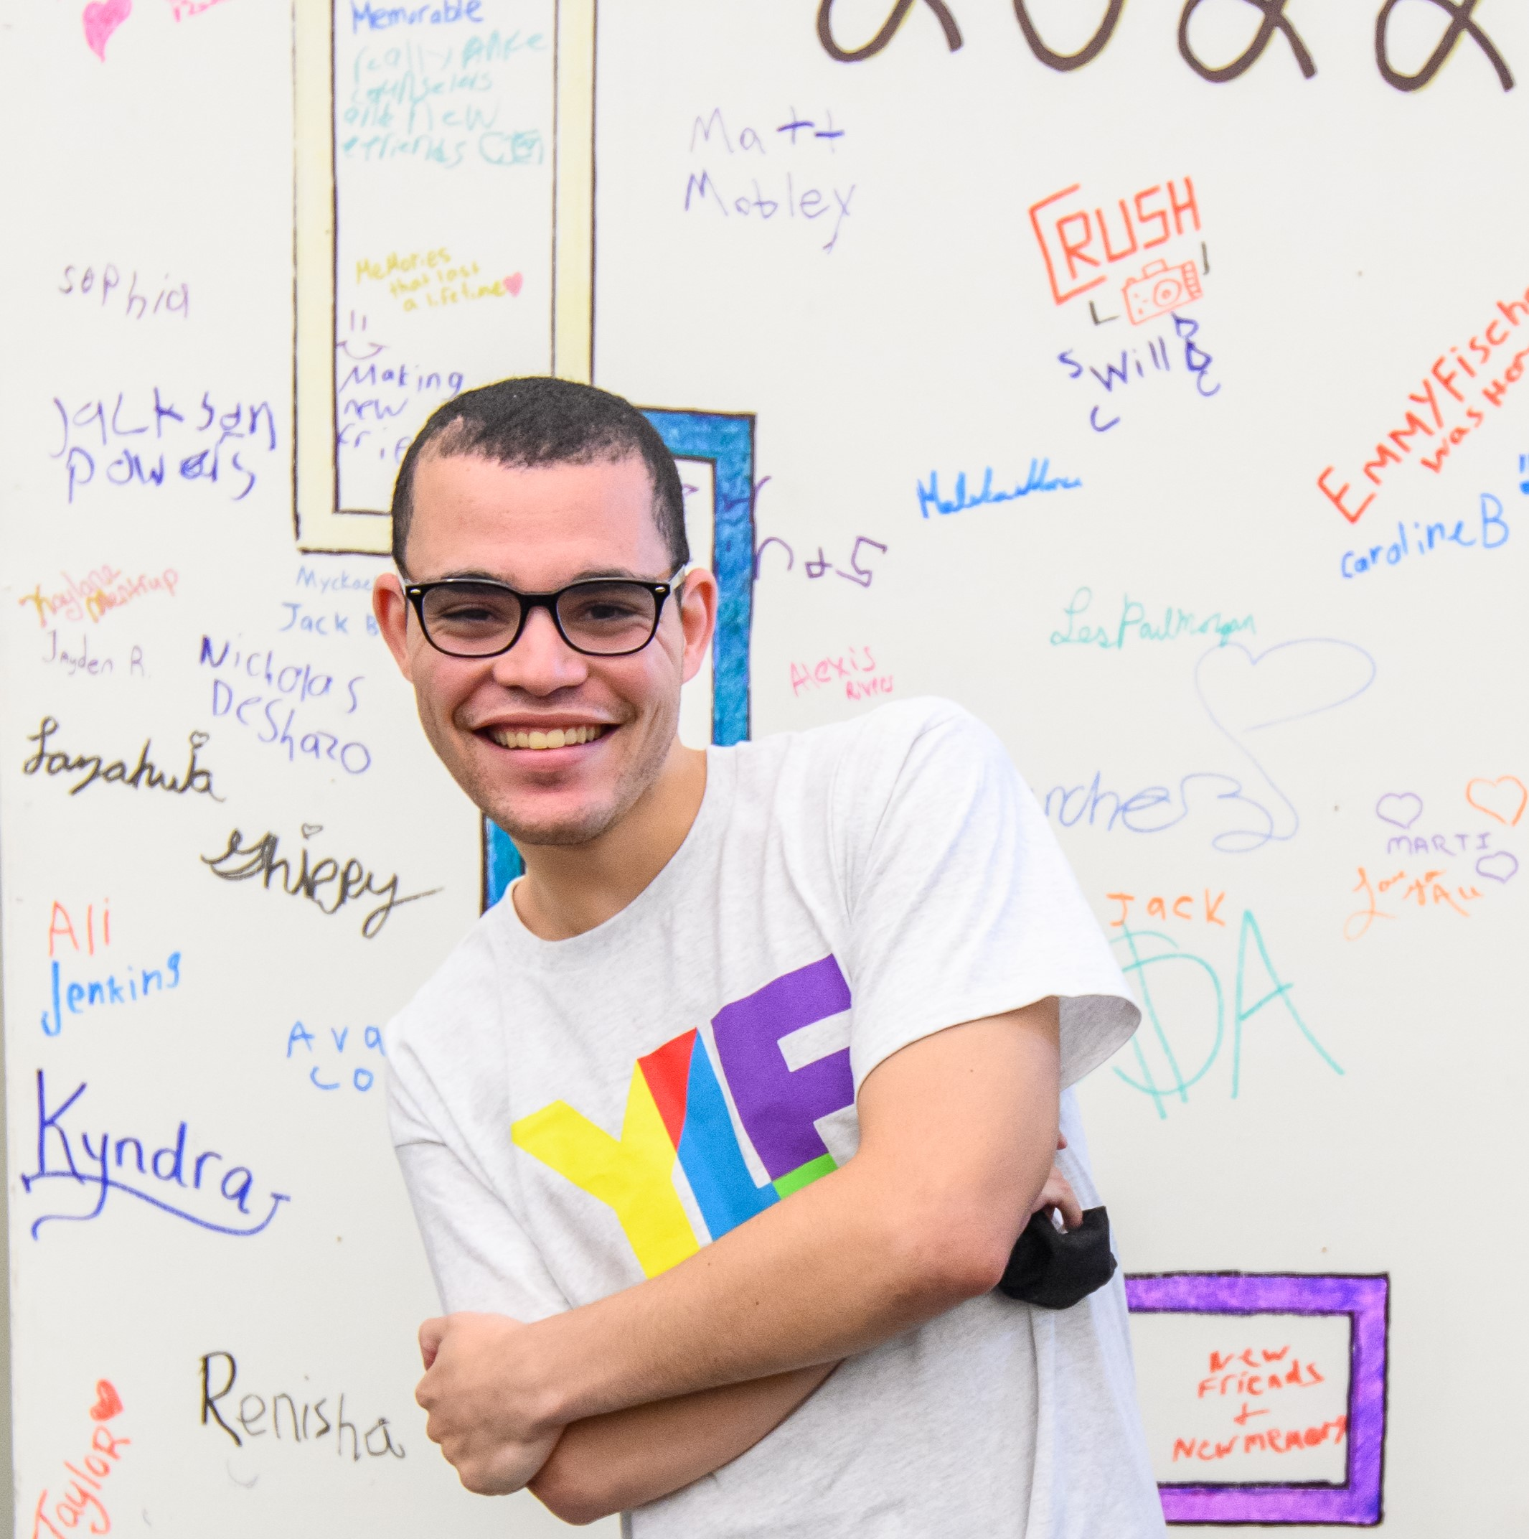
>>Slide 28
Youth Panel on Leadership

Slide 29
>>Slide 29
Wednesday Jones
Age: 25
Pronouns: they/them/theirs and she/her/hers
Hobbies: Swimming, Medical Science
Leadership Development:
  Youth Leadership Forum
  Hire Me SC
  Diversity Peer Educator
  Equip
  Obama Foundation Community Leadership Corps
I want to see the disability community really embrace disability justice and use it as a framework for our advocacy.

Slide 30
>>Slide 30
Alexis Rivers
Age: 21
Pronouns: She/They
Hobbies: Reading Manga, Watching Anime, and Roller Skating
Leadership Development:
  Youth Leadership Forum
  Equip
To change some of the language and bring awareness to intersectionality. I would like to further spread the Independent Living philosophy with others by developing more inclusive and accessible events.

Slide 31
>>Slide 31
Jack Symonette
Age: 21
Pronouns: He/Him
Hobbies: Video Games
Leadership Development:
  Youth Leadership Forum
  Project Search
  Equip
  Charleston County Sheriff's Office
I want to bring the independent living philosophy to places that it has not traditionally been. For example, in my job with the Charleston County Sheriff's Department.

Slide 32
>>Slide 32
Evaluation Survey
We appreciate your feedback! Look for the link in the Chat for your convenience as we approach the end of the presentation.
https://uthtmc.az1.qualtrics.com/jfe/form/SV_do2k0McGrs1WSwu

Slide 33
>>Slide 33
Questions for Youth Panel?

Slide 34
>>Slide 34
Contact your presenters
Kimberly Tissot – ktissot@able-sc.org
Aaron Baier – abaier@able-sc.org
Wednesday Jones – wjones@able-sc.org
Alexis Rivers – arivers@able-sc.org
Jack Symonette – jsymonette@able-sc.org

Slide 35
>>Slide 35
Final Questions and Evaluation Survey
Any final questions?
Directly following the presentation, you will see a short evaluation survey to complete on your screen. We appreciate your feedback!
https://uthtmc.az1.qualtrics.com/jfe/form/SV_do2k0McGrs1WSwu

Slide 36
>> Slide 36
IL-NET Attribution
The IL-NET is supported by grant numbers 90ILTA0002 and 90ISTA0002 from the U.S. Administration for Community Living, Department of Health and Human Services, Washington, D.C. 20201. Grantees undertaking projects under government sponsorship are encouraged to express freely their findings and conclusions. Points of view or opinions do not, therefore, necessarily represent official Administration for Community Living policy.

